Slide 1
To boldly Go – A new direction

Slide 2
TODAY
The travel landscape
Visitor trends
the media landscape
moving forward in a new direction

Slide 3
Factors Influencing Travel IN 2016
Exchange Rates More Favourable since end of 2015 for inbound travel (North America Expenditure increased 57% in Q3
European Travel Behaviour - 2016
EU15 markets took holidays to Iceland and Scandinavia – Direct Competitors to Scotland?
Safety and security concerns for French & German
Rest of World Travel to Scotland increased (See UNWTO Barometer)
Increase in airline capacity between Scotland and North America.
Delta Air Lines, Icelandair, Air Canada Rouge, Air Transit and WOW contributed a further 90,000 seats throughout 2016
Took more self-drive holidays across Europe
International events taking place over the summer period, namely the European Football Championships in France, and the Rio Olympics
Consumer Drivers for tourism behaviour in 2016
Notes:
Visitors from North America increased 36% in trips and 57% in expenditure during Q3 2016 against the same period in 2015. This may be attributed to more affordable rates against the Pound to these markets.
• An increase in airline capacity between Scotland and North America may have also had an impact. Airlines Delta Air Lines, Icelandair, Air Canada Rouge, Air Transit and WOW contributed a further 90,000 seats throughout 2016.
• The majority of overseas visitors came from Europe. Despite numbers from our core markets being down on the same period in 2015, markets such as France and Germany were affected by safety and security concerns. Visitors from these destinations also took more self-drive holidays across Europe during this time, which may have affected travel to Scotland.
• EU15 markets also took more holidays to destinations such as Iceland and Scandinavia, which could be seen as direct competitors in terms of product to Scotland.
• Travel may have also been affected by the number of international events taking place over the summer period, namely the European Football Championships in France, and the Rio Olympics.
• Despite the decrease in core European markets, Other EU nations (such as Poland) increased 48.5% against the same period in 2015.
• Visitors from outside North America and Europe were also up during Q3 2016 (7%) against the same period in 2015.

Slide 4
Trend impact on Scottish Tourism
Consumers are seeking experiences over products, with greater emphasis being placed on:
road trip based holidays – fluid itinerary travel
seeking adventure experiences within a controlled environment, such as mild camping – intrepid travel
Inspired by film, literature, folklore….story telling
Rise in Green living
Wellbeing & cultural enrichment
More reliant on technology – just in time inspiration
Notes:
In this age of uncertainty, being proactive and monitoring change means we can adapt our offering.

Slide 5
Scotland Visitor Survey 2015 & 2016
East beach, lossiemouth

Slide 6
Scotland’s scenery and landscape remains a key motivation to visit, as does its history and culture. Other drivers vary by market and visitor type.
Although 74% were repeat visitors only 24% cited this as a driver for visiting again
Old man of storr, isle of skye
Visitors from Europe 10%
Q10 Thinking broadly about your decision to choose Scotland for your holiday or short break, what was it that attracted you to spend your holiday / short break in Scotland on this occasion? Base: S1 All (11743)
What Attracts Visitors To Scotland?

Slide 7
Word of mouth recommendation is an important factor, particularly for European, Long Haul and first time visitors, whilst Scot residents are motivated by a desire to holiday at home
37% 1st time
35% European
31% Long Haul
Scot residents are also motivated by deals and special offers (12%) and accommodation prices (8%).
Travel review sites are influential even at early motivation stage, particularly for international visitors.
Q11 Which of the following persuaded you to spend your holiday / short break in Scotland on this occasion? Base: S1 All (11743)
What Persuaded Visitors To Spend Holiday In Scotland?

Slide 8
1 in 10 visitors were influenced by a travel feature about Scotland, whilst TV, film and books are also important prompts to consideration, especially for international visitors
Q12 Did any of these prompt you to consider Scotland for this holiday / short break? Base: S1 All (11743)
What Prompted Visitors To Consider Scotland?

Slide 9
User generated content, particularly reviews & ratings, was important for visitors when planning their trip to Scotland
Long Haul visitors were most likely to mention each of these types of content, consistent with their higher usage of multiple online sources in planning
Photos (by travellers and professionals) and videos were particularly sought by 16-24s
28% of 65+ did not use this type of content at all
Q11 And what types of online information did you use when planning your holiday / short break in Scotland? Base: S2 All who used websites to plan holiday (2210)
Types Of Online Information Used For Planning

Slide 10
In person advice the preferred approach for visitors to gain information on what to see and do, with local people playing a crucial role. Younger visitors are more likely to use online sources, but not exclusively.
Google (47%), travel guide websites (17%) and social media (14%) most popular with under 35s
Long Haul and European visitors mention multiple sources of information
Q29 During your holiday or short break in Scotland, which of the following sources of information did you use to look for things to see and do? Base: S2 All (2999)
Information Sources For Things To See And Do
Notes:
Europe Long Haul
Talking with locals 54% 65%
Printed travel guide books 45% 32%
Google 42% 44%
Visitscotland.com 37% 36%
Travel guide websites 16% 24%
Social media 10% 12%

Slide 11
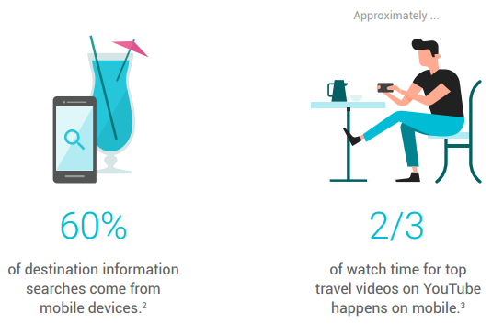
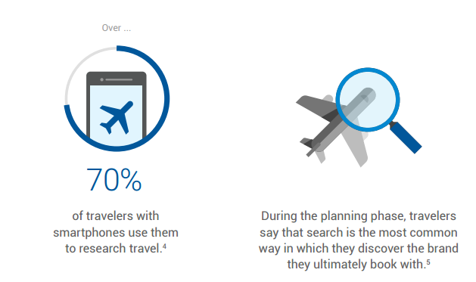
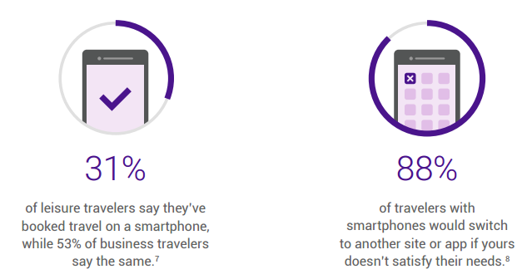
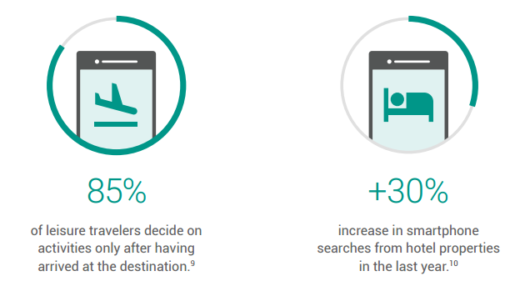
Just in time inspiration
Notes:
Google Travel Infographic: How Mobile Shapes the Customer Journey: https://think.storage.googleapis.com/docs/travel-infographic-mobile-shapes-customer-journey-c.pdf
Search is key throughout the user consideration, planning, booking & on-arrival journey

Slide 12
Loch morlich
Inspiring portrayal of modern scotland
‘DRIVING ADVOCACY’ IS OUR STRATEGY
Notes:
But embracing these opportunities requires a different approach.
When looking back to marketing as it was 15-20 years ago, it was something you paid for (top yellow circle – brand marketing) – essentially you were screaming at people to buy your product in the hope that someone was listening and that they would take action as a result. Which is incredibly expensive and inefficient.
Because of the advent of the internet and digital we’re now afforded the opportunity to use partnerships and all the content generated by visitors and citizens of Scotland to our advantage. We can now curate this content and push it out so that we’re not having to pay for everything but we’re still creating great experiences for our consumers, and we’ll see a much better return on our collective investment as a result.
To do this, we need to focus our time and effort much more below this line (dotted line in slide) on user generated content and content partnerships, which will much more readily encourage advocacy.

Slide 13
Loch morlich
Inspiring portrayal of modern scotland
Harness networks of influence
‘DRIVING ADVOCACY’ IS OUR STRATEGY
Notes:
19 million visitors to vs.com (4 times as many as to VisitBritain’s website
Generating 3 million referrals to industry
Need to drive this harder and harvest partnership working

Slide 14
High cost & competition
Uk holidays
27,100
low cost & risk
low probability of conversion
high probability of conversion
WE LET Partners DO THE HEAVY LIFTING
Notes:
Figures in yellow bar = Global Monthly Searches
When considering high volume search terms, if VisitScotland wanted to capture this audience they would either have to invest a significant amount of budget to pay for advertising space with Google, or generate huge volumes of content to be organically selected as a search result for that term – neither of which they have the resource for.
To reach this audience efficiently, VisitScotland are looking to partner with those who are already credible and trusted by consumers in this territory. Essentially they are borrowing the equity of the content and media brands who naturally pull this traffic.
The key is to go to the places where consumers already are and to filter content through these media owners.
VisitScotland has achieved this with TripAdvisor, where they’ve effectively taken over their real estate by creating a destination landing page for Scotland. http://www.tripadvisor.co.uk/Tourism-g186485-Scotland-Vacations.html
This is significant because it ensures Scotland has the right quality of content on this hugely influential platform, which is essentially acting as an extension of the VisitScotland website.
It’s partnerships like this that help us infiltrate these high volume search terms.

