Slide 1


Case Study
THE NEW
LIBRARY MODEL

Slide 2

Who Are We?
CULTURAL
ENTREPRENEURS
Involved in the publishing and distribution of cultural content since 1990
Well established in Canada, France and Italy
At the centre of a network with over 550 partners in over 40 countries across the globe
INTERNATIONAL
LEADERS
Be present and active in priority markets
Support our partners’ commercial strategies
VISIONARIES
Notes:
Brief history of the company
Began in 1990
Software development
In 2008 started the adventure into the world of digital books
Common bond: a robust technology serving the needs of customers

Slide 3





Our Technology

Slide 4
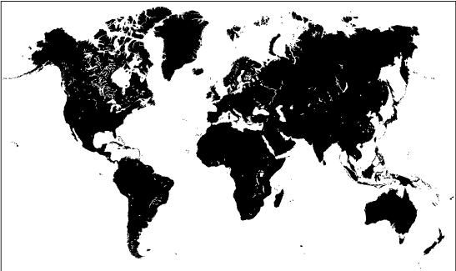
Our Technology
Over 65,000 ebooks stored
Millions of users purchased ebooks via Cantook Hub
Connected to over 700 resellers around the world
Notes:
Cantook Hub is our ebook warehousing and distribution service
Over 500 publisher clients worldwide, primarily established in Canada, France and Italy
Nearly 65,000 ebooks available
Retailers from across the world: Of course, we include major platforms such as Amazon, Apple, Google and Kobo, but we also connect to numerous independent bookstores. In fact, our strength of our growth has always been about setting our sights on national markets.
Also available as a white label service (ex: Entrepôt numérique, Eden Livres and Edigita)

Slide 5
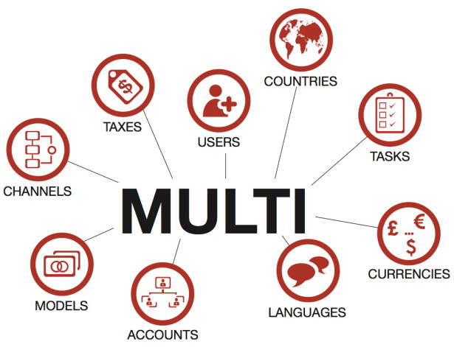
Who Are We?
Notes:
More important: This is the ONLY platform which is entirely multi-lingual, multi-currency, multi-everything

Slide 6
Our Technology
Send review or promo copies with a few clicks
Makes it simple to organize promotional campaigns
Send multiple copies in sales mode
Easily track campaigns with realtime statistics
Notes:
The Cantook Courrier service allows for the free delivery of ebooks. For instance as a press service for journalists, or to offer consultation copies for teachers.
It is also possible to send bundles of ebooks or multiple copies of the same ebook to be sold, such as for use in a classroom, or to a corporate trainer for an upcoming workshop.

Slide 7
Our Technology
Makes any website an e-commerce site
Fast and simple to implement: Only a few lines of code to add
Sell directly on the website or through social media
Notes:
A turnkey service that allows publishers to sell ebooks on their own website without the need for a full e-commerce site.
Note : Whatever the product used, each of our customers are part of the Cantook network. As such, they can take part in shaping new features and future developments of Cantook. Our products reflect the needs of clients.

Slide 8
Re-Imagining
The Library Model

Slide 9
A Simple(?) Idea
Bring together all stakeholders of the book chain to form a unified product for library users
  Publishers
  Distributors
  Bookstores
  Libraries
Notes:
Cantook Station is our overall solution for the sale and lending of ebooks.
Our idea is to bring together all stakeholders from the book industry (publishers, distributors, booksellers, librarians) to deliver a strong product to the end user.
Cantook Station allows libraries to access several ebook resellers from a single interface. This allows libraries to purchase titles directly from within Station, enabling them to put their collection together based on what they really want, instead of purchasing ebook bundles with imposed titles.
Our system includes a discovery layer allowing library users to discover new authors, new collections, and so on.

Slide 10



Deployment
Initial launch
  Quebec Public Librairies (with BiblioPresto and pretnumerique.ca)
Notes:
The first deployment of this system was with public libraries in Quebec (BiblioPresto and pretnumerique.ca )

Slide 11


Deployment
Second large-scale launch
  Bibliothèques municipales de Grenoble (with Feedbooks)
Notes:
The second major deployment is with the Grenoble public libraries in France (with our partner Feedbooks)

Slide 12
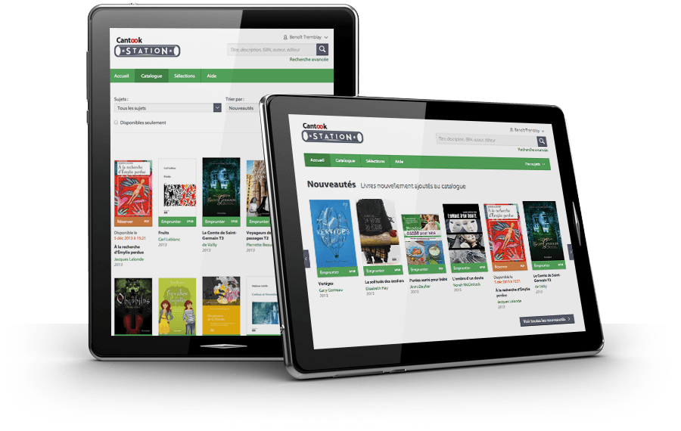
Deployment
Launch of
Cantook Station
  B2B turnkey
  e-lending solution
Notes:
Launch of a B2B turnkey solution: Cantook Station has also been designed for associations or companies to offer its members or employees a digital library, which can also couple as an online bookstore.

Slide 13
Our Technology
Choose your ebooks from a catalog of thousands of titles
Users can consult and borrow ebooks from your collection in full respect of submitted licenses.
Access your collection’s statistics, such as ebook usage and sales
Entirely web-based
No installation required
Hosting is included
Customized for your organization
Notes:
5 - The guiding principle of all our projects: a robust technology, backed by people who help people.

Slide 14
Questions?

Slide 15





Contact Us
twitter.com/de_marque
facebook.com/DeMarqueInc
www.cantook.com
linkedin.com/company/de-marque
info@demarque.com
propulsion.demarque.com

