Slide 1
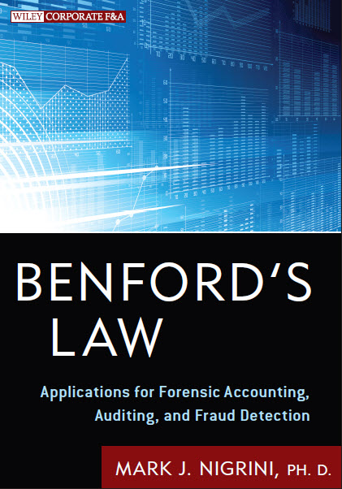
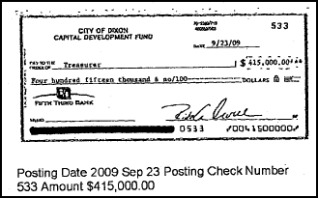
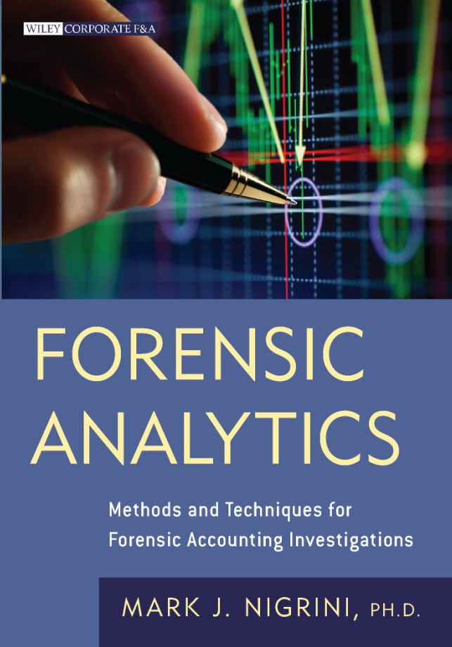
Fraud numbers
Mark J. Nigrini, Ph.D.

Slide 2
Which schemes?
Financial statement fraud which uses misrepresented financial data to deceive investors, auditors, and analysts about the true financial condition of a business entity.
Bribery schemes which involve giving or offering something of value to a person in a position of trust to influence their judgement or conduct.
Occupational fraud which uses deception to misuse or divert an employer’s resources to obtain a personal gain.

Slide 3
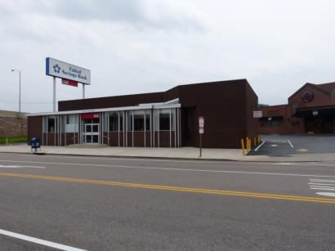
Katherine harrell
Round Numbers

Slide 4
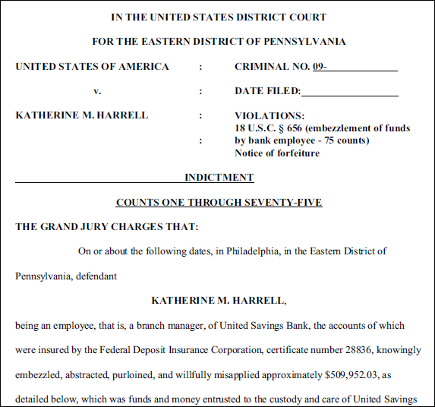

Slide 6
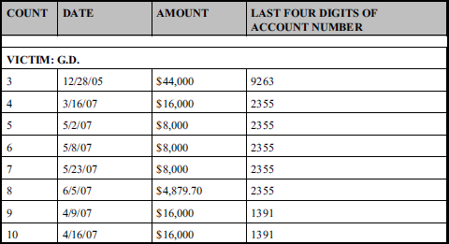

Slide 7
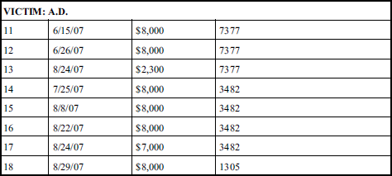

Slide 8
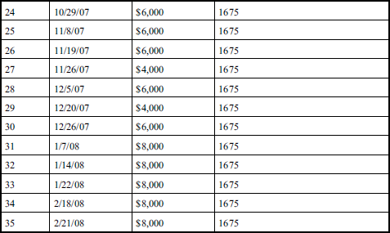

Slide 10
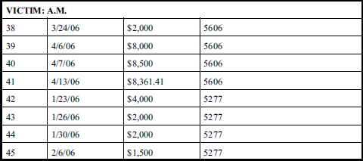

Slide 11
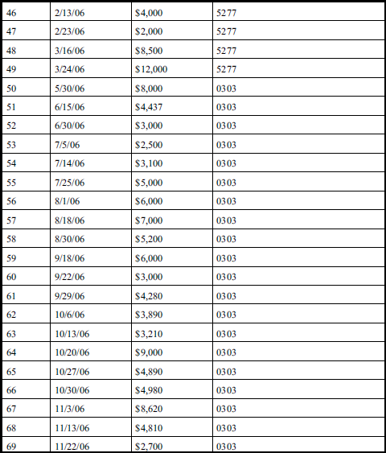

Slide 13
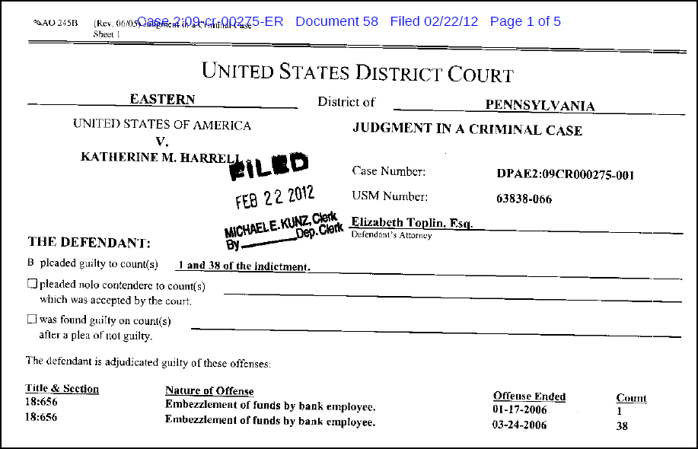

Slide 14
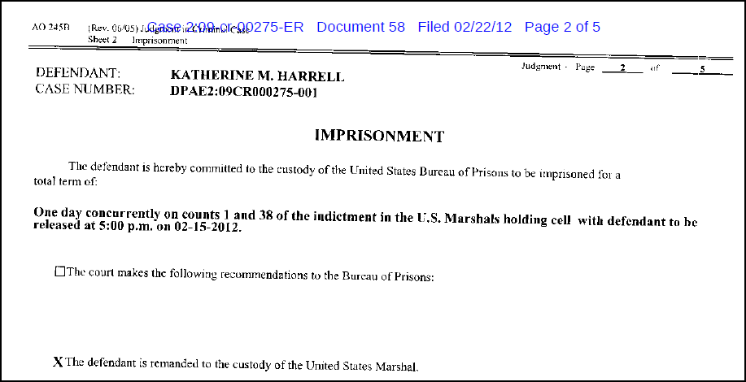

Slide 15
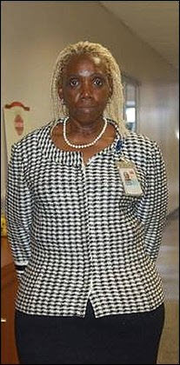

Slide 17
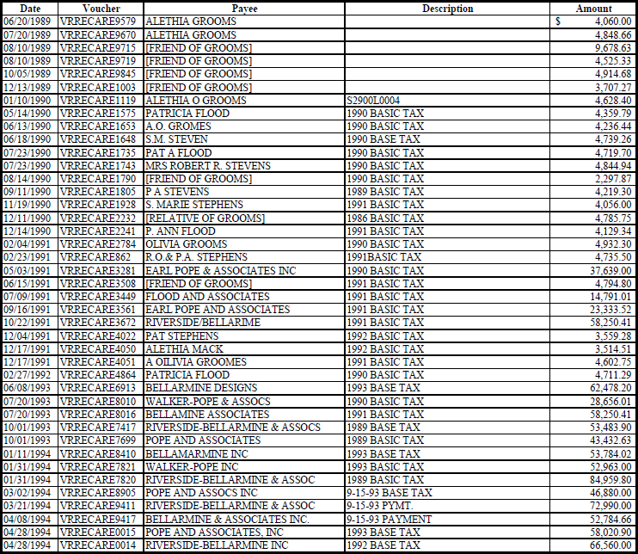

Slide 18
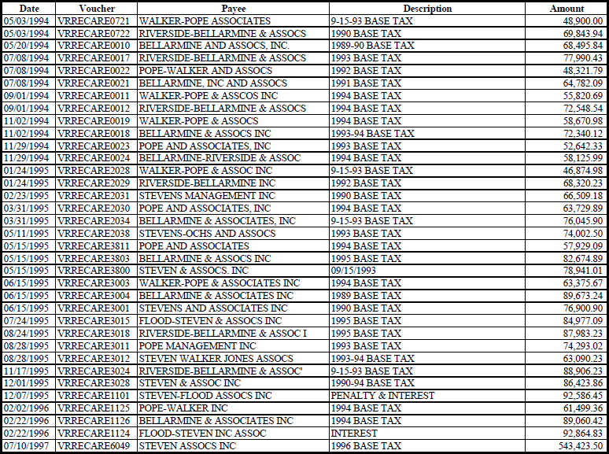

Slide 19
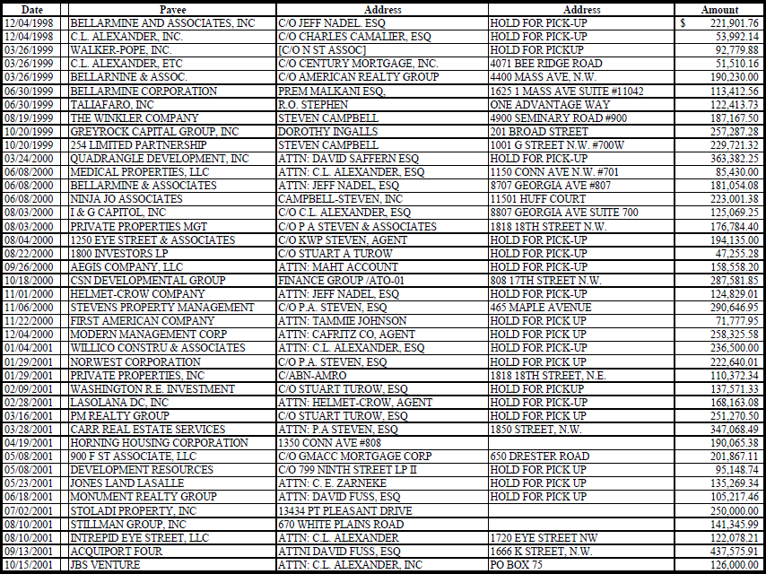

Slide 20
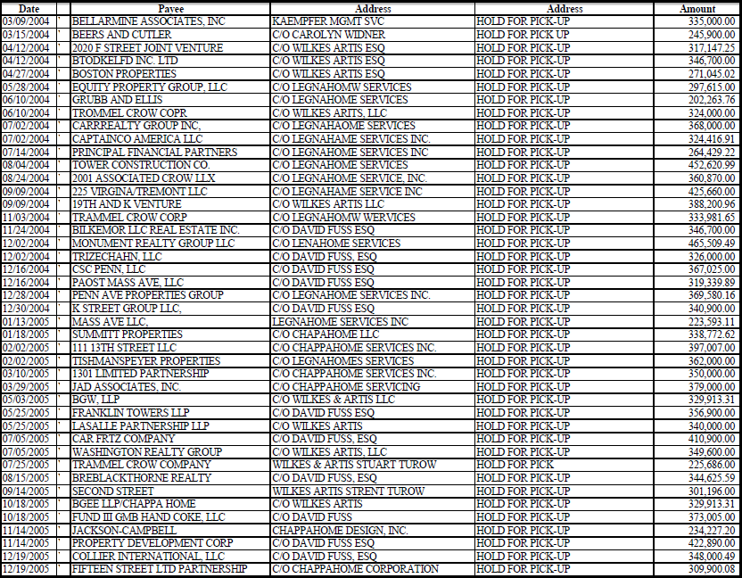

Slide 21
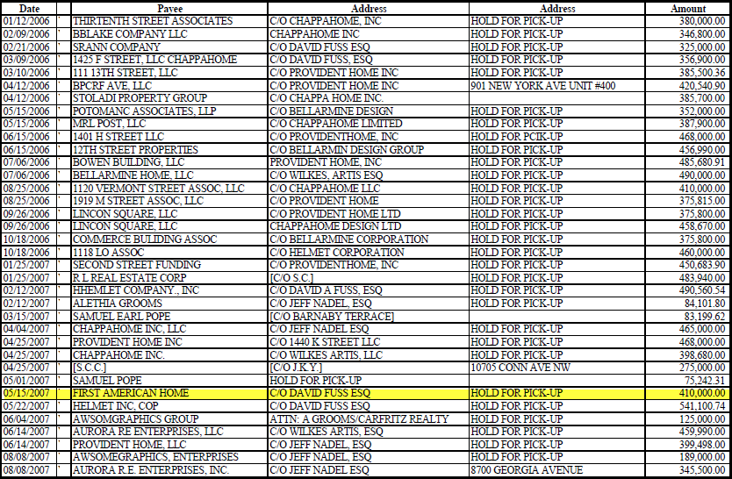

Slide 25
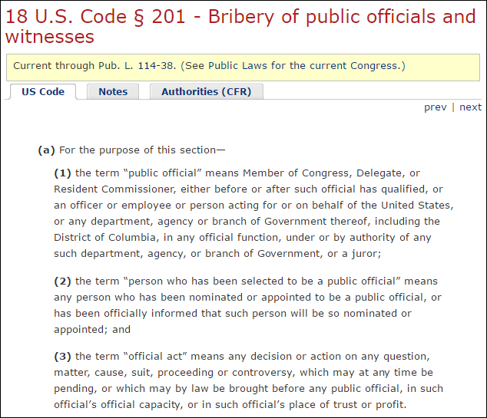

Slide 26
Rising Numbers

Slide 27
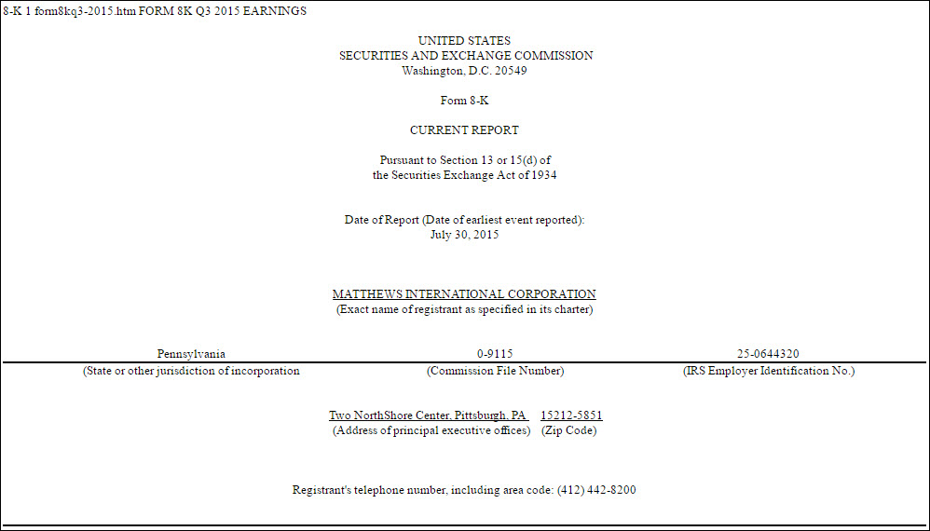

Slide 28
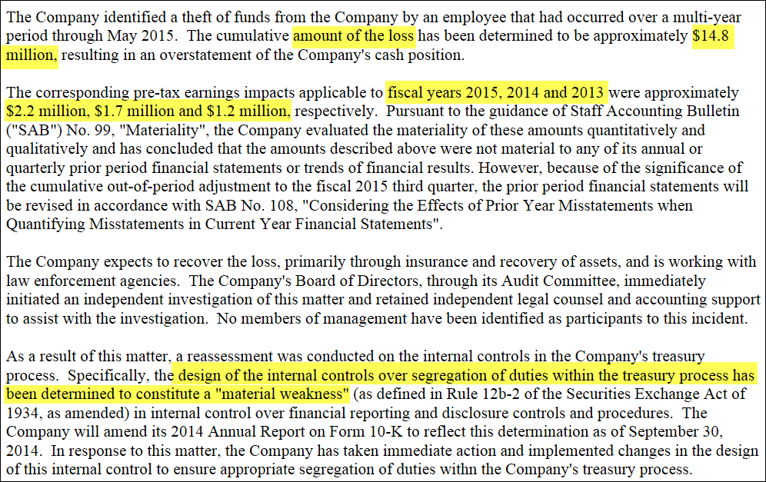

Slide 29
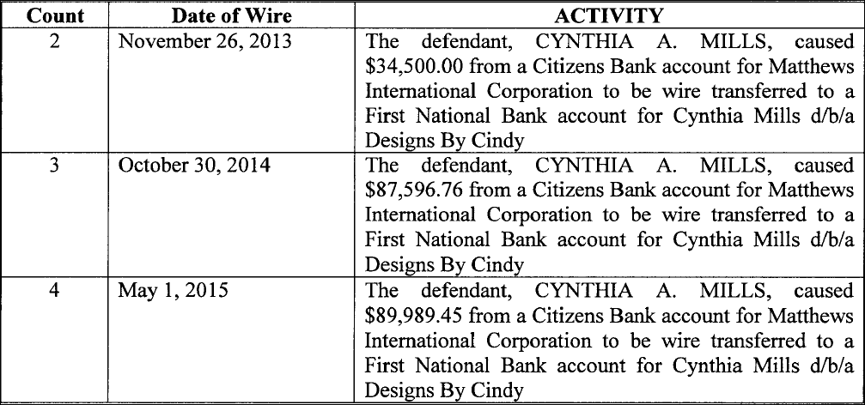

Slide 31
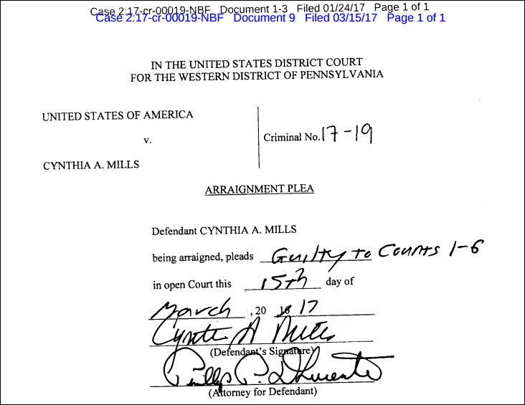

Slide 32
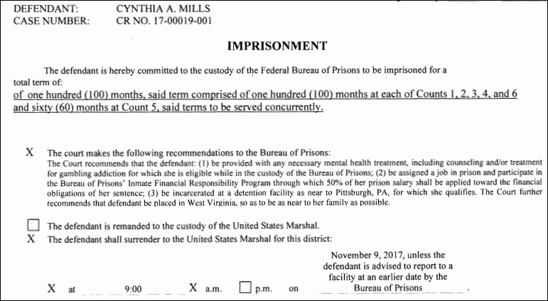

Slide 33
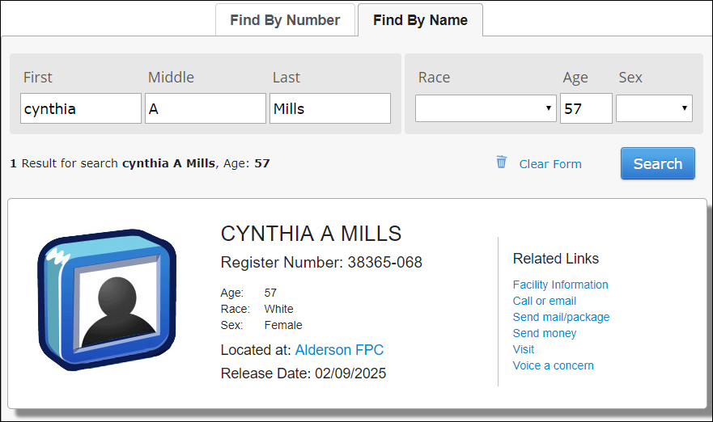

Slide 34
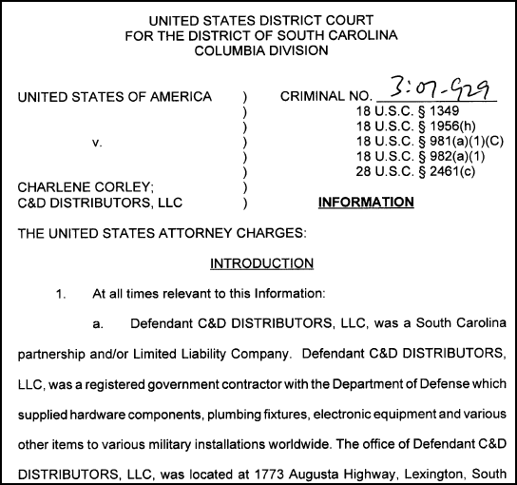

Slide 35
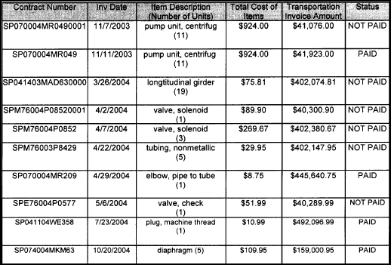

Slide 36
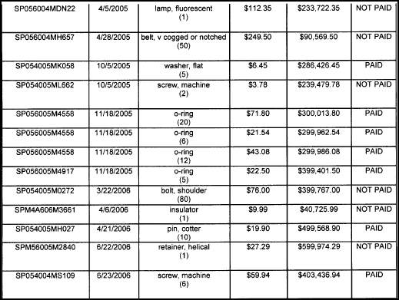

Slide 38
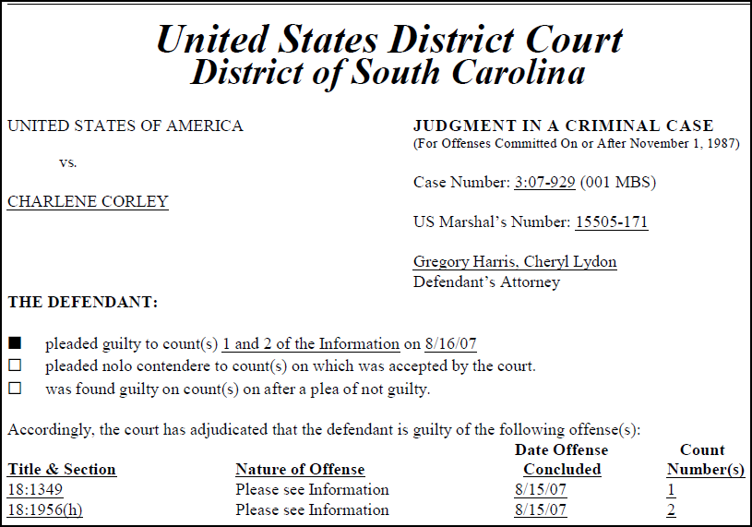

Slide 39
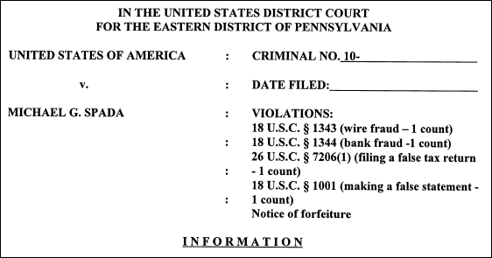
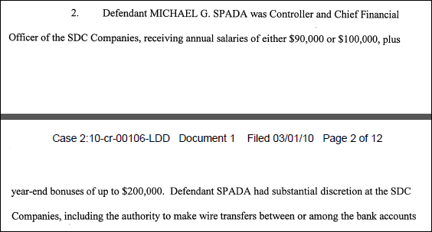

Slide 40
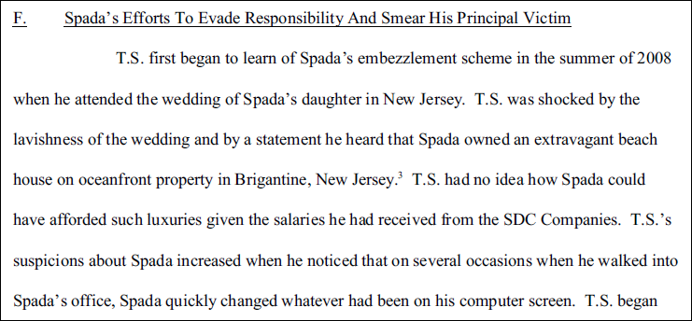

Slide 41
Threshold Numbers
Threshold numbers are numbers that are just above internal control threshold which is a level, point, or numeric value above which additional checks or procedures will take place, and below which those additional checks or procedures will not take place.
Thresholds could simply be a level, point, or numeric value above which something is true and below which it is not.

Slide 44
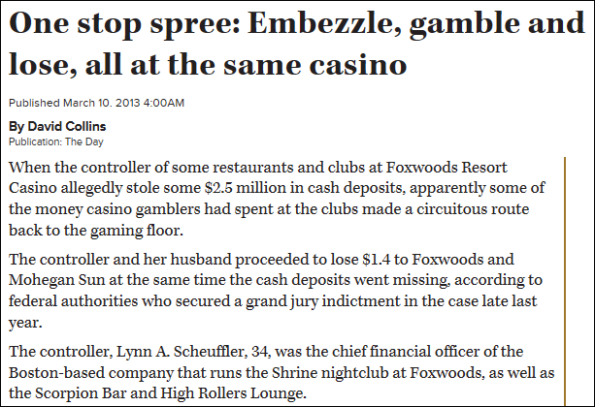
Lynn Scheufler

Slide 45
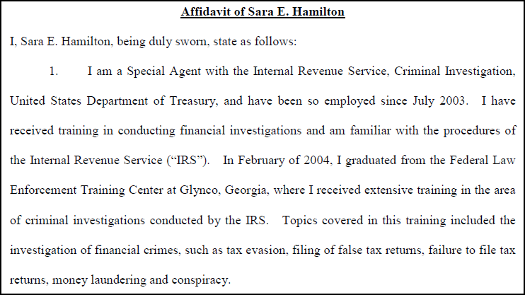

Slide 46
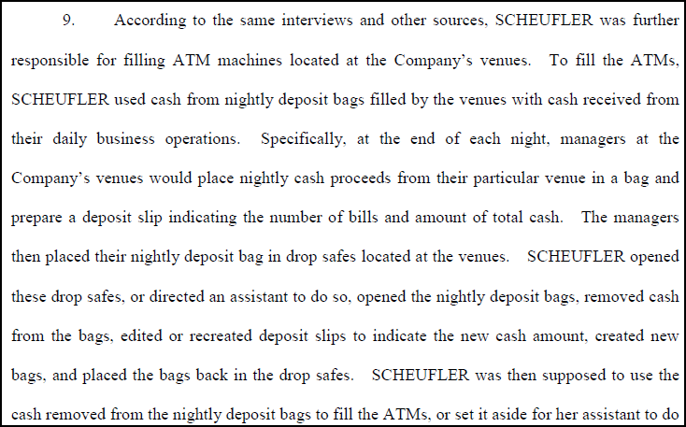

Slide 47
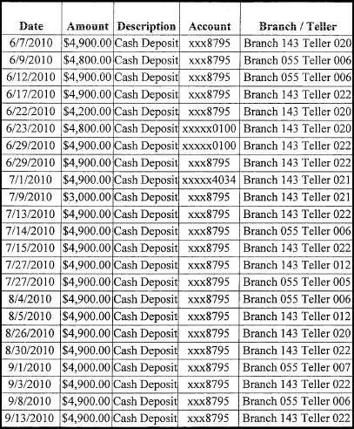

Slide 48
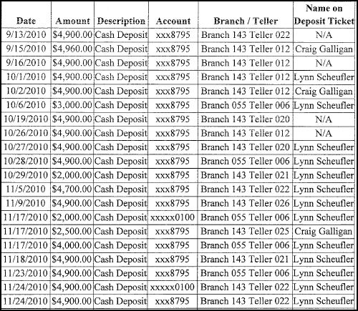

Slide 49
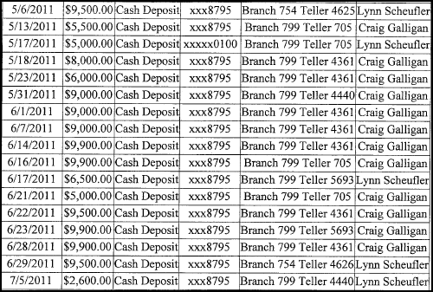

Slide 50
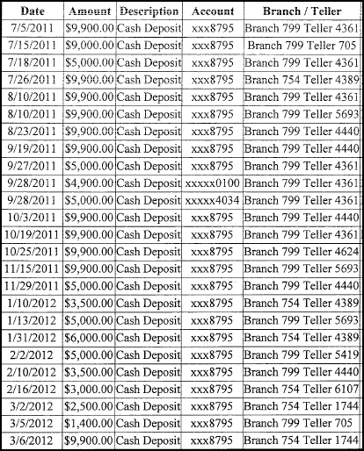

Slide 51
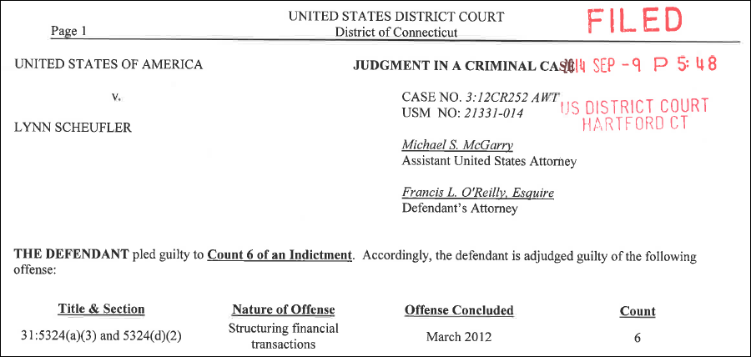

Slide 55
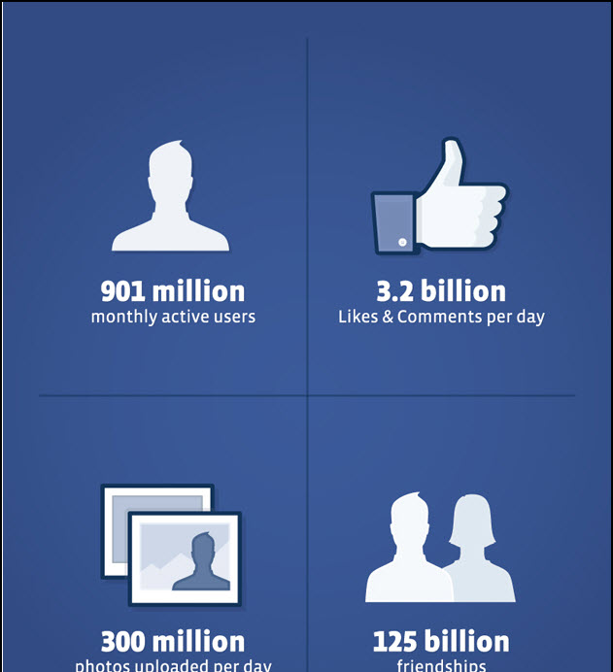

Slide 56
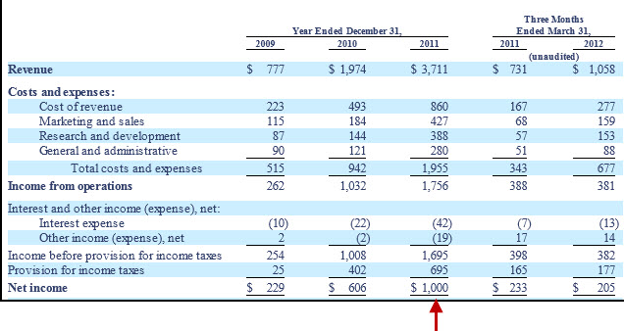

Slide 58
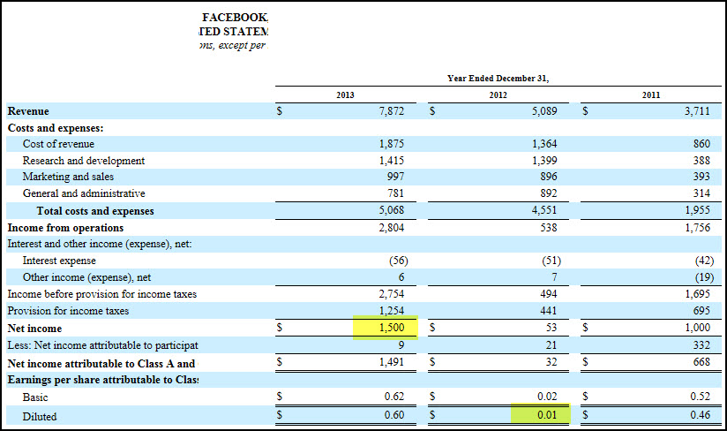

Slide 59
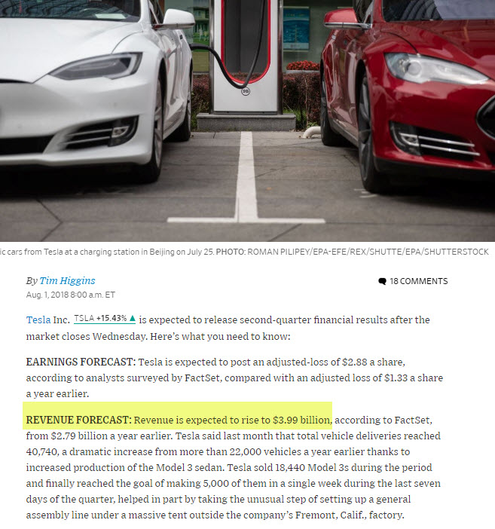

Slide 60
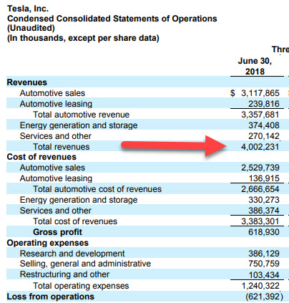

Slide 61
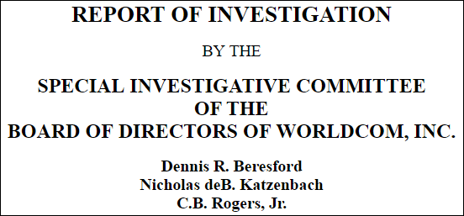
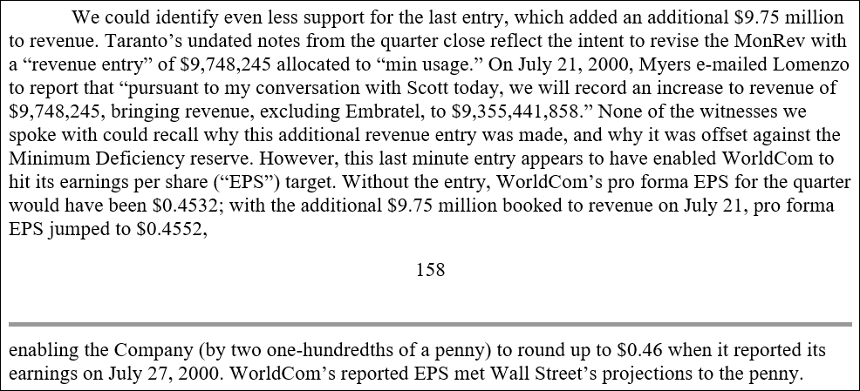
Rounded Numbers

Slide 62
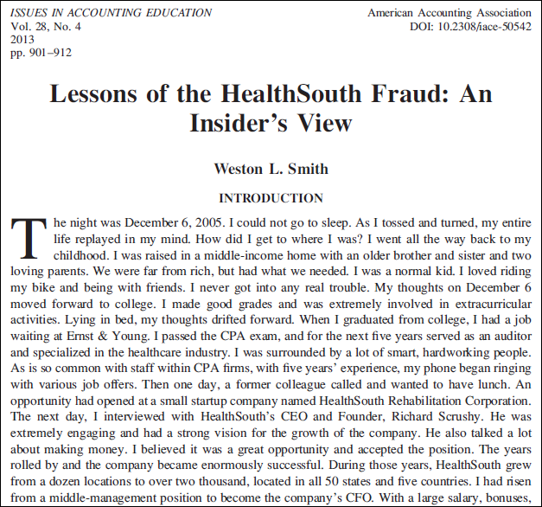

Slide 63
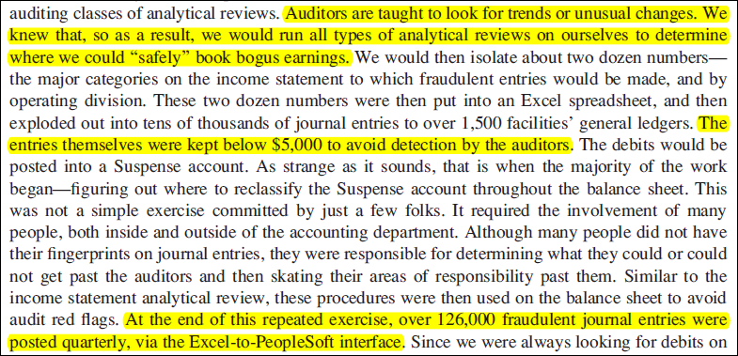

Slide 64
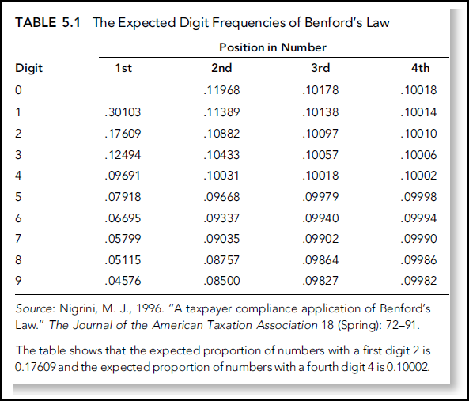

Slide 73
Repeated Numbers

Slide 74
Outlier Numbers
It would seem that savvy fraudsters would want their numbers to look normal and to fit in with the crowd.
Exceptions could occur when fraudsters don’t know what normal is or when they rate the chances of being caught as small.
Large fraud numbers could be called outliers.

Slide 78
Accounting Numbers
Are based on the past.
Financial statement numbers are useful for predicting debt-paying ability and profitability when the past can reliably be used to predict the future.
A stable business environment helps.

Slide 79
December 6, 2018

Slide 87
Fraud numbers
Round numbers
Rising numbers
Threshold numbers
Rounded numbers
Non-Benford numbers
Repeated numbers
Outliers

Slide 88
Fraud numbers
Not small numbers
Frauds do not always use numbers
Discovery is surprising
New audit data analytics guidance
Future research

Slide 89
Plan the ADA.
y.
Perform the ADA.
Evaluate the results and conclude whether the purpose and specific objectives of performing the ADA have been achieved.
I have posted two useful videos on YouTube.
Benford’s Law, Part 1 (Theory)
https://www.youtube.com/watch?v=EV_fAJqW3MI&t=15s
Benford’s Law, Part 2 (Excel)
https://www.youtube.com/watch?v=N7Nd7hrCgrE&t=52s

Slide 90
People do commit fraud
Insiders commit fraud
The legal system is overloaded
and so.......

