Slide 1
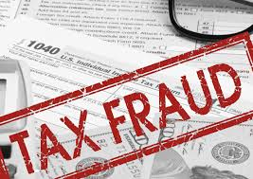
Combating Refund Fraud:
Recent Trends and Successful
Prevention Techniques
Revenue Solutions, Inc.
2017 MSATA Annual Conference
Indianapolis, IN
August 22, 2017

Slide 2

Introduction
David Casey
  Executive Consulting Manager, RSI
  9+ years with Revenue Solutions, Inc.
  22+ years experience in tax & revenue

Slide 3

Agenda
Refund Fraud Problem
Types of Refund Fraud
Industry Best Practices
Proven Solution Approaches
RSI Experience
Recent Activities/Results
Future Trends
Q&A

Slide 4

Refund Fraud: The Problem…
As refund fraud schemes become more sophisticated, so must the methods of deterrence to stop fraudulent refund checks before they go out, while at the same time maintaining expected turnaround time and avoiding disruption or inconvenience for compliant taxpayers.
  ‘Tax-refund fraud to hit $21 billion,
  and there's little the IRS can do’
  – CNBC February 11, 2015
4
Notes:
4
Article is wrong – we can do better and have! Yes, the problem had become much worse between 2013 and 2015 (up from 6.5B to 21B), but IRS and States, as well as the tax industry (tax preparation software companies) have taken measures to curb fraud. More on that later.
Data/accounts are being hacked at:
Employers
Tax preparers
IRS breaches
Green dot cards
Return looks valid as the return matches other data available in the system (W2)
Bank account / address change

Slide 5
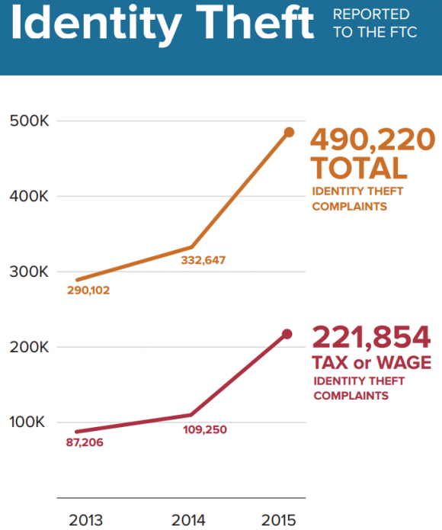
The Problem with ID Theft
Agencies move towards fully electronic returns filing
Online tax preparation software enables thieves to create a fake return
Instead of using stolen Social Security numbers to create their fraudulent returns, they buy compromised credentials to gain access to past returns stored on tax preparation software
Using information from a real return to create a false one improves the odds that it will evade detection
2013
2014
2015
Notes:
Refund goes to prepaid debit card.

Slide 6


Types of Refund Fraud
Fraud or Adjustment Issue
Invalid Person
(Fictitious Identity)
Identity Theft
(In-State vs.
Out-of-State)
Valid Person with an Invalid Claim of Withholding Credit
Other Credit and Deduction Eligibility
Notes:
Invalid Person
Someone willfully attempts to commit fraud by fabricating personal demographic and other return information and requests a refund.
These returns should be identified and stopped by confirming the identity information via prior State returns, IRS filings and other information (e.g., TIN validity), and other data sources, including commercial data and identity verification services, such as Equifax. Where identities cannot be automatically confirmed through available data and therefore may be fraudulent, some targeted manual review procedures may be conducted, or the efficient use of other commercial sources of data and identify verification services may be required.
Identity Theft – In-State Filer
The identity of a valid In-State filer is stolen and used by someone else to file a return that might otherwise pass return validation edits.
Items listed on the tax return are logically segregated into “trusted” and “untrusted” line items when used in the verification process.
Identity Theft - Non-State Filer
The identity of a non-State filer is stolen and used by a criminal to file a return that might otherwise pass return validation edits.
Similar to the “Invalid Person” fraud scheme, these refund requests are evaluated against available third-party data including: W-2s, IRS and other sources to confirm identity and withholding and other credit claims.
Valid Person with an Invalid Claim of Withholding Credit
A valid person attempts to inflate or fabricate their withholding credit (or other refundable credits) in order to create or inflate a refund.
These returns should be identified and stopped by first confirming the identity information (as described above), and then by confirming the withholding credit sourced from the one or more W-2s or other income reporting schedule with the return. This is accomplished by confirming the employee-reported W-2 data (from MeF data or keyed from image for paper returns) against the annual employer-reported withholding data, as well as by confirming the validity of the employer and their withholding tax account data and confirming that actual withholding tax payments were made and the account wasn't established for fraudulent means.
Other Credit and Deduction Eligibility
Taxpayers claim to be eligible for other refundable tax credits or deductions for the purpose of receiving or increasing the amount of their refund.
Same breadth of data and techniques used by the solution can be applied towards the reliable detection of other issues on the returns of valid taxpayers - issues that can be effectively addressed prior to issuing the refund. This is typically because existing tax processing systems do not have access to multiple sources of external data, employer-reported information, and taxpayer filing history across all filed returns, in order to detect other issues.
Inflating the refund by falsifying information
Wages / Withholding
Unreimbursed Expenses
Child credits
Out of state credits
Other credits / deductions

Slide 7

IRS Tax Scams/Consumer Alerts
Soliciting Form W-2 information from payroll and human resources professionals
IRS-Impersonation Telephone Scams
Surge in Email, Phishing and Malware Schemes
Tax Refund Scam Artists Posing as Taxpayer Advocacy Panel
Scams Targeting Tax Professionals
See IRS Dirty Dozen Tax Scams
  https://www.irs.gov/uac/tax-scams-consumer-alerts
  https://www.justice.gov/tax/stolen-identity-refund-fraud
Notes:
We’ve even seen registering and filing Form W2s as a fictitious employer just before filing season
https://www.irs.gov/uac/tax-scams-consumer-alerts
https://www.justice.gov/tax/stolen-identity-refund-fraud
The IRS crackdown on tax fraud has prompted crooks to find alternative avenues. Many have shifted their felonious focus to tax refund fraud at the state level.
To stem this growing trend, state tax officials are part of the IRS Security Summit team. As such, they are utilizing many of the same added anti-fraud techniques that the IRS employs.
And those procedures tend to slow down refunds.
Expected refund delays in 4 states: This filing season, tax officials in Georgia, New Jersey, New Mexico and Virginia have officially announced that their taxpayers will be getting their state refunds later than usual. due to enhanced refund review and validation procedures.“
Focus used to be to get these refunds out the door as soon as possible. Now states are slowing the process down. But at what cost to the taxpayer?
Online tax preparation software makes it easy for crooks to create a fake return. Having the refund deposited to a prepaid card provides a low-risk way to access the stolen money.
And the crooks are getting better at beating the system.
Instead of using stolen Social Security numbers to create their fraudulent returns, they buy compromised credentials to gain access to past returns stored on tax preparation software. Using information from a real return to create a false one improves the odds that it will evade detection.

Slide 8
Best Practices…
… based on Lessons Learned
Historically, Agencies tax processing systems have had limited access to external data sources during returns processing
Balance service to Individual Income Taxpayers,
with need to prevent fraud
Agencies have a lot more information at their
disposal to confirm identities, employers, wages, withholding
credits, other claims, etc. → pre-refund
Use data from: prior filing history, IRS, other agencies
(DMV, Labor, etc.), employers, etc.
Analyze and validate information in advance
Implement rules to definitively release returns and to identify
clear issues; with full transparency
Automate case handling where possible, manage follow-up actions, and integrate with returns processing flow

Slide 9
More than ID Theft – It’s Analytics:
Refund Issuance Risk Continuum
When assessing risk:
Confirm taxpayer identity
Confirm claims of refundable credits
Assess probability of under-reporting (for potential audit selection prior to posting and refund issuance)
Known taxpayer with good compliance history; identity and all credit claims can be confirmed.
Confirmed fraud situation based on clear inaccuracies or highly suspicious information
Confirmed valid identity or known taxpayer, but employment, withholding, and/or access to other refundable credits cannot be fully confirmed.
LOW RISK
.
HIGH RISK
Situation that may result in refund reduction if audited prior to refund (e.g., unreimbursed expense claims, EIC claims) – cost/yield is the primary case selection consideration.
Probable fraud - Identity is invalid or cannot be confirmed; access to credits also cannot be confirmed.
Goals… review or interact with the fewest returns, stop the most fraud, and reduce overall impact to compliant taxpayers
Notes:
Discovery and Fraud Modeling Framework
Basic Fraud Solution Configuration
Pre-Validation Rules library
Fraud Pattern Selections library
Patterns based on requirements and known common scenarios
Tax Preparer Fraud Model
Based on prior filing results, but deployed to provide updates during the filing season
Fraud Detection Model
Based on prior filing results, but also “Adaptive” Modeling Process to allow for rebuilds

Slide 10
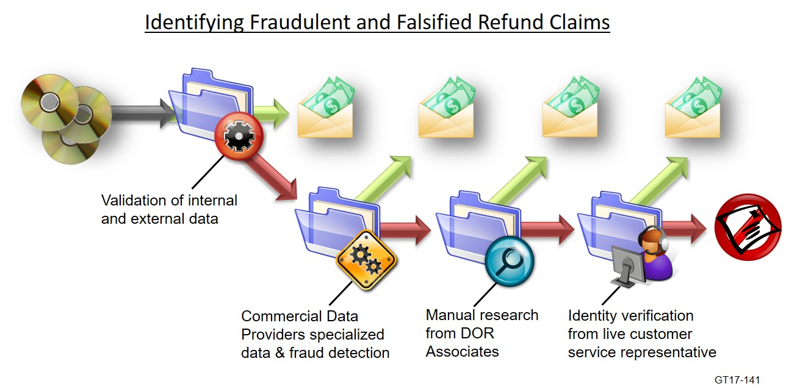
Proven Solution
Approach
Change from current resource-intensive process to identifying cases through an automated “pre-validation”
Automate and accelerate decision making on up to 95% or more of compliant taxpayers to place focus on isolating the potential 5% fraud
Use Federal data, employer data, and other data sources to automate confirmation of SSN/Name, EITC Eligibility, Employer, Employment, Withholding credit, Employer registration/payments
Utilize data to analyze, select, organize and prioritize selection of exception cases within “review queues”
Prioritize case reviews based on risk and aim to enforce a process of “one case, one review” to eliminate multiple reviews
Automate evaluation and release of refund suspensions of “low risk” cases through the use of pre-validation rules and risk models
Notes:
DAVE – SEE MY SEPARATE EMAIL ON SLIDE 16-19 COMMENTS

Slide 11
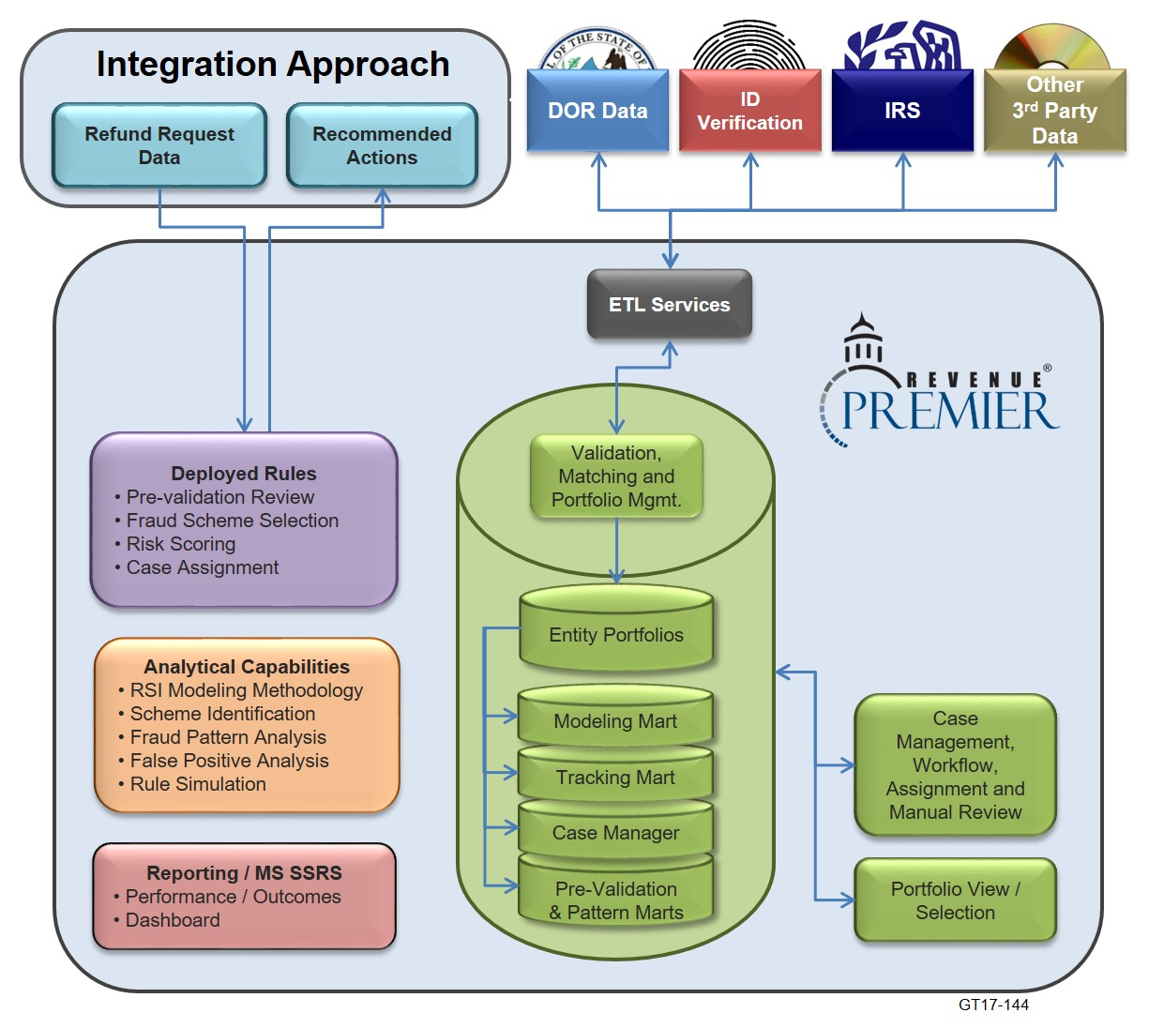
Revenue Premier Solution Context
Integrated and accessible data sources for both rules and analysis
Coordination with returns handling in tax accounting system
Key capabilities and assets that have broader applicability
Secure online system for case workflow, review and research
Full transparency to raw data, portfolios, analysis marts, case data, and tracking
Notes:
First, PRE-VALIDATE
Identify those identities that can be confirmed in advance, consider them pre-validated, and use list to accelerate refund requests submitted under these IDs and name combinations; limit “in-line” processing
Second, REVIEW and SCORE
For those returns that are not pre-validated, conduct a comprehensive review of entity/taxpayer information in the warehouse to attempt to confirm:
Identity (ID and Name)
Refundable credit claims
Third, make a DECISION
For those returns where identity and credits can be confirmed (either manually or automatically), allow the refund request to be processed
For those returns where identity and credits cannot be confirmed, issue a system-generated letter to the taxpayer requesting additional information
Fourth, ACT AUTOMATICALLY when there is no response to the notice
Inactivate credits
Post return without credits ($0 Balance or Receivable)
Most fraudulent returns will have no response to the notice, and require limited or no manual intervention
Monitor volumes and outcomes closely and adapt as necessary
New potential pools of pre-validated taxpayers
New rules for automatically releasing refunds where specific criteria are met
Ongoing manual review of decisions for accuracy and for suggested modifications to rules

Slide 12


“Front End” (Receipt of Return) Examination Workflow
“Back End” (Receipt of Additional Documentation) Examination Workflow
Data
Capture
Prior Year Returns
Paper
Business Rules
Suspend
Manual Review
Manual Review
Incomplete
MeF
Information Request or Adjustment Notice to Taxpayer
Accepted as Filed
Adjusted
Still Incomplete
Adjusted
Now Accepted
Identity Verification Notice (New) to Taxpayer
PAYABLE
Selective Recommendation Reviews
PAYABLE
Integration Points
Return Data
Request
Type A
Recommendation (Release, Adjust, Verify Identity)
Request Type B
Identity Verification
Identity Verification Process
Call In
KBA
Data Resources
Business Rules
Recommendation (Pass, Fail, No Response)
Prior PIT Returns
PIT Accounting
IMF/IRTF, IRMF
WH Accounting
Employer-Rpt W-2s
Motor Vehicles
IRS breach files
Validation Database
Third-Party Identity
Verification
Data Handling
Portfolio Warehouse:
RSI Refund Fraud and Issue Detection Solution
Analytics
Notes:
When talking about information requests talk about how we use white lists so people who provide correspondence and are cleared for that suspension do not get asked for it as the rule would look for that scenario, provided nothing pertaining to that had changed

Slide 13

RSI’s Direct Refund
Fraud Experience
Project | Savings/Results | Unique Aspects
Mass. (2006) | $15m first year ~$150m to date | RSI’s first data-driven refund evaluation project, incorporating IRS, DMV, filing history, employer data, etc.; use of “pre-validation”, patterns, work estimates
Maine (2010) | ~$26m (w/other initiatives) ~3x productivity improvement | 5-Year benefits-based contract with “turnkey” support was transitioned to fixed ongoing support (as part of broader compliance solution); includes Tax & Rent rebate validation and IIT non-filer cases as well
Vermont (2010) | ~3x productivity improvement | Part of a larger 5-year, benefits-based compliance practices modernization project (including fraud, discovery, audit, collections)
North Carolina (2011) | ~$10-15m/year $50-75m to date | Previously part of a larger benefits-based funded project, but fixed price deliverables; improved 2016 with FSET for more timely W-2s (payroll providers)
Penn. (2013) | $28m in first 2 tax seasons | Completed 4 years, 3-year benefits-based contract and 2-year renewal on fixed price basis; RSI provides onsite “turnkey” support for solution
Indiana (2015) | ~$11.8m in first 3 months | About a 4 month initial deployment; Helped build internal DOR capability to analyze/refine/support ongoing

Slide 14
What is the IRS Doing?
Providing information to States, including Valid TIN File, SSA Death Master File, IRMF IMF/IRTF, Personal Income Tax Refund Fraud (daily)
Electronic Tax Administration Advisory Committee (ETAAC) shifted its focus to addressing the serious problem of tax identity theft abuses
Security Summit established to combat refund fraud and establish a group across IRS, States, Tax Preparer Software Providers, and other industry experts to create a framework to share information
Information Sharing and Analysis Center (ISAC) will provide early warnings to States about new and emerging identity theft and refund fraud schemes
Continuous improvements to Fraud Detection to help IRS, States, and Tax Preparation Software Providers combat refund fraud
Reported ID Theft has dropped by two thirds, from 297,000 in the first 5 months of 2015 to 107,000 in the same period for 2017
-Accounting Today July 25th, 2017

Slide 15
What are States Doing?
Agencies continue to strengthen their own internal “identity resolution” databases (from many data sources) and evolve their refund fraud processes
Ongoing State-IRS-NATP collaboration
State sharing through Secure Data Transfer
Accelerating electronic employer W-2 filing and slowing down refund issuance to confirm withholding pre-refund; definitive credit accounting
  Some States now require employers to file taxpayer income and withholding by Jan. 31 and may not issue refunds before March 1,
  Some States no longer give refunds on debit cards unless they are tied to a bank account.

Slide 16
What are States Doing? – Cont’d
  States are requiring Withholding to be filed quarterly
Decrease over-withholding situations by adjusting withholding tables and processes
Expanded IP PIN use … efficient “opt in” process
Agency-hosted (or at least directed) identity verification processes (i.e., “quiz”) for various needs
Proactive anomaly detection approaches and deeper analytical capabilities as a new agency core competency

Slide 17
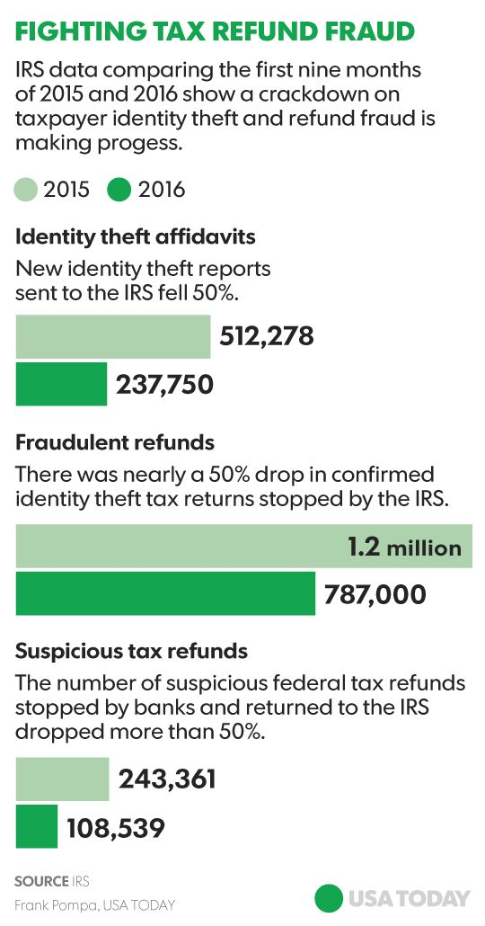
Recent Results…
Efforts of IRS, State Tax Agencies, Private Tax-Preparation and tax-filing software companies and others
An unprecedented public-private crackdown has helped cut taxpayer identity theft reports in half
As electronic tax returns were filed, tax-preparation firms gave the IRS information about their review of the transmissions, including any improper or repetitive use of Internet Protocol numbers, the electronic addresses where the returns originated
The tax-prep firms and the IRS also shared information about computer device identification data linked to the tax returns' origin, as well as metadata from the transmissions
The IRS also placed a new verification code on some of the W-2 tax return forms that individuals used to file tax returns
New safeguards planned for the 2017 tax-filing season will focus on "trusted customer" features that help ensure the authenticity of both the taxpayer and the tax return
‘Tax-refund fraud to hit $21 billion,
and there's little the IRS can do’
– CNBC February 11, 2015
Notes:
Formally announced last year, the crackdown was prompted by a years-long surge in tax refund fraud, including an embarrassing breach in which cyber-thieves stole as much as $39 million in federal refunds based on taxpayer information hacked from an IRS website
The number of people who filed IRS affidavits stating they had been victimized by identity theft dropped 50% during the first nine months of the year compared with 2015, from 512,278 to 237,750, the federal tax agency said.
Similarly, IRS data showed a nearly 50% drop, from 1.2 million to 787,000, in the number of confirmed fraudulent tax returns that made it into the agency's tax return processing systems.
The number of suspicious refunds stopped by banks and returned to the IRS also dropped by 50%, as the number of banking partners in the public-private effort rose, from 514 to 620.
"Add all this up, and it means we're seeing fewer bad returns, fewer bad refunds and fewer taxpayers becoming victims," IRS Commissioner John Koskinen said in comments prepared for a briefing on the results to date.

Slide 18

What does the future hold?
Increased public/private collaboration using multi-layered approach
Increased electronic data sharing and therefore
improved opportunities to confirm the identities of
valid taxpayers
  State-to-state exchanges (e.g., to confirm
  non-resident refund requests)
  Other agencies (e.g., motor vehicle licenses)
  Payer reporting (e.g., W-2s, 1099s, etc.)
  Federal data (e.g., issuance of valid ITINs, valid SSN/Name combinations from SSA, near real-time data exchanges, etc.)
Increased automation of desk examination prior to posting and refund processing, given:
  Improved technology: data availability, processing capacity, decision management services, integration options (e.g., web services), face recognition software, etc.
  Increased validation across: employer withholding tax payments, employer-issued W-2s, and taxpayer-claimed withholding credits
Increased fraud schemes: more sophistication, exploiting web-based filing channels, from other states and foreign countries, and focusing now on business taxes
20
Notes:
18

Slide 19

Questions?
David Casey
Executive Consulting Manager
Revenue Solutions, Inc.
(888) 826-1541 ext. 262
DCasey@rsimail.com

