Slide 1
BARBARA CARNES, MD, AREA MEDICAL DIRECTOR
KAISER PERMANENTE SOUTH BAY MEDICAL CENTER
Created with Haiku Deck

Slide 2
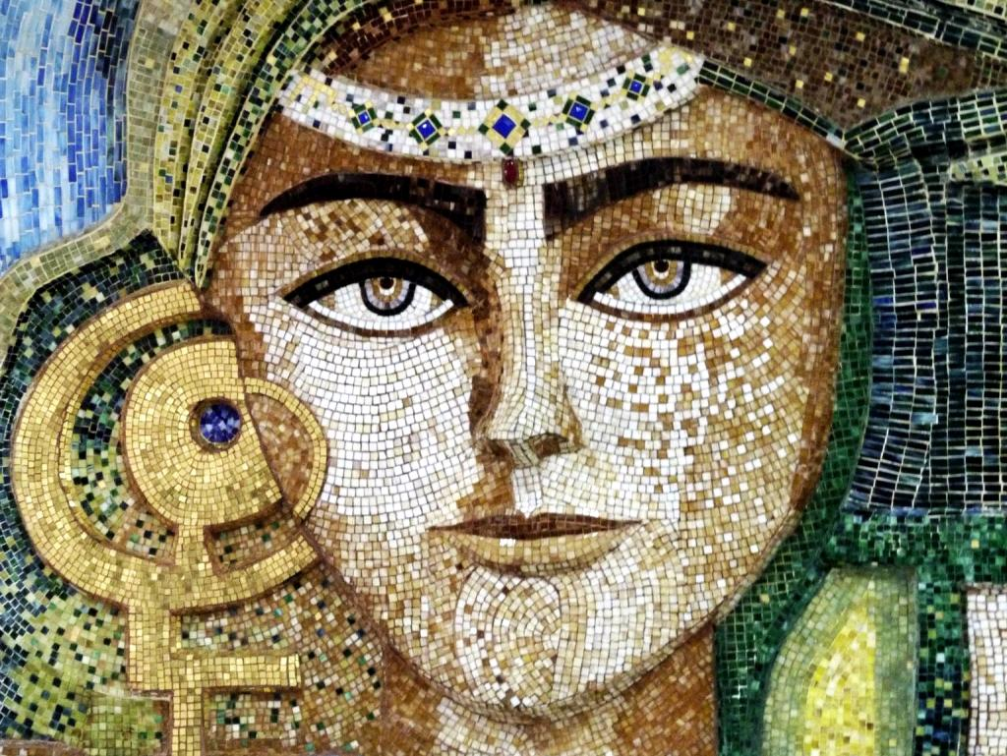
1. Stop Feeling Guilty 2. Recognize Biases & Roles 3. Women & Leadership
Photo by Rusty Clark ~ 100K Photos - Creative Commons Attribution License https://www.flickr.com/photos/23206546@N04
Created with Haiku Deck

Slide 3
Domestic Responsibilities Expanded Roles Perfectionism

Slide 4
What Children Think About Their Working Parents
Ellen Galinsky: 1,000 children, ages 8 to 18 Findings
Majority of parents received an “A,” regardless of parents being employed full or part time, or stay at home for:
being there when their children are sick
raising them with good values
making them feel important and loved, no differences were found
"If you were granted one wish to change the way your mother's and your father's work affects your life, what would that wish be?"
Only 10 %--whether they had working parents or not--picked as their No. 1 response "more time" with their mother.
65% worry about the stress levels at home. No significant difference between working parents and stay at home parents
Galinsky, Ellen. Ask the Children: What America's Children Really Think About Working Parents". New York: William Morrow and Company, 1999.

Slide 5
UNCONSCIOUS GENDER BIAS: TIME TO ACKNOWLEDGE AND CHANGE
Women’s successes: “getting lucky, working hard, or help from others”
Men’s success: skill
Objective requirements are often applied rigorously to women but leniently to men
Women tend to be evaluated more harshly than men and often by a male standard such as “working full time”
Gender bias comes from men and women and both men and women are negatively impacted

Slide 6
Cultivate Women Leaders
Aspirations
Motivation
Power vs. Affiliation
Overestimating Consequences

Slide 7
Explaining Gender Differences at the Top
800 employed individuals, categorized core life goals:
Men: fewer goals and are more motivated by power
Women: greater number of goals and tend to be more motivated by affiliation — the desire for warm, close relationships with others
630 MBA Graduates Surveyed
Women view advancement to Leadership as equally attainable as men
Women view advancement to Leadership as less desirable than men
Women are more likely than men to feel anxious about the sacrifices or difficult trade-offs they would have to make for Leadership
Women tend to associate power-related goals (such as taking on a high-level position) with more negative outcomes than men
Gino, Francesca. Wood Brooks, Alison. (2015) Explaining Gender Differences at the Top. Harvard Business Review.

Slide 8
Current Situation
Women make up more than half of the workforce
As you move up the organization, fewer women
(2009) Zenger Folkman

Slide 9
SOUTHERN CALIFORNIA PERMANENTE MEDICAL GROUP
Almost half of our physicians are women
Leadership positions are dominated by men
Data as of June 2017

Slide 10
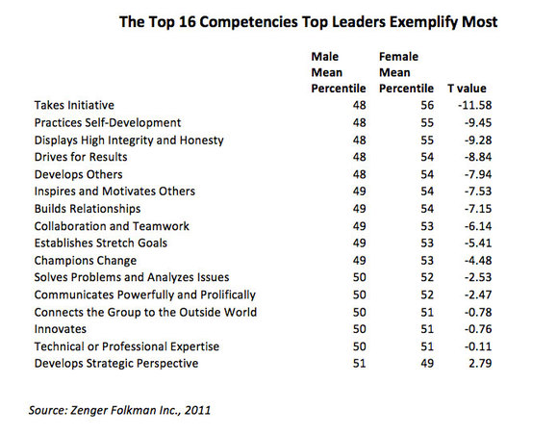
(2011) Zenger Folkman

Slide 11
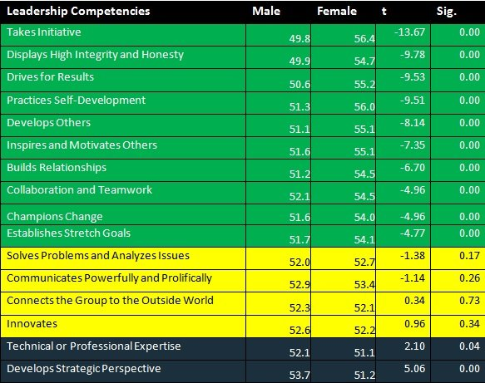
Women’s Leadership Competencies
Sherwin, Bob. (2014)
Why Women Are More Effective Leaders Than Men. Business Insider.
www.businessinsider.com/study-women-are-better-leaders-2014-1

Slide 12
PHYSICIAN REPORT 2015
Women as
Physician Leaders
Findings from 3,285 female physicians, representing all medical specialties:
Financial compensation, prestige, and bolstering a resume ranked low on the list of reasons for pursuing a leadership role, while having a positive influence on others in the organization and effecting change were most important to both current women
Women physicians overestimated negative consequences of leadership
Women in leadership positions reported greater happiness in their careers (72%) compared with non-leaders (63%), while both groups were similarly happy with their lives outside of work(83% for both).
Stephanie Cajigal; Greg Weiss; Nelson Silva (2015) Women as Physician Leaders: Challenges and Opportunities. Medscape. http://www.medscape.com/features/slideshow/public/femaleleadershipreport2015

