Slide 1
Connect: The Art and Science of Persuasive Communication
Toby Groves, Ph.D.
toby@tobygroves.com

Slide 2
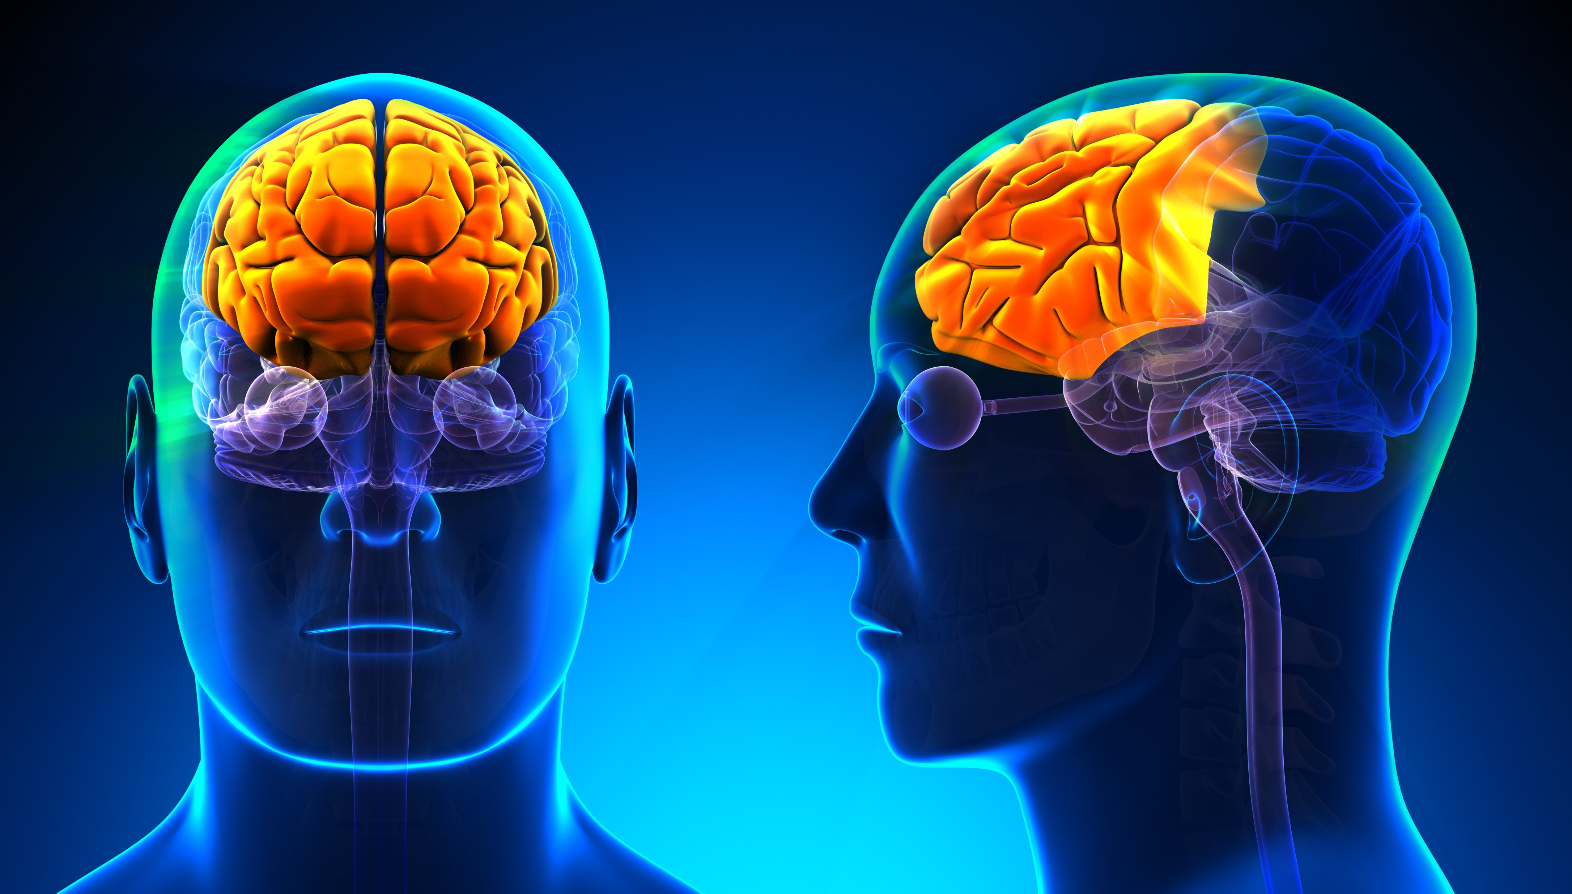
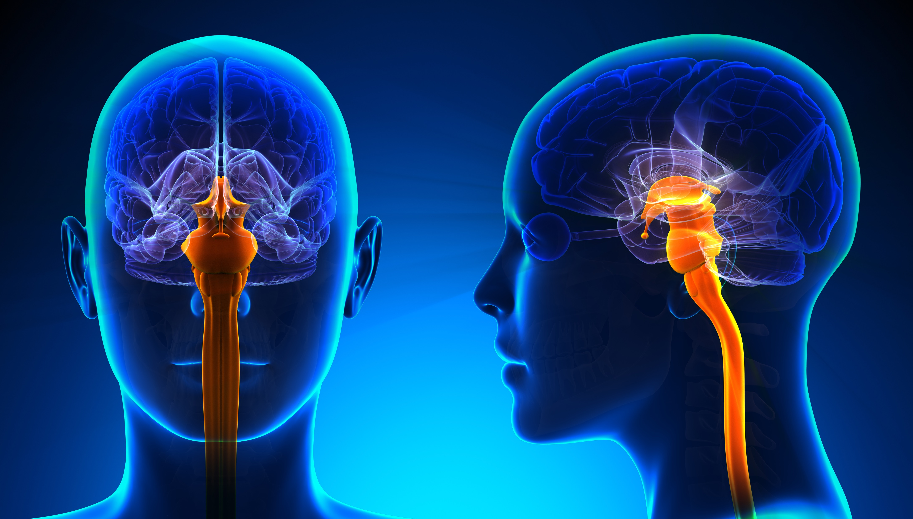
Mind-Lenses
Logical lens (slow, conscious)
Cortex handles logic and language but is subject to depletion (fatigue)
Emotional lens (fast, preconscious)
Handles belief and trust (not language)
Automatic lens (fastest, subconscious)
(RAS) Handles conditioned associations

Slide 3
We respond to meaning
Create context:
Memories
Associations
Expectations
Meaning over Logic

Slide 4
Capacity
Duration
Focus
Working Memory is
Limited in:
“Depletion”

Slide 5
The Neuroscience of Decision Making
Instead of a conscious reasoning process to arrive at a judgment
We usually have immediate and sub-conscious intuition
Followed by conscious reasoning to support that intuition

Slide 6
How can we ease depletion?
Spur curiosity
Take breaks from mentally demanding tasks
Help the audience identify with the topic (to see how they fit in)
Depletion

Slide 7
Heuristics:
We use “Rules of Thumb” to simplify decision making-but these simple rules lead to biases, especially under stress
Limited capacity for complex problems
Inability to recognize counter-intuitive solutions to problems
Increased likelihood of attention going towards default judgment
Context

Slide 8
Imagine that the U.S. is preparing for the outbreak of an unusual foreign disease, which is expected to kill 600 people. Two alternative programs to combat the disease have been proposed. Assume that the exact scientific estimate of the consequences of the program are as follows:
If program A is adopted, 200 people will be saved.
If program B is adopted, there is a 1/3rd probability that 600 people will be saved, and a 2/3rds probability that no people will be saved.
-or-
If program C is adopted, 400 people will die.
If program D is adopted, there is a 1/3rd probability that nobody will die, and a 2/3rds probability that 600 people will die.
Framing

Slide 10
Make the first offer. Research shows that you are more likely to get better terms and achieve a result closer to your goal.
If you make the first offer you are achieving an important psychological advantage called anchoring.
Anchoring-Sets the stage. Everything is compared to the anchor
Most people aren’t aggressive enough in setting the anchor because of fear they will be far off and disengage the other party
Best first offer? Just outside partners reservation price
Anchoring
and
Negotiation

Slide 11
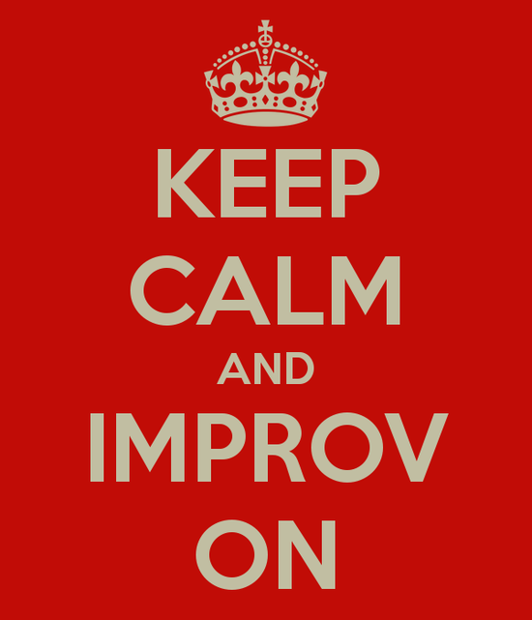
The Art and Science of Improvisation
Rule #1 Yes and - This is the holy grail of improv. Accept the ideas that others put forth
Rule #2 Act/React- Take responsibility and confront your fears. Have faith that others will have your back
Rule #3 Make someone else look good and you look good- Instead of looking out for yourself, look out for the other team members. This builds trust, acceptance, responsibility and commitment
Rule #4 Be Vulnerable and Honest- Be as natural as possible
Rule #5 There Are No Mistakes- Trust that everyone is doing the best they can, and use all ideas

Slide 12
Strong initial views:
Resistant to change because of the way we interpret subsequent information
When new information meets prior belief contrary evidence is dismissed as unreliable, or unrepresentative
We must also realize that when no initial view is present, the opposite situation can occur-we are at the mercy of the way the problem was formulated (framing)
Persuasive Approach

Slide 13
Draw them quickly to content they will find important - emotionally meaningful
Frame it so they quickly see what they desire or want to avoid (RAS). Consider context and mood when developing your approach.
Persuasive Approach

Slide 14
Be prepared to:
Remove ambiguity
Be clear-you will build credibility
Don’t let them misunderstand-you could work hard for an agreement that doesn’t work out.
Be prepared to:
Deal head-on with the hard issues
Avoidance only makes it worse
Ignoring risk doesn’t remove risk
Persuasive Approach

Slide 15
Biases that may reveal themselves through verbal and nonverbal cues
The context of the situation that will influence the way the message is framed
Know Yourself and Your Audience

Slide 16
Non-Verbal Cues
What are they?
Body language
Micro-expressions
Para-linguistics
Speed of speech
Tone
Persuasive Communication

Slide 17
Mood (affect)
Good mood (non-threatening topic)-More likely to use bottom-up thinking- more open for creative solutions and unusual associations
Bad mood (distracted/threatening topic/system two depleted)-Top down, rules-based thinking - may take more risk on loss related items
Context

Slide 18
Some tips from informational interviewing
How would you start?
Persuasive Communication

Slide 19
Persuasive Communication
Start SLOW-SAFE-PERSONAL
Set relaxed atmosphere
Start on “safe ground”
Reveal something about yourself –Reciprocity
Establish Rapport
Opportunity to establish “baseline” behavior
Set non-threatening tone for open dialogue

Slide 20
This will require research
Put yourself in their shoes
What are their motivations
What do they hope to hear/not to hear
Know Your Audience!

Slide 21
What do they and don’t they know?
Preconceived notions?
How will they use this information?
What can you provide that will support this?
-What is the worst mistake they could make with the info?
Know Your Audience!

Slide 22
Connect: The Art and Science of Persuasive Communication
Toby Groves, Ph.D.
toby@tobygroves.com

