Slide 1
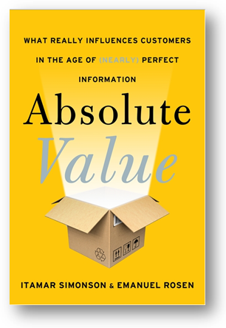
What Really Influences Customers in the Age of (Nearly) Perfect Information

Slide 2
When marketing theories were developed, consumers made decisions very differently

Slide 3
We’ll reexamine common beliefs about…
Branding
Loyalty
“Irrationality”
Communication
Market Research

Slide 4
What exactly has changed in the way consumers make decisions?
A shift from relative to absolute

Slide 5
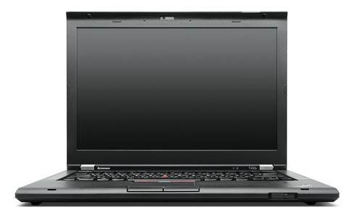
I used a Toshiba that worked fine
It’s the most expensive so it must be the best

Slide 6
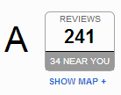
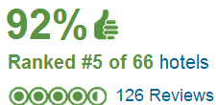
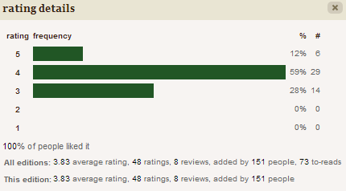
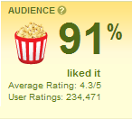
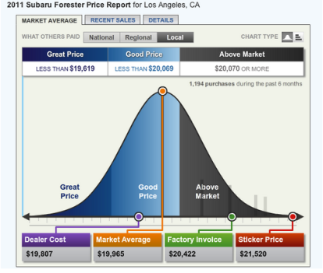
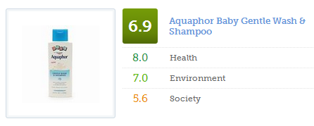
O

Slide 7
A Customer’s Decision is influenced by a mix of three sources
O
O
O
M
M
P
Other people
Prior preferences
Marketers

Slide 8
Branding
Common belief:
“A company’s brand is more important today than it has ever been.”

Slide 9
“Higher Yelp penetration leads to an increase in revenue for independent restaurants, but a decrease in revenue for chain restaurants” Source: Michael Luca, “Reviews, Reputation, and Revenue: The Case of Yelp.com,” Harvard Business School Working Paper No. 12-016, September 2011.

Slide 10
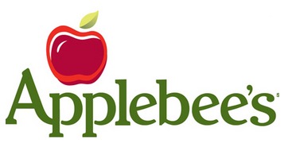
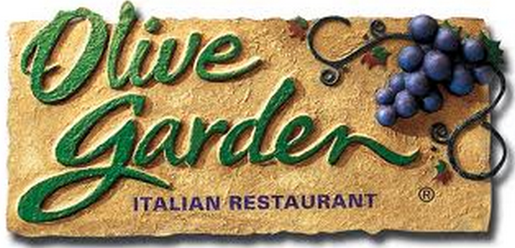

Slide 11
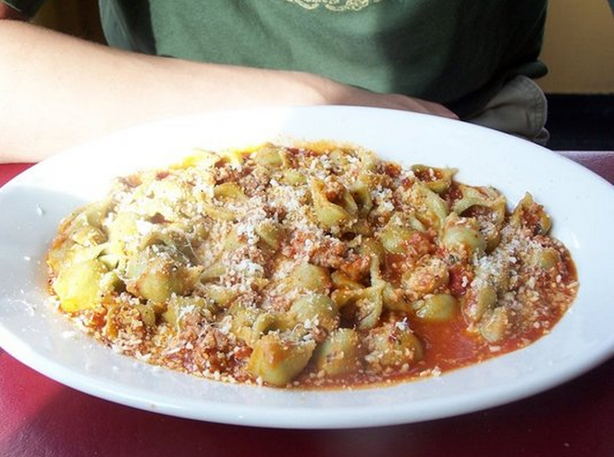
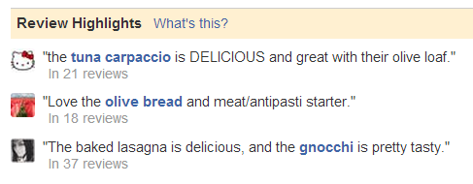
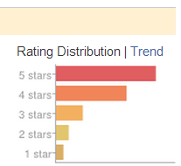

Slide 12
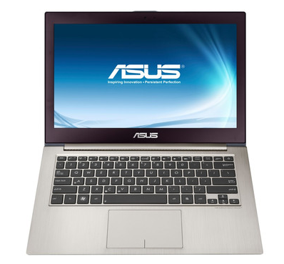
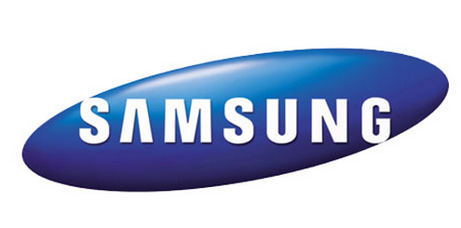
Implication: Brands Mean Less
Lower barriers to entry
Easier Diversification

Slide 13
Loyalty
Common belief:
Nurturing customer loyalty is the best investment.

Slide 14
What percentage of guests always stay at the same hotel brand? ___
8%
Source: Deloitte

Slide 15
Past Experience and Loyalty are Less Important
Success is driven by your current product
Your competitors probably face the same problem
Measuring loyalty is less informative

Slide 16
“Irrationality”
Common belief:
Customers are irrational. Choices greatly influenced by context and framing of an offer

Slide 17
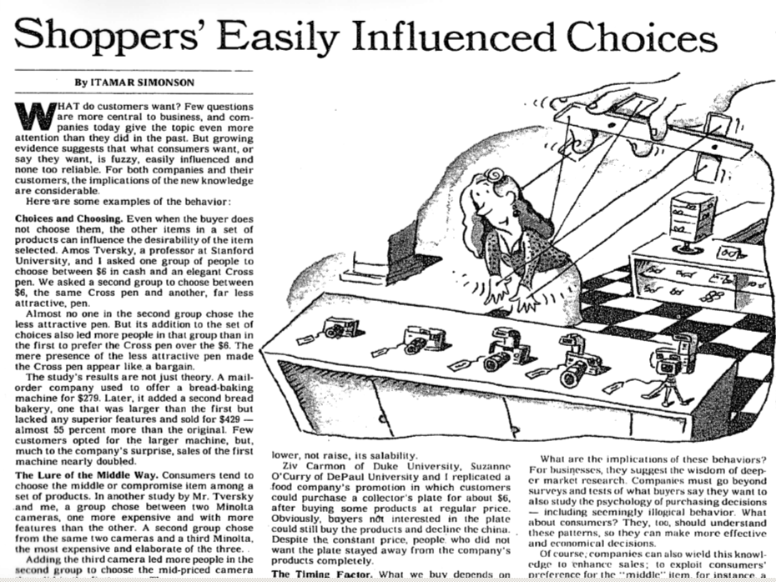

Slide 18
Consumers act more rationally
“Irrationality” tactics not as effective as before
As consumers, we’ll make better choices

Slide 19
Communication
Common belief:
Positioning, brand awareness, persuasion are key

Slide 20
When Consumers Rely on Reviews
Don’t try to persuade them that your product is the best. (They go to O for that)
Positioning worked when they relied on M
Don’t focus on top-of-mind brand awareness
Focus on generating interest in specific products
Promote ongoing flow of authentic O content

Slide 21
Market Research
Common belief:
Ask lots of questions and you’ll know what consumers want

Slide 22
A 2007 study conducted before the release of iPhone concluded that such convergent products are not desired by U.S. consumers

Slide 23
The Problem? The study measured __ but consumers were influenced
by __
P
O

Slide 24
From Predicting to Tracking
Less measurement of P, satisfaction, loyalty.
More systematic tracking of O.
Experiment. Adjust. Experiment.

Slide 25
We reexamined five concepts:
Branding
Loyalty
“Irrationality”
Communication
Market Research

