Slide 1
A perspective on SWIFT, Regulation and Standards
Matthieu de Heering
Head of Russia, CIS, and Mongolia - SWIFT
07Nov2014

Slide 2

SWIFT is the global provider of secure financial messaging services
212
10k+
5*9
Notes:
212 countries
10 000 + Institutions
99.999 availability
COOPERATIVE
THREE PILLARS:
COMMUNITY
STANDARDS
AND PLATFORM

Slide 3

Messaging
21 mio
FIN messages per day
6 billion
FIN
messages per year
6 trillion USD per day
25 mio
peak day messages

Slide 4











Oversight
Governance
Board
Board committees
National Member Groups
National User Groups
Notes:
Stress oversight from RIKS
Stress governance and the fact that SE board member chairs SSC and Norwegian ESA board member chairs BPC

Slide 5
SWIFT in Russia, CIS & Mongolia
1989: First customer, VEB
  in Kazakhstan: Kazakh Interbank Settlement Centre
2009: SWIFT Moscow office opened
  Kazakhstan is 2nd country by traffic
Today: 1000+ customers
  in Kazakhstan: 43
Traffic growth: 60% plus
Payments represent biggest business
  cross border and domestic

Slide 6
Agenda
SWIFT Community approach & cooperation with our members
  Market Infrastructures
  Participants
Focus on Financial Crime Compliance

Slide 7
Engagement for our communities

Slide 8
ISO 20022
How does it fit into the ISO structure?
ISO Technical Committee TC68
Financial Services
SC2
Security
SC4
Securities
SC7
Banking
ISO 20022
RMG
RMG members nominated by P-member countries and A-liaison organisations
TSG & SEG members nominated by all member countries and liaison organisations
TSG
RA
SEG
Securities
SEG
Trade Services
SEG
Payments
SEG
FX
SEG
Cards
Notes:
Where does the ISO 20022 platform fit in the ISO structure?
ISO is a federation of 164 national standards bodies, i.e., the ISO member countries. The standardisation work is spread over various ‘Technical Committees’ (TCs) to which the 164 ISO member countries can decide to participate. Technical Committee TC68 is in charge of ISO standards related to Financial Services (such as the BIC, the LEI, the IBAN, the ISIN, the CFI, the MIC, ISO 8583, ISO 15022 and many others, including ISO 20022).
The work of TC68 is further split among three ‘Sub-committees’ (SCs), each in charge of standards for a specific area. In total, 78 ISO member countries are involved in the work of TC68 and its Subcommittees, among which 31 are actively participating in the standardisation work (they are called the ‘P’-member countries). In addition, standards organisations, which because of their international nature, cannot access the ISO work through a specific country, can be authorized to establish a direct ‘Liaison’ with the TCs or SCs they are interested in. When they participate actively in a committee, these Liaison Organisations are called category ‘A’ liaison organisations. In total, TC68 and its sub-committees have accepted 16 liaison organisations, such as the ECB, EPC, ISDA/FpML, FIX Protocol Ltd (FPL), ISITC, IFX Forum, Mastercard, VISA, Euroclear, Clearstream and SWIFT.
ISO 20022, because it covers all financial messages, reports directly to TC68. Other standards generally report to the Subcommittees. As such, the ISO 20022 Registration Management Group reports to TC68 and the RMG members can be nominated by the P-member countries and the category ‘A’ liaison organisations. The RMG monitors the RA, the TSG and the SEGs. The RA is nominated by TC68 and has a specific contract with ISO. The TSG and SEG members can be nominated by any type of TC68 member countries or liaison organisations.

Slide 9
Legal Entity Identifier
Enable consistent and accurate identification of all legal entities that are parties to financial transactions to support systemic risk management.
More than 60,000 codes issues
Standards body - ISO17442
  Standard approved in May 2012; endorsed by FSB
  Non-intelligent alpha-numeric ID - unique, persistent and freely available

Slide 10
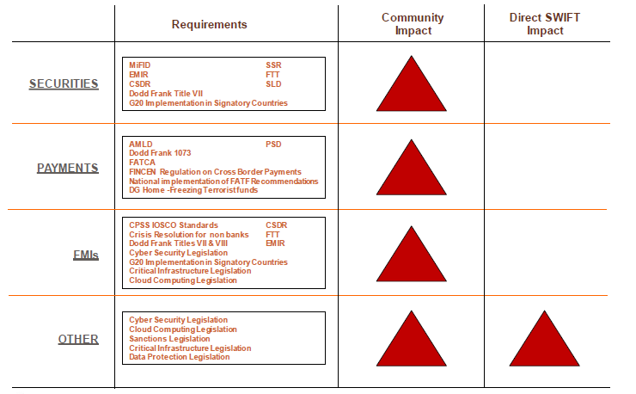
Regulatory Summary – SWIFT Community

Slide 11
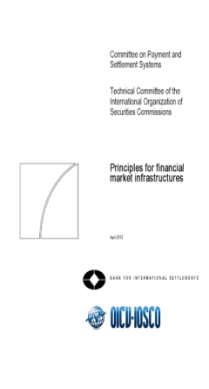
Principles for Financial
Market Infrastructures (PFMIs)
Foster financial stability
Limit systemic risk
Increase safety
Support greater efficiency
Published by CPSS-IOSCO
24 principles
Issued for consultation in 2011
Finalised in April 2012
To be applied December 2012 (*)
(*) “CPSS and IOSCO members will strive to adopt the new standards by the end of 2012 and put them into effect as soon as possible”
High Value Payment Systems
Low Value Payment Systems
Central Counterparties
Central Securities Depositories
Trade Repositories
Critical Service Providers

Slide 12
What are Critical Service Providers (CSPs)?
Annex F - Principles underlying the key role of CSPs
CSPs are 3rd party service providers delivering services that are critical to FMIs’ operations
FMIs depend on the continuous and adequate functioning of CSPs
FMIs need to assess the reliability of the CSPs they rely on
A strong CSP should
  Meet the FMI’s functional requirements
  Ensure full compliance with the oversight expectations for CSP in PFMI (Annex F)
  Commission verification of compliance (assurance process)

Slide 13
Expectations for robust, secure and resilient CSPs
Annex F : Oversight expectations applicable to CSPs
Risk identification management
Information security
Reliability and resilience
Technology planning
Communication with users

Slide 14
SWIFT’s role in the PFMIs
SWIFT is a Critical Service Provider
SWIFT has identified itself as a CSP for the services it provides to FMIs
Notes:
SWIFT is a critical service provider
SWIFT is not an FMI
SWIFT core products and services should not be considered outsources services

Slide 15
SWIFT complies with PFMI annex F
How do we demonstrate Compliance?
Today, SWIFT supports FMIs in their Compliance…
PFMI Annex F: Oversight expectations applicable to CSPs | ISAE 3402 and High Level Expectation Assurance report
Risk Identification management
Information Security
Reliability and resilience
Technology planning
Communication with users
√
√
√
√
√

Slide 16
T2S – where SWIFT fits in
T2S brings harmonised Delivery versus Payment securities settlement to the EU, with the aim of making cross border settlements as efficient as domestic settlements.
Closely aligned with the CSD-Regulation
Follow up of Giovannini assignment
23 participating CSDs
4 CSD migration waves for T2S
Messaging Standards – ISO 20022
SWIFT is one of the value-added network suppliers

Slide 17
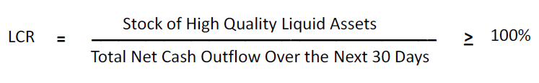
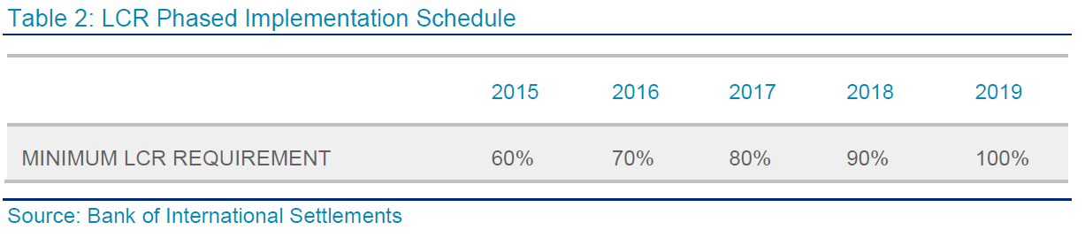
Basel III and Intraday Liquidity Reporting
Global
Content
Impact
Capital requirements
Liquidity requirements
Leverage ratio
Additional capital buffers
Improved monitoring of available liquidity

Slide 18
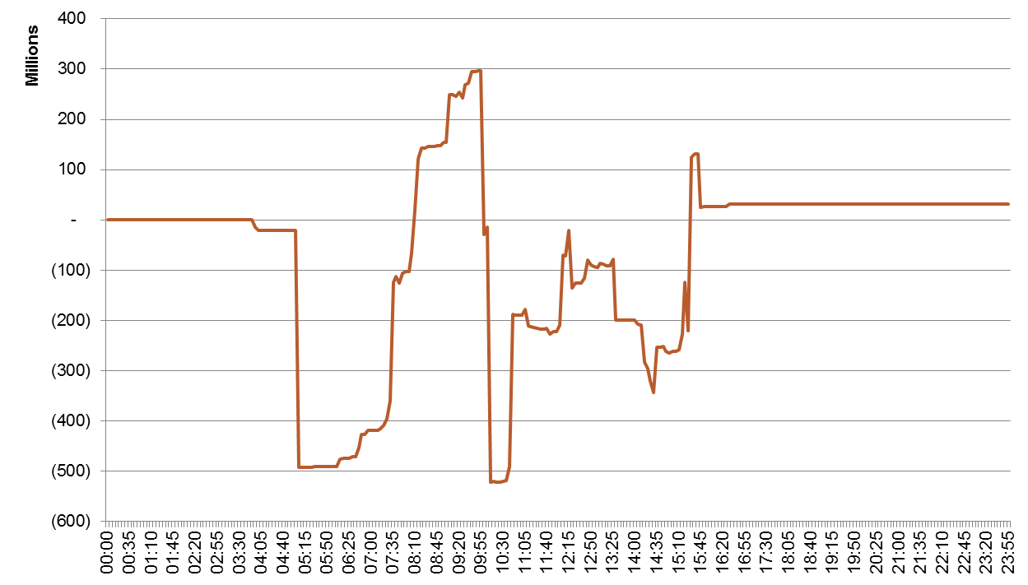
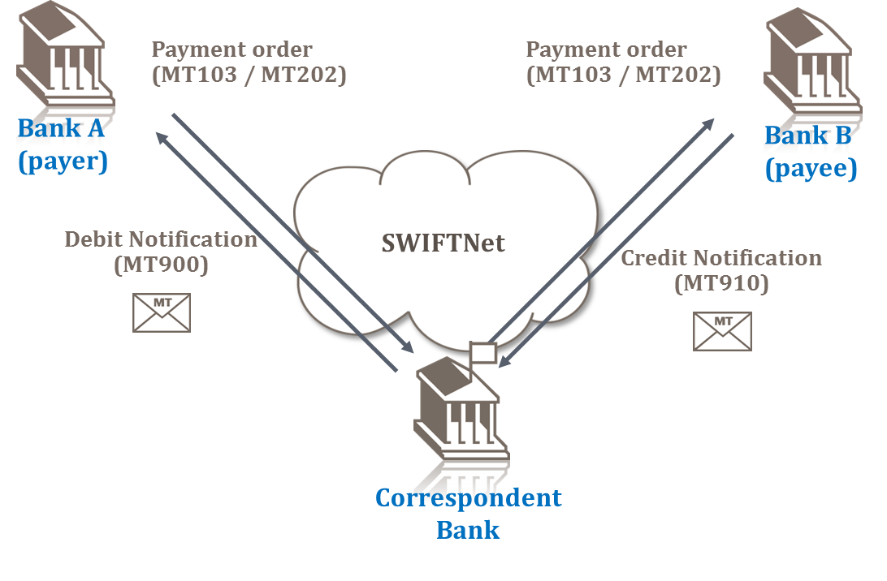
Liquidity reporting and management
Options
Intraday liquidity
  MT900
  MT910
Intraday reporting
  MT94x
End-of-day reporting
  MT950
Real-time full information
  FINInform
Business Intelligence

Slide 19
SEPA
Content
Impact
Borderless system for secure and efficient transfers within the EU
Deadline Eurozone – August 2014
Deadline remaining EU – 2016
Covers credit transfers and direct debits
Impacts banks and corporates
Increased ISO20022 adoption
Mandatory IBAN adoption
IBAN to BIC mapping required
Increased need for reference data

Slide 20
How SWIFT supports members in SEPA compliance
Effective
SEPA Compliance
Analysis
Messaging
Ref. Data
Training
- Impact Analysis
- BBAN to IBAN
conversion
- Standards
mapping
- Integration
FileAct
SEPA Plus
IBAN Plus
ISO20022
SWIFT
Notes:
20

Slide 21
Financial Crime Compliance

Slide 22
A community issue calling for a community solution …
Financial crime is top of the agenda for banks
All geographies / All types of players impacted
Significant costs
at stake….
... Yet no competitive advantage for banks
Lots of duplication…
… for universal challenges

Slide 23
Financial Crime Compliance Roadmap
Live
Development
Qualification
Standards
Sanctions list service
Exploration
Data repository
KYC registry
Traffic analysis
Business intelligence for Compliance
Processing services
Scree-ning
Testing
FATF 16
Quality
Traffic restriction (RMA)
AML testing & tuning
Sanctions
KYC
AML
Notes:
Two words one each:
Screening – in the cloud without banks needing to operate own infrastructure (small medium banks)
Larger ones have their own infra – Testing to make sure and be able to demonstrate that it works with empirical analysis
RMA – make sure you are doing business with the entities you wanna do business with
BI 4 compliance – using SWIFT stats to do better monitoring on AML (banks know what they are doing but not what the market is doing from a compliance perspective) Q2 next year
KYC registry – building a utility solution for bilaterally expensive problem, using information submitted to SWIFT upon joining of all 10k institutions. We provide data resp.ty is with banks
FATF 16 – how to ensure that regulatory required ordering and beneficiary of the payment properly identified in payment qualification = know we will do it, looking at how
Sanctions list service – harmonised list service
AML testing and tuning – similar to testing but for AML versus terrorism
CONCULSION – SWIFT community sees financial crime compliance as a transformational movement for SWIFT – high economies of scale and non competitive, and we are ideally positioned (as global provider of int’l xbd flows)

Slide 24
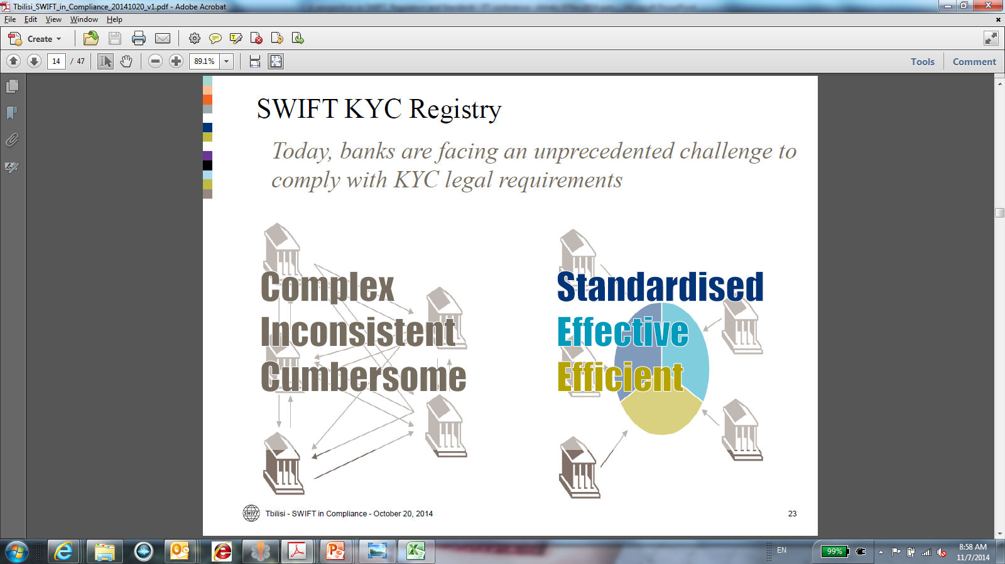

Slide 25
KYC Registry – Guiding principles
A SWIFT managed global KYC Registry
Leverage SWIFT membership process
Provide enrichment based on SWIFT traffic data
Operated and secured according to SWIFT standards
Focus on banks KYC (reach to more than 7000 banks)
Banks remain (1) owner and in control of their information and
(2) responsible for their KYC process, criteria and results.

Slide 26
Thank you
Matthieu de Heering
Геринг Матвей Филиппович
Head of Russia CIS Mongolia
Руководитель московского офиса SWIFT
Глава региона Россия, СНГ и Монголия
T
+7 495 228 5923
matthieu.deheering@swift.com
www.swift.com
E
W

Slide 27
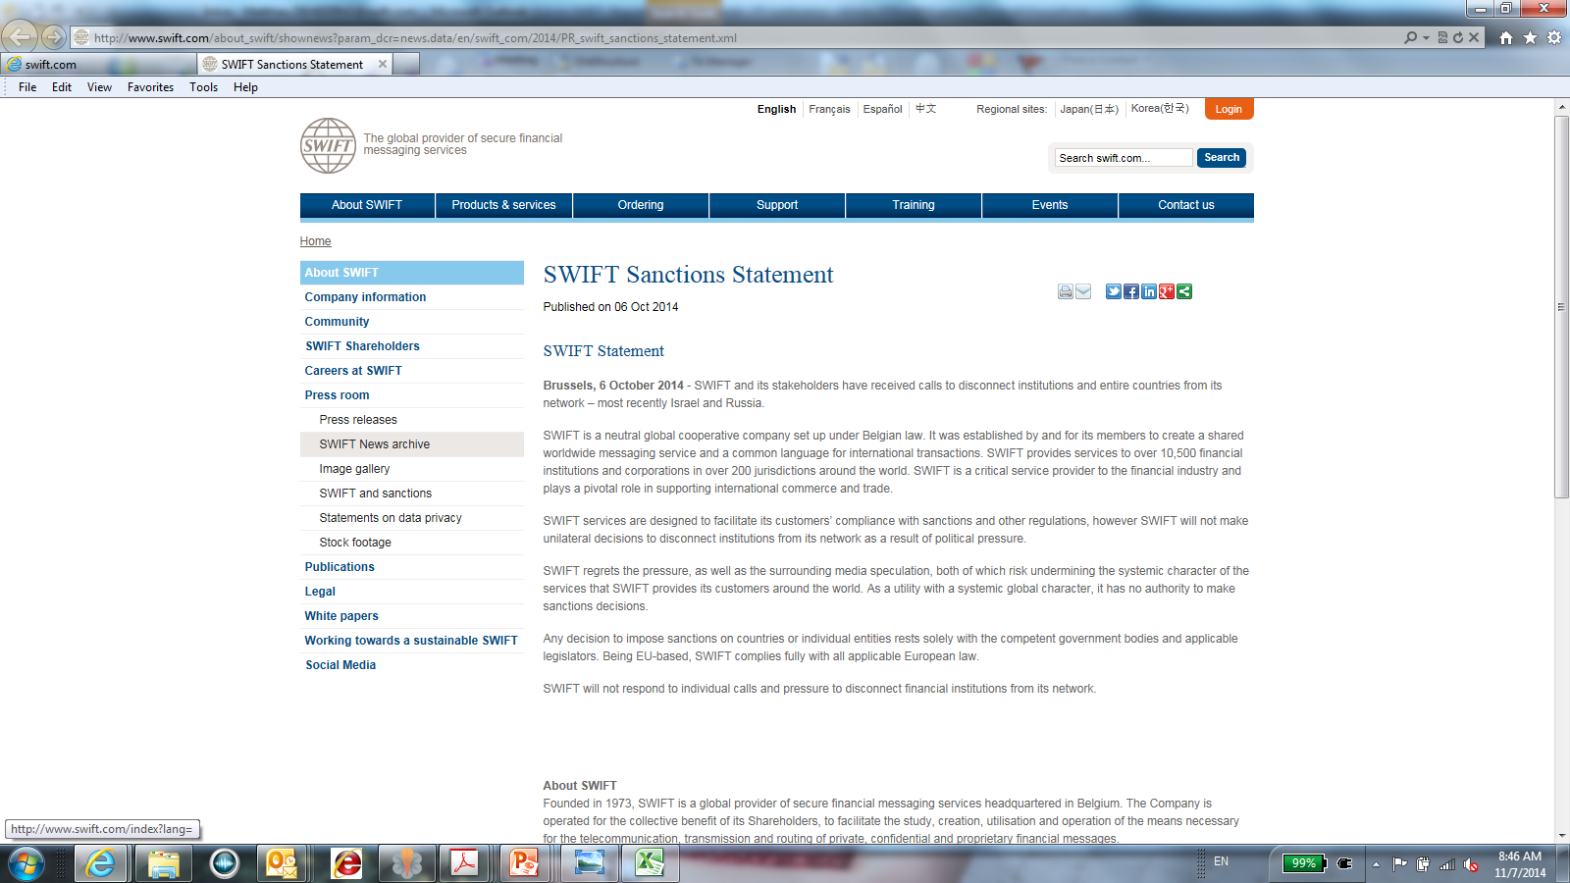
Sanctions Statement

Slide 28
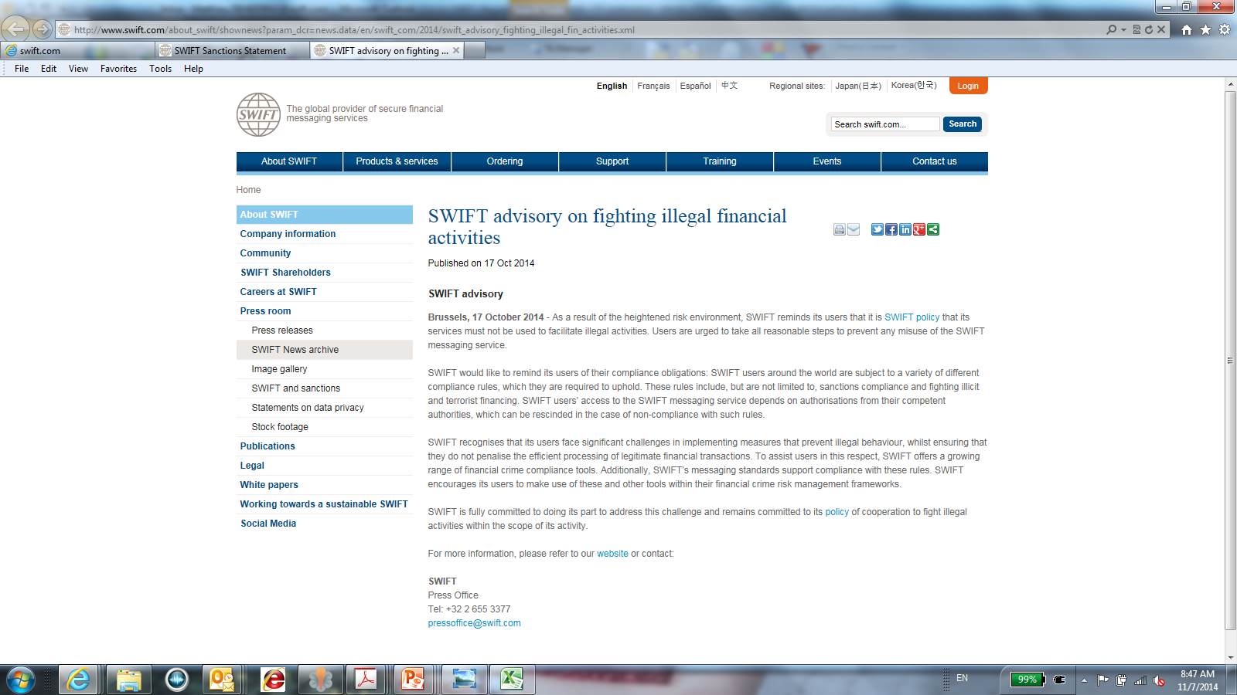
Advisory on fighting illegal activities

