Slide 1
Understanding the sources of illicit alcohol can lead to effective solutions
WCO Knowledge Academy
July 3, 2014
Lance Hastings
Head of Regulatory & Tax Affairs
SABMiller plc

Slide 2
Perspective of global brewers
Global Brewers Initiative To lead the responsible advancement of beer interests on a global scale, delivering local benefit to our markets of operation and a global platform for sustainable, profitable category growth.

Slide 3
Understanding the sources of illicit trade
Three pillars support effective engagement
RESEARCH
SOURCE
SOLUTIONS

Slide 4
Understanding the sources of illicit trade
Research regarding the illicit trade of alcohol is a vital input for effective management
Supply-side focus can be more appropriate when sources are more industrialised or commercial
Demand-side studies can provide critical insights particularly in less developed markets when the illicit trade is more localised
RESEARCH

Slide 5
Understanding the sources of illicit trade
SOURCE
Counterfeit
Smuggled
Tax Avoidance
Non-conformed products
Other
Our research shows that each market has a unique profile

Slide 6
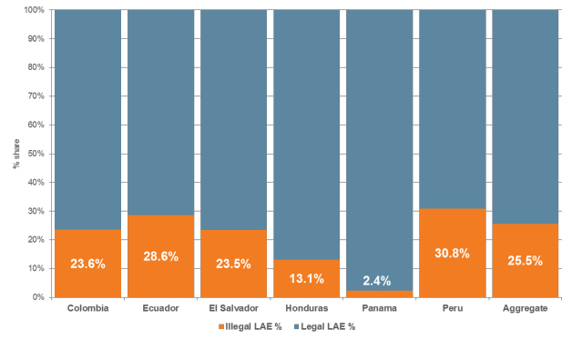
Understanding the sources of illicit trade
One region with many variances
SOURCE

Slide 7
Understanding the sources of illicit trade
Colombia
SOURCE

Slide 8
Understanding the sources of illicit trade
SOLUTIONS
Targeted
Proportionate
Effective
Least burdensome to legitimate businesses

Slide 9
Understanding the sources of illicit trade
A critical success factor in dealing with illicit trade of alcohol is a broad, comprehensive coalition of stakeholders that are focussed on appropriate solutions based on robust data and analysis.
This is particularly important for goods that are designed for human consumption or contact (ie food, beverage, cosmetics and pharmaceuticals)
SOLUTIONS

Slide 10
Thank you
Lance Hastings Head of Regulatory & Tax Affairs
Lance.Hastings@sabmiller.com
m +44 (0) 7423 524 655

