Slide 1
The Kresge Foundation 2nd annual CREWS Convening
October 23-25, 2018 | Atlanta, GA The Renaissance Atlanta Midtown Hotel

Slide 2
Equity in The American South
What is equity?
Why does equity matter to you?

Slide 3
What is Equity?

Slide 4
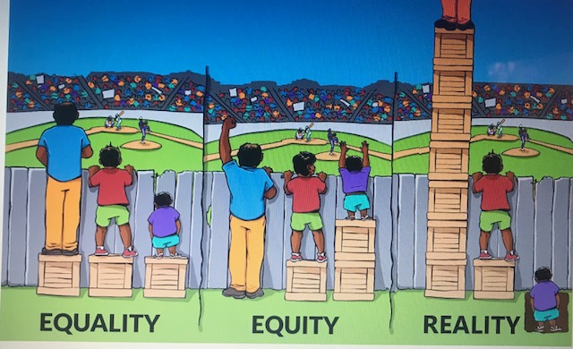

Slide 5
The work of CREWS connects to Equity
Equity promotes silo busting as a winning strategy
We work with community to be more responsive to climate change
Communities must plan for storm water and wastewater in more equitable ways
Involve community leaders directly economic, social, and health-related benefits of water
Find ways to include community water and waste water processing in an energy-efficient manner
Embeds climate change considerations into the capital planning processes for storm water and waste water

Slide 6
Source: Equality of Opportunity Project

Slide 7
ASSET BASED COMMUNITY DEVELOPMENT (ABCD)
The belief that neighborhoods and communities are built by focusing on the strengths and capacities of the residents and associations that call the community "home.“
A place based approach focusing on the assets (resources) of an identified geographic area
The belief that the assets (resources) including a community's institutions can be identified and mobilized to build community.
A range of approaches and tools, such as asset mapping, that can put these beliefs into practice.

Slide 8
ASSET BASED COMMUNITY DEVELOPMENT(ABCD) GUIDING PRINCIPLES
EVERYONE HAS GIFTS – people can contribute and want to contribute. Strong communities know they need everyone
RELATIONSHIPS BUILD A COMMUNITY – make them, utilize them, and maintain them! Be intentional, nourish relationships, they are the core of community building
PEOPLE ARE AT THE CENTER – leadership in everyday life must be at the center of community initiatives rather than just assisting agency leaders
LEADERS INVOLVE OTHERS AS ACTIVE MEMBERS OF COMMUNITY – engage others from as many sectors as required AND as possible. Strong community leaders invite a growing circle of people to act
PEOPLE CARE ABOUT SOMETHING – people want to be engaged, they need to be motivated to get involved, discover their motivation
MOTIVATION TO ACT – is not a random occurrence, people act when they feel strongly or are concerned about an issue; have personal talents to contribute, or want to help themselves and other members of their community

Slide 9
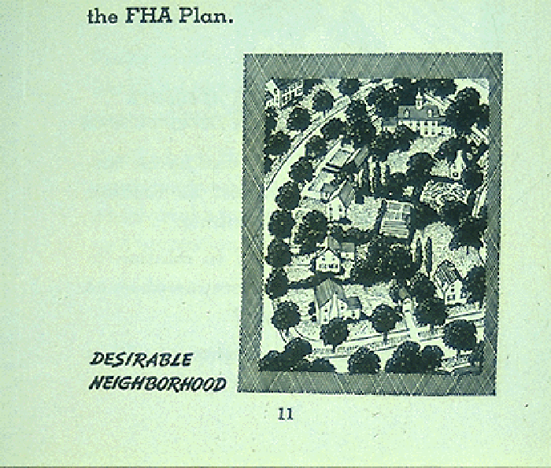
HISTORY…The difference between EQUITY & EQUALITY
Historical Policies:
Explicit Segregation
“If a neighborhood is to retain stability, it is necessary that properties shall continue to be occupied by the same social and racial classes. A change in social or racial occupancy generally contributes to instability and a decline in values.”
–Excerpt from the 1947 FHA underwriting manual

Slide 10
We are caught in an inescapable network of mutuality, tied in a single garment of destiny. Whatever affects one directly, affects all indirectly.
-Dr. Martin Luther King, Jr.

Slide 11
CRITICAL QUESTIONS
Are you engaging communities as a “missionary” or “community builder”?
Are you working to EMPOWER or ENABLE community stakeholders?
Are you supporting the community in understanding and leveraging their community assets/resources to strengthen community engagement?
Are those most affected by the issue actively involved in defining/identifying inequities, and shaping solutions?
How does your work support and/or improve the conditions for the communities and people most in need?
Will the people most negatively affected by inequities identified benefit the same, less so, or more so from my engagement?
What barriers or unintended consequences impact marginalized or underserved populations?
Are we managing our privilege and power when engaging diverse community stakeholders?
Are we assessing and helping to address privilege and power dynamics within the partnership and the community?

Slide 12
MOVING TOWARDS EQUITY
“If you want a future that’s distinct from the past, you have to be with people who you aren’t used to being with and have conversations that you’re not used to having.”
-Peter Block

Slide 13
THANK YOU!
Dwayne Patterson, VP of Strategy and Engagement
dpattterson@psequity.org
Partnership for Southern Equity (PSE)
www.psequity.org
www.atlantaequityatlas.com
@PSEquityMatters (Twitter and YouTube)
@PSEquity (Instagram)
Partnership for Southern Equity (Facebook)

