Slide 1
Construction Fraud Auditing
Awareness, Prevention,
Detection, & Cost Recovery

Slide 2
AvalonBay Communities, Inc.
“An equity REIT in the business of developing, redeveloping, acquiring and managing multifamily communities primarily in New England, the New York/New Jersey metro area, the Mid-Atlantic, the Pacific Northwest, and Northern & Southern California”
NYSE and S&P 500 Company
Own/interest in 291 apartment communities in 12 states
85,000 apartment homes
Revenue (12 months ended March 31, 2019) - $2.3 Billion
Market Cap of $28 Billion

Slide 3
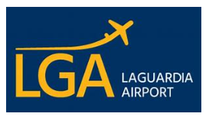
CohnReznick LLP
Construction Services
Risk Assessments
Control Frameworks
Contract Compliance
FAR Compliance
Continuous Monitoring
Change Order / Claims Support
Monitor $2B Annually

Slide 4
Introduction & Objectives
Moderator – David Hutchins
Key Objectives
Provide inside view of construction auditing
Spotlight fraud risks with real world examples
Provide viewpoints on when & how to audit
Help a non-construction auditors recognize need for audits
Address specific questions from the audience

Slide 5
Panel
Ron Luczak, CCA
Director of Internal Audit, AvalonBay Communities, Inc.
Internal auditor & consultant
Leads construction auditing for a $28B Real Estate Co.
Audited 100+ projects with an avg. project cost of $60M
Identified $5M+ of related overcharges/billings
Reviewed projects ranging from golf courses to high-rise residential buildings, including the tallest residential building in Brooklyn, NY (57-stories)

Slide 6
Panel (continued)
Eric Wayne, PE
VP of Mid-Atlantic Construction, AvalonBay Communities, Inc.
Registered Professional Engineer in Commonwealth of Virginia
Construction executive with 27 years experience directing over 25 residential, retail, and commercial projects totaling over $1.5B in total development costs
16-year veteran US Army Corps of Engineers; Afghanistan - 03-04
Awards – “Excellence in Construction”, “Most Innovative Infill Land Planning”, “Award of Merit Best Mixed-use Design, Builders Choice Awards,” &“Multifamily Executive Award - Best Mid-Rise Project of the Year”
Previously worked with US Department of Energy, Camden Development, PN Hoffman & Associates, and Clark Construction Group

Slide 7
Panel (continued)
Rick Westerman, CPA, CFE, CFF
Director, Construction Practice, CohnReznick
30 years experience - accounting, internal controls, & related systems
Perform construction contract compliance assessments including analysis of costs incurred, costs claimed and billed amounts
Conducts Forensic examinations involving contract disputes, financial records re-creation, and accounting irregularities
Former CFO & CAE of a publically traded Company
Forensic accounting teacher at The Catholic University of America

Slide 8
2018 ACFE Report to the Nations
Overall Occupational Fraud
Based on survey responses – 5% of annual revenues lost to fraud
Internal control weaknesses responsible for 50% of fraud cases
Most common detection method – Tips-40%, IA-15%, Mgt.-13%
Construction Industry
Construction - 5th highest median loss due – avg. $227k per case
Most common frauds – corruption (42%), billing schemes (37%)

Slide 9
Construction Industry ACFE Fraud Schemes
Category | Description | Frequency of Occurrence | Median Loss | Median Duration
Corruption | Employee’s use of his/her influence for the purpose of obtaining a benefit for themselves or someone else | 42% | $250,000 | 22 Months
Billing Scheme | A person causes his/her employer to issue an irregular payment for goods or services | 37% | $100,000 | 24 Months
Non-Cash Misappropriations | An employee steals or misuses a non-cash asset | 23% | $98,000 | 18 Months

Slide 10
Recent Construction Fraud $100 Million Pay-to-Play
Details / Background
NYC commercial office space build-out & redesign work ($9.4B/year industry).
Issue / Scheme / Impact
Fraud involved Bloomberg (owner) & General Contractor (Turner Construction) – contractors pay bribes or provide kickbacks in return for securing work, which was concealed by altering bids so they appeared lowest & best-qualified.

Slide 11
Recent Construction Fraud (continued)
Results / Impact
14 people & 3 companies were charged with grand larceny, conspiracy, money laundering, and bribery. Unsure as to what the effect was for all parties involved, but the scheme cost Bloomberg about $15M.
Fun Fact
Not Bloomberg’s 1st time at the rodeo –In 1998, Bloomberg did the exact same thing. They replaced their General Contractor with Turner, as the previous GC was found guilty of a $2B bid-rigging and bribery scheme.

Slide 12
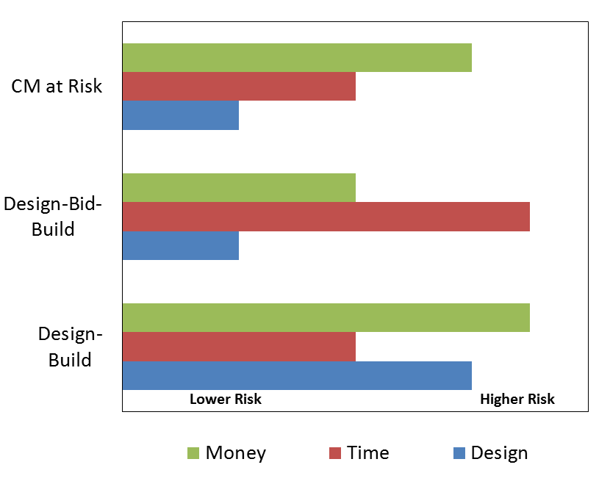
CONSTRUCTION 101 - BASICS
Construction Delivery Methods

Slide 13
CONSTRUCTION 101 – BASICS (CONTINUED)
Construction CONTRACT VEHICLES
Lump Sum or Fixed Price
Cost Plus Fee with a Guaranteed Max Price
Time and Material
Combinations of above
Notes:
A common contracting approach in the Construction Management at Risk delivery method is to enter initially into an agreement with the CMR for a fixed-fee contract for pre-construction and General Conditions costs, along with an agreed contractor’s markup fee as a percentage of construction costs.
Once the design has progressed to a point where a GMP can be established, the contract is converted to a GMP contract, with all remaining fixed costs rolled into the GMP.
Numerous variations in procurement exist when using the DBB method. The most common approach to bidding a project in vertical construction – a building or treatment facility – is for general contractors to submit a sealed lump-sum or fixed price bid. In most horizontal projects such as transportation, the most common approach to bidding is unit price, line item bids, where quantities are easily measured during construction and the owner pays only for what is installed.
One common contracting method in the Design-Build delivery method is to initially enter into an agreement with the DB team for a fixed-fee contract for design and pre-construction costs and an agreed General Conditions costs and construction fee given as a percentage of total construction costs.
Once the design has progressed to a point where a Guaranteed Maximum Price (GMP) can be established, the contract is converted to a GMP contract, with all fixed costs rolled into the GMP.
Another method used is to enter into a fixed price sum agreement for the entire DB effort.

Slide 14
CONSTRUCTION 101 – BASICS (CONTINUED)
Construction PLAYERS
Owner / Developer
Architects
Construction Manager
General Contractor
Subcontractor
Consultants

Slide 15
Panel discussion
Why is construction auditing important ? Is it necessary?

Slide 16
How would you address? common management rebuttals to an audit—
“Our construction management firms monitor the project.”
“We have a great relationship with the GC & have no problems.”
“GCs on our jobs have never been convicted of fraud.”

Slide 17
What are your Top High Risk Areas?
Contract terms & conditions
Bidding
Change orders
General conditions
Labor, and material costs
Subcontracts and payment
Sub-tier subcontractors

Slide 18
Panel discussion
When do you bring in the auditors?

Slide 19
Panel discussion
What are your top things to do during an audit?

Slide 20
Panel discussion
What are your top things NOT to do during an audit?

Slide 21
Panel discussion
How is technology impacting construction auditing?

Slide 22
Panel discussion
Internal vs. External Audit Pros & Cons

Slide 23
Panel discussion
How do you define a successful audit?

Slide 24
Panel discussion
Tell us
about your best cost recovery

Slide 25
Panel discussion
What’s your favorite war story?

Slide 26
Questions?

Slide 27
Contact Information

