Slide 1
Trade Facilitation from a Business perspective
WCO, Brussels, July 11th 2014
Dr Mohammad Saeed
Senior Trade Facilitation Adviser

Slide 2
International Supply Chain
Country
Of
Origin
Agents
Customs
Port
Operator
Marine
Carrier
Producer
Buying agents, bank, road/Rail operator, consolidator, freight forwarder
Country
of
Destination
Marine
Carrier
Port
Operator
Customs
Agents
Custom House brokers, Bank,
De-Consolidators, Road/Rail Operator
Buyer

Slide 3
4 types of procedures to be accounted for
Commercial
Procedures
Transport
Procedures
Regulatory
Procedures
Financial
Procedures
Establish Contract
Order Goods
Advise On Delivery
Request Payment
Establish Transport Contract
Collect,
transport and Deliver Goods
Provide Waybills,
Goods Receipts Status reports
Obtain
Licences
Provide Customs & cargo Declarations
Apply Security
Procedures
Clear Goods for Export / Import
Provide Credit Rating
Provide Insurance
Provide Credit
Execute Payment
Issue Statements

Slide 4
What are the export transaction cost impacted by Trade Facilitation ?
Building
Internal
capacities
Performing
Market
Search
Adapting
product
for export
Managing
cross-border
operations
Setting-up
overseas
distribution
Securing
cash
flows
1
2
3
4
5
6
Collect, produce, transmit and process information and documents
Comply with border agencies requirements
Organize logistics from manufacturers premises to clients grounds

Slide 5
Logistics costs range from ~4% to ~15% of product value Significant variations between regions
Transport costs as % of total product value
by region and country groupings
1. Source: UNECA 2004

Slide 6
~46% of logistics costs are made of transportation costs (incl. border-crossing costs)
Breakdown of logistics costs¹: worldwide Average
(% of total logistics costs)
1. Source: Establish Davis Logistics Costs database, 2013 – Worldwide

Slide 7
Border inefficiencies translate into direct and indirect costs impacting business competitiveness
Direct costs
Time and resources invested in managing export administrative activities
Collect, produce, transmit and process required information and documents
Indirect costs
Increased operational costs
Delays translate into extra transport, insurance or warehouse costs
Increased working capital requirements
Inventories immobilized are carried out by the exporter (except for EXW sales)
Product deterioration
Delays can lead to the degradation of products and render them unfit for sale
Lost business opportunities
Direct: joining a punctual regional trade
Indirect: immobilized stock could have been sold to a local client

Slide 8
SME are particularly vulnerable to these additional costs
!
On a relative basis, SME dedicate more HR to export than large business
Intermediate financing required to cover working capital needs is very expensive
SME are often classified as “High risk” operators by border agencies…
…and they rarely can join “ Authorized Economic Operator” scheme
SME cannot afford large logistics provider services who could speed up the border crossing process
!
!
!
!

Slide 9
Trade Facilitation is…
Transparency and efficiency in international trade supply chain through;
Simplification,
Standardisation,
Harmonisation and
Modernisation
An ongoing and multi-agency function
Better achieved through collaboration between public and private sector
Has the potential to reduce costs and address inefficiencies
Notes:
9
9

Slide 10
What businesses want to improve their exports competitiveness ?
At-the-borders
Behind-the-borders
Transparent, accessible and predictable rules and procedures
Business need to know what to expect
Standardized forms, assembled into a ‘single bunch of documents’
Compatible with trade documents and transport contracts, preferably in electronic format
A single access point to all border regulatory agencies and public services
To reduce duplication of efforts
Simple, efficient and uniform formalities and procedures
A system based upon justice and reward for compliance
Adequate infrastructure to support trade and transport goods quickly and securely
Ports, roads, rail, storage facilities
Service providers who can connect buyer and seller efficiently
Means to allow goods to proceed promptly to their final destination
No longer itineraries, no unpacking, no delays
TFA is more focused on such « softer » issues
Have the comfort to be part of the policy making process

Slide 11
TFA meets businesses requirements (1/6)
What businesses want?
Transparent, accessible an predictable rules and procedures
What does
the TFA
provide ?
Art.1.1 – Publication of trade related information in a non-discriminatory and easily accessible manner
Art.1.2 – Information available through Internet including practical steps for importation, exportation, and transit
Art.1.3 – Create or maintain one or more enquiry points to answer reasonable enquiries and provide relevant forms and documents
Art.3 – Provide traders with advance rulings, notably on good’s tariff classifications and rules of origin

Slide 12
TFA meets businesses requirements (2/6)
What businesses want?
Standardized forms and uniform formalities and procedures
What does
the TFA
provide ?
Art.10.1 – Review import, export and transit formalities and documentation requirements with a view to:
Minimizing incidence/complexity of operations
Decreasing and simplifying documentation requirements
Art.10.3 – National export, import or transit formalities, procedures and data/documentation are based on international standards or parts thereof
Art.10.7 - Apply the same procedures for the release and clearance of goods at the border points throughout its territory

Slide 13
TFA meets businesses requirements (3/6)
What businesses want?
A single access point for all public services et agencies
What does
the TFA
provide ?
Art.8 - Ensure cooperation and coordination between national border agencies and cooperate with neighboring countries
Alignment of working days and hours, alignment of procedures and formalities, development and sharing of common facilities, joint controls, establishment of one stop border post control
Art.10.2 – Acceptance by border regulatory agencies of paper or electronic copies from another authorities to which the original has already been submitted
Art.10.4 - Set-up or maintain a single window through which traders will submit, only once, documents and/or data to all border regulatory agencies and through which agencies will submit their response back

Slide 14
TFA meets businesses requirements (4/6)
What businesses want?
Simple and efficient formalities
What does
the TFA
provide ?
Art.7.4 – Set-up or maintain a risk management system for exercising customs control
Focus resources on high risk shipment and let low risk shipments go quickly based on objective criterion.
Art.7.5 - Set-up or maintain mechanism to ensure consignment compliance after release of the goods
Art.7.6 – Measure and publish periodically, and in a consistent manner, the average release time of goods
Art.11 – Simplified procedures and formalities for goods in transit

Slide 15
TFA meets businesses requirements (5/6)
What businesses want?
Just and rewarding system
What does
the TFA
provide ?
Art.4 –Right to administrative review and/or to judicial appeal of decisions made by Customs authority
Art.6 .2– The amount of fees and charges for customs processing should be limited to the costs of service rendered
Art.6.3 – Penalties commensurate with severity of breach and voluntary disclosure considered as a mitigating factor
Art.7.7 - Provide additional facilitation to selected operators called ‘authorized operators’
AO selected (among other) on compliance track record with customs and other related laws and regulations

Slide 16
TFA meets businesses requirements (6/6)
What businesses want?
Be part of the policy making process
What does
the TFA
provide ?
Art.2.1 – Provide traders and other interested parties the opportunity and sufficient delay to comment changes to new or amended trade-related regulations
Art.2.2 – Consult, on a regular basis, border agencies, traders and stakeholders within national territory1
Art.23.2 - Establish and/or maintain a national committee or similar mechanism on trade facilitation whose responsabilities include
Domestic Coordination (sharing information): G2G, G2B and B2G, B2B
Implementation of Provisions of TF Agreement

Slide 17
TFA implementation will drive trade cost down
Total Trade Costs depend on the good, trader and country
Direct TTCs amount to 4-15% of the value of goods
Indirect TTCs (delays, corruption, etc.) amount to 1-24%
TF measures at the border have a high potential for cost reduction
From 13% to 15% depending on countries’ income levels
Overall potential trade cost reduction by income group

Slide 18
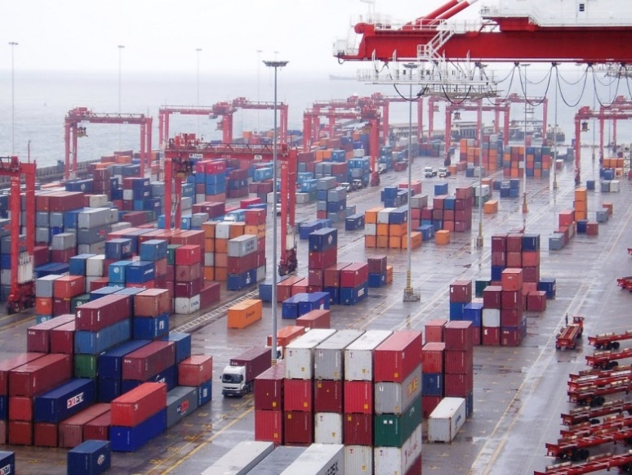
The Way Forward for the private sector
Be aware what is happening in the world
Align and equip yourself with emerging trade realities
Collaborate among yourselves
Develop partnership with government regulators
Benchmark with peers and globally
It is a continuous process

Slide 19
How can ITC help? Presenting our integrated TF program
Improving
SMEs Competitiveness for exports
through implementing the Trade Facilitation Agreement
1
2
3
4
Comply with TFA short term requirements
Build national capacity for TFA implementation
Support the implementation of TFA measures
Strengthen SMEs ability to cross borders
Ministries, customs and other border agencies
Ministries, customs and other border agencies
Ministries, customs and other border agencies
Traders, exporters freight forwarders
Mobilize private sector operators to collectively present their perspective in TF policy formulation
Partner with other trade facilitation agencies and Private sector organisations to achieve synergies
Mainstream regional integration dynamics and promote sharing of south-south best practices
Strengthen capacity of Trade supporting Institutions (TSIs) on Trade Facilitation

Slide 20
Focus: Comply with TFA short term requirements
1
Support TFA categorization process: Category A, B, or C and estimate indicative and definitive implementation dates
1
Comply with TFA short term requirements
Support domestic ratification process: for acceptance of protocol of amendment and notifications to the WTO
Support evaluation of financial and technical assistance required for Category C provisions
Ministries, customs and other border agencies
Assist in preparing bankable project plans to raise donor funds and mobilize technical assistance

Slide 21
Example : Supporting the TFA categorization process
Categorization assistance completed
Categorization assistance planned
Mauritius
Tajikistan
Ecuador
WAEMU
countries
Overall, ITC has received more than 25 requests for assistance in the categorization process
Mongolia

Slide 22
Focus: Build national capacities for TFA implementation
2
Set up or strengthen National TF Committee
In compliance with TFA art. 23.2
2
Build national capacities for TFA implementation
Raise awareness and build capacity of private sector and governments regulatory agencies on the TFA and national obligations
Ministries, customs and other border agencies
Research and publications

Slide 23
Example: Recent awareness raising activities
Jamaica
Workshop on “Leveraging trade facilitation and logistics to power MSMEs in Jamaica”
Ukraine
Workshop on Improving SMEs Competitiveness for exports through implementation of the Trade Facilitation Agreement
Bhutan
Training programme on export rules, procedures and integration into international trade dedicated to the private sector
Sri Lanka
Awareness building events on the TFA dedicated to public and private stakeholders
Analysis of the agreement on its benefits for the country and for private sector competitiveness
Laos
Liberia

Slide 24
Example: capacity building and publications
Capacity Building
Training module for SMEs to explain for each key measure foreseen in the TFA
What is the policy objective of the measure? What are its key features? What are the benefits for SMEs ? How can the private sector leverage different provisions to improve its competitiveness ?
Trade Facilitation Online
Dedicated web based helpline to answer all implementation related queries from private businesses and border regulatory agencies
Publications
How to strengthen public-private dialogue?
Institutionalize the public private dialogue for establishing or strengthening the national Trade Facilitation Committees: implementation guidelines and model ToRs
Implementation Guidelines dedicated to regulatory agencies of developing countries/LDCs
Explain measures in non-legal terms, map issues/steps/means required to implement, explain how to monitor the implementation

Slide 25
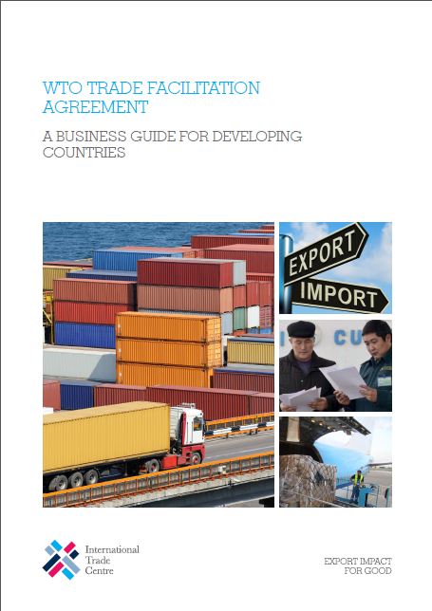
Example: ITC publications, TFA Business Guide
Following WTO-TFA adoption, ITC published a guide on the Bali package
WTO Trade Facilitation Agreement - A Business Guide for Developing Countries
Publication tailored to policy maker and business managers
Jargon free explanation
Focus on what businesses need to know to take advantage of the agreement
Help policy makers identify their TACB needs
Guide well received by stakeholders in developing and LDCs
Guide already published in French, English, Arabic, Chinese and Russia

Slide 26
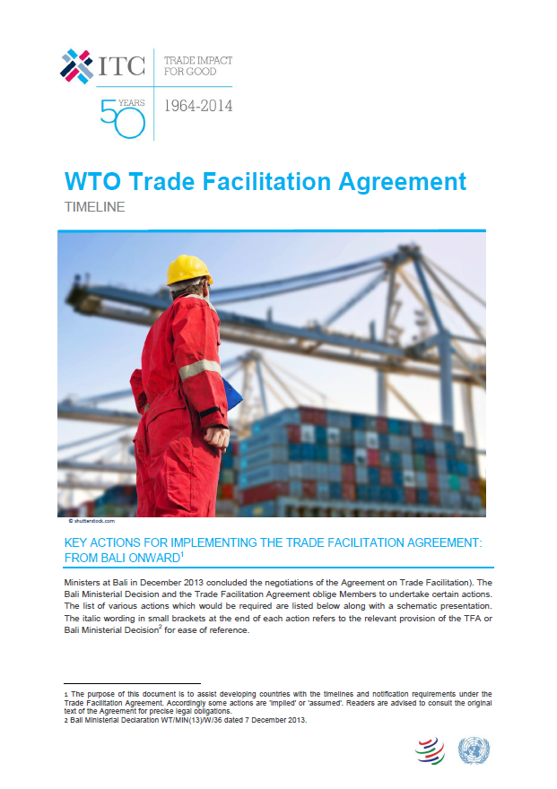
Example: ITC publications, TFA Timelines
In May 2014, ITC published another document related to the TFA
‘Timelines’ for implementing the TF Agreement
Objective: helping the regulatory agencies understanding the obligation timeline arising from the TFA
Notification of category A provision
Information about TA required
Specific timelines are laid out for Developed Countries, Developing countries and Least Developed Countries

Slide 27
Focus: Supporting the implementation of the TFA measures
3
Transparency provisions
Publish National Trade procedure guide (Art1.1)
Publish trade related information online (Art.1.2)
Set-up or strengthen enquiry points (Art.1.3)
Set-up advance ruling mechanisms (Art.3)
3
Support the implementation of the TFA measures
Simplified formalities provisions
Ministries, customs and other border agencies
Implement electronic payments facilities(Art.7.2)
Set-up national framework for risk management (Art.7.4)
Set-up post-clearance audit mechanisms (Art;7.5)
Implement Authorized operator schemes (Art.7.7)
Support single window schemes (Art.10.4)

Slide 28
Focus: Strengthen SMEs ability to cross borders
4
Enhance SMEs ability to comply with existing trade procedures: training, networking with border officials…
4
Strengthen SMEs ability to cross borders
Support informal cross-border traders to go formal: Building on WICBT project already on-going in Uganda and Burundi
Enhance TSI capacities to support private sector in managing cross-border operations
Traders, exporters freight forwarders
Connect SMEs with logistic providers: for integration of SMEs in global value chains

Slide 29
Focus: ITC institutional collaborations
UNCTAD
Provide effective TACB to developing countries and SMEs to support the implementation of the WTO – TFA
Mauritius, Mongolia, Tajikistan
WEF & Bain
Joint publication of forthcoming ‘Trade Enabling Report’ focused on implementation of Trade Facilitation Agreement
Including ITC led authored case studies for sharing best practices from south-south perspective
Brazil Govt.
APEX Brazil
Assist developing countries in Africa in the categorization process
One event in Angola and one in Mozambique are planned in July ‘14
Brazil CNI¹
Translate ITC publications: Business Guidelines and Timelines into Portuguese for dissemination to Portuguese speaking countries
WCO
Collaboration on implementing TFA measures
TMEA
FIATA & ICC
On-going discussion on collaborative work in the area of TF
¹National Confederation of Industry

Slide 30
Concluding Thoughts
Trade-related costs must be reduced
For the private sector to use trade as a vehicle for growth, diversification and innovation
Trade facilitation helps achieving this goal
TF reduces both at the border and behind-the-border processes costs
Trade facilitation is most effectively pursued when stakeholders work in coordination
Government, SMEs, TSIs, TNCs, and development partners
Trade Facilitation Agreement provides businesses the opportunity to be part of the decision making process
Through consultations (Art.2) and the National Trade Facilitation Committee
ITC, as the development partner for businesses, has a comparative advantage in facilitating this process

Slide 31
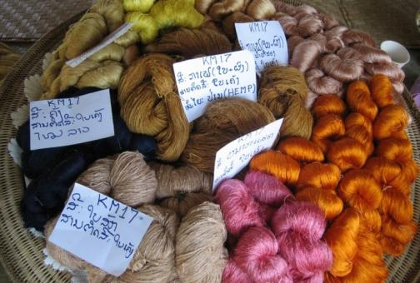
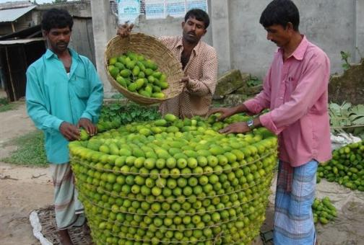
Thank you !
For further information, questions or comments please contact:
tradefacilitation@intracen.org

