Slide 1
Avalon Care Centre Bedrail Reduction Program
Presented by Dawn Roy
Restorative Care Coordinator and Sarah Slater Director of Care

Slide 2
Why are we doing this?
To be in compliance with the Ministry of Health standards and the Long-Term Care Homes Act.
To implement (RNAO) Registered Nurses Association of Ontario Best Practice Guidelines
BUT MOST IMPORTANTLY, to ensure the overall safety and wellbeing of our residents.
Notes:
.

Slide 3
Bedrail Use at Our Home
45.26% of residents were using 2 bedrails at the beginning of our project. These individuals became the focus of our initiative
Following our program 16.42% are currently using 2 bedrails
Residents, family members and staff are much more knowledgeable about bedrail use and the risks and benefits.

Slide 4
Bedrail Use Facts
It is understandable that many staff and families have concerns about their loved ones falling out of bed if proper safeguards are not in place.
However, bedrails are NOT the best safeguard to keep residents from falling out of bed and can even make injuries more serious.
Notes:
Many residents in long-term care are weak and frail, or suffer from severe illnesses, confusion, pain, agitation, and uncontrollable body movements. All of these factors can directly affect a resident’s safety in bed when bedrails are in place.
We associate bedrail use with good care and see bed rail use across health care. Many people consider bedrails reliable for keeping residents safe, but in fact bedrails are a “hidden” danger that can cause injury and death

Slide 5
Bedrail Use Facts
They prevent residents from interacting with their environment and may cause some residents to feel “locked in” and increase agitation.
As a result, resident may attempt to climb out over their bedrails which can lead to serious injury and/or even death.
Many studies have shown that removing bedrails from resident beds actually result in a decrease in the number of serious injuries caused by entrapment or falls.

Slide 6
Risks of Bedrail Use
When used unnecessarily or improperly bedrails pose the following risks:
Entrapment
Strangulation
Increased Responsive Behaviours
Notes:
Entrapment (Residents limbs can become entangled between the bars of bedrails or between the mattress and the bedrail causing bodily harm or injury such as bumps/ bruises and skin tears etc.) Strangulation (Residents neck can become trapped between the bars of the bedrail or between the mattress and the bedrail causing suffocation and/or even death)
Increase responsive behaviours (bedrail use can cause increased agitation and a feeling of being trapped)

Slide 7
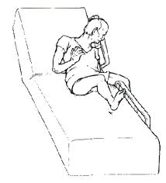
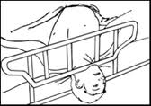
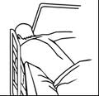
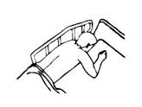
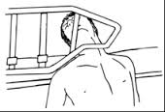
Types of Entrapment
Notes:
Potential Entrapment Zones on Beds Between bars within a bedrail
Between the bedrail and mattress
Openings at top and bottom of bed between head/foot boards and bedrails

Slide 8
Appropriate Use of Bedrails
Bedrails should only be used as:
Positioning device (to assist resident to move self up in bed)
PASD (Personal Assistance Services Device) for bed mobility (roll side to side or sit self up at edge of bed, transfer)
Notes:
A complete resident assessment of bed mobility must be performed prior to bedrails being used. In addition, the interdisciplinary team must determine that no other alternative devices or precautions will be effective in meeting the residents needs before using bedrails.

Slide 9
Bed Mobility Assessments
An individualized bed mobility assessment is completed by a qualified member of the multidisciplinary team on admission, quarterly and when a significant change of status occurs
Once all factors are considered, the need for bedrails to assist the resident in maintaining or improving mobility is determined.
Notes:
The assessments are a component of the thorough RAI MDS assessment.
A comprehensive assessment looks at the following:
A resident medical diagnosis
A resident health and mental conditions
Symptoms and behaviours
Resident fall risk
Resident ability to communicate and make needs known
Resident physical abilities

Slide 10
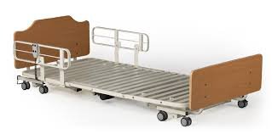
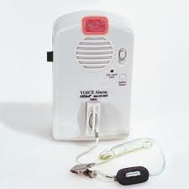
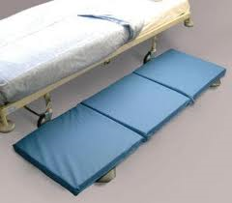
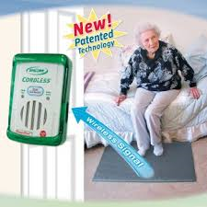
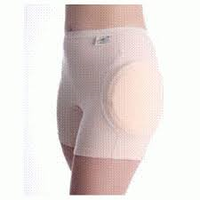
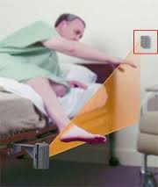
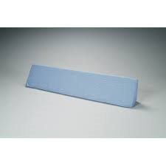
Alternative Interventions to Bedrail Use
Notes:
Body pillows for positioning to ensure proper alignment in bed
Mattresses with raised edges
High impact floor mats at bedsides
High/Low bed frames placed in lowest position for residents with fall risks
Ensure proper mattress size/fit for bed frame
Hip protectors
Alarm systems
Ensure proper positioning when placing residents in bed
Frequent safety checks
Regular toileting routines

Slide 11
Key Steps to Implement Bedrail Reduction Program
Education
Culture Change
Proper Assessment
Appropriate Alternatives to Bedrail Use Available
Notes:
(Educate all staff, families and residents about risks and dangers of bedrail use, and the alternative interventions and precautions to put into place for safety). As care providers we need to be able to:
Recognize and learn the dangers of bedrails
Recognize when bedrails are being used as restraint
Be familiar with the alternative interventions to bedrail use and the precautions
Culture Change – for example the use of side rails was so engrained that it was an automatic documentation task on admission of a resident. It was important to recognize staff efforts at trying alternatives and being more open to these changes. Their efforts became contagious from one staff to another as they saw success.
Proper Assessment – a bed mobility assessment tool
Appropriate alternatives to bedrail use: having sufficient supplies available such as high-low bed, alarm systems, hip protectors, floor mats etc.

Slide 12
Conclusion
As staff members of a Long-Term Care Home, it is our responsibility to ensure that residents have a safe and comfortable bed environment and that any use of bedrails does not endanger the safety of our residents.

