Slide 1
Should Traditional Publishers Feel Threatened by the Potential of Self-Publishing?
Dana Beth Weinberg, PhD
January 15, 2014

Slide 2
Newly Self-Published

Slide 3
Traditionally Published

Slide 4
Matter of life and death?

Slide 5
Publishers’ Core Activity
Publishers produce, package, distribute, market, and sell content (the books?) provided by contract workers (the authors!)

Slide 6
Changing Focus and Power
From editorial logic to market logic
From “love of books” to consumerism
From editors to “bean counters” and “suits”

Slide 7
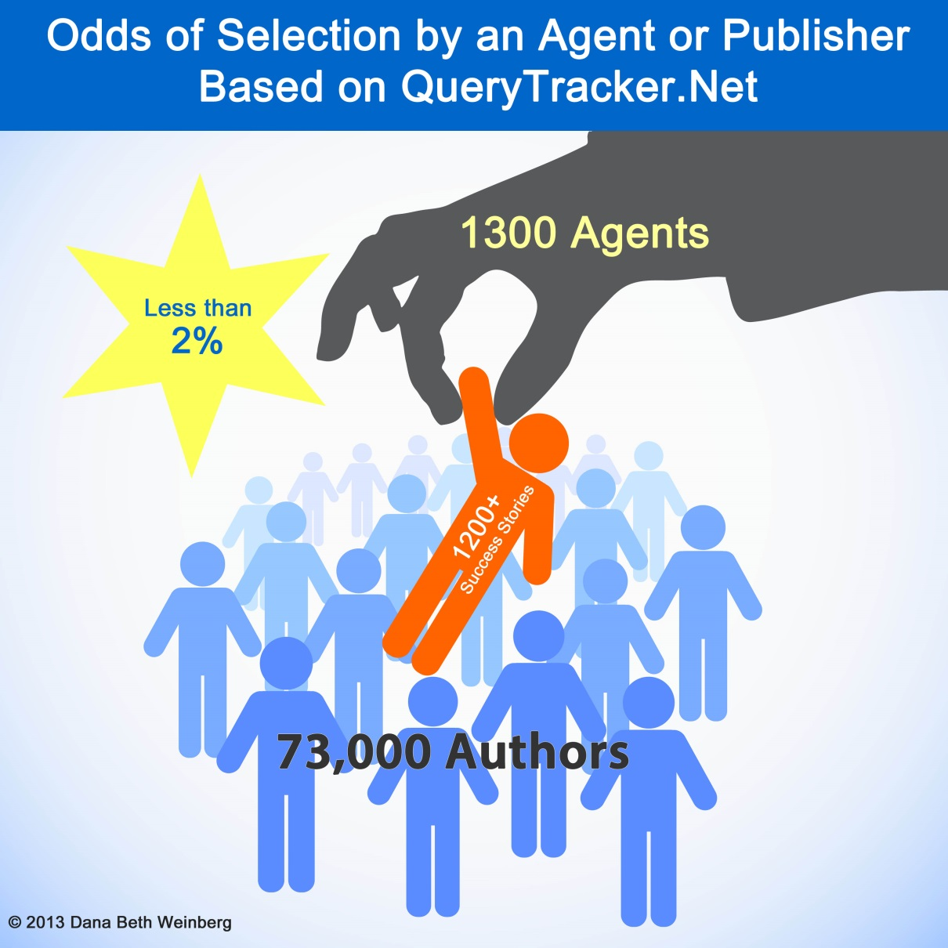
Oversupply of Authors

Slide 8
Changing Social Contracts
High Expectations, Low Commitment
Careers across organizations
Temporary and contract employment
Expectations of productivity and being on-call

Slide 9
The Query Letter
Dear Editor,
Please, please, please consider my manuscript for publication. I have 1 million Facebook and Twitter followers clamoring to buy this book, and Hollywood has already offered me a movie deal.
Sincerely,
Shirley T’Sell

Slide 10
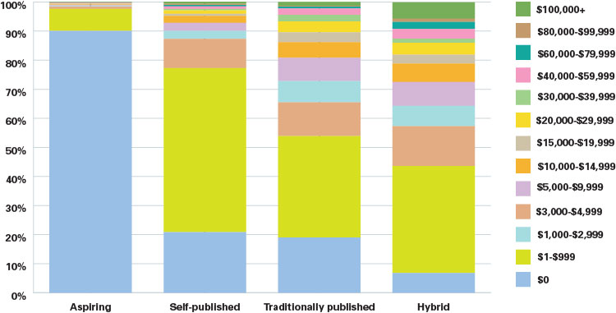
A Segmented Market Author Median Writing Income

Slide 11
Distribution of Authors (% of Total Sample)
Survey Authors
Completed Manuscripts 58%
Submitted 15%
Not submitted 9%
Published 33%
Traditionally Published 13%
Hybrid 5%
Self-Published 20%
Hybrid 2%
Started But Not Completed 34%
Not Started 8%

Slide 12
Indie Math
Self-Publishing
Traditional Publishing
4 novellas @ 25k words
$2.99 at 70% royalty rate – download fees → $2.04
3,000 fans
______________________
$24,480
$5,242 with only 642 fans!
1 novel @ 100k words
$3,000 to $4,999 advance (maybe)
$6.99 @ 25% e-book royalty
3,000 fans
______________________
$5,242 (advance earned out)

Slide 13
What Can Publishers Do for Authors?
Advantages of traditional publishing:
Sales
Quality
Distribution
Marketing
But authors reported they weren’t consistently satisfied with their experiences.

Slide 14
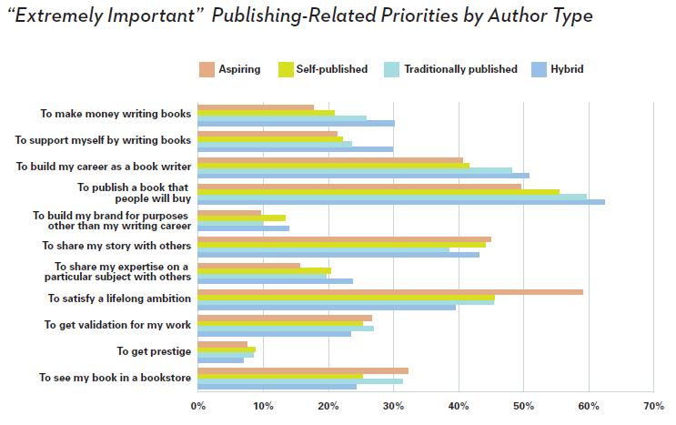
Why They Write
It’s not all about the $

Slide 15
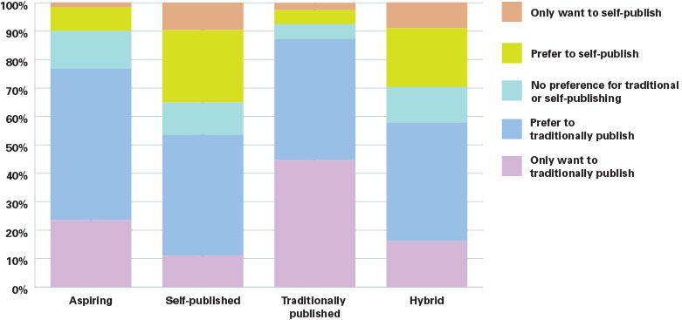
Opportunities for Publishers Publishing Preferences

Slide 16
Relationships with Authors
Developing, keeping, and leveraging talent
Or
Treating authors as disposable, replaceable, and needing to be highly supervised and managed

Slide 17
Revising the Contract
Commitment
Empowerment
Partnership
In other industries, high performance work systems yield better outcomes for workers, clients, and organizations.
Why not in publishing?
→ High Performance

Slide 18
Crucial Questions
What do authors want and need?
What can publishers offer?
What mutual benefits are possible?

