Slide 1


Narrative Medicine
Its Use in Medical Education
Stephen Ludwig, MD
Professor of Pediatrics
Perelman School of Medicine – UPENN
Senior Advisor for Medical Education – DIO
Children’s Hospital of Philadelphia

Slide 2
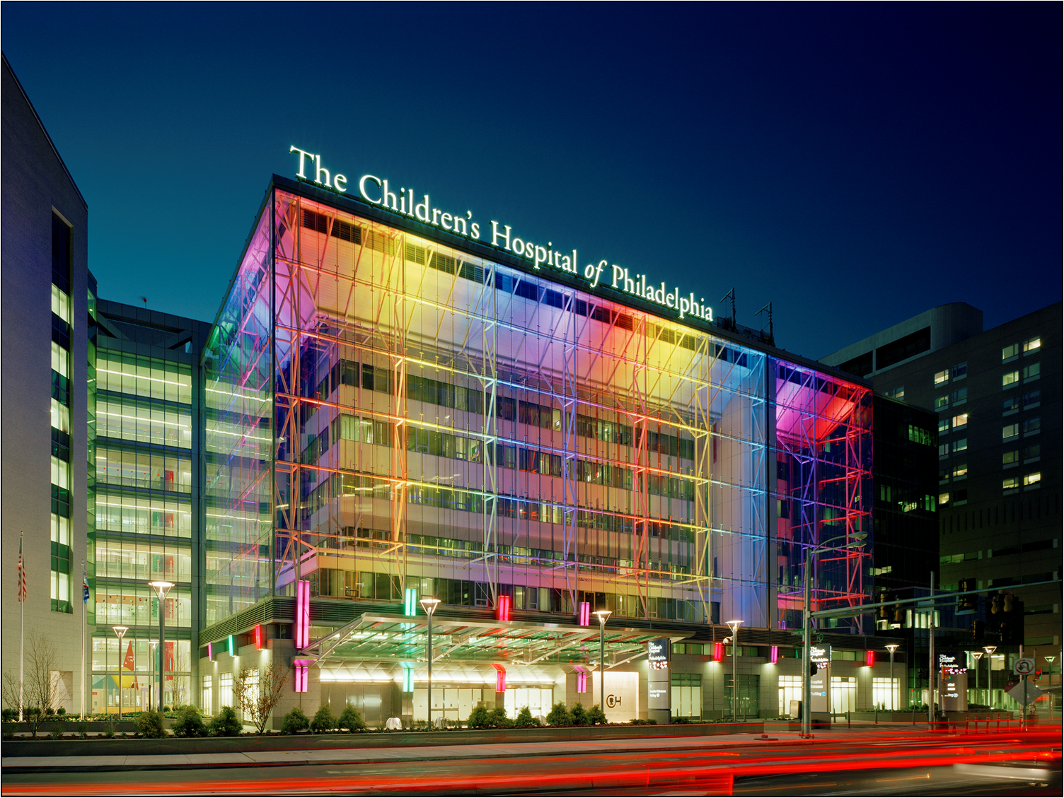

Slide 3
Disclosures
None

Slide 4
Learner Objectives
Define humanism and professionalism
Explain the dynamic tension between these qualities
Identify ways to enhance humanism in our practice
Advocate for the use of narrative medicine to aid in this educational process

Slide 5

ACGME Competencies
Patient Care
Medical Knowledge
Interpersonal and Communication Skills
Professionalism
Practice Based Learning and Improvement
Systems Based Practice

Slide 6
ACGME Competencies
Professionalism
  Residents must demonstrate a commitment to carrying out professional responsibilities, adherence to ethical principles, and a sensitivity to diverse patient populations

Slide 7
ACGME – Pediatric Milestones
Competency – Professionalism
  Professionalization
  Professional Conduct
  Humanism
  Cultural Competence

Slide 8
Definitions
Professionalism –
  A lifelong developmental process that informs the effective, ethical and safe practice of the healing skills.

Slide 9
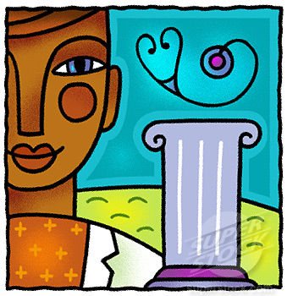

Slide 10
Definitions
Humanism -
  The ability to provide care based on the physician’s (or nurse’s) ability to maintain the perspective that the professional and patient are equal members of the human family.

Slide 11


Slide 12
Linking Professionalism to Humanism: What it Means and Why it Matters
“Humanism is the passion that animates professionalism”
Jordan Cohen, MD
Acad Med 2007;82:1029

Slide 13
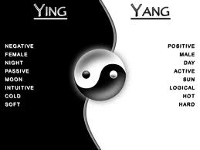
The dichotomy between detachment and engaged

Slide 14

Imbedded and Integrated in Each Of Us
Humanism Professionalism

Slide 15
The Habit of Humanism
Miller and Schmidt Acad Med 1999;74: 800
A framework for making humanistic care a reflexive clinical skill
Three essential tasks
  Identify the multiple perspectives in any clinical encounter
  Reflect on how these perspectives might converge or conflict
  Choose to act altruistically

Slide 16
Using Narrative Medicine to
Facilitate Humanism
Narrative Medicine
“Walk in their shoes”
Home Visiting
Exploring the human within the professional – “Ludwig Arts and Humanities Conference”
Others

Slide 17

Walk in Their Shoes

Slide 18
Walk in Their Shoes
Assign learners to meet family in ED waiting room
Go through the entire ED visit as an Uncle or Aunt
Provides important perspective on the system
Provides in depth contact with a family
Students then write about the experience

Slide 19
Morgan Stanley Children’s Hospital
Use a similar program as “walk in their shoes”
Review comments from students on a regular basis
Program leader – Cyril Sahyoun, MD

Slide 20
Student Comment
“I was once told the first day of medical school is the closest we would ever be to a patient for the rest of our lives. I think I became close to M and her mother but I had to travel a bit to get there”
Courtesy of Cyril Sahyoun, MD

Slide 21
Student Comment
“ The biggest thing I learned was always to be mindful. In medicine there is no such thing as a mundane case”
Courtesy of Cyril Sahyoun, MD

Slide 22
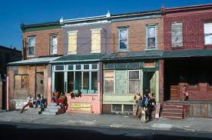
Home Visiting Program

Slide 23
Home Visiting Program
Residents visit one of their primary care patients at home
Accompanied by social work or visiting nurse
Sometimes use public transportation
Permission of family
Takes the place of a well child visit
Write about their experience
De-briefing important

Slide 24
Home Visit
See the community
See the child and family on their own turf
Evaluate family psychosocial factors contributing to or diminishing health
Broaden the human view of the patient in the context of family and community
Understand provider’s biases, emotional responses, mindset

Slide 25

Narrative Medicine

Slide 26
What is Narrative Medicine
“A medical approach that recognizes he value of people’s narratives in clinical practice, research, and education” Wikipedia.com
“An interdisciplinary field that enhances healthcare through effective communication and understanding between caregivers and patients. The intimate interface between two people who both yield and gain from the experience” TheIntima.org

Slide 27
Narrative Medicine
Medical practice unfolds in a series of complex narrative situations
  Provider – Patient
  ****Provider – Self****
  Provider – Colleagues
  Provider – Society
  Reflection about practice allows providers to interpret their emotional responses to patients, make sense of their own personal and professional trajectories, discover aspects of patient stories that may be hidden

Slide 28

Arts and Humanities Day

Slide 29



Schwartz Center Rounds
The Stephen Ludwig
Arts and Humanities Rounds
June 18, 2014

Slide 30
Stephen Ludwig Arts and Humanities Day
Today is a day to celebrate our humanism
We have the same human emotions, fears and joys as our patients and their parents even when we must be objective, critical, scientific, distanced and professional
This day celebrates the things we do to relieve stress, have fun, escape from our professionalism, let our hair down, express ourselves.

Slide 31
How Does This Relate to Today?
Keep your humanism alive
One way to do it is to engage in things outside of health care that make you remember you are human
This will enhance your professionalism – relieve stress, get to know colleagues in a different way, have your patients see you as a person, enrich your life in general
Today we present a few exceptional examples but any humanistic endeavors will do.

Slide 32
Narrative Medicine and Burnout
Burnout in Medicine - Fatigue, Depersonalization, Reduced Self Worth
Treatments
  Reflection (narrative medicine)
  Manage time and energy
  Positive reframing
  Self care strategies
  Mentors who care

Slide 33
Thank you

