Slide 1
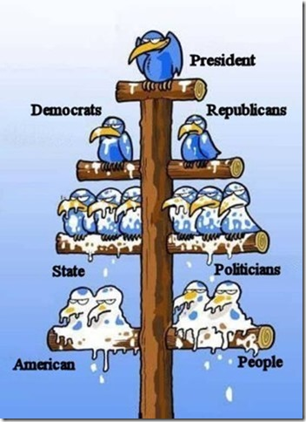

Slide 2
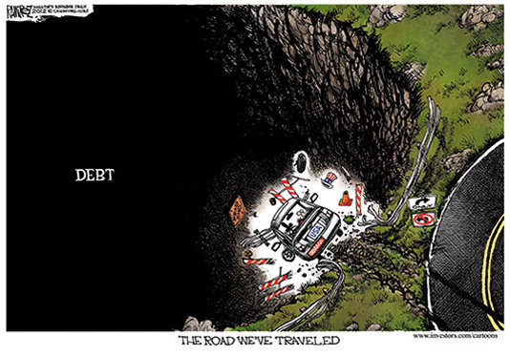

Slide 3
REAL GDP GROWTH IN NBER EXPANSION PERIODS

Slide 4
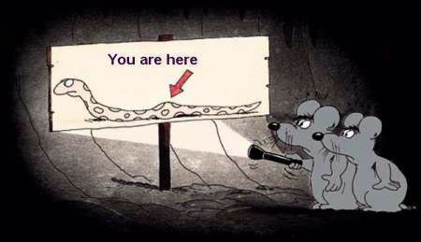
TWO WAYS OUT, NEITHER DESIRABLE

Slide 5
INTEREST RATES & STOCK PRICES

Slide 6
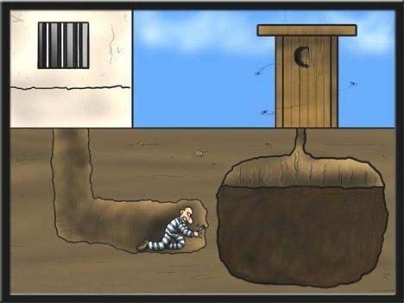
NIRP
UNINTENDED
CONSEQUENCES

Slide 7
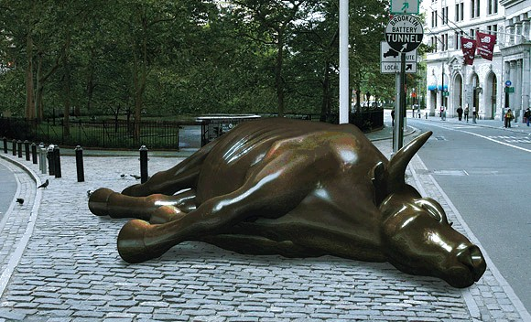
2008, 2016?

Slide 8
THE ECONOMIC OUTLOOK
Growth has been anemic in this recovery
Fiscal policy has been flat, Disruptive regs
The Fed has been unable to attain either of its objectives
Low interest rates have not stimulated spending and hiring but harmed savers

Slide 9
THE ECONOMIC OUTLOOK
Neither consumers nor small business owners are enthusiastic about the future
An erosion of competitive forces, an increase in government intervention
Demographics are turning negative in most developed countries
Most of the developed world operating with negative interest rates

Slide 10
RULES FOR SURVIVAL
HAVE A BUSINESS PLAN
Should a transportation company assume $2/gal gas prices for the next 5 years? A business plan is a critical tool for success.
It incorporates everything you have learned about the business you are in, your competitors, economic conditions in your market and the U.S., your forecasts for revenue growth, your cost projections (much more reliable than your sales forecast), assumptions about prices for inputs and what you sell, cash flow.
If your plan is very good, your performance will track the plan. If you experience a deviation, your plan is the blueprint for identifying the problem, its source and provides a framework for you to adjust to deal with it.

Slide 11
RULES FOR SURVIVAL
SCOUT OUT YOUR LOCATION Very important preparation, monitor traffic patterns and problems, ease of “in and out” to your location before making a final selection. Are other firms operating in your area an asset or a liability?
MAKE FRIENDS WITH A BANKER Banks are not venture capitalists and prefer to lend to companies with a solid history, not a new untested concept. But at some point, you will likely get a loan and most likely from a bank. Develop those relationships before you need them.

Slide 12
RULES FOR SURVIVAL
MAKE FRIENDS WITH NON-COMPETITORS IN YOUR BUSINESS Owners love to talk about their business, but not to competitors! Check out businesses like yours in other markets, learn about problems and successes from owners of firms like yours.
AVOID OPTIMISTIC FORECASTS OF YOUR SALES Can your sales grow faster than retail sales in your market? A sales forecast must be very realistic and actual sales must be monitored closely for the first year to verify the validity of the forecast and to understand seasonal or other fluctuations.

Slide 13
RULES FOR SURVIVAL
ENSURE YOU HAVE ADEQUATE CAPITAL TO SURVIVE YOUR WORST SCENARIO If your business plan assumes $2 gas, what happens to your bottom line and the drain on capital if they return to $4? A plan is not a straight jacket, it is a management tool that allows you to explore scenarios, test the impact of your assumptions.
PAY ATTENTION TO ECONOMIC DEVELOPMENTS IN YOUR MARKET Population change, entry/exit of major firms are important. Government agencies (Federal Reserve Bank, Dept of Labor) and private groups like the Chamber have good information on your market.

Slide 14
RULES FOR SURVIVAL
JOIN PROFESSIONAL ORGANIZATIONS IN YOUR MARKET These are great opportunities to learn more about the local economy, about regulations that are being imposed or considered and need to be addressed, and meet people with similar problems and learn about their solutions.
FINANCIAL MANAGEMENT SKILLS A great chef can prepare exceptional dishes and go broke failing to manage food costs. Make sure that someone in your firm (if not you) has firm control of cash flow management and monthly financial statements. When something goes wrong, it shows up here first.

Slide 15
RULES FOR SURVIVAL
LOCAL POLITICS MATTER Seattle raised the minimum wage to $15, now considering dictating work schedules; Cities are passing mandatory family/sick leave bills; Philadelphia wants to impose a 3 cent/ounce sugar drink tax, there is a tax on liquor by the glass.
Such “surprises” can dramatically alter the economics of your business.

Slide 16
RULES FOR SURVIVAL
GET IDENTIFIED WITH YOUR CUSTOMERS Offer a $1 credit if they will give you an email address and allow you to contact them for sales, etc. Find out how to effectively advertise your presence to the market, useful events you can participate in or sponsor. Use new technology (scanners, inventory control) to manage inventory and identify what customers like.

Slide 17
HOW ARE SMALL FIRMS DOING?
Top Concerns of Small Businesses
Healthcare costs
Uncertainty about the economy
Uncertainty about government policies
Cost compliance with regulation and red tape
Profit taxes deplete capital
Tax codes too complex
Tax codes changed too frequently

Slide 18
HOW ARE SMALL FIRMS DOING?
A subpar recovery
Consumer sentiment not robust
Owners not optimistic about the economy this year
Owners’ capital spending plans are subpar
Owners not inclined to borrow and invest in their firms
Net business creation positive; Population growth helps
The $15 minimum wage + Healthcare + Family leave

Slide 19
Index

Slide 27
GETTING STARTED
Don’t assume the answer is “No”
“Cookie cutter” vs. “Relationship lending”
Search! There are 6,000+ independent banks
Establish a relationship with one or more banks
Get to know employees, lending officer, even if you aren’t currently interested in a loan

Slide 28
APPLYING FOR A LOAN
Meet with the loan officer, describe your needs, find out what they want to see/know about you
Select “receptive” banks; Sometimes banks specialize in certain types of lending
Prepare a business description
Prepare a business plan

Slide 29
APPLYING FOR A LOAN
Describe the precise use of funds, expected impact on the business, revenue implications
Organize background materials, tax returns, etc.
Document collateral, appraisals, etc., if needed
Be thorough, organized, professional, complete

Slide 30
ONCE YOU HAVE THE LOAN….
Keep your lender informed. Stay in touch
Update your financial information
Provide progress reports, good or bad
Make payments on time

Slide 31
ONCE YOU HAVE THE LOAN….
If problems arise, talk to your lender
Remember, it’s savers’ money that you are using
Give your bank your personal business
Participate in bank social events
Remember, banks aren’t venture capitalists

Slide 32
Number of Employees

Slide 33
JOB GROWTH IN TWO NBER RECOVERY PERIODS, 1983 AND 2009
AVERAGE 689,000
AVERAGE 439,000
QUARTERS OF RECOVERY
HAVER ANALYTICS

Slide 35
REASONS APPLICANT “NOT QUALIFIED”

Slide 37
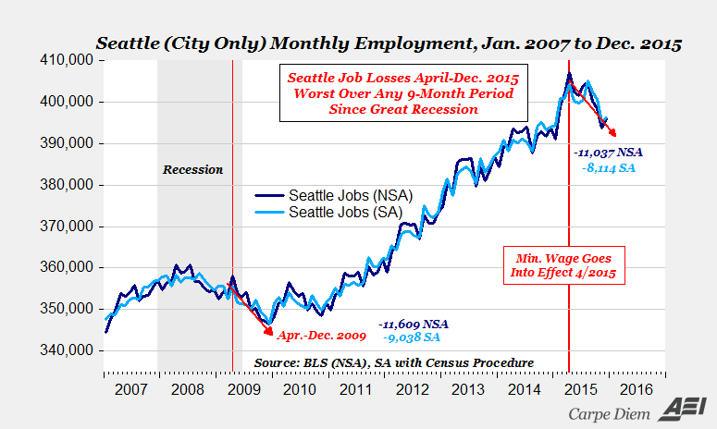

Slide 39
Private Sector Establishments Births and Deaths
(Seasonally Adjusted)

Slide 40
ALWAYS FIND WAYS
TO MAKE YOUR JOB
INTERESTING

