Slide 1
State Innovations in Long-Term Services and Supports: Providing Person-Centered, Community-Based Care and Advancing Quality and Purchasing Strategies
NASUAD HCBS Conference
September 1, 2015
Alexandra Kruse, Senior Program Officer,
Center for Health Care Strategies
Supported by The SCAN Foundation

Slide 2
Welcome and Introductions
  Alexandra Kruse
  Senior Program Officer, Center for Health Care Strategies
Chris Welch
LTSS Program Specialist, Texas Health and Human Services Commission
Jay Taylor
Deputy of Audit and Compliance for Long Term Services and Supports, Bureau of TennCare, Tennessee Division of Health Care Finance and Administration
Aquila Jordan
Director, Regulation and Policy, Office of the Secretary, Legal Division, Kansas Department for Aging and Disability Services

Slide 3
Agenda
CHCS Introduction and Overview of National Long-Term Services and Support Scan Texas: State Innovations in Long-Term Services and Supports: Providing Person-Centered, Community-Based Care Tennessee: TennCare Long Term Services & Supports Value Based Purchasing Kansas: Integrating Long-Term Services and Supports in Managed Care Questions and Answers

Slide 4
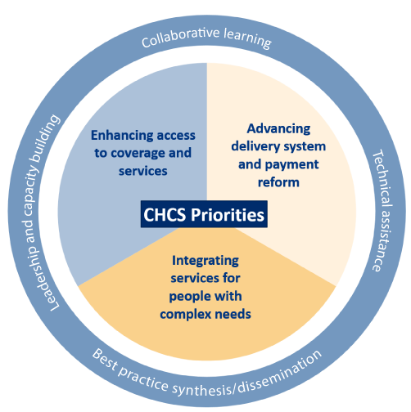

About the Center for Health Care Strategies
A non-profit health policy center dedicated to improving the health of low-income Americans
Notes:
CHCS was established in 1995 through a major grant from the Robert Wood Johnson foundation to improve the underpinnings of the nation’s health care safety net.
Today, the mission of the Center for Health Care Strategies (CHCS) is to find opportunities to improve the Medicaid delivery system so that all of its beneficiaries get the right care from the right providers at the right time.
To achieve its mission, CHCS’ work with states, health plans, and federal policymakers focuses on four priorities:
Enhancing access to coverage and services;
Advancing quality and delivery system reform;
Integrating care for people with complex needs; and
Building Medicaid leadership capacity.

Slide 5
ACA Vehicles to Rebalance Long-Term Care Settings
Historically, Medicaid programs were not designed to support individual choice of settings:
  Facility-based care is an “entitlement”
  HCBS often has waiting lists
  Limited coordination for HCBS participants across all service areas
The ACA provides states with opportunities to move individuals to or support them in the community through:
  Money Follows the Person (MFP) Demonstration
  Balancing Incentive Payment Program
  Community First Choice (CFC) Options Program
Notes:
ACA holds a lot of opportunities for state innovation, specifically to continue to shift to HCBS settings and expand access to community based supports for state LTSS consumers.

Slide 6
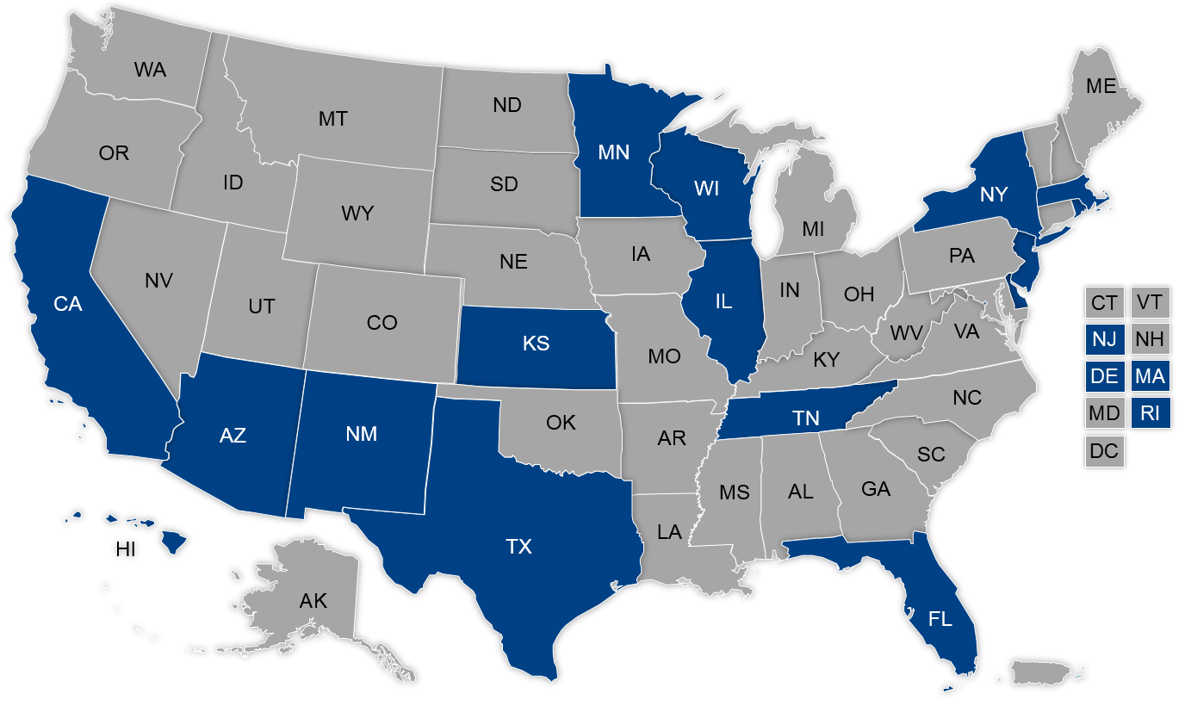
State Migration to
Managed Long-Term Supports and Services
States moving from FFS to MMC; 16 states have comprehensive, state-wide MLTSS
Populations and services included vary by state
6
Source: Mathematica Policy Research. Unpublished Data. January 2015.
Notes:
19 capitated Medicaid MLTSS waivers approved by CMS to date
CMS recognizes MLTSS as the future of the delivery system for LTSS and individuals dually eligible for Medicare and Medicaid
CMS seeking to codify 2013 Guidance to States Using 1115 Demonstrations of 1915(b) Waivers for MLTSS Programs in proposed 2015 Medicaid Managed Care Regulations
services could include nursing facility and/or HCBS
Use similar authorities for other LTSS authorities: Section 1115, combination 1915 (b)/1915 (c) waivers; 1932(a) State plan authority
To create a managed care LTSS environment, the state and the MCO work to maintain network adequacy and maintain oversight through performance measures
Payments would be on a capitated basis to plans
The MLTSS population enrolled varies by state, services could include nursing facility and/or HCBS
Use similar authorities for other LTSS authorities: Section 1115, combination 1915 (b)/1915 (c) waivers; 1932(a) State plan authority

Slide 7
National LTSS Scan: Introduction
CHCS project supported by The SCAN Foundation
Analyze LTSS delivery system innovations in states using both MLTSS programs and ACA vehicles to transform care for vulnerable LTSS populations
Seven states interviewed:
  - Arizona - New Jersey
  - California - Tennessee
  - Kansas - Texas
  - Minnesota
Policy brief will highlight key takeaways
Notes:
States interviewed for inclusion: AZ, KS, MN, NJ, TN, TX
State interviewed for context: CA
Why did we select these states? Each has a history of moving forward with rebalancing, person-centered care planning, purchasing and delivery system advancements toward VBP, and integration of care for individuals receiving LTSS (most are duals).
State innovations to long-term services and supports (LTSS) systems have been effective in rebalancing care to community-based settings, improving the quality and person-centeredness of care, and advancing new quality and purchasing strategies. The Center for Health Care Strategies is conducting an analysis of LTSS delivery system innovations in six states (Arizona, Kansas, Minnesota, New Jersey, Tennessee, and Texas) to describe progress in implementing these changes. This session will highlight the following elements of recent state innovations in Kansas, Tennessee, and Texas: (1) goals for the LTSS delivery system changes; (2) lessons from the design and implementation process; and (3) future goals or next steps.

Slide 8
National LTSS Scan: Emerging Themes
Continuous stakeholder engagement: NJ
Reinvestment in HCBS: TX, TN
Addressing housing and other social determinants of health: CA, TN
Integrating all services for individuals using LTSS: KS
Value-based purchasing in NF and HCBS settings: AZ, TN
Workforce development to strengthen LTSS purchasing and delivery systems: TN, TX
Medicaid/Medicare integration through both financial alignment demonstrations and D-SNPs
Notes:
Continuous stakeholder engagement: Use robust stakeholder engagement strategies (members; providers; health plans; advocacy groups) throughout all phases of MLTSS
Reinvestment in HCBS*: Use ACA opportunities including Money Follows the Person (MFP), Community First Choice Options (CFCO) and Balancing Incentive Program (BIP) to rebalance (TX, TN)
Social determinants of health/housing: Work with health plans on housing for MLTSS enrollees, including offering payment incentives (TN)
Value-based purchasing (VBP): Employ VBP for LTSS providers (NFs and HCBS) to promote value over volume (AZ, TN)
Medicaid/Medicare integration: Leverage MLTSS to promote integration of services for Medicare and Medicaid
NJ’s ONGOING stakeholder engagement process: From release of concept paper, MLTSS Steering Committee, Medicaid Advisory Committee, Stakeholder workgroups, etc.
This level of engagement (with consumers, PROVIDERs, local community organizations, advocacy orgs, etc) is essential as states and the federal government move forward with delivery system reforms that touch individuals who receive LTSS services- MLTSS; FAD; D-SNP platforms; ACOs??
Housing: AZ, TN, TX
VBP: TN efforts and workforce development, AZ payment reform, TX building data analytics capacity
Integrating: TN, MN, AZ D-SNP platforms, TX FAD
Workforce: TN, TX - States are focusing on HCBS workforce development as in essential component to strengthening LTSS purchasing and the delivery system
ACA: BIP, CFCO, MFP (TX), MN CFSS program
Create a framework for achieving greater integration of all care for MMEs and move quickly to:
Build on current rebalancing efforts
Engage stakeholders in the design/implementation of MLTSS
Simultaneously, strengthen MIPPA requirements for D-SNPs and contract with those committed to integrating care for MMEs, including through MLTSS plans
Work with federal and plan partners to achieve maximum D-SNP integration of: Medicare/Medicaid data; care management; and services

Slide 9
Agenda
CHCS Introduction and Overview of National Long-Term Services and Support Scan Texas: State Innovations in Long-Term Services and Supports: Providing Person-Centered, Community-Based Care Tennessee: TennCare Long Term Services & Supports Value Based Purchasing Kansas: Integrating Long-Term Services and Supports in Managed Care Questions and Answers

Slide 10
State Innovations in Long-Term Services and Supports: Providing Person-Centered, Community-Based Care
Chris Welch
LTSS Program Specialist
Texas

Slide 11
Money Follows the Person
Behavioral Health Pilot (MFP-BHP) Goals
Builds off long-standing MFP efforts
Transitions adults with severe mental illness and/or substance abuse disorders from nursing facilities to the community
Helps people be successful in the community by integrating mental health and substance abuse services with Long-term Services and Supports (LTSS)
Includes Cognitive Adaptation Training (CA) and substance abuse services provided up to six months before and after discharge
Results in positive, long-term changes to the Medicaid system

Slide 12
MFP-BHP Outcomes
381 individuals have transitioned into the community under the pilot since 2008
To date, 72% of individuals in the pilot have maintained independence in the community
Examples of increased independence include getting a job at competitive wages, driving, volunteering, getting a GED, teaching art classes, leading substance use peer support groups and working toward a college degree

Slide 13
Community First Choice
Senate Bill 7, 83rd Legislative Session, requires the most cost-effective approach to basic attendant and habilitation service delivery
Health and Human Services Commission (HHSC) met this requirement by implementing Community First Choice (CFC) services on June 1, 2015
CFC benefits are state plan benefits and available to all individuals enrolled in Medicaid who meet criteria

Slide 14
CFC Overview
For CFC eligibility, an individual must:
  Be a child or an adult who is eligible for Medicaid;
  Require an institutional level of care for:
    a nursing facility;
    a hospital;
    an institution of mental disease (under age 21 or 65 or older); or
    an intermediate care facility for individuals with an intellectual disability or related condition; and
  Receive an annual redetermination.

Slide 15
CFC Services
Personal assistance services
Habilitation
Emergency response services
Support management

Slide 16
Community First Choice Goals
Provides an expanded array of state plan Long-term Services and Supports (LTSS) for eligible individuals
Provides access to services for individuals with intellectual or developmental disabilities (IDD) currently on waiver interest lists
Allows Texas to claim an enhanced state match for CFC services

Slide 17
CFC Implementation Challenges
Timeframe for implementation
  Competing staffing resources:
    Nursing facility carved into managed care
    Dual Demonstration
    Residual work from managed care expansion statewide
Obtaining an approved State Plan Amendment
Creating additional LTSS for a state with a robust array of existing LTSS

Slide 18
CFC Implementation Challenges
Collaboration between multiple state agencies, managed care organizations, provider agencies, stakeholder groups, etc.
Ability to assess and begin delivery of services timely
Stakeholders with competing priorities

Slide 19
CFC Implementation Successes
Able to offer benefits to individuals who would otherwise continue to wait for services
Used existing provider base
Used existing Level of Care assessments
Modified existing functional assessments
Stakeholder support for implementing CFC
Fostering closer collaboration between multiple entities

Slide 20
Lessons Learned
Start early
Stakeholder input and buy-in early in development process
Adequate stakeholder education
Develop program independent of existing infrastructures

Slide 21
Future Goals for LTSS in Texas
Legislative direction to offer additional services for STAR+PLUS members with intellectual or developmental disabilities was provided in 84th Legislative session
  Non-medical transportation
  Respite care
Implement the successful interventions and practices from the Behavioral Health Pilot in Medicaid managed care system

Slide 22
Contact Information for CFC
Community First Choice – http://www.hhsc.state.tx.us/medicaid/managed-care/community-first-choice/
  Email questions to: MCD_CFC@hhsc.state.tx.us
MFP-BHP - http://www.dshs.state.tx.us/mhsa/MFP/
  Jessie Aric, MHP-BHP Program Manager Jessie.aric@dshs.state.tx.us

Slide 23
Agenda
CHCS Introduction and Overview of National Long-Term Services and Support Scan Texas: State Innovations in Long-Term Services and Supports: Providing Person-Centered, Community-Based Care Tennessee: TennCare Long Term Services & Supports Value Based Purchasing Kansas: Integrating Long-Term Services and Supports in Managed Care Questions and Answers

Slide 24
TENNCARE
LONG TERM SERVICES & SUPPORTS (LTSS)
Value Based Purchasing

Slide 25


Presentation Goals
Provide an overview of TennCare LTSS Value Based Purchasing (VBP) initiatives
Discuss the Quality Improvement in LTSS (QuILTSS) development process, including stakeholder engagement
Discuss the lessons learned from QuILTSS for Nursing Facilities (NFs)
Preview next steps for LTSS VBP, applying lessons learned to HCBS
25

Slide 26
TennCare’s LTSS VBP
QuILTSS focused on the member’s experience in NFs and HCBS for seniors and adults with physical disabilities
Enhanced Respiratory Care initiative for ventilator-dependent individuals or others with significant respiratory care needs receiving services in a NF
  Services provided to individuals with I/DD:
  New Behavioral Health Crisis Prevention, Intervention and Stabilization services and Model of Support
  Section 1915(c) waivers
  New MLTSS program – Employment and Community First CHOICES
  May include ICF/IID services in the future
26

Slide 27
QuILTSS Stakeholder Engagement
RWJF grant for technical assistance provided by Lipscomb University School of TransformAging
18 community forums in 9 cities and online survey of consumers, families, and providers
Findings: http://www.lipscomb.edu/transformaging/tareport used to develop a Quality Framework
Stakeholders provided input into the design of the bridge payment approach and reconsideration process
Stakeholder processes continue as the model evolves
a division of
27

Slide 28
QuILTSS Timeline
October and November 2013: Community forums
December 2013: Technical Assistance Report
Spring 2014: Stakeholder meetings to establish QuILTSS framework and specific measures
August 2014: Implement Bridge payment process for NFs, including on-line submission, multiple reviews, feedback, and reconsideration process with external stakeholder committee
Fall 2014: Stakeholder meetings to establish HCBS measures
2015: MCO contract changes, HCBS settings rule assessments (system, MCOs, and provider), NCI-AD, new technologies to collect point-of-service quality data
28

Slide 29
QuILTSS Quality Framework
This framework was developed with the stakeholder group based on the input received during the community forums, with the intent of applying across LTSS and settings, where appropriate (some measures will be different for HCBS)
Threshold Measures
  Minimum standards to participate in QuILTSS
Quality Measures
  Satisfaction of Member/Resident, Family and Staff (35 points)
    Conducting surveys and taking action based on results
  Culture Change/Quality of Life (30 Points)
    Respectful treatment, member choice, member/family input, meaningful activities
  Staffing/Staff Competency (25 Points)
    Volume of staff, choice of staff, consistency of staff, initial and ongoing staff training
  Clinical Performance (10 Points)
    Health related measures, prevention and early detection, ongoing functional assessment
a division of
29

Slide 30
Current Status
As of August 1, 2015:
QuILTSS for NFs has been active for one year
  291 NFs have made submissions (296 Medicaid)
  NFs have completed 5 quarterly submissions
  MCOs have distributed over $16 million in payments for quality-based rate adjustments for the first 4 submissions
QuILTSS for HCBS is in development
  Hosted a series of HCBS-specific stakeholder meetings
  Program changes / capacity development to support QuILTSS in process
a division of
30

Slide 31
NF Performance
Total QuILTSS Scores
Available Points
QuILTSS Submission
31

Slide 32
NF Performance
Total QuILTSS Scores
# of Facilities
Score
QuILTSS Submission
32

Slide 33
NF Performance
Facilities receiving QuILTSS points
% of Facilities
QuILTSS Submission
33

Slide 34
NF Performance
Facilities receiving QuILTSS points
% of Facilities
QuILTSS Submission
34

Slide 35
TN 5 Star rating is improving
October 2013, average=2.9
February 2015, average=3.2
35

Slide 36
Comparison of QuILTSS for NF vs. HCBS
NFs
296 facilities
Homogeneous providers
History of data collection
History of QI processes
24/7 interaction with members
Well-organized industry groups
New money to support quality
component of rate
HCBS
500+ providers
Heterogeneous providers
Diversity of
  Data collection history
  QI process history
  Organizational structure
Periodic interaction with members
Industry group is not as well-organized
No new money, rates adjust higher and lower
36

Slide 37
Lessons Learned
Stakeholder involvement (formal and informal)
Transparency is key (nobody likes surprises)
This is an iterative process (you cannot get there all at once)
You will need to develop the capacity of the system to measure and improve quality
Be at least two steps ahead of the system (you need a lot of lead time for the planning)
Communication, communication, communication (and then communicate some more)
  Frequent
  Consistent
  Questions
Program must support member-focused quality
Clear expectations and clear feedback to providers
37

Slide 38
QuILTSS for HCBS
Focus on Personal Assistance and Residential Services
Utilize the QuILTSS framework, with adjustments as appropriate
Person-Centered Plan is key to driving the member experience
  Goals and preferences
  Employment and community integration
Leverage technology
  Point-of-service satisfaction survey in Electronic Visit Verification
38

Slide 39
VBP for I/DD services
  New Behavioral Health Crisis Prevention, Intervention and Stabilization services and Model of Support to be implemented later this year
  Delivered under managed care program, in collaboration with I/DD agency
  Focus on crisis prevention and in-home stabilization, sustained community living, reduced inpatient utilization
  Performance measures (e.g., decrease in PRN use of anti-psychotics, decrease in crisis events, increase in in-place stabilization when crises occur, and decrease in inpatient psychiatric admissions and inpatient days) will be tracked and utilized to establish a VBP component (incentive or shared savings) for the reimbursement structure
  Section 1915(c) waivers
  Under SIM grant, developing acuity-based reimbursement approach for residential and day services, using the Supports Intensity Scale
  Plan to develop a “QuILTSS-like” quality component or reimbursement as well
39

Slide 40
VBP for I/DD services
Employment and Community First CHOICES
  MLTSS program to be implemented in 2016
  Promotes integrated employment and community living as the first and preferred outcome for individuals with I/DD
  Outcome-based reimbursement for certain employment services
  Reimbursement approach for other services will take into account provider’s performance on key outcomes, including number of persons employed in integrated settings and # of hours of employment (after a reasonable period for data collection and benchmarking)
  May modify ICF/IID reimbursement structure in the future, using approach similar to NF services (with modifications, as appropriate)
40

Slide 41
Enhanced Respiratory Care (ERC)
Chronic Ventilator Care, Ventilator Weaning, Tracheal Suctioning
Clinical Components
  Liberation rates
  Time to liberation
  Infection rates
  Hospitalization rates
Technology Components
  Availability and use of state of the art technology that supports liberation and maximizes independence
41

Slide 42
The Bottom Line…
At the end of the day, LTSS VBP is not about the money.
It is not about the system. It is not about the provider.
VBP is about the members and the quality of their experience.
We want to pay for the right service, in the right place, at the right time…delivered in a manner that is consistent with members’ needs, goals and preferences, and that helps them live the lives they want to live.
42

Slide 43
Agenda
CHCS Introduction and Overview of National Long-Term Services and Support Scan Texas: State Innovations in Long-Term Services and Supports: Providing Person-Centered, Community-Based Care Tennessee: TennCare Long Term Services & Supports Value Based Purchasing Kansas: Integrating Long-Term Services and Supports in Managed Care Questions and Answers

Slide 44
Integrating LTSS in Managed Care
Aquila “Q” Jordan, JD/MPA
Director, Policy and Regulations
A.Jordan@kdads.ks.gov

Slide 45

Better Lives for Aging and Disabled Persons in Kansas
Self-Determination
Greater Independence
Competitive Employment
Improved Access to Services
Better Overall Care
45

Slide 46
Top Service Challenges for States
Highest Cost Individuals
  People with challenging behavior
  –Criminal offenses adjudicated and non-adjudicated
  –Sexual offenders
  –Mental health disorders
  People with significant medical care needs
Waiting Lists
  Decreasing or minimizing use
  Serving based on priority need or place in line
Managing Cost
  Equity & Fairness
  Reasonableness
Implementing Promising Practices
  Person-Centered Practices
  Positive Behavioral Approaches
  Competitive Employment
46
Notes:
Physical Health/Medical Services, including pharmacy, dental and vision benefits

Slide 47
KanCare History
January 1, 2013
Coordination of care under 1115 Demonstration
  Physical health/Medical services
  Behavioral health services
  Non-emergency medical transportation
  Nursing facility and other long-term care facilities
  Value-added benefits and in lieu of services
  Long-term services and supports (Waiver HCBS)
Mandatory enrollment in managed care
  BUT the HCBS programs continue to operate under the 1915(c) waiver authority concurrently with the 1115 waiver
  Excluded I/DD long-term services and supports
47

Slide 48
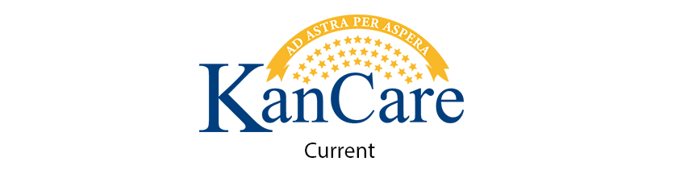

1115 WAIVER SERVICES
1915(c) HCBS WAIVERS
Medical services
Behavioral health services
EPSDT & state plan benefits
Transportation
Nursing facilities
Other long-term care
Value-added benefits
In lieu of services
Autism
Frail elderly (FE)
Intellectual/Developmental disability (I/DD)
Physical disability (PD)
Serious emotional disturbance (SED)
Technology assistance (TA)
Traumatic brain injury (TBI)
48

Slide 49
HCBS Programs under 1915(c)
Waiver | Population Served
Autism | individuals with Autism Spectrum Disorder (ASD) ages 0-5 years
Frail Elderly | frail individuals over age 64
Intellectual and Developmental Disability | individuals with intellectual disabilities and developmental disabilities (I/DD) ages 5 and older
Physical Disability | individuals ages 16-64 with physical disabilities
Serious Emotional Disturbance | individuals with serious emotional disturbance (SED) ages 4-21
Technology Assisted | medically fragile and technology dependent (MFTD) individuals ages 0-21
Traumatic Brain Injury | individuals with traumatic brain injury (TBI) ages 16-64
Under the 1915(c) waivers, more than 25,000 individuals receive long-term services and supports in one of seven waivers:
49

Slide 50

Managed Care
& I/DD
The goals of managed care are to provide better results through service and support coordination across multiple services and providers to meet individuals’ needs.
Isaiah at our Family Reunion – August 2013
50

Slide 51
KanCare I/DD Implementation
I/DD Pilot Project in 2013
  Stakeholder, provider, MCO and state workgroup
  ~ 500 I/DD consumers and 25 providers participated
  Tested billing and claims system, updated workflows and process, evaluated coordination outcomes
MCO Readiness Reviews in November 2013
  Full day onsite reviews to cover five core areas
  Reviewed policies, staffing, training, procedures, and billing/claims
51
Notes:
Created by the Secretary to develop recommendations related to:
Overall KanCare Pilot Project design, including outcome measures for evaluating KanCare pilot project and tracking outcomes
Identifying reimbursable CDDO costs related to the KanCare pilot project and potential ways to efficiently address those costs.
Help MCOs gain greater understanding of IDD prior to implementation
Demonstrate improved coordination of care for IDD under managed care
Develop and Test Billing Payment System specifically for IDD providers
Collaboration to develop the access, implementation and operational criteria.
Approx. 500 IDD consumers and 25 providers participated
Pilot Steering Committee made up of 6 CDDOs, 6 appointees by the Secretary, a DD Council Representative, and MCOs
Implemented July, 1, 2015 for SMI (including IDD ) populations
Stakeholder Engagement
Conducted two public forums
Consumer and provider Tours
Federal rules regarding Health Homes say members cannot be enrolled in a Health Home and also have a targeted case manager who is not part of their Health Home.
Kansas designed its Health Home model to provide I/DD consumers with the opportunity to enroll in a health home but also keep their TCM.
TCMs provide 2 of the 6 core services and are paid by the HHP and cannot bill TCM separately during that month
The State cannot force or require third parties, such as the HHPs or I/DD TCM providers, to contract with each other.
If a TCM is not contracted with a Health Home partner (HHP), the member can choose another HHP or opt out of the Health Homes entirely
State cannot force or require third parties, such as the HHPs or I/DD TCM providers, to contract with each other.

Slide 52
KanCare I/DD Implementation
Implemented February 1, 2014
  Eliminated secondary waiting list
  Trained care coordinators and targeted case managers on person-centered planning process
  Regular engagement calls with MCO and state
    Weekly consumer calls at noon on Wednesdays
    2x weekly provider calls on Mondays and Fridays
  Reports and Updates
    Bulletins: I/DD (weekly), HCBS (monthly)
    MCO billing, claims & credentialing report
52
Notes:
Created by the Secretary to develop recommendations related to:
Overall KanCare Pilot Project design, including outcome measures for evaluating KanCare pilot project and tracking outcomes
Identifying reimbursable CDDO costs related to the KanCare pilot project and potential ways to efficiently address those costs.
Help MCOs gain greater understanding of IDD prior to implementation
Demonstrate improved coordination of care for IDD under managed care
Develop and Test Billing Payment System specifically for IDD providers
Collaboration to develop the access, implementation and operational criteria.
Approx. 500 IDD consumers and 25 providers participated
Pilot Steering Committee made up of 6 CDDOs, 6 appointees by the Secretary, a DD Council Representative, and MCOs
Implemented July, 1, 2015 for SMI (including IDD ) populations
Stakeholder Engagement
Conducted two public forums
Consumer and provider Tours
Federal rules regarding Health Homes say members cannot be enrolled in a Health Home and also have a targeted case manager who is not part of their Health Home.
Kansas designed its Health Home model to provide I/DD consumers with the opportunity to enroll in a health home but also keep their TCM.
TCMs provide 2 of the 6 core services and are paid by the HHP and cannot bill TCM separately during that month
The State cannot force or require third parties, such as the HHPs or I/DD TCM providers, to contract with each other.
If a TCM is not contracted with a Health Home partner (HHP), the member can choose another HHP or opt out of the Health Homes entirely
State cannot force or require third parties, such as the HHPs or I/DD TCM providers, to contract with each other.

Slide 53
KanCare Health Homes Implementation
Implemented July, 1, 2015 for SMI (including I/DD) populations
Stakeholder Engagement (July 2014 to July 2015)
  Conducted two public forums
  Consumer and provider tours
Federal rules: Members enrolled in a health home cannot have a targeted case manager who is not part of their health home
  Kansas Model: Blended health home model for I/DD to all TCMs to bill for 2 of the 6 core services and be paid monthly by Health Home Partner (HHP)
  Limitation: If a TCM is not contracted with a (HHP), the member can choose another HHP or opt out of health homes entirely
  Robust website
  Over 100 presentations.
53
Notes:
Created by the Secretary to develop recommendations related to:
Overall KanCare Pilot Project design, including outcome measures for evaluating KanCare pilot project and tracking outcomes
Identifying reimbursable CDDO costs related to the KanCare pilot project and potential ways to efficiently address those costs.
Help MCOs gain greater understanding of IDD prior to implementation
Demonstrate improved coordination of care for IDD under managed care
Develop and Test Billing Payment System specifically for IDD providers
Collaboration to develop the access, implementation and operational criteria.
Approx. 500 IDD consumers and 25 providers participated
Pilot Steering Committee made up of 6 CDDOs, 6 appointees by the Secretary, a DD Council Representative, and MCOs

Slide 54

KanCare Lessons Learned
54

Slide 55
KanCare Lessons Learned
Engagement is Critical
Provider Education – increased sophistication in contracting, billing, and claims
Consumer Education – early and frequent engagement across disability populations
Pay for Quality
Pay for Performance is about results and outcomes
Pay for Quality is about quality of life, quality controls, and quality assurance
Communication is Constant
Develop consistent avenues for communication from stakeholders early on
Develop a system for sharing, gathering, and updating information frequently
Measure Progress AND Outcomes
Improvements in coordination of care may occur in unexpected areas
Ongoing technical assistances allows for constant improvement and innovation
55
Notes:
Friends and Family Advisory Council (monthly)
KanCare Ombudsman Consumer Lunch and Learn calls (bi-weekly)
Initial implementation created frequent calls (weekly, 2x weekly)
KanCare Consumer and Specialized Issue Workgroup (CSI)
KanCare Provider and Operational Issues Workgroup (POI)
HCBS Member and Provider “Lunch and Learn” calls
HCBS Program Steering Committees and Workgroups
HCBS Provider Forum (monthly)
Friends and Family Advisory Council
CDDO, CMHC, ADRC, KACIL, TCM, Big Tent, and InterHab engagement

Slide 56
Measure Progress
MANAGED CARE IS
more than a financing mechanism.
Defining quality outcomes for people with disabilities
Seeking opportunities for integrating care with services
Improving independence and self-determination
Working and living in the community with strong relationships
Focusing on the person: their dreams, hope and desires
Collaborating together to find innovative solutions
PROGRESS
supporting more people and their families in the community
56

Slide 57
Why Integrate the Waivers?
To create fairness for groups that get HCBS
To offer a larger set of services
To improve transitions between HCBS programs and from children’s to adults’ services
To support development and expansion of community-based services
To make things simpler for KanCare members, their families, providers and the state
57
Notes:
Presently, when a person is determined financially and functionally eligible for an HCBS program, they are limited to a specific package of services even if they could benefit from a service on another HCBS program.
There are also people who qualify for more than one HCBS program who then must choose one program and one package of services.
At times people transition from one HCBS program to another. For example a person with physical disabilities may want to transition to the HCBS program for the frail elderly. Or children move from the TA HCBS program to the IDD or PD HCBS program. Waiver integration would mean fewer and smoother transitions.
As part of this initiative, we will propose some new services, as well as offering some existing services to more populations.
We expect this integration to eliminate some redundant reporting and multiple waiver amendments, extensions and renewals – all of which are very time-consuming and do not add value to supporting people to live in the community.
To create fairness for groups that get HCBS
services should be offered on person-centered need rather than disability definition
To offer a larger set of services
some people have disabilities that mean they could get services from more than one HCBS program, but they are limited to a single set of services
To improve transitions between HCBS Programs and from children’s to adults’ services
Autism, TA and SED often move to IDD
Can incentivize employment and independence to move to adult services
To support development and expansion of community-based services
Pilot and test new options and services, expand service provision options
To make things simpler for KanCare members, their families, providers and the state
Fewer transitions between programs, all MCOs to meet needs based on assessed need, not just based on disability population
Simplify administrative oversight (7 waivers, 2 authorities → 2 waivers, 1 authority)

Slide 58
How Will Waiver Integration Work?
Full integration of seven 1915(c) waivers into the 1115 waiver
HCBS eligibility requirements by waiver population will remain the same, but there will be two sets of services instead of seven:
  Children’s benefit
  Adults’ benefit
Core Features - No Changes
  Eligibility rules, processes and assessing entities stay
  Early Periodic Screening Diagnosis and Treatment (EPSDT)
  Access to state plan services
  Person-centered integrated service plans of care
  Core quality measurements of the 1915(c) waivers
  HCBS Transition Plan and HCBS Final Rule
58
Notes:
We want to offer essentially two packages of services.
We plan to retain the current eligibility pathways for determining functional eligibility for HCBS. The current entities that assess people for HCBS would continue to do so. For example, the Aging and Disability Resource Center will continue to complete assessments for the FE, PD and TBI populations.
All the current coverage of services within KanCare provided through the state plan would continue. So any service that is demonstrated as medically necessary and covered would be provided.
HCBS will still be based upon what is authorized in an individual’s plan of care, developed through an assessment and person-centered process.

Slide 59

There is a wide variation in mental abilities, behavior and physical development in individuals with Down syndrome [ or any disability]. Each individual has his/her own unique personality, capabilities and talents. In other words, people with Down syndrome [or any disability] are not all the same; just like individuals in the typical population are NOT all the same.
– Noah’s Dad (blog)
59

Slide 60
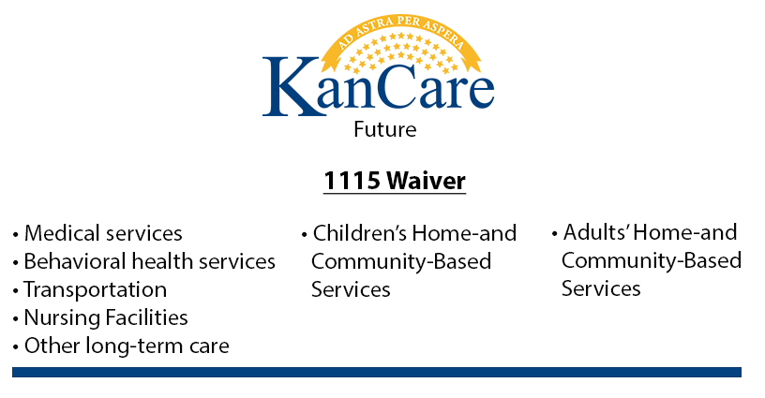
1115 WAIVER SERVICES
Medical services
Behavioral health services
EPSDT & state plan benefits
Transportation
Nursing facilities
Other long-term care
Value-added benefits
In lieu of services
KanCare CommunityCare
  Children’s HCBS benefit
    Short-term
    Long-term
  Adults’ HCBS benefit
    Short-term
    Long-term
60

Slide 61
Cross-Walk of HCBS Waivers
Children’s HCBS
Adults’ HCBS
Autism (0-5)
Intellectual/Developmental disabilities (5-21)
Serious emotional disturbance (0-21)
Technology assisted (0-21)
Physical disability (16-21)
Traumatic brain injury (16-21)
Frail elderly (65+)
Intellectual/Developmental disability (22+)
Physical disability (22-64)
Traumatic brain injury (22-64)
Note: The ages are proposed population groups and subject to change based on public comment and feedback
61

Slide 62
How Will Integration Improve Services?
Increase Access to Services
People will get needed services and supports no matter which disability group they are in
Reduce or get rid of waiting list for services by improving traditional service models
Provide supports for natural caregivers
Improve Community Integration
Help more people get real jobs in the community
Offer better supports for person-centered independent living no matter what disability a person has
62
Notes:
We want people to receive services that they have a need for without putting people into disability-defined boxes.
We think that this approach will result in some efficiencies and savings that will allow us to reduce or eliminate the waiting list.
We also want to support more people in real, meaningful jobs within the community.

Slide 63

Nothing about me without me.
Cathy, 45, has a killer freestyle and is a jazz connoisseur
63
Notes:
We want people to receive services that they have a need for without putting people into disability-defined boxes.
We think that this approach will result in some efficiencies and savings that will allow us to reduce or eliminate the waiting list.
We also want to support more people in real, meaningful jobs within the community.

Slide 64
Timeline
DATE | ACTIVITY
Aug-Sept 2015 | Public meetings & conference calls
September 30, 2015 | Publicly post draft 1115 amendment
Sept-Nov 2015 | Stakeholder engagement – technical
November 9-13, 2015 | Public meetings on draft amendment
November 20, 2015 | Post public comments
January 4, 2016 | Submit 1115 amendment to CMS
Jan-May, 2016 | Stakeholder engagement – operations
July 1, 2016 | KanCare CommunityCare begins
64
Notes:
Once CMS posts our final amendment, they will accept public comment for 30 days. They will then begin formal discussions with us and start drafting the special terms and conditions that will govern this amendment once approved.

Slide 65
State Considerations
Technical Elements of the Amendment
Stakeholder workgroups and engagement
Statutory and regulatory compliance
Service definitions, limitations, and rates
Quality assurance and performance measures
Operational Elements of Implementation
Education of state staff, consumers, providers, legislators, and other stakeholders
MCO and provider readiness reviews
Assessments, eligibility & workflows
Updated policies, tools, and protocols
Transitions, terminations & appeals
65

Slide 66

Most People with Disabilities in Services
Live with Family
Sustainability depends on how well the system supports:
Person-centered independent living
Families
People with employment
66
Notes:
Kansas has less than 40% of population that live with family or on their own. Nationally more than 60% or on their own so we have some work to do.

Slide 67
For more information about KanCare: www.kancare.ks.gov
For more information about waiver integration: http://www.kancare.ks.gov/section_1115_waiver.htm
OR www.kdads.ks.gov
67

Slide 68
Agenda
CHCS Introduction and Overview of National Long-Term Services and Support Scan Texas: State Innovations in Long-Term Services and Supports: Providing Person-Centered, Community-Based Care Tennessee: TennCare Long Term Services & Supports Value Based Purchasing Kansas: Integrating Long-Term Services and Supports in Managed Care Questions and Answers

Slide 69
Questions?
Contact Information:
Alexandra Kruse: akruse@chcs.org
Chris Welch: Chris.Welch@hhsc.state.tx.us
Jay Taylor: Jay.Taylor@tn.gov
Aquila Jordan: a.jordan@kdads.ks.gov
www.chcs.org
69

Slide 70
Visit CHCS.org to…
Download practical resources to improve the quality and cost-effectiveness of Medicaid services
Subscribe to CHCS e-mail updates to learn about new programs and resources
Learn about cutting-edge efforts to improve care for Medicaid’s highest-need, highest-cost beneficiaries
www.chcs.org
70

