Slide 1
Mark Your Calendar
OCT. 5-7, 2016
Fairmont Hot Springs Resort

Slide 2
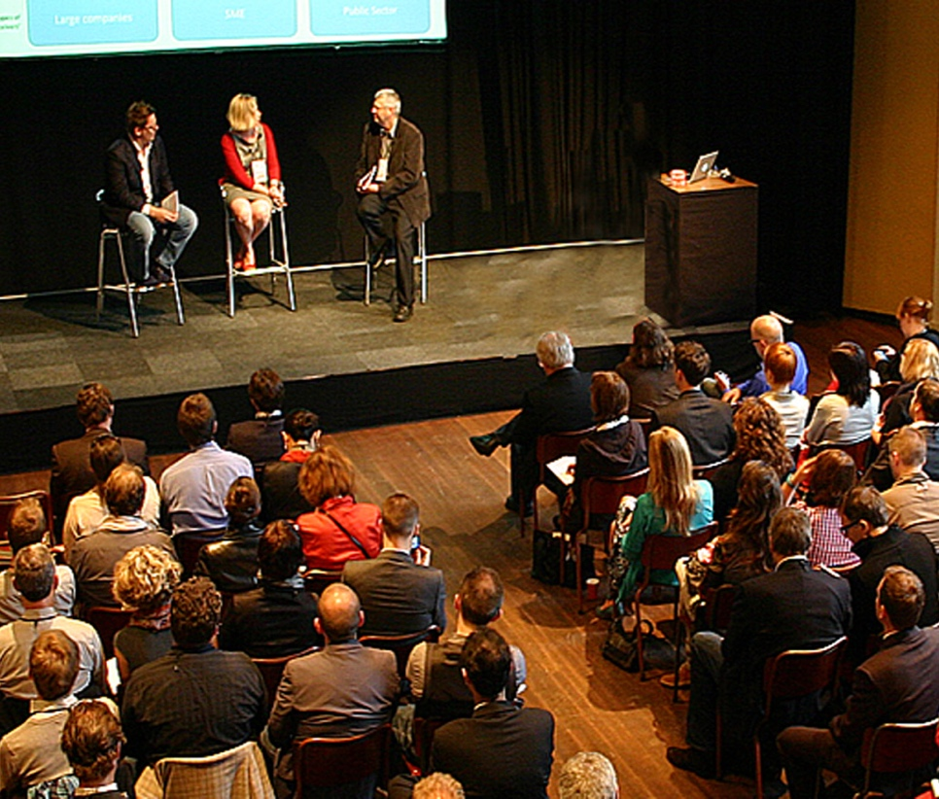
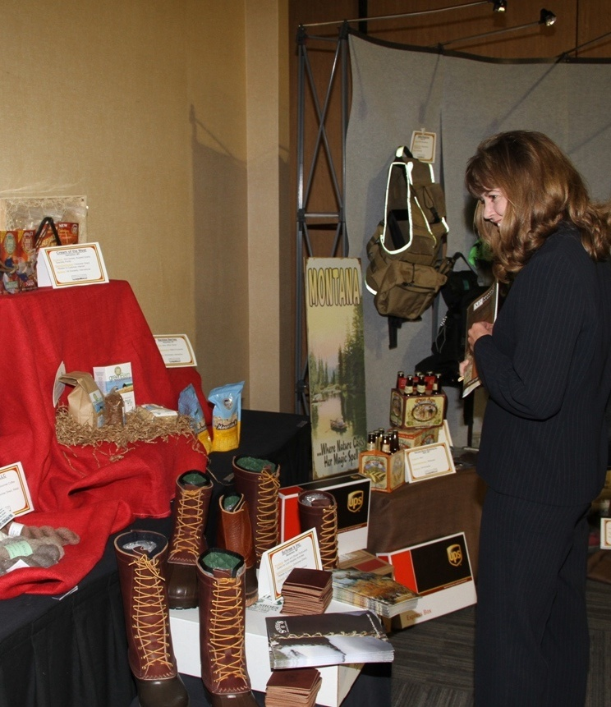
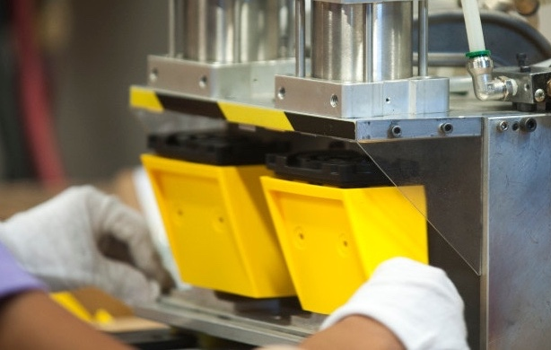
What happens at the COMPETE SMART CONFERENCE Doesn’t Stay in Montana - it just starts here.

Slide 3
Compete Smart 2016
3 Days
1 Dynamic Keynote Speaker
25+ Sessions
3 Multi-Plant Tours
3 Networking Events
30+ Allies / Exhibitors
100ft MT Products on Display
Brings together 275-300 manufacturers, suppliers, students and manufacturing allies for three days of business and community building sessions, tours, and networking.

Slide 4
Why Support Compete Smart
Reach 275-300 Manufacturers & Supporters
Gain visibility with Montana’s Manufacturing Community
Showcase services & opportunities
Enhance your presence through extensive publicity and recognition (before, during and after the event!)
Network with other manufacturers and supporters
Further your commitment to manufacturers, the bedrock of Montana’s economy
DID YOU KNOW?
Manufacturing in Montana now produces over $14 billion in output (sales) annually and directly employs 22,100 workers across the state.

Slide 5
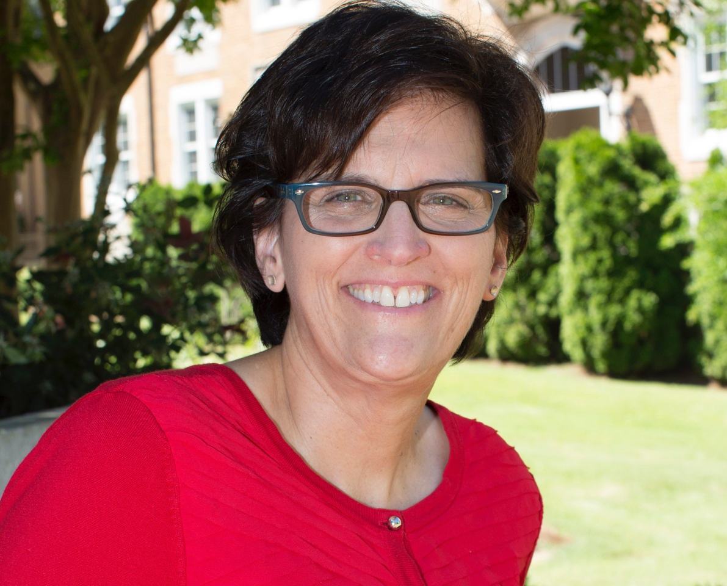
Sponsor Compete Smart
Sponsor our Luncheons. ($7,500)
Lunch will include the keynote address given by Janyce Fadden, who will speak on Strategic Doing, an asset-based collaborative process, and how combining forces turns out better products, profits and communities.

Slide 6
BRIDGING business, community, and education to advance a region's competitiveness

Slide 7
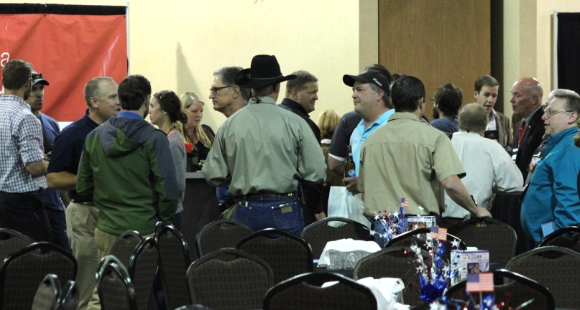
Sponsor Compete Smart
Sponsor one of our Networking Receptions. ($7,500)
Compete Smart Opening Reception Help us kick-off the 2016 Compete Smart Conference in style! On Wednesday, October 5th, participants will enjoy hors d’oeuvres - this is a great opportunity to have a captive audience!
20-year Anniversary Celebration & Manufacturing Day Party
We are celebrating 20 years of Making it happen under the Big Sky and national Manufacturing Day! What a perfect combination to celebrate one of Montana’s biggest assets – our Manufacturers.

Slide 8
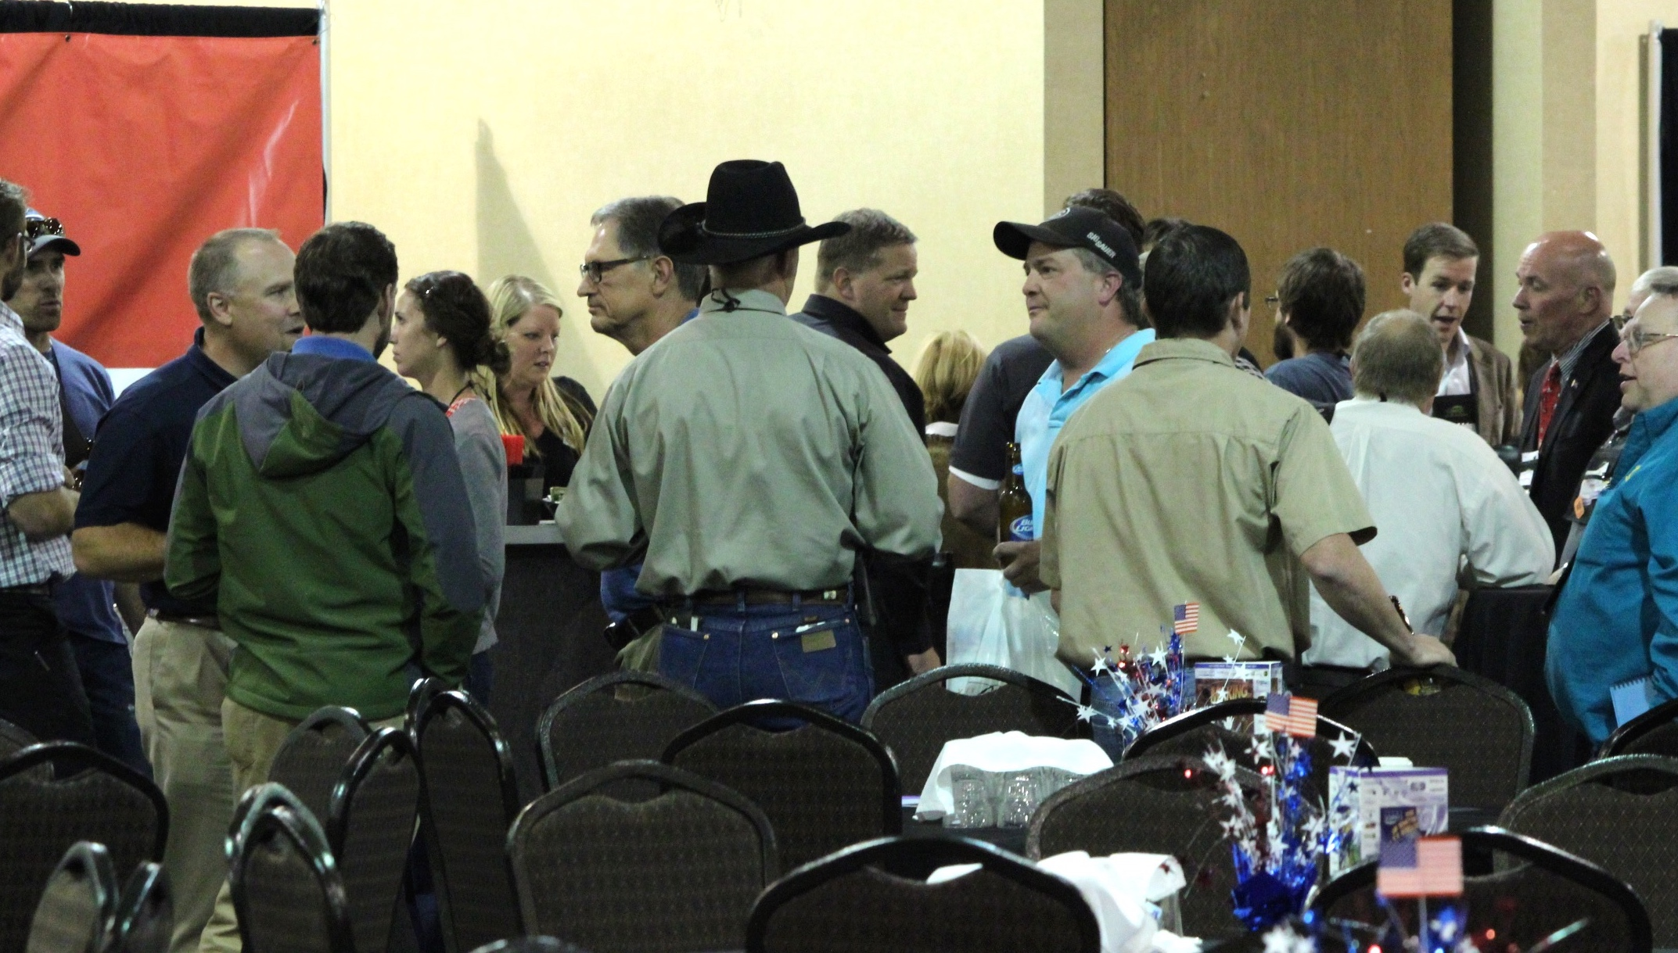
Compete Smart 2014

Slide 9
Some other opportunities
Gold Level Sponsor ($5,000)
Thursday/Friday Breakfast:
Conference participants will start the day with you.
Silver Level Sponsor ($2,500)
Golf Tournament:
Headline the inaugural golf tournament on Wednesday as the main sponsor!
Session Sponsor:
Sponsor two of the information-packed breakout sessions.
Learn more: www.etouches.com/competesmart

Slide 10
Thank you for supporting Compete Smart 2016

