Slide 1
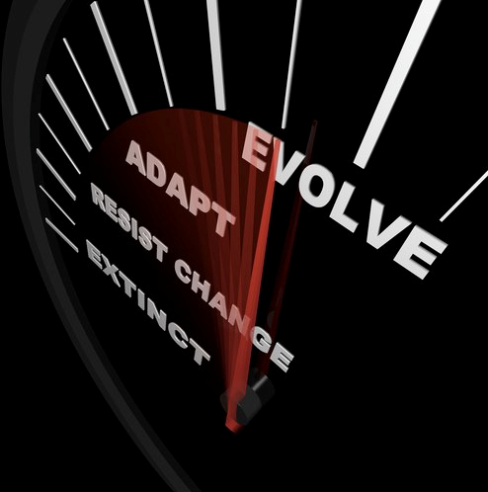
Modern Workplace
Paul Sinclair

Slide 2
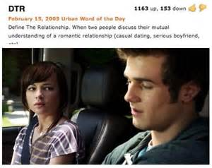
DTR: Defining the (Modern Workplace) Relationship

Slide 3
Goals for Today
Overview of Generational Challenges Facing Modern Workplaces
3 Trends With Practical and Legal Consequences
Performance Appraisals
Telecommuting and Remote Workplaces
BYOD

Slide 4
Demographics is Destiny
The Baby Boomers (born 1946-1964) were previously the largest generation in American history, with roughly 76 million people.
The Generation X (born 1965-1983) was significantly smaller, with fewer than 46 million people.
Generation Y has surpassed even the Boomers, with approximately 80 million born in the U.S. and the potential of growing closer to 100 million due to immigration.

Slide 5
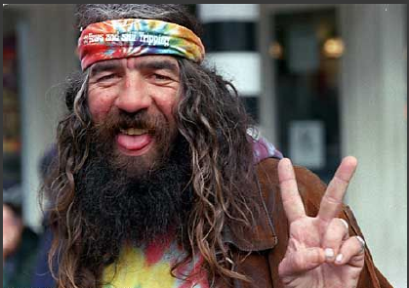
Baby Boomers
Now 52-70
Postwar childhood
Vietnam War
Revolution in social identities (race, gender)
“Digital immigrants" in mid-adulthood

Slide 6
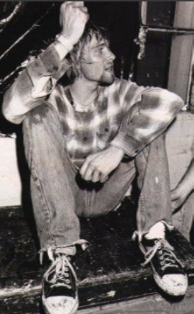
Generation X
Now 37-51
1980s consumerism
Fall of communism
Importance of the individual
Digital immigrants in adolescence and young adulthood

Slide 7
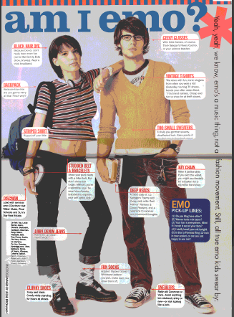
Millennials: Born 1960-1994
Now 22-35
Millennials
Also called
Gen Y (after Gen X)
Generation Me
Shaped by:
9/11
Great Recession
Digital natives

Slide 8
iGen (or iY): Born 1995-2012
Now 4-21
Have never known a world without the Internet
Kids & teens when:
Facebook went big (2006)
The iPhone arrived (2007)
The iPad debuted (2010)
Recession over before entered the job market
Parental overprotection

Slide 9
Generation Gap
By 2025, the U.S. Department of Labor estimates that the 76 million Boomers will have retired.
However, there are only 46 million individuals from Generation X to replace them, leaving a gap of 30 million.
Enter the Millennials!

Slide 10
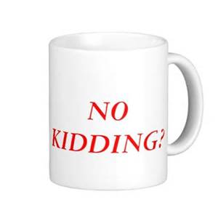
Generation iY – 8 Trends
Job hopping in search of perfect career now
Ribbons regardless of performance
Intimate familiarity and innovative use of technology
Parental involvement in the workplace

Slide 11
Generation iY – 8 Trends
Expectation of change, amusement, and immediate feedback
Search for meaning not money
Dealbreaker: want to work with friends
Pursuit of influence and affluence

Slide 12
Extended Adolescence: "26 is the New 18"

Slide 13
Millennial Views of Work
Largest generational difference: Growth of work-life balance
Fewer Millennials say “I expect work to be central part of my life:
More say that “not wanting to work hard” might prevent them from getting a job they want
Lesser focus on work and more individualism
May be at the root of anecdotal evidence for Millennials being:
Less invested in quality of work
Less attention to detail
Less interested in pleasing bosses
More structured childhood: Need clear directions; less independent workers

Slide 14
Grow Me or Lose Me
21% of Millennials report changing jobs within past year, which is more than 3x the number of non-millennials who report the same.
60% are "open to new job opportunity" and 36% will actively "look for a job with a different organization in the next 12 months.
BUT, Development is especially important for Millennials, 87% of whom rate “professional or career growth and development opportunities” as being key to their engagement and job satisfaction.
Gallup: How Millennials Want to Work and Live (2016)

Slide 15
Managing Modern Workforce
Past Future
My Paycheck My Purpose
My Satisfaction My Development
My Boss My Coach
My Annual Review My Ongoing Development
My Weaknesses My Strengths
My Job My Life
Gallup: How Millennials Want to Work and Live (2016)

Slide 16
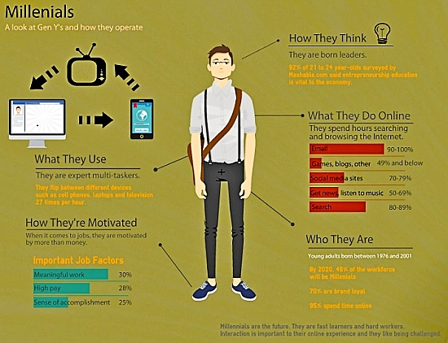
Managing Modern Workforce
Generation Why? Must explain why it matters and why they matter
Want to contribute their ideas
Need for structure and clear directions
“Spell it out” for them
Want a manager who cares about them and their goals (“I want you to be successful”)

Slide 17
Modern Workforce—Performance Evaluations
"Why Your Millennials Think Your Reviews Suck"
75% feel "in the dark" about how they are viewed by peers and management (results are unhelpful)
69% believe the review process is flawed (process is unhelpful)
62% were "blindsided" by their annual review
25% have called in sick or have taken time off due to "review anxiety"
85% believe performance reviews should be used to "build confidence" rather than criticize
~Wakefield Research, 2015

Slide 18
How Do You Feel About Your Eval System?
According to a 2013 Corporate Executive Board Study:
95% of managers are dissatisfied with their performance management system
90% of human resource leaders believe their performance management systems do not yield accurate information

Slide 19
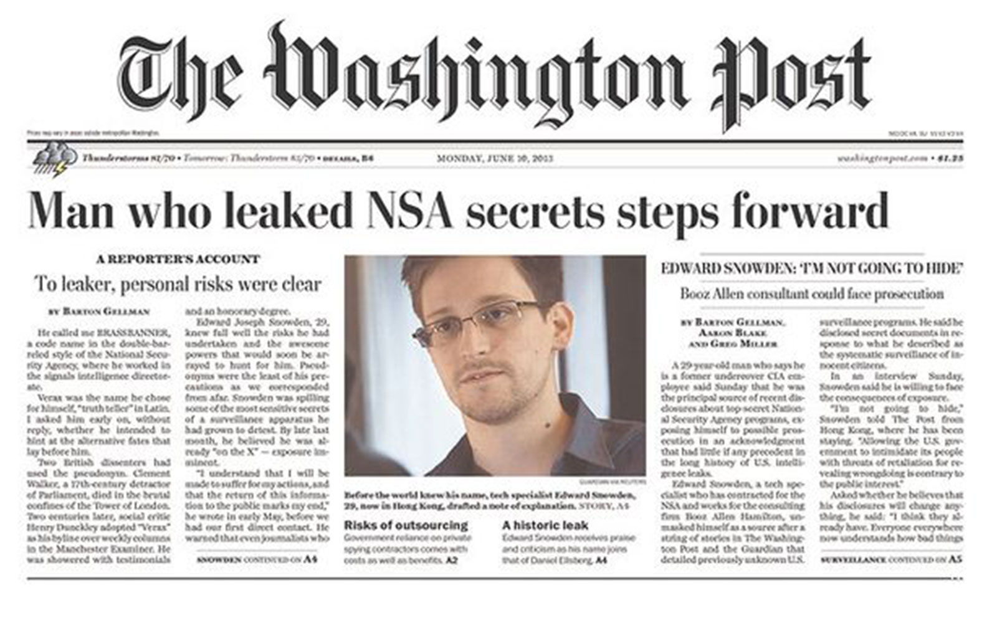
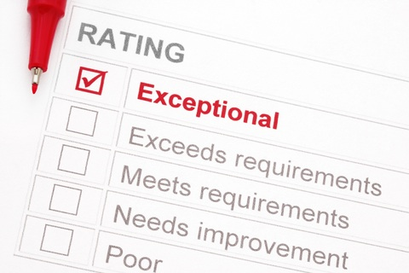
Remember, Study Finds That Basically Every Single Person Hates Performance Reviews
Picture of washington post
Provide Feedback not Criticism
Focus on strengths, not weaknesses
Basically every single person hates performance reviews

Slide 20
How Do You Feel About Your Eval System?
“Study Finds That Basically Every Single Person Hates Performance Reviews”—Washington Post, Jan. 27, 2014 (Culbertson, S. S., Henning, J. B., & Payne, S. C. (2013). Performance appraisal satisfaction: The role of feedback and goal orientation. Journal of Personnel Psychology, 12(4), 189-195)
Except lawyers—we LOVE them…
until we HATE them

Slide 21
What is Going on Here?
Is there any logical explanation for all this animosity?
"If people don't respond to us the way we perceive ourselves, and we can't change the incoming data, we will ignore or distort."
~Tavris/Aronson, Mistakes Were Made (but not by me)(2007)

Slide 22
Big Data/Little Data
Accenture, Adobe, Deloitte, Gap, IBM, Microsoft have all eliminated the annual performance evaluations
Why?
They don't work very well
They cost too much to administer
They may drive away talent

Slide 23
Start with Little Data—Deloitte's Approach
Count the hours it takes to do all the work
2 million hours for 65,000 people (more than 30 hrs/person/yr)
Determine what is really measured with performance reviews
62% of variance in ratings are accounted for by raters’ peculiarities of perception: “Although it is implicitly assumed that the ratings measure the performance of the ratee, most of what is being measured by the ratings is the unique rating tendencies of the rater. Thus ratings reveal more about the rater than they do about the ratee.” Journal of Applied Psychology
Stop asking about skills; start asking about intentions:
People may rate other people’s skills inconsistently, but they are highly consistent when rating their own intentions. Ask team leaders not about the skills of each team member but about their own future actions with respect to that person.

Slide 24
Start with Little Data
Case Study: 50 convicted criminals started a moving company called The Other Side Movers
Within six months, they paid off their first moving truck and purchased two more. Business will exceed $1 million in revenue the first year. They catapulted to the top of every referral site to become the #1 ranked moving company in their area.
How? “Feedback is normal.”

Slide 25
Start with Little Data
The core value at The Other Side Movers is: "200% Accountability."
Every employee is expected to be 100% accountable for the quality of his/her own work AND
100% accountable for the quality of the work of everyone else they see.

Slide 26
How Do They Do It?
Patch Ups
Pull Ups

Slide 27
How Do They Do It?
Pull Ups: "If you see someone doing something wrong, you are obligated to immediately 'pull them up.'" You don’t delve into detail during the pull up – you simply offer corrective feedback. The person receiving the feedback is encouraged to simply respond with "okay." The vast majority of this kind of feedback is delivered by peers.
Patch Ups: After giving someone a tough “pull up” team members are taught to offer a “patch up.” Patching up means helping them know they are cared about and respected.

Slide 28
How Do They Do It?
The Games: At least weekly, employees sit in a circle and engage in a peer-driven process of bringing feedback to those you care enough about to help them improve. It often gets loud and raucous. Feedback recipients are often defensive. But as other members of the group add their perspective to the feedback given, employees find it less tenable to deny the concerns – and eventually find the humility to embrace what colleagues are saying.
"The frequency of the Games — not the quality of delivery — lowers the emotional stakes over time to where team members become comfortable hearing difficult truths."

Slide 29
Therefore, What????
"The primary reason people struggle with giving and receiving feedback is not a lack of proficiency but of frequency." ~Joseph Grenny, Harvard Business Review, Aug. 19, 2016
"We ought to spend more time increasing frequency rather than improving delivery." ~Joseph Grenny, Harvard Business Review, Aug. 19, 2016
"My research over the past 30 years has shown that you can largely predict the health of an organization [goal attainment, morale, risk taking, teamwork] by measuring the average lag time between identifying and discussing problems." ~Joseph Grenny, Harvard Business Review, Aug. 19, 2016

Slide 30
Telecommuting: What Changed?
New technology (Live Meeting, WebEx, Skype)
New generation of workers raised on "distance learning" and on-line collaboration
Innovative policies such as ROWE ("Results Only Work Environments") make "presenteeism" optional
EEOC scrutiny of attendance requirements
Federal Telework Act (2010): allows federal employees to work from home or with flexible schedules.
Already, 79 agencies participate with 42% of them reporting cost reductions.

Slide 31
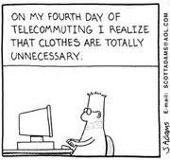
Telecommuting: Trends
Regular telecommuting grew by 61% between 2005-2009 and trends suggest regular telecommuters will total 4.9 million by end of 2016. ("The State of Teleworking in the US" (June 2011):
9.4% of US workers, or 13.4 million people, worked at least one day at home per week in 2010, compared with 7%, or 9.2 million, in 1997. (The Wall Street Journal, 3/5/13).

Slide 32
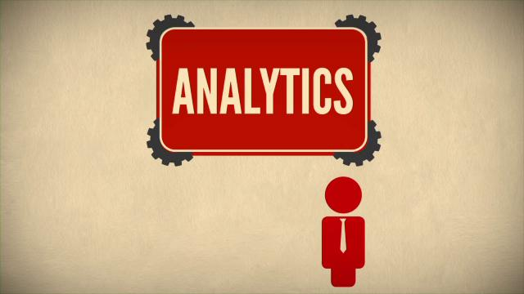
Telecommuting: Analytics
Summary of 500 studies on the impact of work-from-home programs:
79% of people want to work from home.
36% would choose it over a pay raise.
Gen Y workers are particularly attracted to flexible work arrangements, rating them as 8 on a 10 scale for impact on their overall job satisfaction.
61% of employees who don't currently work from home say they would give up some pay in exchange for being allowed to do so.
46% of companies that allow it say it has reduced attrition.
72% of employers say telework has a high impact on retention.
(http://www.globalworkplaceanalytics.com/resources/costs-benefits/)

Slide 33
Telecommuting Under the ADA – EEOC's View
EEOC Fact Sheet, Work At Home/Telework as a Reasonable Accommodation(Oct. 27, 2005). (http://www.eeoc.gov/facts/telework.html)
Encourages employers to consider telecommuting as accommodation for employees whose medical condition prevents them from coming to the workplace regularly

Slide 34
Telecommuting Under the ADA – EEOC's View
Factors to consider:
Ability to supervise the employee adequately
Need for equipment or tools that cannot be replicated at home
Need for face-to-face interaction and coordination of work with colleagues, clients, or customers
Need for immediate access to documents or other information located only in the workplace.
EEOC Fact Sheet, Work At Home/Telework as a Reasonable Accommodation (Oct. 27, 2005) (http://www.eeoc.gov/facts/telework.html)

Slide 35
Telecommuting: View of Federal Courts
"Much ink has been spilled establishing a general rule that, with few exceptions, “an employee who does not come to work cannot perform any of his job functions, essential or otherwise.” …We will save the reader a skim by omitting a long string-cite of opinions that agree, but they do. Our Circuit has not bucked the trend. And for good reason: “most jobs require the kind of teamwork, personal interaction, and supervision that simply cannot be had in a home office situation.
(EEOC v. Ford Motor Co., 782 F.3d 753 (6th Cir. 2015) (en banc).

Slide 36
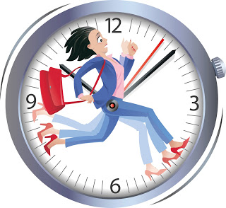
Telecommuting: Other Legal Concerns
Fair Labor Standards Act: Need to keep track of hours worked
FMLA: Keep track of hours not worked
OSHA: Does it apply?

Slide 37
Telecommuting: Reasons to Consider
Provides flexibility for employees with different family needs
Offsets increases in compensation
Reduces "bricks and mortar" expenses
Attracts "non-traditional" workers

Slide 38
WTH is BYOD?
BYOD: Bring Your Own Device
AKA: BYOT
BYOP
BYOPC
Working Definition: An employer policy or practice of allowing or encouraging employees to use personally-owned electronic devices, such as laptops, tablets, and smart phones within and outside the formal workplace to perform work.
BRING YOUR OWN DRAMA

Slide 39
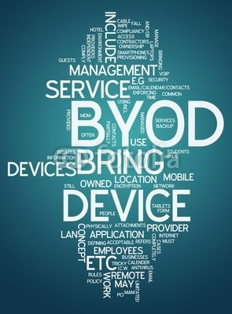
ETA for BYOD?
It's Here—74% of employers allow some form of it (more than 80% of employees report using OD)
PC World—by 2017, 50% of employers will require it
A Little History
Flipping Out Over Flip Phones: No Cell Phones with Cameras in the Federal Courthouse
Check Your Smartphone at the Door Please
Theft of Trade Secrets, Pictures of Processes
Privacy Concerns
The Answer to BYOD: Don't Bring That Thing in Here!

Slide 40
ETA for BYOD?
Why Did This Happen?
Higher Productivity
Intel Study showed, on average, employees were getting 57 minutes more work done each workday with its BYOD program
Productivity gains were the result of working on commuter trains, from home, or waiting in an airport
Costs Savings
CIOInsight Study showed companies where employees bring their own devices to work save an average of $1,000 per year, per employee, in service costs
IBM's CIO acknowledged that they have not saved any money: “BYOD programs have hidden costs that actually cause companies to spend more money than they realize and make the programs more expensive to operate than the traditional model.”
Intel study showed no cost savings
Increased Employee Convenience
Technology is now PERSONAL and CULTURAL ... and getting cheaper.
Employees will get what they want, and likely, what is most current; employers will not.

Slide 41
ETA for BYOD?

Slide 42
WTH is BYOD a B*D?
Employees are already using their own technology for work
Security Risks
Technology Risks
Employment Risks

Slide 43
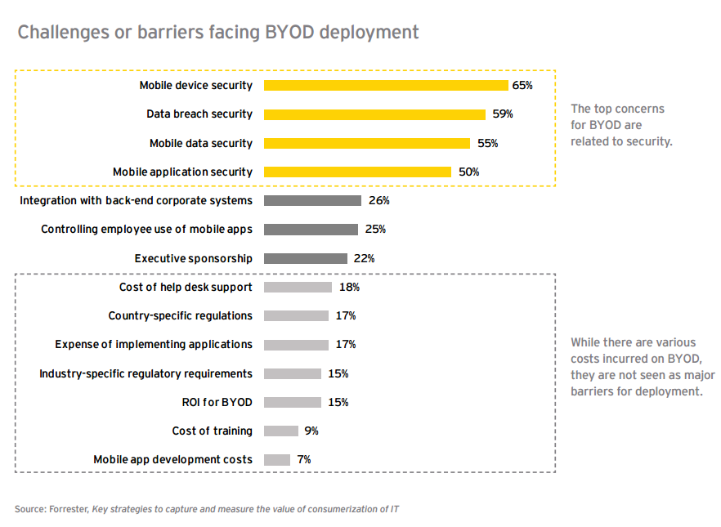
WTH is BYOD a B*D?

Slide 44
What is Being Done?
Apple’s iOS 7 includes "Activation Lock" feature.
Works as a "kill switch" and allows owner to remotely wipe the device-not carrier dependent, but not perfect.
Virtually all carriers and systems have kill switch mechanisms, including Android
Minnesota and California are the first states to require kill switches by state law

Slide 45
WTH is BYOD a B*D for HR?
When BYOD is TMI: Discrimination and Harassment Issues
Bonnie uses her iPad for work. She's having trouble syncing with a custom database for client management. She brings her iPad to the IT department to see if they can fix it up for her. On Bonnie's desktop are the following apps: Glucose Buddy, AsthmaSense, Crohn's Diary, Healthy Heart, Smart Blood Pressure, and WebMD Pain Coach.
IT department employee says to the guy in the next cubicle, "holy cow, what disease does this woman not have?"
John uses his iPhone in his sales role. He's been having trouble getting his phone to work correctly with both his internal and external calendars. Things don't appear to be updating correctly. When he brings his phone in to IT to be looked at, Susan finds that John's screen saver is a picture of John's wife in a naughty nightie. You don't want to know what's on the camera roll. Susan is deeply offended and goes to HR.

Slide 46
WTH is BYOD a B*D?
When BYOD equals OT: "Off the Clock" Work and the FLSA
The CEO's assistant leaves work at 5:30 p.m. At about 6:30 p.m., the CEO sends her a text message to give him a call, if it's convenient. Assistant calls CEO and talks for about 15 minutes or so about a few things that were left over at the end of her day. They spend another 10 minutes coming up with a plan for the next day. The assistant then sends a few emails from her laptop to contact a couple of other executives about a potential meeting in the morning. About 9:30 p.m., she checks her email and sees that everyone has responded, so she spends a few minutes sending out an Outlook Calendar meeting request with an attached agenda for tomorrow's meeting.
34% of employees report receiving work emails after regular work hours and are expected to respond (Right Management Survey).
The issue? That's one hour of "overtime" for the assistant.

Slide 47
WTH is BYOD a B*D?
When BYOD spells OSHA: Workplace Safety
As Bob is on his way home from his last customer visit of the day, he texts his wife to let her know he'll be home in an hour. Bob then has a text message exchange with his boss while he's driving and smashes into a parked car.

Slide 48
WTH is BYOD a B*D?
When BYOD means a TRO: Dealing with Lost Data
Jill regularly uses a smartphone to access the company's network and download particular items that would be helpful in working with customers. Jill loses her phone at a trade show. Or was it at a bar? She can't really remember.
John leaves the company, and not on great terms. He has always used his own laptop and phone to do his work. He has all the company's data and custom software on his laptop.
What about the fact that John's phone number is the one all the customers call to get in touch with him on business matters?

Slide 49
WTH is BYOD a B*D?
When BYOD lowers RPM's: Productivity
Employees appear to be spending much of their work time on social networking sites, snap chatting with friends, and worse.

Slide 50
BYOD and SOPs
Stop it
Embrace it
Control

Slide 51
An HR/IT BYOD SOP
Get your IT People Involved
Security Controls
Technological Capabilities
Implement a Comprehensive Policy—if you’re not there yet, you’re not alone. As of 2015, only 28% of employers had BYOD policies.
Retain Flexibility

Slide 52
An HR/IT BYOD SOP
Define Scope: Applies to any mobile device that is used to access corporate resources—think tool boxes and work boots.
No expectation of privacy.
Require all devices to support encryption, remote wiping of all corporate and personal data, lockouts, and password protection.
Require corporate approval of all devices to be used.
Require employees to authorize the addition of any hardware or software required by the employer and by its personnel.
Require strong password protection at the welcome screen level and that the password will not be disclosed, even to family members.

Slide 53
An HR/IT BYOD SOP
Require that the device automatically locks after a few minutes of inactivity.
Require the employee to certify that s/he has not, and will not, permit any device to be jail broken or rooted.
Require the employee to report lost or stolen devices to the carrier AND employer immediately. Also require the reporting of any unauthorized access.
Require the employee to install operating system upgrades, software upgrades, software patches, and anti-virus and anti-malware software as they become available.
Consider prohibiting use of BYOD by non-exempt personnel or prohibit them from working "off the clock."

Slide 54
An HR/IT BYOD SOP
Require employees to use their devices consistent with all other company policies.
Prohibit employees from saving company files to the cloud.
Require iPhone, iPad, and Mac users to enable the “find my phone” application—Activation Lock. Same for other operating systems
Specify what portion, if any, of the voice and data plan costs the company will pay (by level, title, department, or other designation).
California requires reimbursement of employee expenses
Require consent for monitoring, accessing and preserving any data.
Deal with the termination issue up front—suggest they back up personal data as their information may be wiped upon termination.

Slide 55
An HR/IT BYOD SOP
Review other company policies and contracts where reference to the BYOD policy would serve as a reminder/obligation:
Anti-Harassment and Discrimination Policies
Conflict of Interest Policies
Confidentiality Policies
Workplace Safety Policies
Hours of Work and Overtime Policies
Collective Bargaining Agreements
Employment agreements

Slide 56
An HR/IT BYOD SOP
Require employees to attend a training session on the BYOD policy.
Require all participating employees to sign a document indicating the employee’s agreement and knowing consent to, understanding of, and intent to adhere to, all of the terms and conditions of the BYOD policy.
Ensure the document reflects the consequences of non-compliance.
Make it clear that this is pay to play.

Slide 58
Questions?

