Slide 1
THE FUTURE OF PAYMENTS & WHAT YOU NEED TO KNOW Enabling Consumer Payments 24/7
A LEEDOM GROUP COMPANY
Jon Leedom, CPP
Paymaxx Pro

Slide 2
Payments Industry Updates
ACH
NACHA- rule updates on thresholds for certain types of returns
Same Day Settlement
Credit Card
Payment Card Industry (PCI 3.0)
EMV, EMV, EMV

Slide 3
Times Are Changing …
Repo Man Hunts For Car
GPS & Starter Interrupt
Manual Ledger Cards
Computerized DMS
ACV of cars sold = $3,200
ACV of cars sold = $5,500
Limited Industry Training
Plethora of Best Practices
Customers Pay Cash In Person
Array of Electronic Payment Options

Slide 4
Why Influence Customer Behavior?
Dealers who have more than 25% of customers on a recurring electronic payment plan have delinquency rates averaging 16.8%
VS
Dealers who have less than 25% of customers on
a recurring electronic payment plan have delinquency rates averaging 23.0%

Slide 5
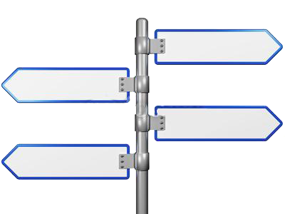
Payment Avenues Multiple Ways a Customer Can Pay
ACH/
Card
Electronic Check Processing (ACH)
Credit / Debit / Prepaid Cards
Web Payments
Mobile Payments
Pay by Phone (Interactive and Automated)
Pay by Text
Terminal Payments
Tablet Kiosk Payments
Pay by Text
Pay by Phone
Pay by Web
Electronic Communications Compliance- It is important to obtain authorization from each customer that grants the Dealer permission to send text/email messages.

Slide 6
Where to Lead the Customer?
Credit Card
Preference is debit card = lower fees to the dealer.
ACH- FIRST CHOICE!
Lower cost to the Dealer…no interchange fees
Everyone asks about NSF Return fees
Recurring vs. Non recurring
Recurring is like cruise control
Non-recurring is more labor intensive
Think incentives for the customer and collectors

Slide 7
Make it easy for the customer…
Nowadays collection departments use different avenues of reaching customers. Gone are the days where your customers are just being reached by a phone call.
Are you collecting payments in a resourceful way?
Are your collection practices safe? Are they legal?
Now is the time to implement new collecting methods!

Slide 8
Paymaxx is integrated with Textmaxx Marketing, Service, Collections and Sales
Making it Easy for the Dealership
Click to capture customer consent
Two way texting with customer
Send automatic payment reminders
Send follow-up Auto Dialer call
Capture/Search conversation history
Templates for Account Info, Marketing, Sales, Service
Making it Easy for the Customer
Opt-in / Opt-out by customer
Access to many payment options
1-Click to Pay via Text, Web or IVR
Easy access to account information
Convenient Communication
Non-Confrontational
Text messages have quickly become one of America’s main form of communication. 94% of text messages are viewed within 9 minutes of delivery.

Slide 9
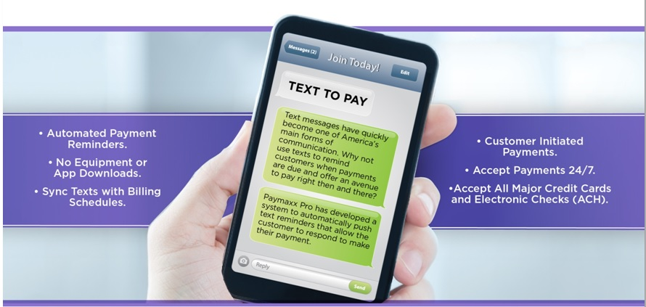
State of the Art Right Now… TEXT TO PAY (COLLECT)
MARKETING SMS

Slide 10
QUESTIONS?
A PAYMENT PROCESSING SOLUTION
Call Jon at 941.584.8311 or email jon@paymaxxpro.com

