Slide 1
Integrated Customs Solution
WCO 2015 Conference
May 07, 2015
Presented by:
Pulak Chakrabarti
President & CEO, CMCI

Slide 2
Challenges for Customs in the 21st Century
Globalization - Increased international trade volumes and complexities
Shifting Patterns
Technological advances and cooperation among economies
Just-in-time delivery and low inventory retention
Multimodal logistics services
Increased complexity of supply chain networks
Increased complexity of risks & threats – illicit trade, illegal passengers, fraud, drug & human trafficking
Admissibility & Revenue
2

Slide 3
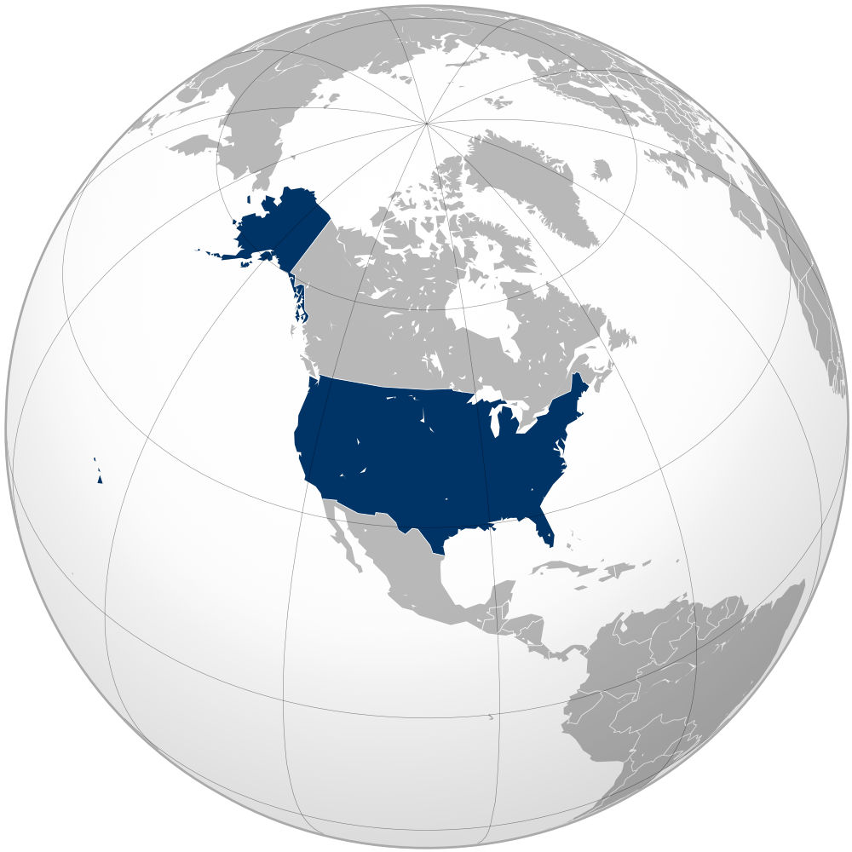
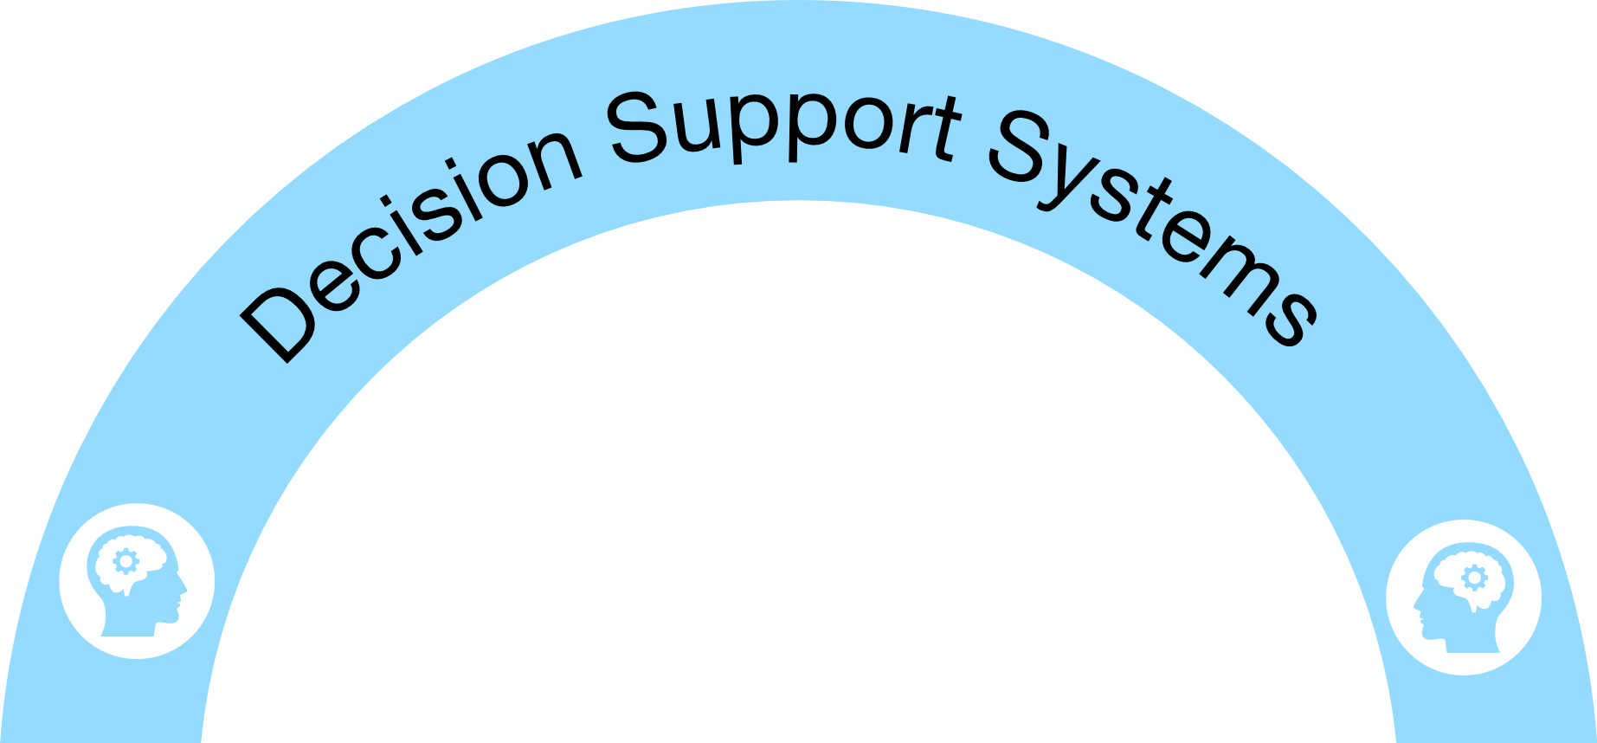
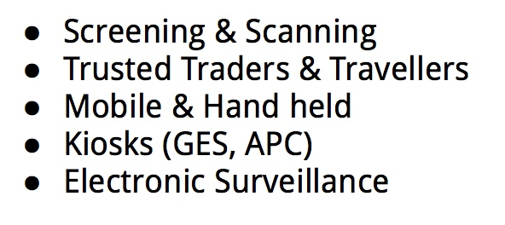
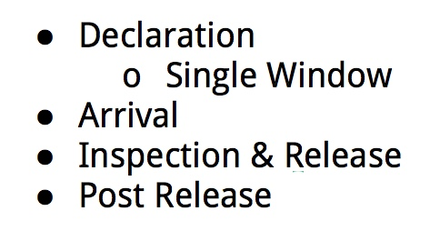
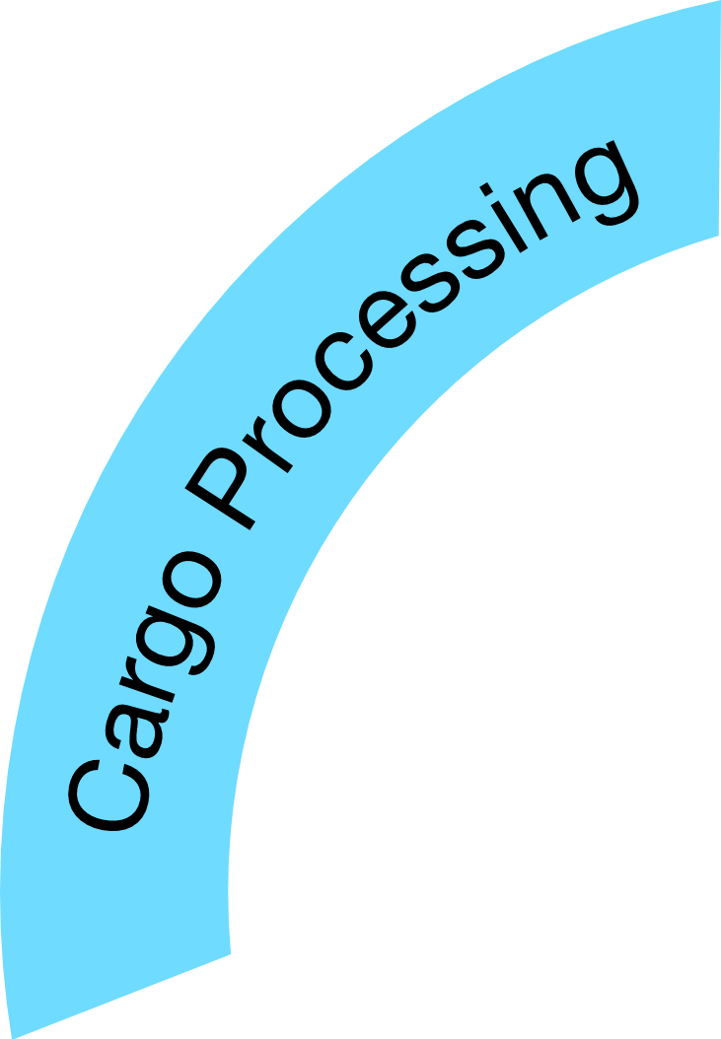
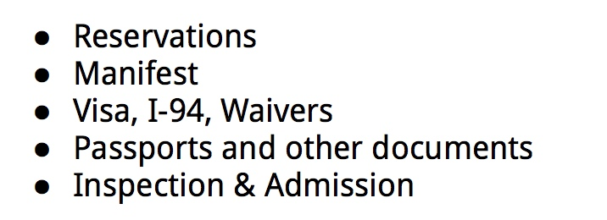
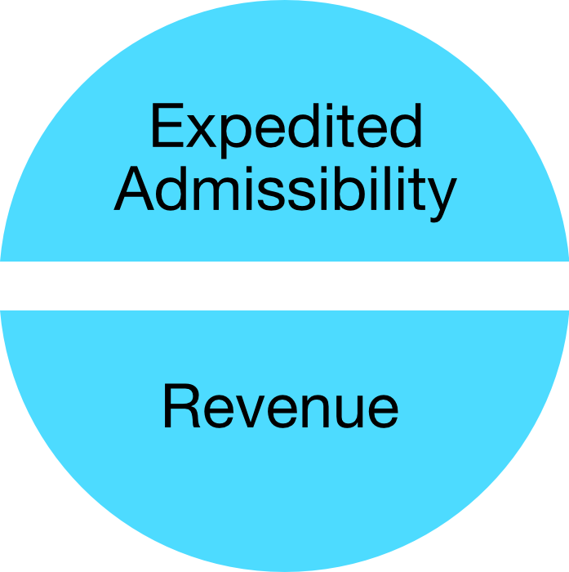
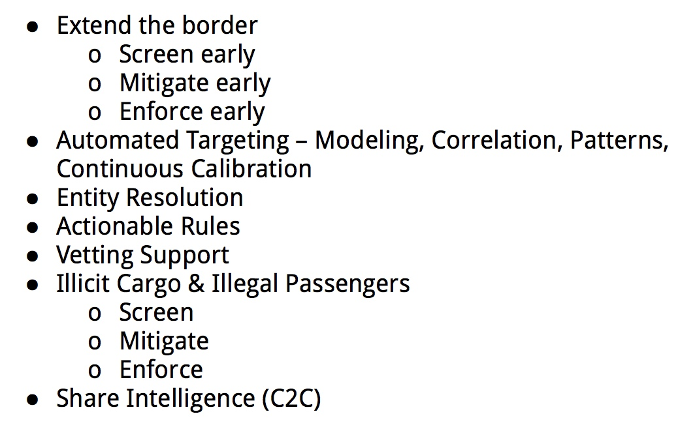
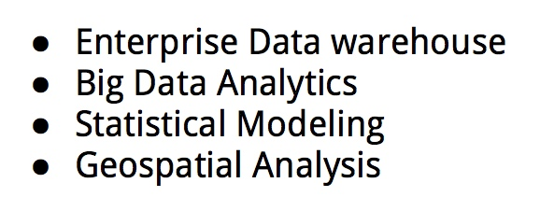
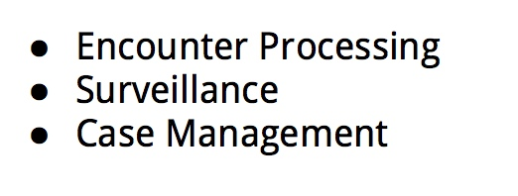
Integrated Customs Solution

Slide 4
Critical Drivers
Customs Capabilities – IT & Resources
Trade Capabilities – IT & Resources
Partnerships & Cooperation
Customs - Business
Business-Business
Customs - Customs
Customs – Other Participating agencies & entities
Simplification & Standardization
Information Sharing & Transparency
4

Slide 5
Capability - Trusted Traders
US-Customs and Trade Partnership Against Terrorism (C-TPAT)
EU-Authorized Economic Operators (AEO)
C-TPAT is a voluntary government-trade initiative
Establish co-operative relationships between Government & Trade
Enhance security through granting recognition to reliable partners
Strengthen & Improve International Supply Chain
Provide highest level of cargo security
Strengthen US Border Security
Enhance trade facilitation
Enhance security through granting recognition to reliable operators
Encourage best practices at all levels in the international supply chain
Strengthen & Improve International Supply Chain
Strengthen EU Territory
5

Slide 6
Mutual Recognition Agreement - US & EU
On May 4, 2012, US and EU signed an agreement on mutual recognition
Each party will accept or recognize results of conformity assessment procedures, produced by the other Party's conformity assessment bodies or authorities, in assessing conformity to the importing Party's requirements
6

Slide 7
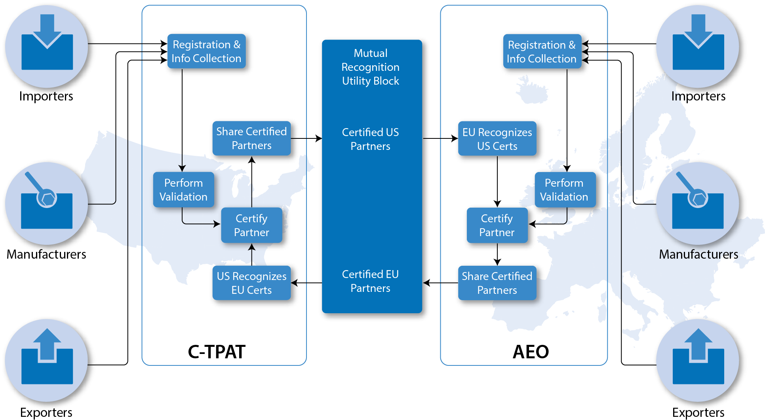
Utility Block – In Action
7

Slide 8
Memoranda of Understanding/Agreements
C-TPAT
AEO
New Zealand – June 2007
Canada – June 2008
Jordan – June 2007
Japan – June 2009
Korean – June 2010
EU – May 2012
Taiwan * – November 2012
Israel - June 2014
Mexico – October 2014
Singapore - December 2014
Switzerland – July 2009
Norway - July 2009
Andorra – January 2011
Japan – May 2011
USA – May 2012
China – May 2014
8

Slide 9
MR Utility Block - Benefits
This capability aligned with the Globally Networked Customs (GNC) Utility Block (UB) concept
Implemented as part of both C-TPAT and AEO initiatives
C-TPAT partners are mutually recognized between the US and EU
AEO partners are mutually recognized between EU and the US
Expedited admissibility
Better supply chain visibility for the governments
Elimination of redundant supply chain security evaluations
Reduced validation burden for the trade partners
Established implementation framework for the future Customs partners negotiating a bilateral agreement
Significant cost savings
9

Slide 10
Implementation Challenges
Establishment of collaborative legal and policy framework needed
Too many MOUs - slower adoption
Longer Implementation
Point to point integration
Data Standardization
ICDs are not harmonized
10

Slide 11
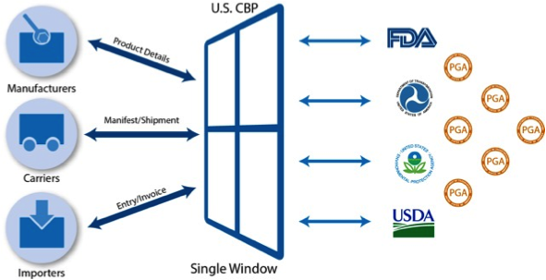
Single Window
Consolidated Information Sharing Capabilities:
Near Real-time information exchange
Improved supply chain visibility
Early determination & resolution of high-risk cargo
Agency Specific Message Set
Interoperability between agencies
11

Slide 12
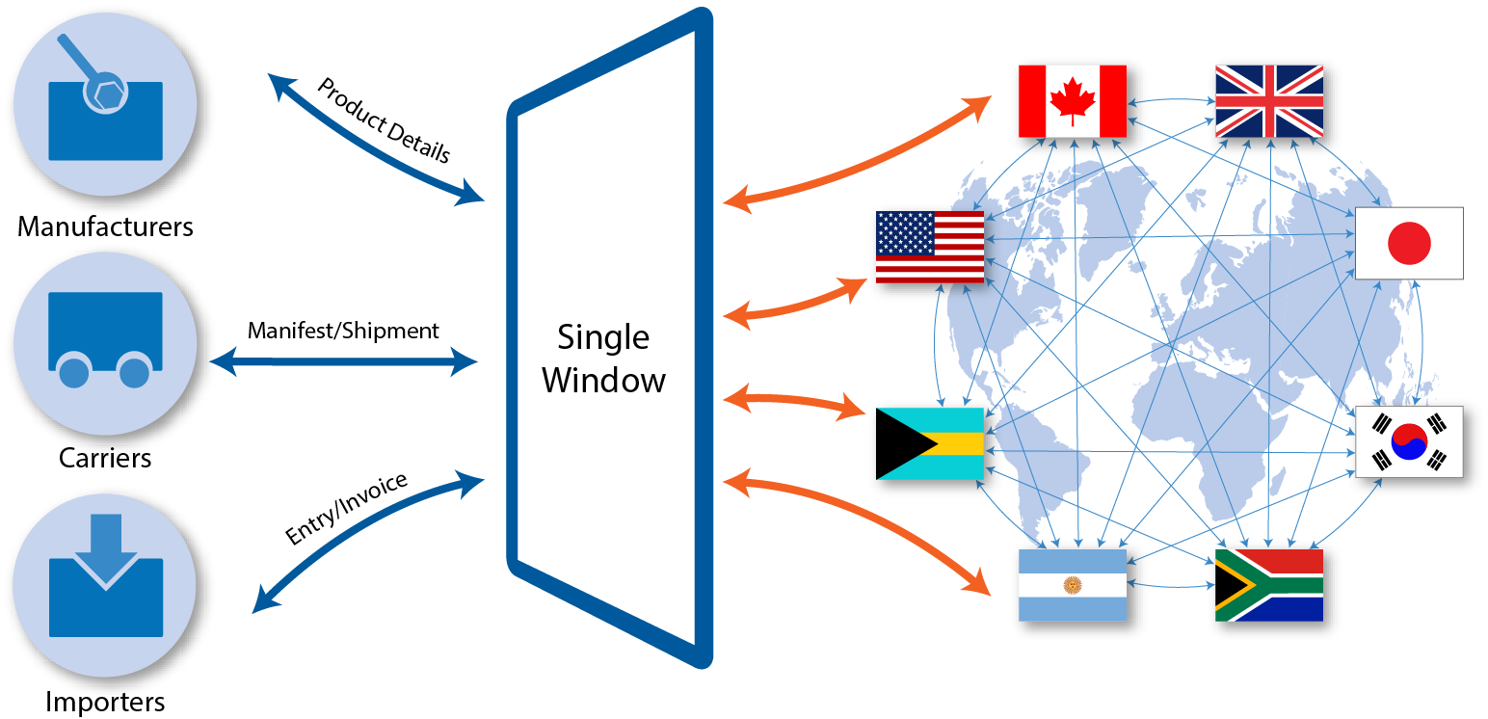
Future Vision of Single Window
12

Slide 13
Future Utility Blocks
Single Window
Promotion & adoption of C-TPAT/AEO
Promotion & adoption of Trusted Travellers
Share Inspection Results – C2C
Intelligence Gateway – C2C
13

Slide 14
Technical Discussions and Q&A
14

Slide 15
15

