Slide 1
Customs 2 Customs Connectivity : an African Success Story
Anton Eccles
Solutions Architect
eTradex (Pty) Ltd
anton.eccles@etradex.co.za
May 2015

Slide 2
Definition of C2C Data Exchange
The process of reciprocal, routine and real-time exchange of data in respect of goods traded between South Africa and Swaziland

Slide 3
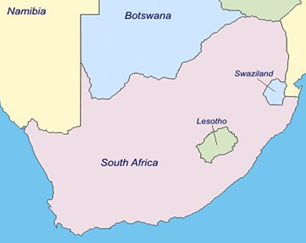
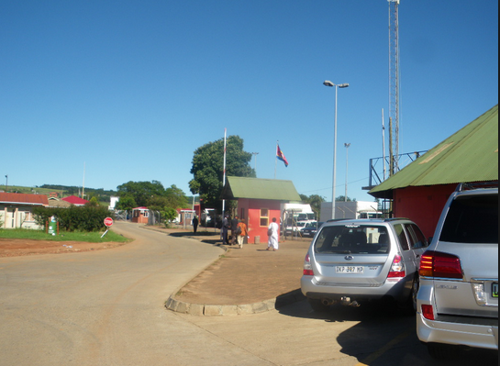
C2C Connectivity Background Swaziland Context
Part of South African Customs Union (SACU)
Significant Majority of Imports and Exports from South Africa
Swaziland is landlocked country
Most Trade by Road

Slide 4
C2C Connectivity Background
The World Bank Time Release Study (TRS) identified the need for data to be exchanged between SARS and SRA due to large trading volumes
Aim of data exchange is to eliminate the dual capturing of customs declarations in RSA and SZ leading to greater trade facilitation and increased levels of compliance and risk management
Data exchange will also facilitate one-stop processing which can be a stepping stone to a One Stop Border Post

Slide 5
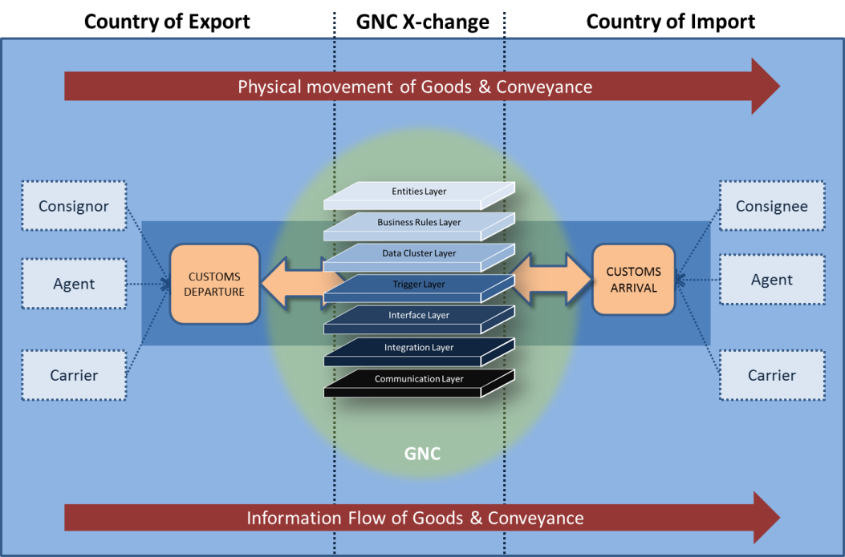
Overview of WCO GNC

Slide 6
OVERVIEW OF THE WCO GNC SRA & SARS
Entities Layer
Bilateral exchange of data
SRA and SARS both Submitter and Receiver of Data
Business Rules Layer
Daily exchange of data (Current)
All Assessed Export and Transit Declarations
Data Cluster Layer
Implementation of Export and Transit Messages
Trigger Layer
Data Exchanged pre-arrival on assessment of Export and Transit Declarations
Interface / Integration and Communication Layer
Integration with ASYCUDA via Customs Connect
The GOVCBR EDIFACT message is used
AS2 communication protocol for secure communication

Slide 7
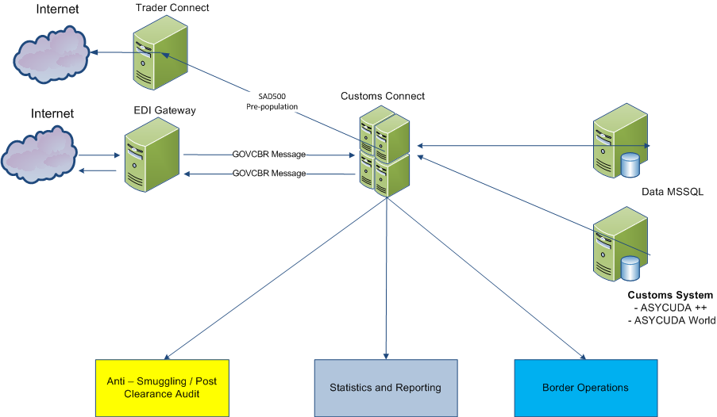
Solution Architecture & Information distribution

Slide 8
PROJECT JOURNEY Phase 1 – Technical Stage
PHASE I – Completed in July 2014
Data Mapping between Customs Authorities
GOVCBR Message Agreement
Development of Data Interchange Model and Mechanism
Development of “Customs Connect”
Searchable Information on individual consignments including exporter, importer, description of goods, value, classification, origin
View as SAD500
Trade Statistics by HS Code

Slide 9
PROJECT JOURNEY Phase 1 – Technical Stage
Development of “Trader Connect”
Enables pre-population of the SRA import customs declaration in a SAD500 format based on the SARS information
Traders only have to verify and nationalise, where required, the SAD500 information to submit the prepopulated information electronically to the SRA Customs Solution – ASYCUDA
Increased speed of transit
Lower Cost Structures

Slide 10
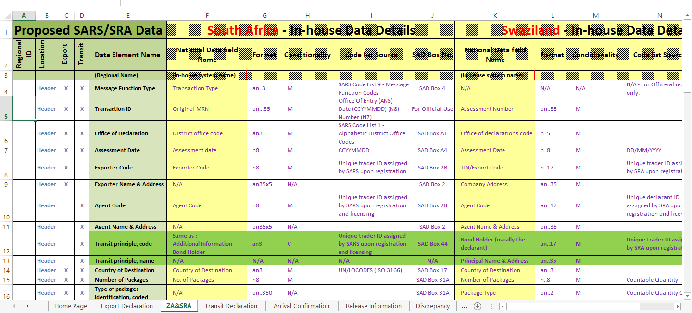
PROJECT JOURNEY Phase 1 – Data Mapping Agreement

Slide 11
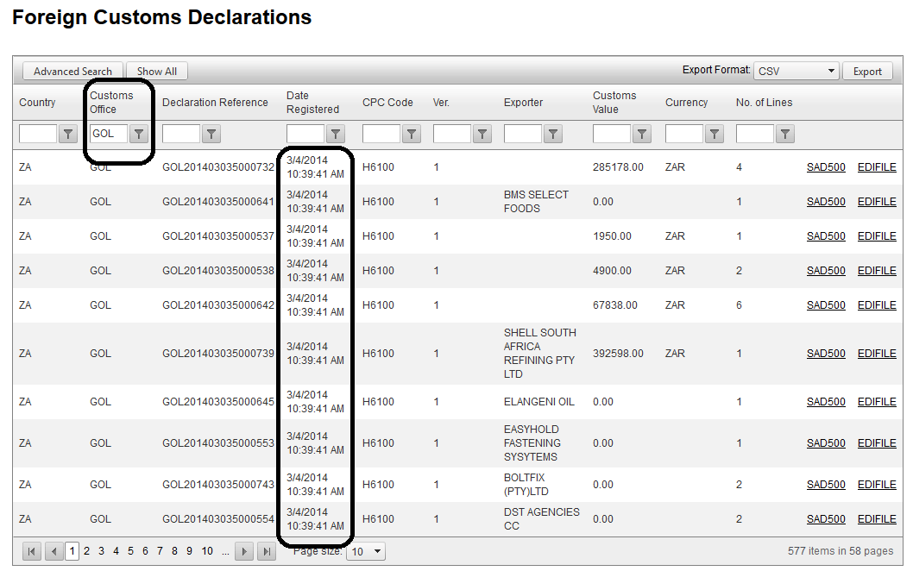
PROJECT JOURNEY Phase 1 – “Customs Connect” Searchable Consignment Data

Slide 12
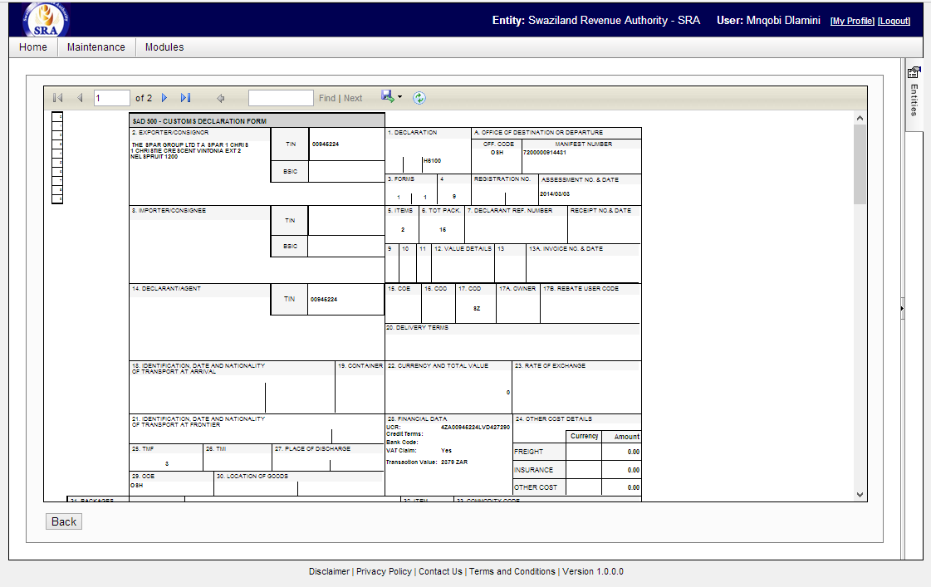
PROJECT JOURNEY Phase 1 – “Customs Connect” SAD500 View

Slide 13
PROJECT JOURNEY Phase 2 – Declaration Matching (February 2015)
Going beyond Data Exchange and Extracting Real Value for Customs Officers and Customs Authority
Automated Matching of SARS Export Declaration to SRA Import Declaration
WCO UCR not yet implemented, but utilise
Multiple Data elements for the automation of the matching of declarations
Automated Risk Analysis and Profiling
Reference Pricing Engine based on SARS Data
Discrepancies between Export and Import Declarations
Information Visibility and training and deployment at all Border Posts
Workflow to flag declarations for further actions by Customs Officers at Border Posts

Slide 14
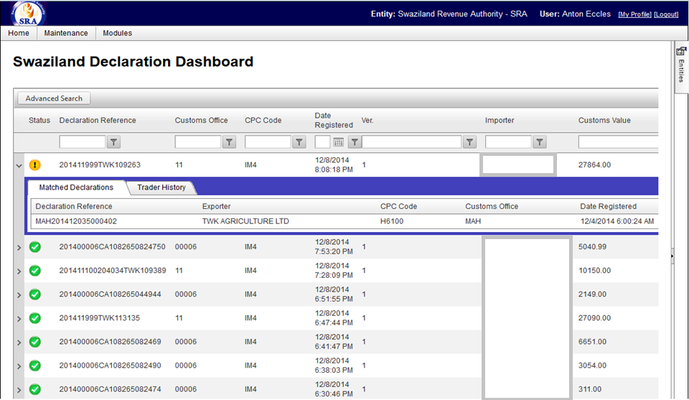
PROJECT JOURNEY Phase 2 – “Customs Connect” Automated Matching

Slide 15
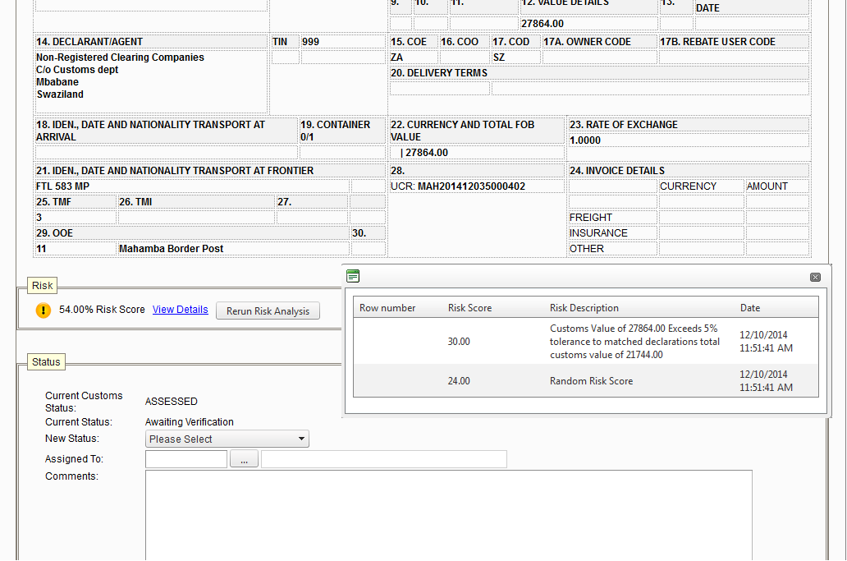
PROJECT JOURNEY Phase 2 – “Customs Connect” Risk Profiling

Slide 16
C2C and Trade Facilitation
WCO GNC and C2C connectivity does not enhance trade facilitation in itself. The use of the data is key:
Pre-population of Import Declaration
Advanced Risk Analysis
Acquittal of Customs Declarations and Border Control.
Post Clearance Auditing
Statistical Reporting
Achievements to Date
Achievements to Date

Slide 17
Customs Connect Solution
Customs to Customs Connectivity
WCO Data Model Version 3
GOVCBR Message
Integrated with ASYCUDA ++ and World
Automated Customs Declaration Matching and Acquittal
Risk Profiling
Trader Connect – Prepopulate Customs Declaration:
ASYCUDA ++
ASYCUDA World
Statistical Reporting

Slide 18
SRA Learnings
Current lack of legal framework – impedes the use of data for enforcement purposes
Internal Policies have to be developed on how the data can be safeguarded, used or distributed
Timeous transmission of data is key
Implementation of a true UCR number will improve matching and automated customs declaration acquittal

Slide 19
Thank You
PLEASE VISIT US AT BOOTH 10 FOR MORE INFORMATION
Anton Eccles
Solutions Architect
eTradex (Pty) Ltd
anton.eccles@etradex.co.za

