Slide 1
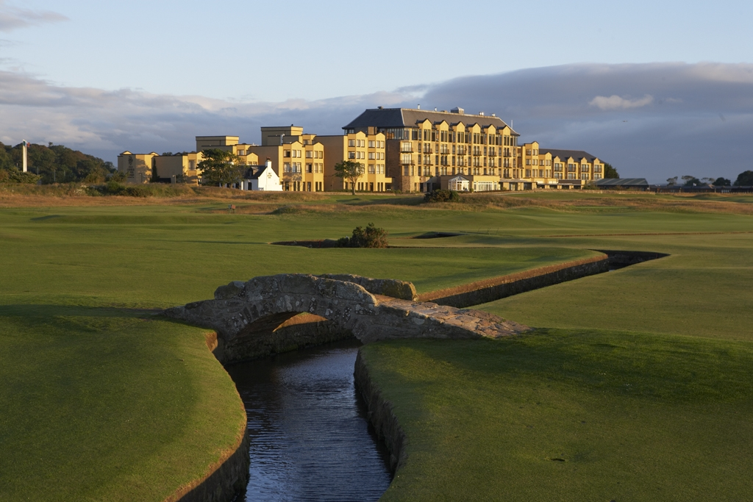
The Old Course Hotel, Golf Resort & Spa

Slide 2

AGENDA
Resort Overview
Project News 2017
Routes to Work – Engaging with Young People
Our People Culture

Slide 3
RESORT OVERVIEW
OLD COURSE HOTEL, GOLF RESOT & SPA

Slide 4

Kitchen & Bath
(Plumbing)
Global Power
(Engines)
Interiors
(Furniture)
Hospitality & Real Estate
(Leisure)

Slide 5

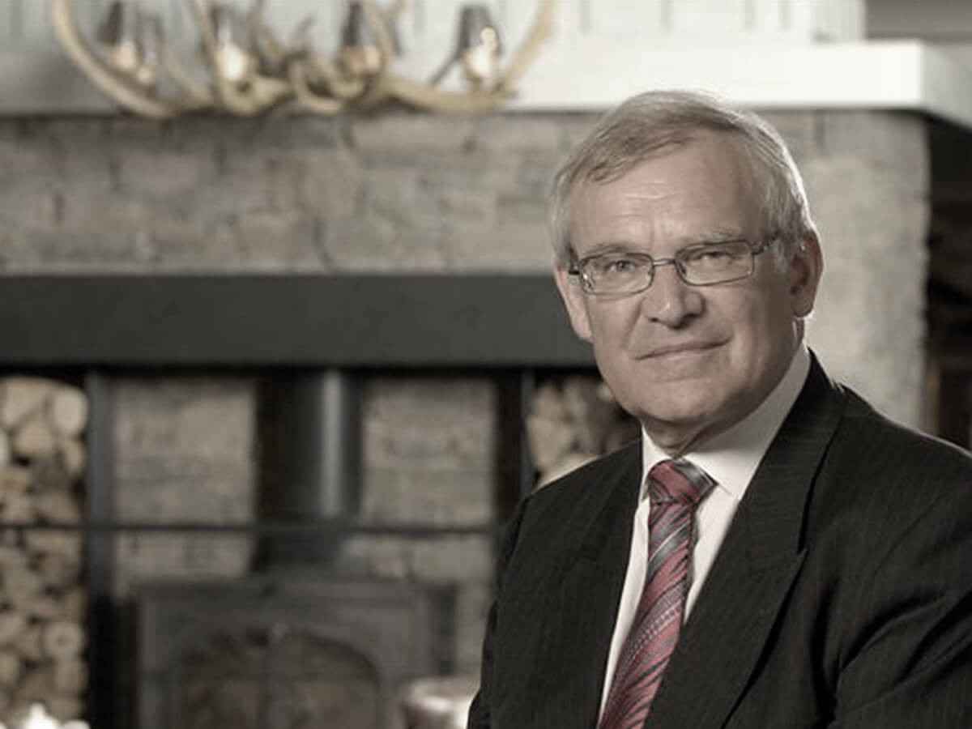
Stephen Carter, OBE
General Manager, The Old Course Hotel, Golf Resort & Spa

Slide 6

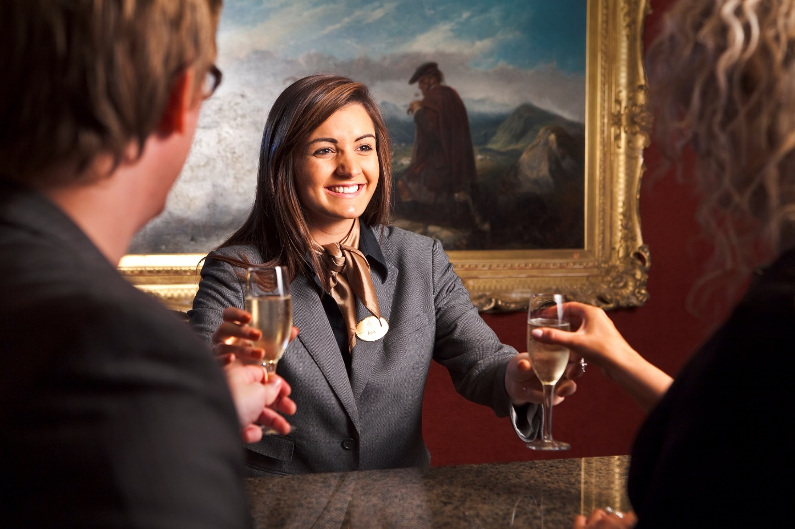



Slide 7
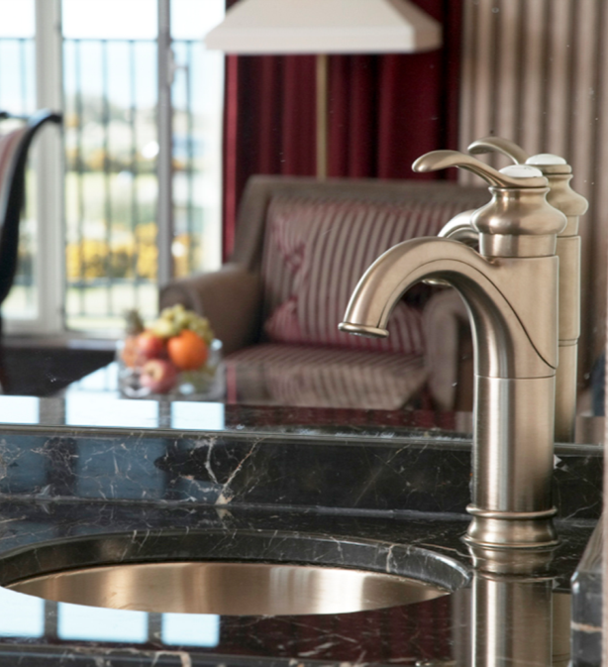
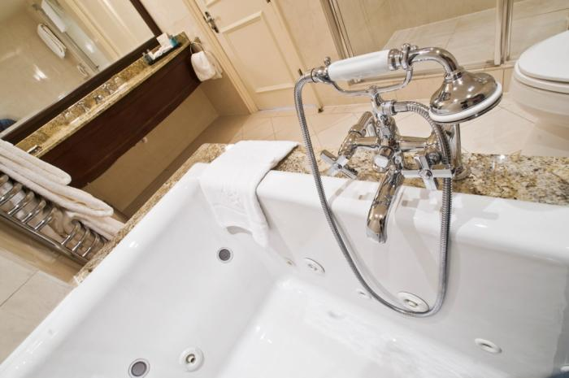

Bathrooms at the Old Course Hotel, featuring Kohler Bathrooms

Slide 8
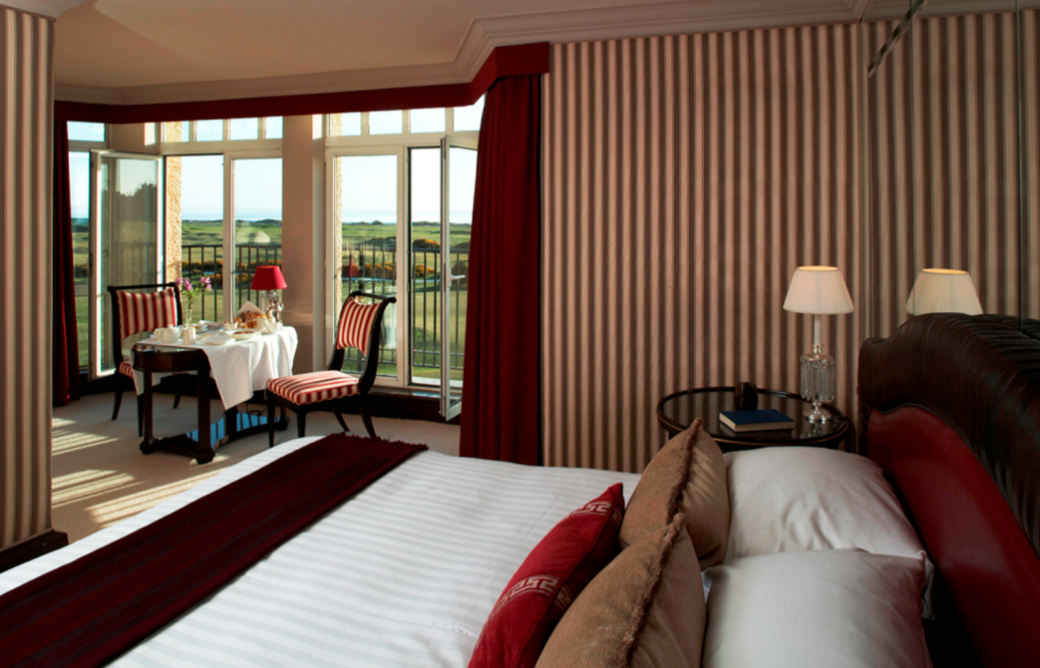
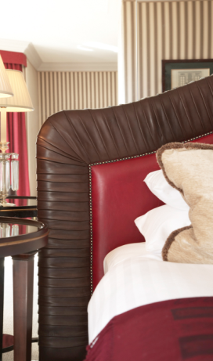
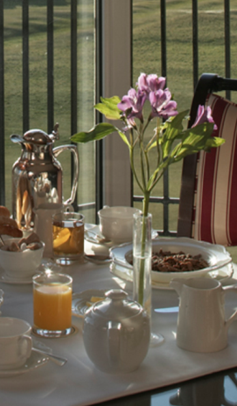
Old Course Hotel Suite Bedroom, designed by Jacques Garcia

Slide 9
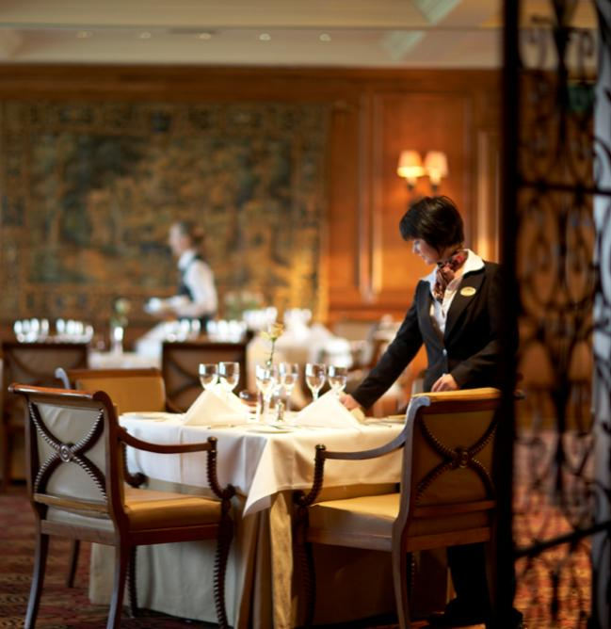
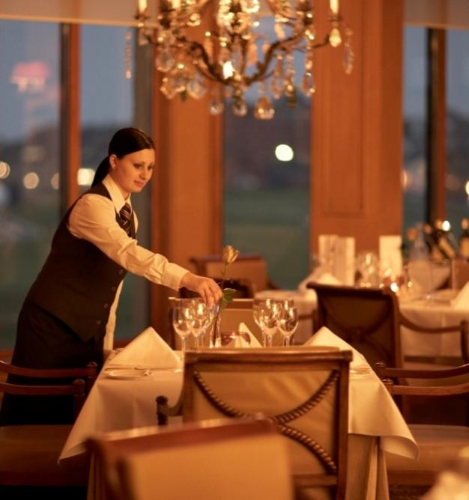
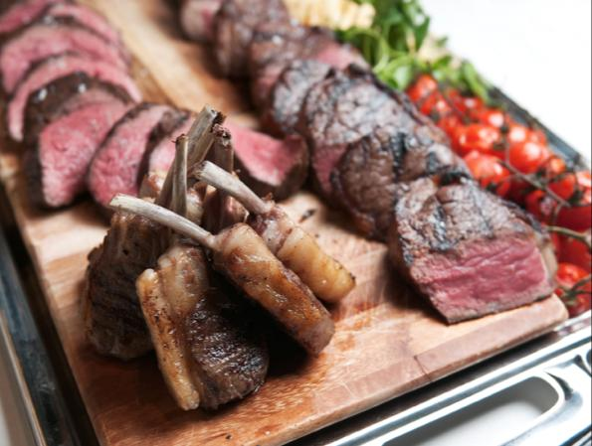

The Road Hole Restaurant - Fourth Floor, Old Course Hotel

Slide 10
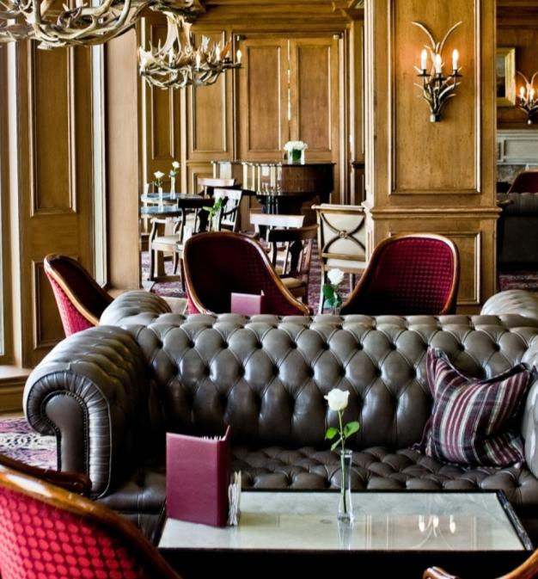


The Road Hole Bar - Fourth Floor, Old Course Hotel

Slide 11

Sands Grill at the Old Course Hotel

Slide 12
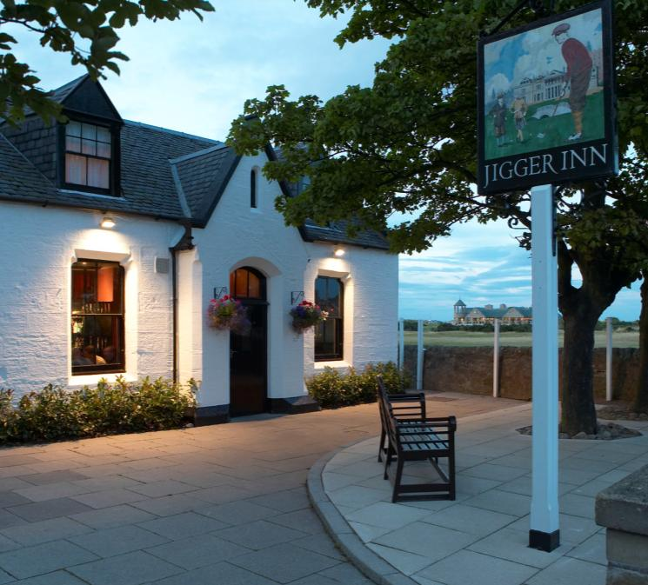
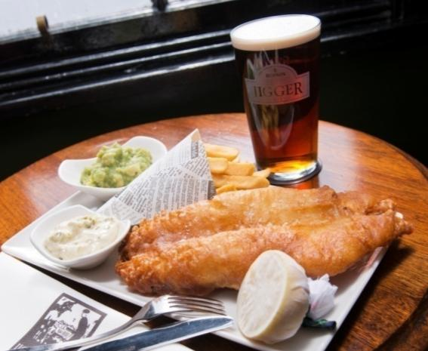
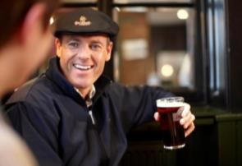
The Jigger Inn – golf’s most famous 19th hole.

Slide 13
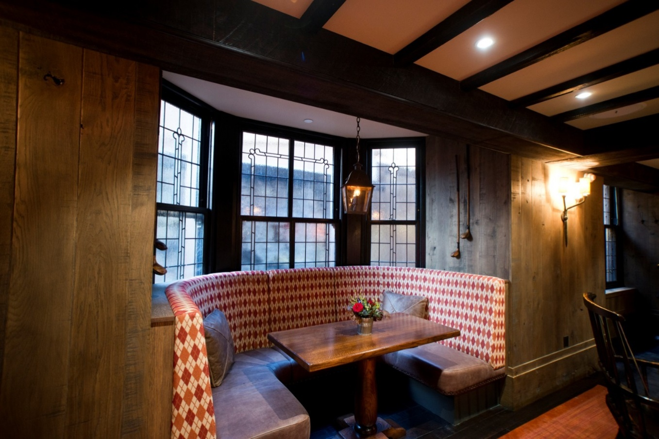

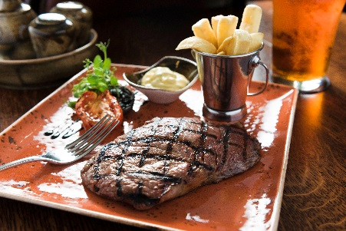
Hams Hame Pub & Grill

Slide 14
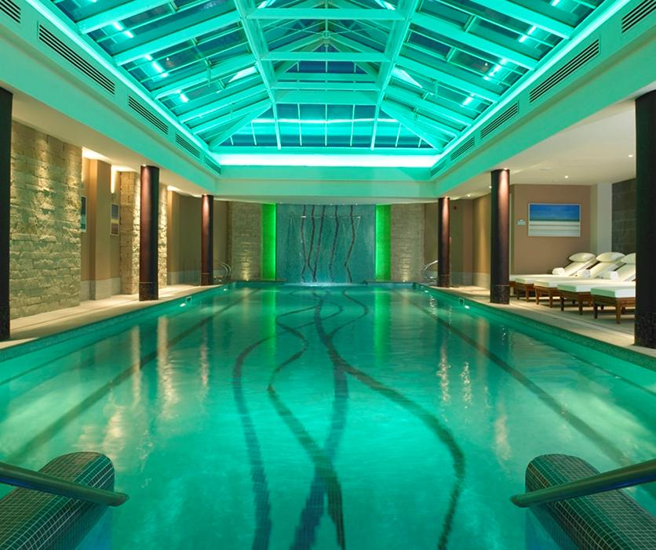
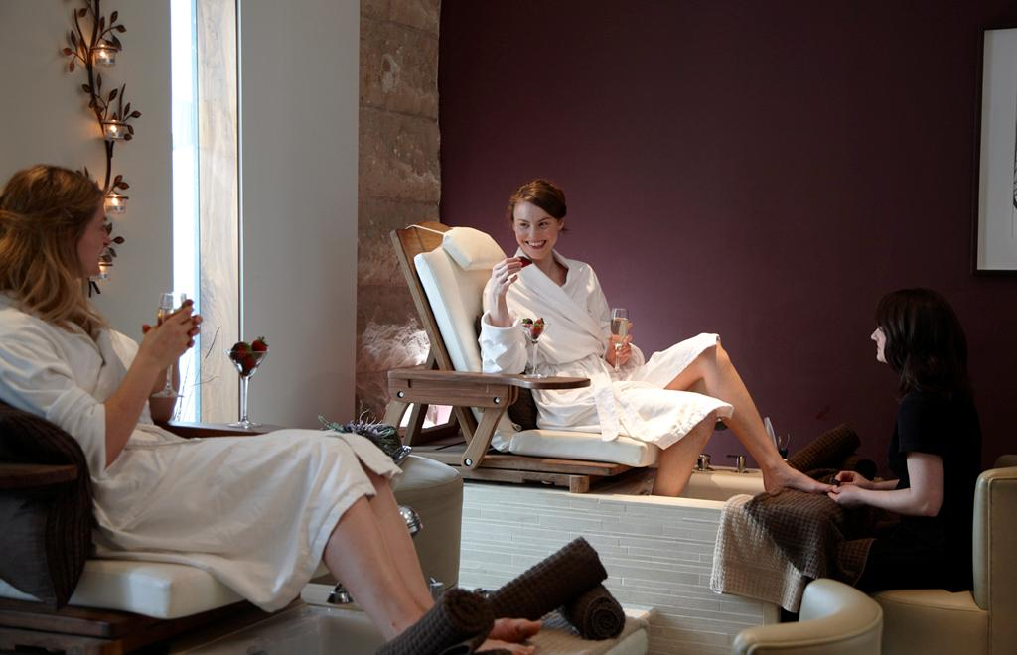
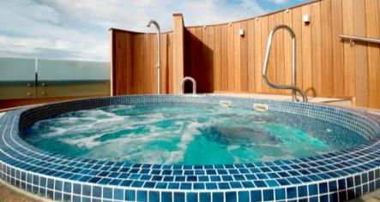

Swimming pool, rooftop hot tub and thermal suite at Kohler Waters Spa

Slide 15
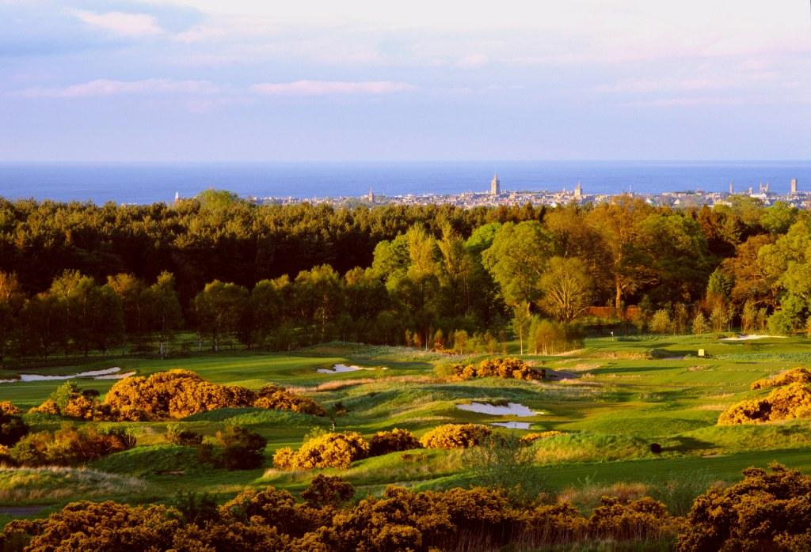
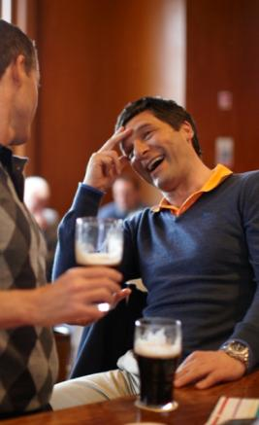

The Duke’s Golf Course – Scotland’s finest heathland course

Slide 16
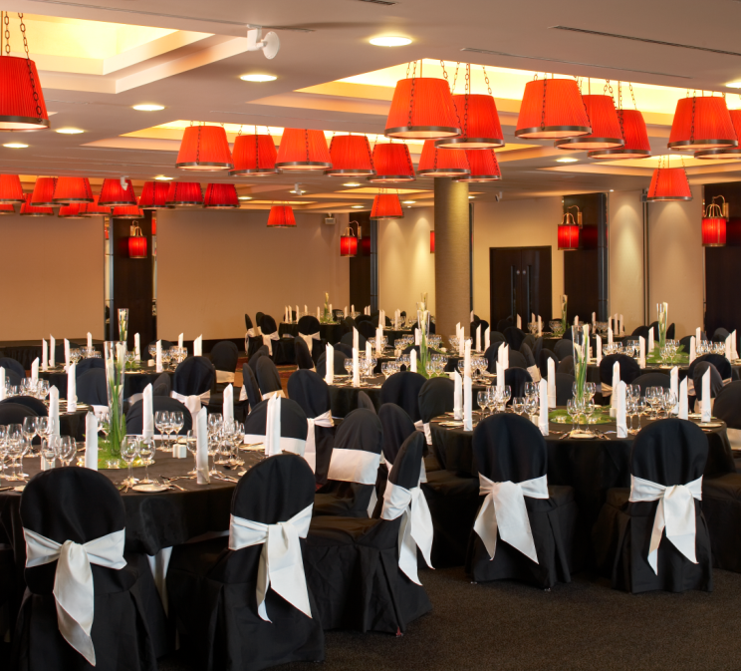
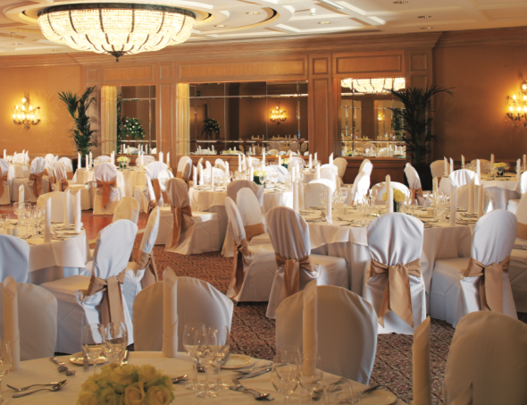
The Hall of Champions and Ballroom at the Old Course Hotel

Slide 17
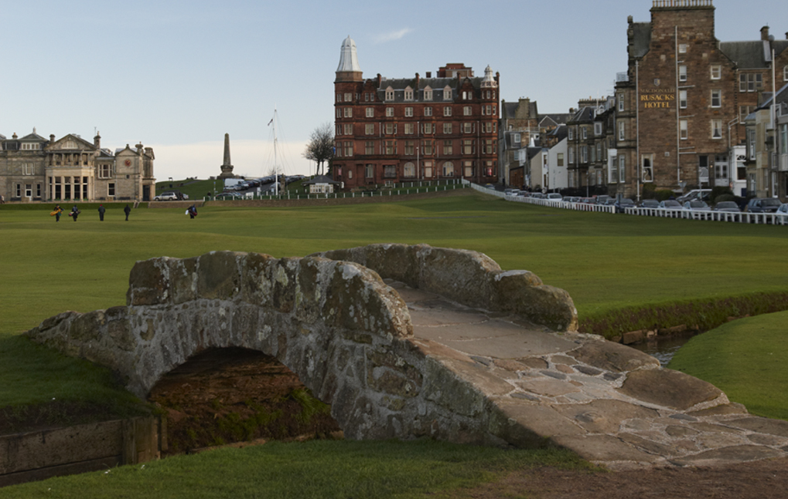
26 Luxury Apartments
Residents Lounge
Rooftop terrace
Resort Overview
Current Projects
Our People
Career Paths
Private function suite
Butler service
Golf & Spa membership
Hamilton Grand

Slide 18
PROJECT NEWS 2017
OUR PRODUCT AND OUR PEOPLE

Slide 19
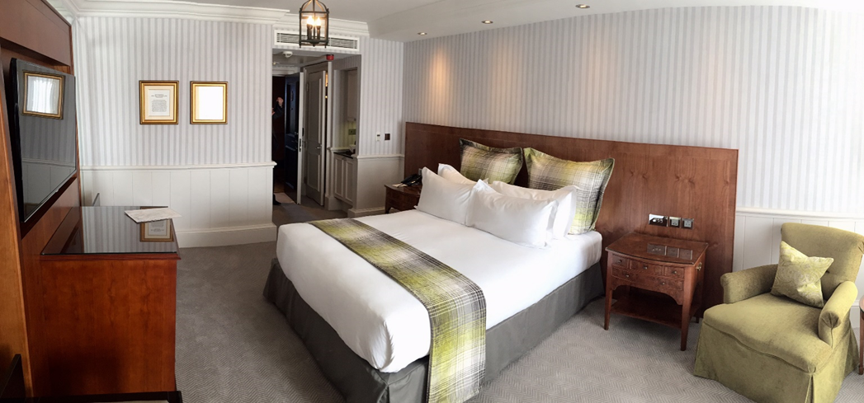
Winter Works (3 January – 13 April 2017)
The Hotel’s refurbishment included roof and window maintenance and a soft refurbishment of over 100 of the 144 guest rooms.
Five Red-Star touches such as USB charging points, ergonomic electrical outlets, luggage store and closet lighting were also incorporated.
Notes:
The rooms have been refurbished to offer guests a contemporary feel with a nod to Scottish traditions with a light, airy colour palette to encourage guests to feel relaxed and rejuvenated during their stay.

Slide 20
Winter Works - Our People Plan
Training & Development - 53 different training sessions and 800 individual training nominations
Highlights:
• 19 newly qualified Coaches
• 25 Departmental Trainers completed industry accredited 3 Day Train the Trainer
• Leadership Development Programme
• Work Experience in Kohler (Destination Kohler)
• Development of New Masterclass curriculum (15 Masterclasses in total)
• Cross Training
• Stewardship and fundraising
Notes:
Written and led by internal experts – E.g. Social Media, Financial Awareness, Food & Wine Pairing, Show Round Training, Recruitment Skills

Slide 21
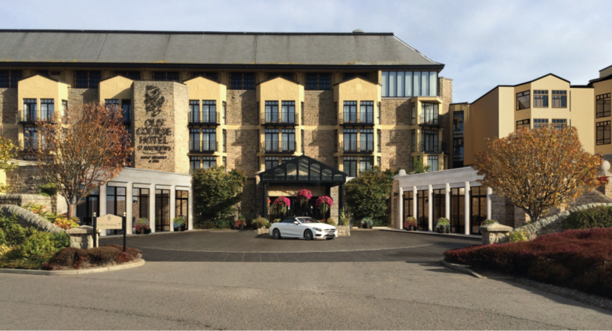
What’s next?
Kohler Water Spa & Leisure Expansion

Slide 22
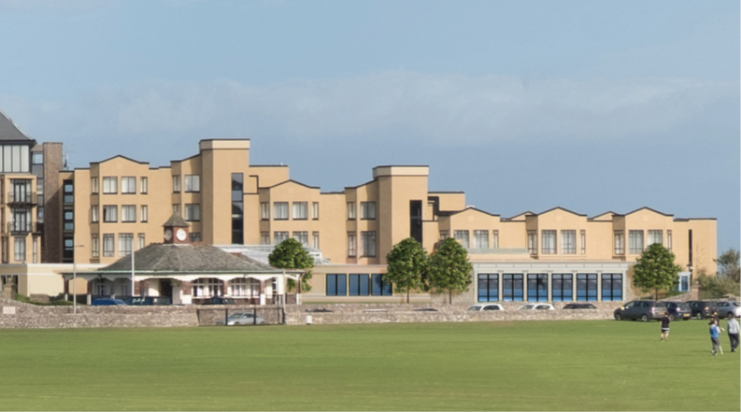
What’s next?
Kohler Water Spa & Leisure Expansion

Slide 23
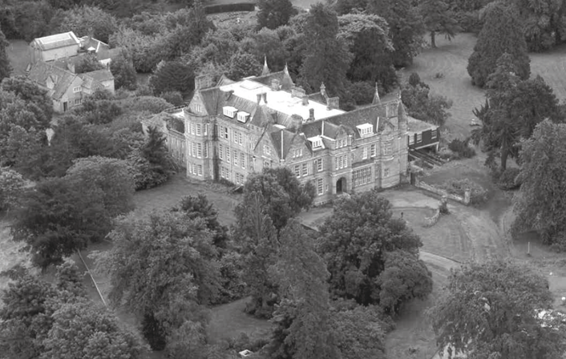
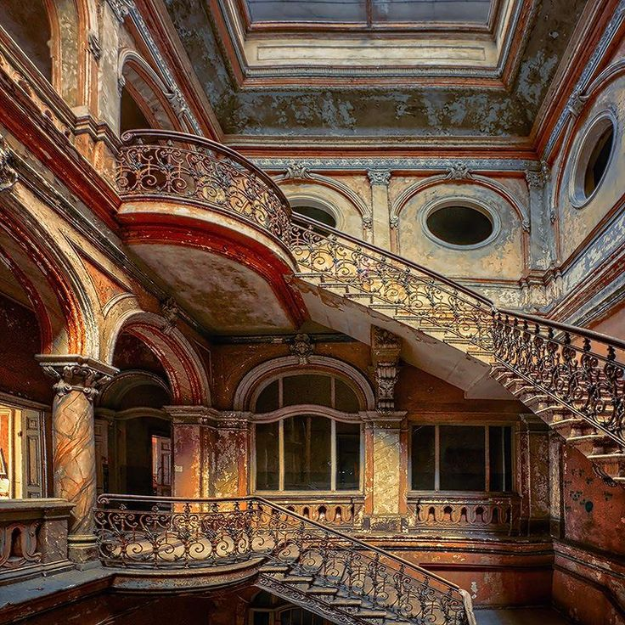
What’s next?
Craigtoun House – The Duke’s Estate

Slide 24
ROUTES TO WORK
ENGAGING WITH YOUNG PEOPLE
(HOW ARE WE DOING?)

Slide 25
Routes to Work
College Internships & Work Placements
SAH Scottish Apprenticeships in Hospitality
Career Ready Interns & Masterclasses
Casual & Seasonal Vacancies
College Careers Fairs
Visits from Schools & Colleges
College Job Boards
Recruitment Events
Assessment Centres
What other opportunities exist?
169 out of 421 employees are under 25 years of age
Notes:
Dundee College
Abertay
Dundee University
Elmwood
St Andrews University

Slide 26
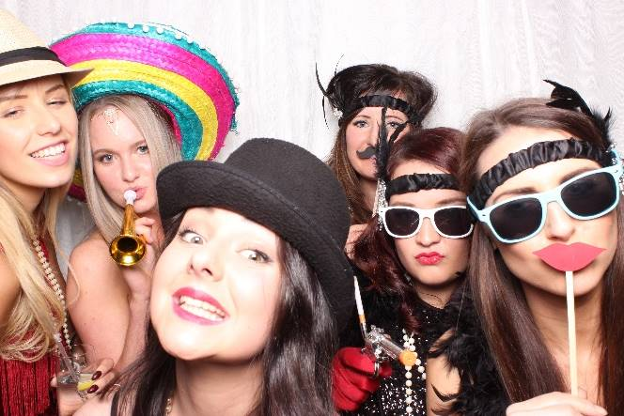
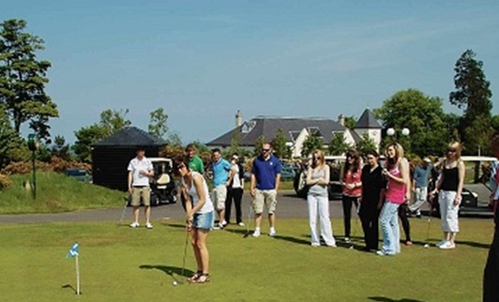
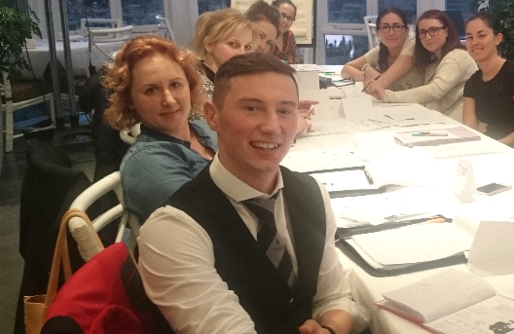
Engaging with Young People
Living Wage Employer
Investment in E-learning & Communications
Continuous Training Curriculum
Personal Development Planning
Internal Promotion Policy
Engagement Events

Slide 27
Engaging with Young People
“If a child can't learn the way we teach, maybe we should teach the way they learn.” (Ignacio Estrada)
What works?
What doesn’t?

Slide 28
5 Mistakes to Avoid
1. Offering limited content
2. Not explaining how the training is relevant
3. Failure to coach
4. Leaving out a digital component
5. Providing little feedback
(Forbes.com, 2016)
Notes:
1. Offering limited content
Millennials tend to want training in self-management and productivity as well as leadership training. “There’s an assumption that millennials are only interested in technical training, but often leadership traits can be a mystery to them,” says DePalma.
2. Not explaining how the training is relevant
Explaining how the training program is applicable to long-term career growth as well as how it will benefit them as new employees allows millennials to build a stronger commitment to the company from the start. “Businesses today can’t just look at reaction to training and it can’t just be about learning,” says DePalma. “It needs to have an application.”
3. Failure to coach
Millennials perform well within a structured chain of command, so setting up a coaching relationship can help them evaluate their successes and failures along the way. “For millennials there is a certain extent of desire to be the best and anything that falls short of that is a huge failure,” says DePalma. Coaching and mentorship can help trainees learn that progress can’t come immediately and they won’t sit in a corner office on their second day of work.
4. Leaving out a digital component
“This generation is interested in connecting and communicating everything they’re doing on Facebook and online, so it’s important that training programs can relate to that.” Because millennials are digital savvy, training programs should be sure to feature integrated technology for instruction.
5. Providing little feedback
Millennials want to know if they're doing a good job. “They want to know what the roadmap is and get feedback,” says DePalma. “Research shows that millennials want more feedback than other generations.”

Slide 29
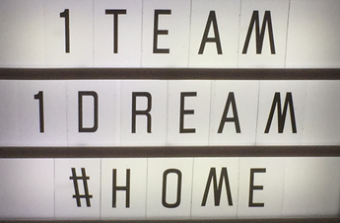
Opportunities
Food & Beverage Service & Culinary
Green Keeping
Reservations & Events
Front Office
Housekeeping
Kohler Water Spa & Fitness

Slide 30
OUR
PEOPLE CULTURE
HOME OF GREAT SERVICE

Slide 31

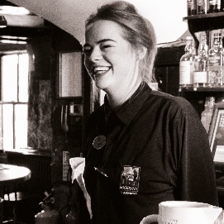
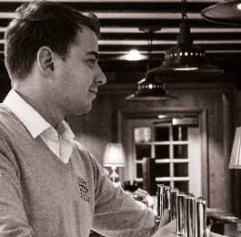
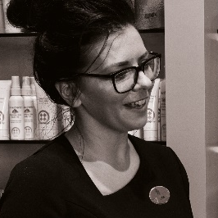

The Old Course will always be…
The HOME of golf.
Notes:
29% employed in the hospitality sector
666,000 visitors per year
1000,000 bed night a year
86% are leisure visitors
20% of visitors state that golf is their primary reason for visiting that 133,200 people a year
Average spend per visitor on green fees is £234 that’s almost half their spend per trip

Slide 32
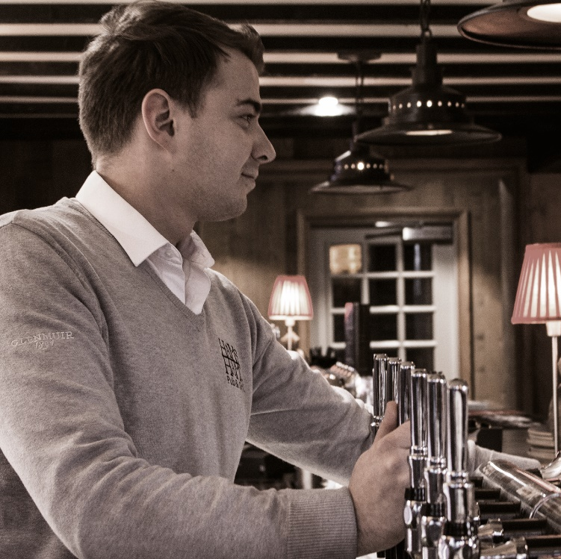
Let’s look at St Andrews….
Almost 700,000 visitors each year
1 Million bed nights are available per year
86% of people coming here are leisure visitors
40% of visitors stay in serviced accommodation e.g. hotels and B&B
Tourists spend £89m in the town each year
89% of customers stop using a brand because of one negative experience

Slide 33
With competition so strong we need to be known as the HOME of great service in
St Andrews.

Slide 34
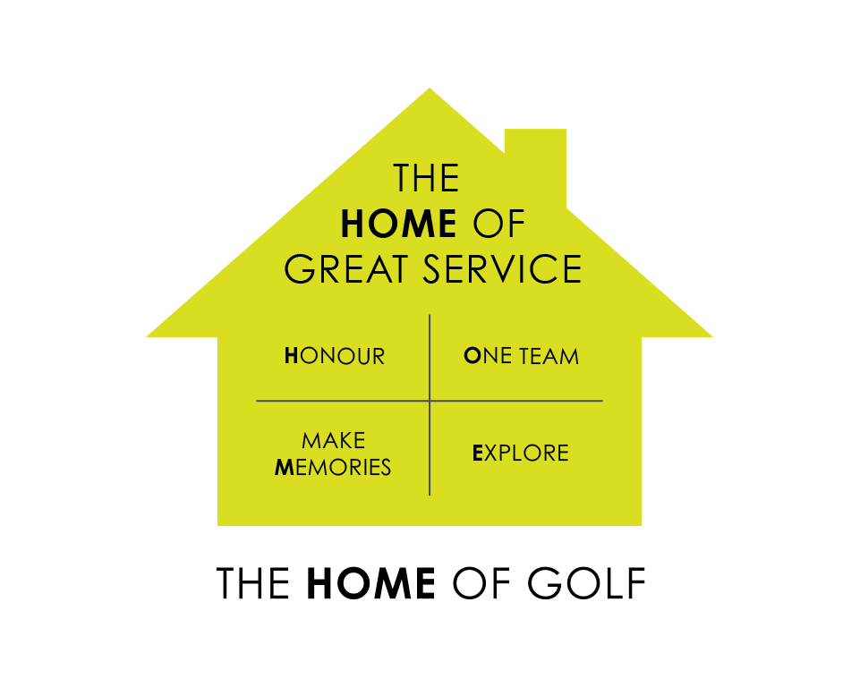
Our People Brand

Slide 35
Video

Slide 36
The Old Course Hotel, Golf Resort & Spa

