Slide 1
Optimizing Metadata for Global Impact
Digital Book World | January 15, 2014
© 2014, the Book Industry Study Group, Inc.

Slide 2
BISG’s mission is to facilitate innovation and shared solutions for the benefit of all companies and practitioners that create, produce, and distribute published content, and the organizations that support them..
© 2014, the Book Industry Study Group, Inc.

Slide 3
BISG’s mission is to facilitate innovation and shared solutions for the benefit of all companies and practitioners that create, produce, and distribute published content, and the organizations that support them..
© 2014, the Book Industry Study Group, Inc.

Slide 4
Horizontal
AAP | AAUP | ABA | ALA
Hachette | Cambridge UP | Tattered Cover | Public librarians
HaperCollins | Oxford UP | Powell’s | Academic librarians
S&S | Univ of Chicago | Vroman’s | School librarians
Grove | Univ of Nebraska | Changing Hands | Institutional librarians
Most trade groups represent verticals.
BISG represents the entire horizontal
industry
BISG
© 2014, the Book Industry Study Group, Inc.

Slide 5
True Neutrality
© 2014, the Book Industry Study Group, Inc.

Slide 6
Standards and Best Practices
Education and Events
Research
© 2014, the Book Industry Study Group, Inc.

Slide 7
Standards and Best Practices
Education and Events
Research
© 2014, the Book Industry Study Group, Inc.

Slide 8
What Is a Standard?
Any norm, convention, or requirement
© 2014, the Book Industry Study Group, Inc.
Notes:
A standard is any norm, convention, or requirement. More specifically, it’s a norm, convention, or requirement agreed to by a series of stakeholders to remove friction from a system.
This image does more to explain the importance of standards to our society than perhaps any other. Think about all of the standards involved in making the use of an ATM seamless: the size of the credit card, the location of the magnet stripe and the information it contains, the organization of a numbered keypad, the 110 volts of electricity used to operate the machine (in the U.S.), and on and on and on. Without standards, your debit card may work in only YOUR BANK’S machines. But because we all want a ubiquitous and easy experience, industry stakeholders agree to comport with standards. This is true in our industry, too.

Slide 9
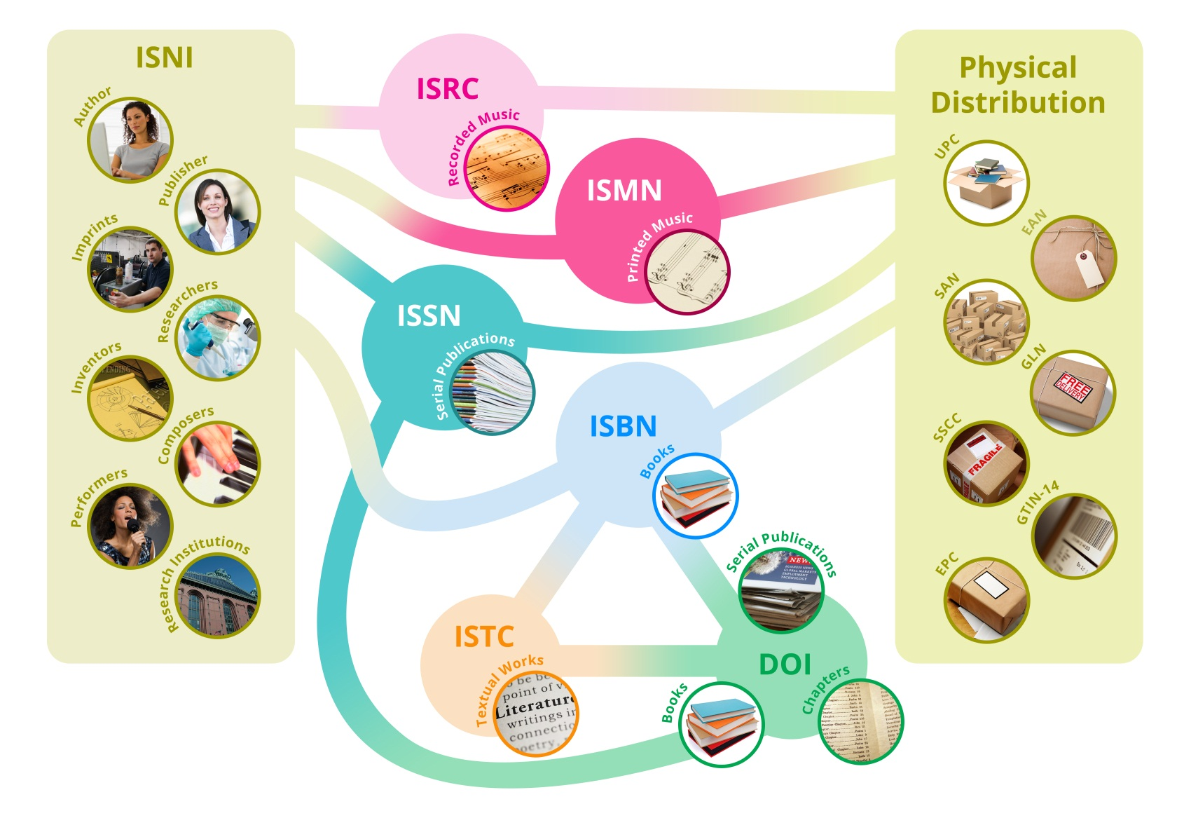
Book Industry Standards – Identifiers
© 2014, the Book Industry Study Group, Inc.
Notes:
Today we will discuss identifiers, which are best exemplified by the ISBN. Though as you can see, ISBN has many, many cousins, each with a specific purpose.

Slide 10
Book Industry Standards –
Machine Readable Codes
© 2014, the Book Industry Study Group, Inc.
Notes:
BISG has a long history of providing guidance to the industry on how and where to place bar codes on books and labels on containers.

Slide 11
Book Industry Standards – Taxonomies
Comics and Graphic Novels: Horror
CGN004040
BISAC
FX
BIC
XQH
Thema
© 2014, the Book Industry Study Group, Inc.
Notes:
Who can tell me what these codes have in common? <CLICK>
They are all subject codes representing horror graphic novels. We will discuss today how Thema helps on a global stage.

Slide 12
Book Industry Standards – Metadata
© 2014, the Book Industry Study Group, Inc.
Notes:
Everything we discuss is contained in metadata, specifically ONIX. We will dive deep into metadata and the effect it has on our publishing ecosystem stakeholders.

Slide 13
Book Industry Standards – Digital Content
© 2014, the Book Industry Study Group, Inc.
Notes:
While EPUB is an important international book industry standard, it is handled in other sessions at this conference. It may come up, but it won’t be our focus today.

Slide 14
Globalization
© 2014, the Book Industry Study Group, Inc.
Notes:
And, of course, we’ll discuss how all of these standards impact global commerce.

Slide 15
Meet the Panel
Laura Dawson
Cameron Drew
Noah Genner
Phil Madans
Product Manager for Identifiers
Bowker
Director, Global Content Acquisition
Kobo
President & CEO
BookNet Canada
Director, Publishing Standards & Practices,
Hachette
© 2014, the Book Industry Study Group, Inc.

