Slide 1
Biosimilars are effective and safe and should immediately replace innovator molecules in the NHS
Dr Chris Deighton
Consultant Rheumatologist

Slide 2
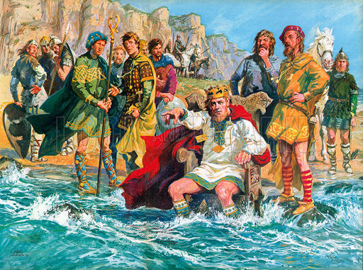

Slide 3
Conflicts of interest
Advisory boards for Hospira and Napp
Work with Pfizer, Janssen, Abbvie, Roche

Slide 4
Arguments for
We have been using biosimilars for years
Biosimilars have to go through rigorous testing
The evidence for switching is reassuring
Biosimilars will bring prices down
Biosimilars will increase access to biologics
The multinationals will be producing biosimilars

Slide 5
Arguments for
We have been using biosimilars for years
Biosimilars have to go through rigorous testing
The evidence for switching is reassuring
Biosimilars will bring prices down
Biosimilars will increase access to biologics
The multinationals will be producing biosimilars

Slide 6
We have been using biosimilars for years
Changes to biologics manufacturing during and post-approval are routine
Remicade – 43
Humira – 23
Enbrel – 22
Originator products are similar but not identical to themselves
(www.ema.eu)

Slide 7
Comparability exercise for Manufacturing Change
“The demonstration of comparability does not necessarily mean that the quality attributes of the pre-change and post-change product are identical, but that they are highly similar and that the existing knowledge is sufficiently predictive to ensure that any differences in quality attributes have no adverse impact upon safety or efficacy of the drug product.” EMA 2014

Slide 8
Arguments for
We have been using biosimilars for years
Biosimilars have to go through rigorous testing
The evidence for switching is reassuring
Biosimilars will bring prices down
Biosimilars will increase access to biologics
The multinationals will be producing biosimilars

Slide 9
Biosimilars have to go through rigorous testing
Physicochemical characterisation
Functional (biological) characterisation
Preclinical studies
Pre-registration PK/PD
Registration clinical studies
Post-registration studies

Slide 10
Arguments for
We have been using biosimilars for years
Biosimilars have to go through rigorous testing
The evidence for switching is reassuring
Biosimilars will bring prices down
Biosimilars will increase access to biologics
The multinationals will be producing biosimilars

Slide 11
Switching
Ebbers HC et al. The safety of switching between therapeutic proteins. Expert Opin Biol Ther 2012;12(11):1473-85
12039 in 58 clinical trials. Human Growth Hormone, Epoetin, G-CSF
No safety signals

Slide 12
Switching
PLANETRA, PLANETAS
2 years follow up data
Similar safety and efficacy
PIONEER study on GCSF chemotherapy for breast cancer
No difference in toxicity or neutralising antibodies

Slide 13
Arguments for
We have been using biosimilars for years
Biosimilars have to go through rigorous testing
The evidence for switching is reassuring
Biosimilars will bring prices down
Biosimilars will increase access to biologics
The multinationals will be producing biosimilars

Slide 14
Arguments for
We have been using biosimilars for years
Biosimilars have to go through rigorous testing
The evidence for switching is reassuring
Biosimilars will bring prices down
Biosimilars will increase access to biologics
The multinationals will be producing biosimilars

Slide 15
Biosimilars are effective and safe and should immediately replace innovator molecules in the NHS
Dr Chris Deighton
Consultant Rheumatologist

