Slide 1
Prospects for Kazakhstan
as a Key Islamic Centre
in Central Asia

Slide 2
Every initiative needs a vision

Slide 3
President Nazarbayev’s vision to promote Kazakhstan as Regional Center for Islamic Finance by 2020
Acknowledgement of President’s vision

Slide 4
TIMELINE
2009 Legislation approved
2010 License issued to first Islamic Bank
2011 First Takaful company
established
2013 Kazakhstan Ijara Company
for leasing to SME’s
2013 Plans for conversion of an existing
conventional bank to Islamic Bank

Slide 5
Vision + E X E C U T I O N
=
Progress

Slide 6
5 YEARS TO ACHIEVE PRESIDENT’S VISION
Commitment
Roadmap
BCG review
Streamlining issues
Tax | Regulatory | Shariah
Products
SME issues

Slide 7
ACTION PLAN
New focus for Roadmap
Redefining priorities
Sukuk
National companies
Awareness Campaign

Slide 8
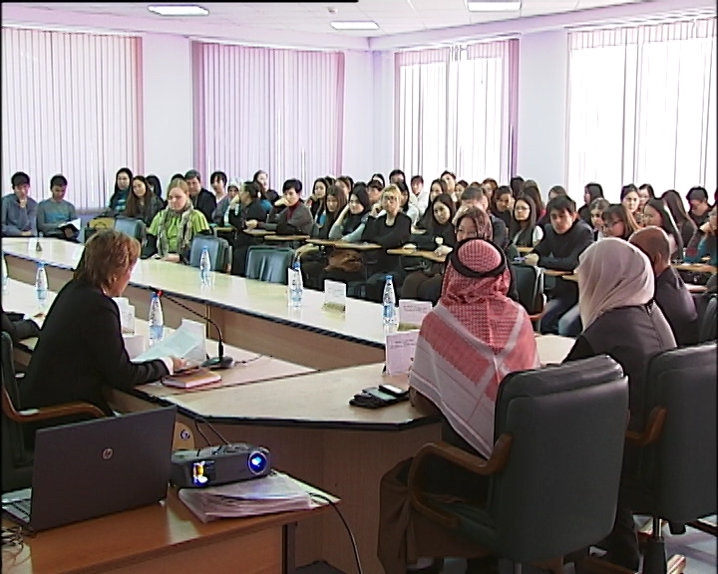

Slide 10
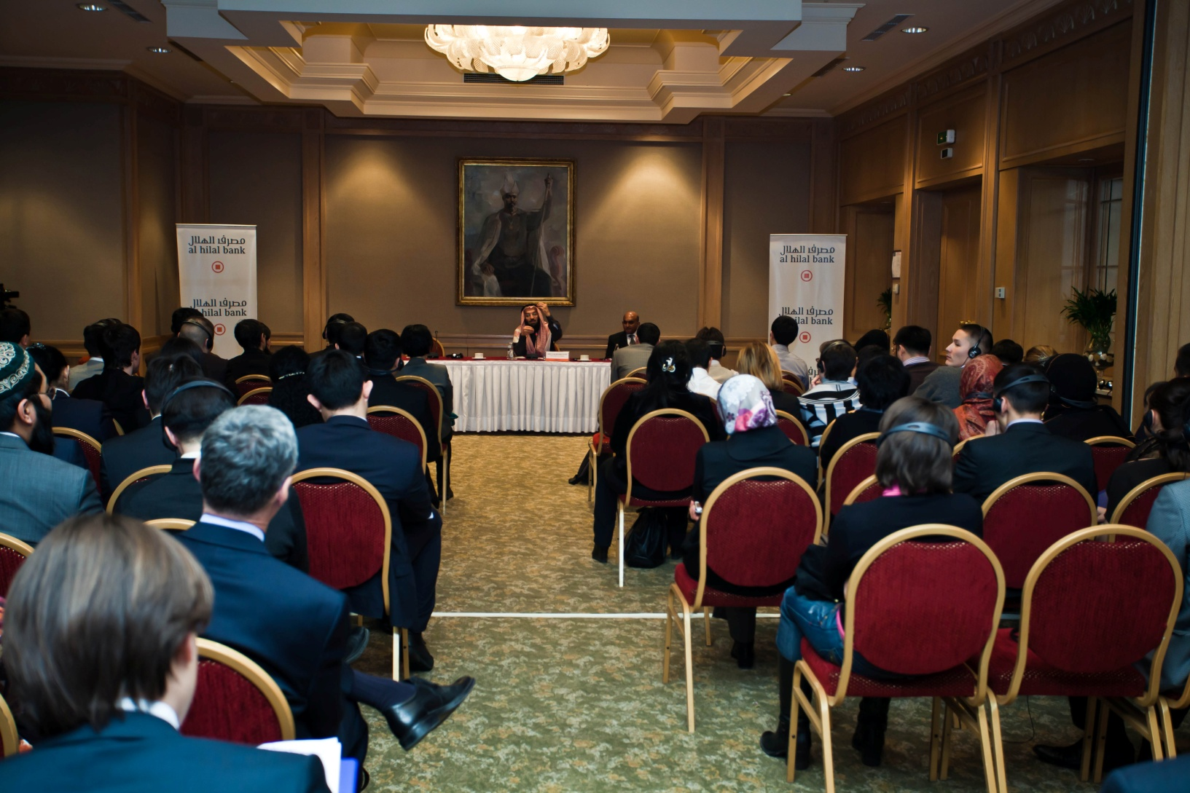

Slide 11
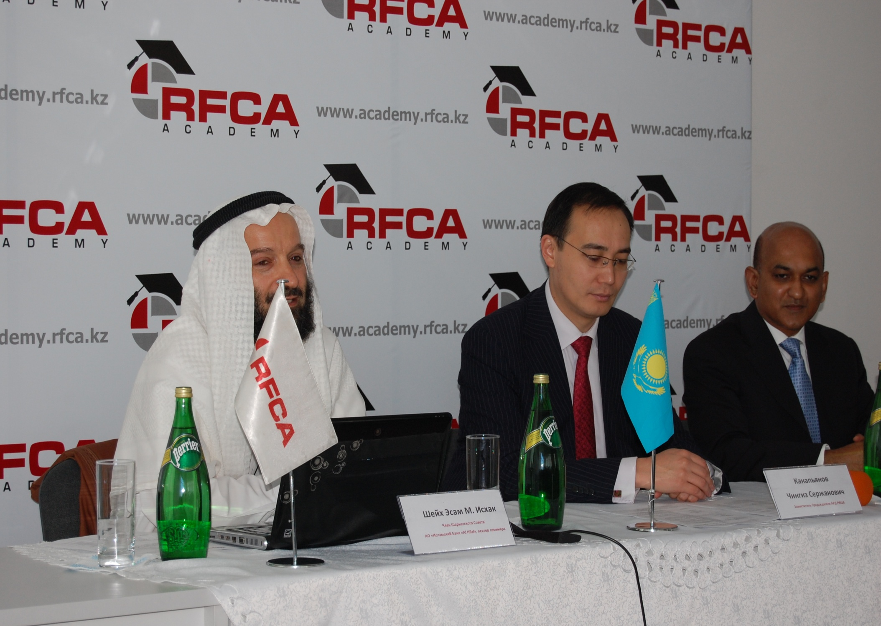

Slide 12
