Slide 1
What’s the fuss about the food industry?
Moira Stalker

Slide 2
Who are FDF Scotland?
The Scottish team at FDF - An independent trade association representing food and drink manufacturers across the UK
Not for profit – we raise our money from membership fees and events and training courses
Notes:
Committees of Advertising Practice (CAP) write and maintain the UK Advertising Codes, which are administered by the Advertising Standards Authority. Also offer the industry authoritative advice and guidance on how to create campaigns that comply with the rules.

Slide 3
300+ members including…
Notes:
Many of you will recognise the names and the logos on this slide and if you don’t recognise the logos you can be guaranteed you have probably eaten their products e.g. MacPhie – supermarket breads and MacDonalds do-nuts.
Many of whom are members of SFDF / FDF
All of these companies, and many more, all need talented staff in a very wide variety of roles to make sure that you, as consumers, get the food you like and that it is made safely, packed to protect it, and reformulated to make it more healthy etc. etc.

Slide 4
Farm to Fork
Food and drink in Scotland
Dynamic and growing £14.4bn (2014)
Exports up 56%
Scottish food & drink manufacturing growth rate twice the UK average
Central to Scotland’s economy - supporting the whole supply chain from farmers and fishermen to local consumers and visitors.
Increasing importance of local food and Drink (est. £600m)
Ambitious for the future
People and skills – key pillar of growth

Slide 5
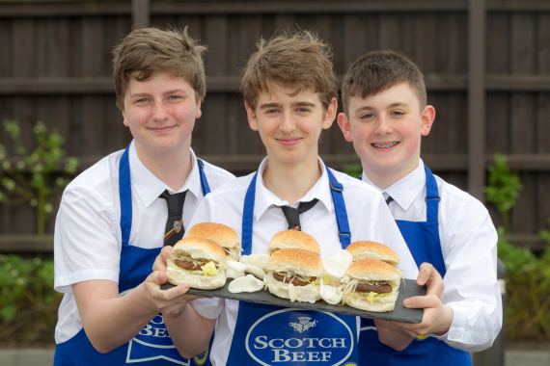
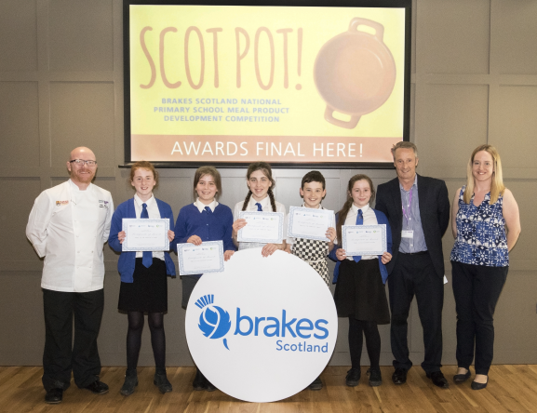
Food and Drink needs talented people
Challenges and opportunities
An ageing workforce
An image problem
Skills shortages in technical disciplines e.g. food science and technology and engineering
Need to attract the best talent to our industry through a pipeline of employment-ready individuals
Retain and develop our workforce
Skills Investment Plan for Food and Drink
27,000 job openings in next 10 years at SCQF Level 7 and above
The long-term shift towards occupations requiring higher-level skills and qualifications is set to continue.
Foundation Apprenticeship in Food & Drink
Graduate Level Apprenticeships
Modern Apprenticeship Programme 12,000 pa –‘earn while you learn’
Skills shortages in scientific, engineering and technical disciplines – STEM
Ambition 2030
People and Skills – Key Pillar of Growth

Slide 6
What do I do?
Help students understand what subjects they study in school might help them in industry – its more than cooking!
Make connections between industry and schools – let students see what the industry is like and meet real people from industry.
Help to inspire students to make connections between the food on their plates and the food and drink industry.

Slide 7
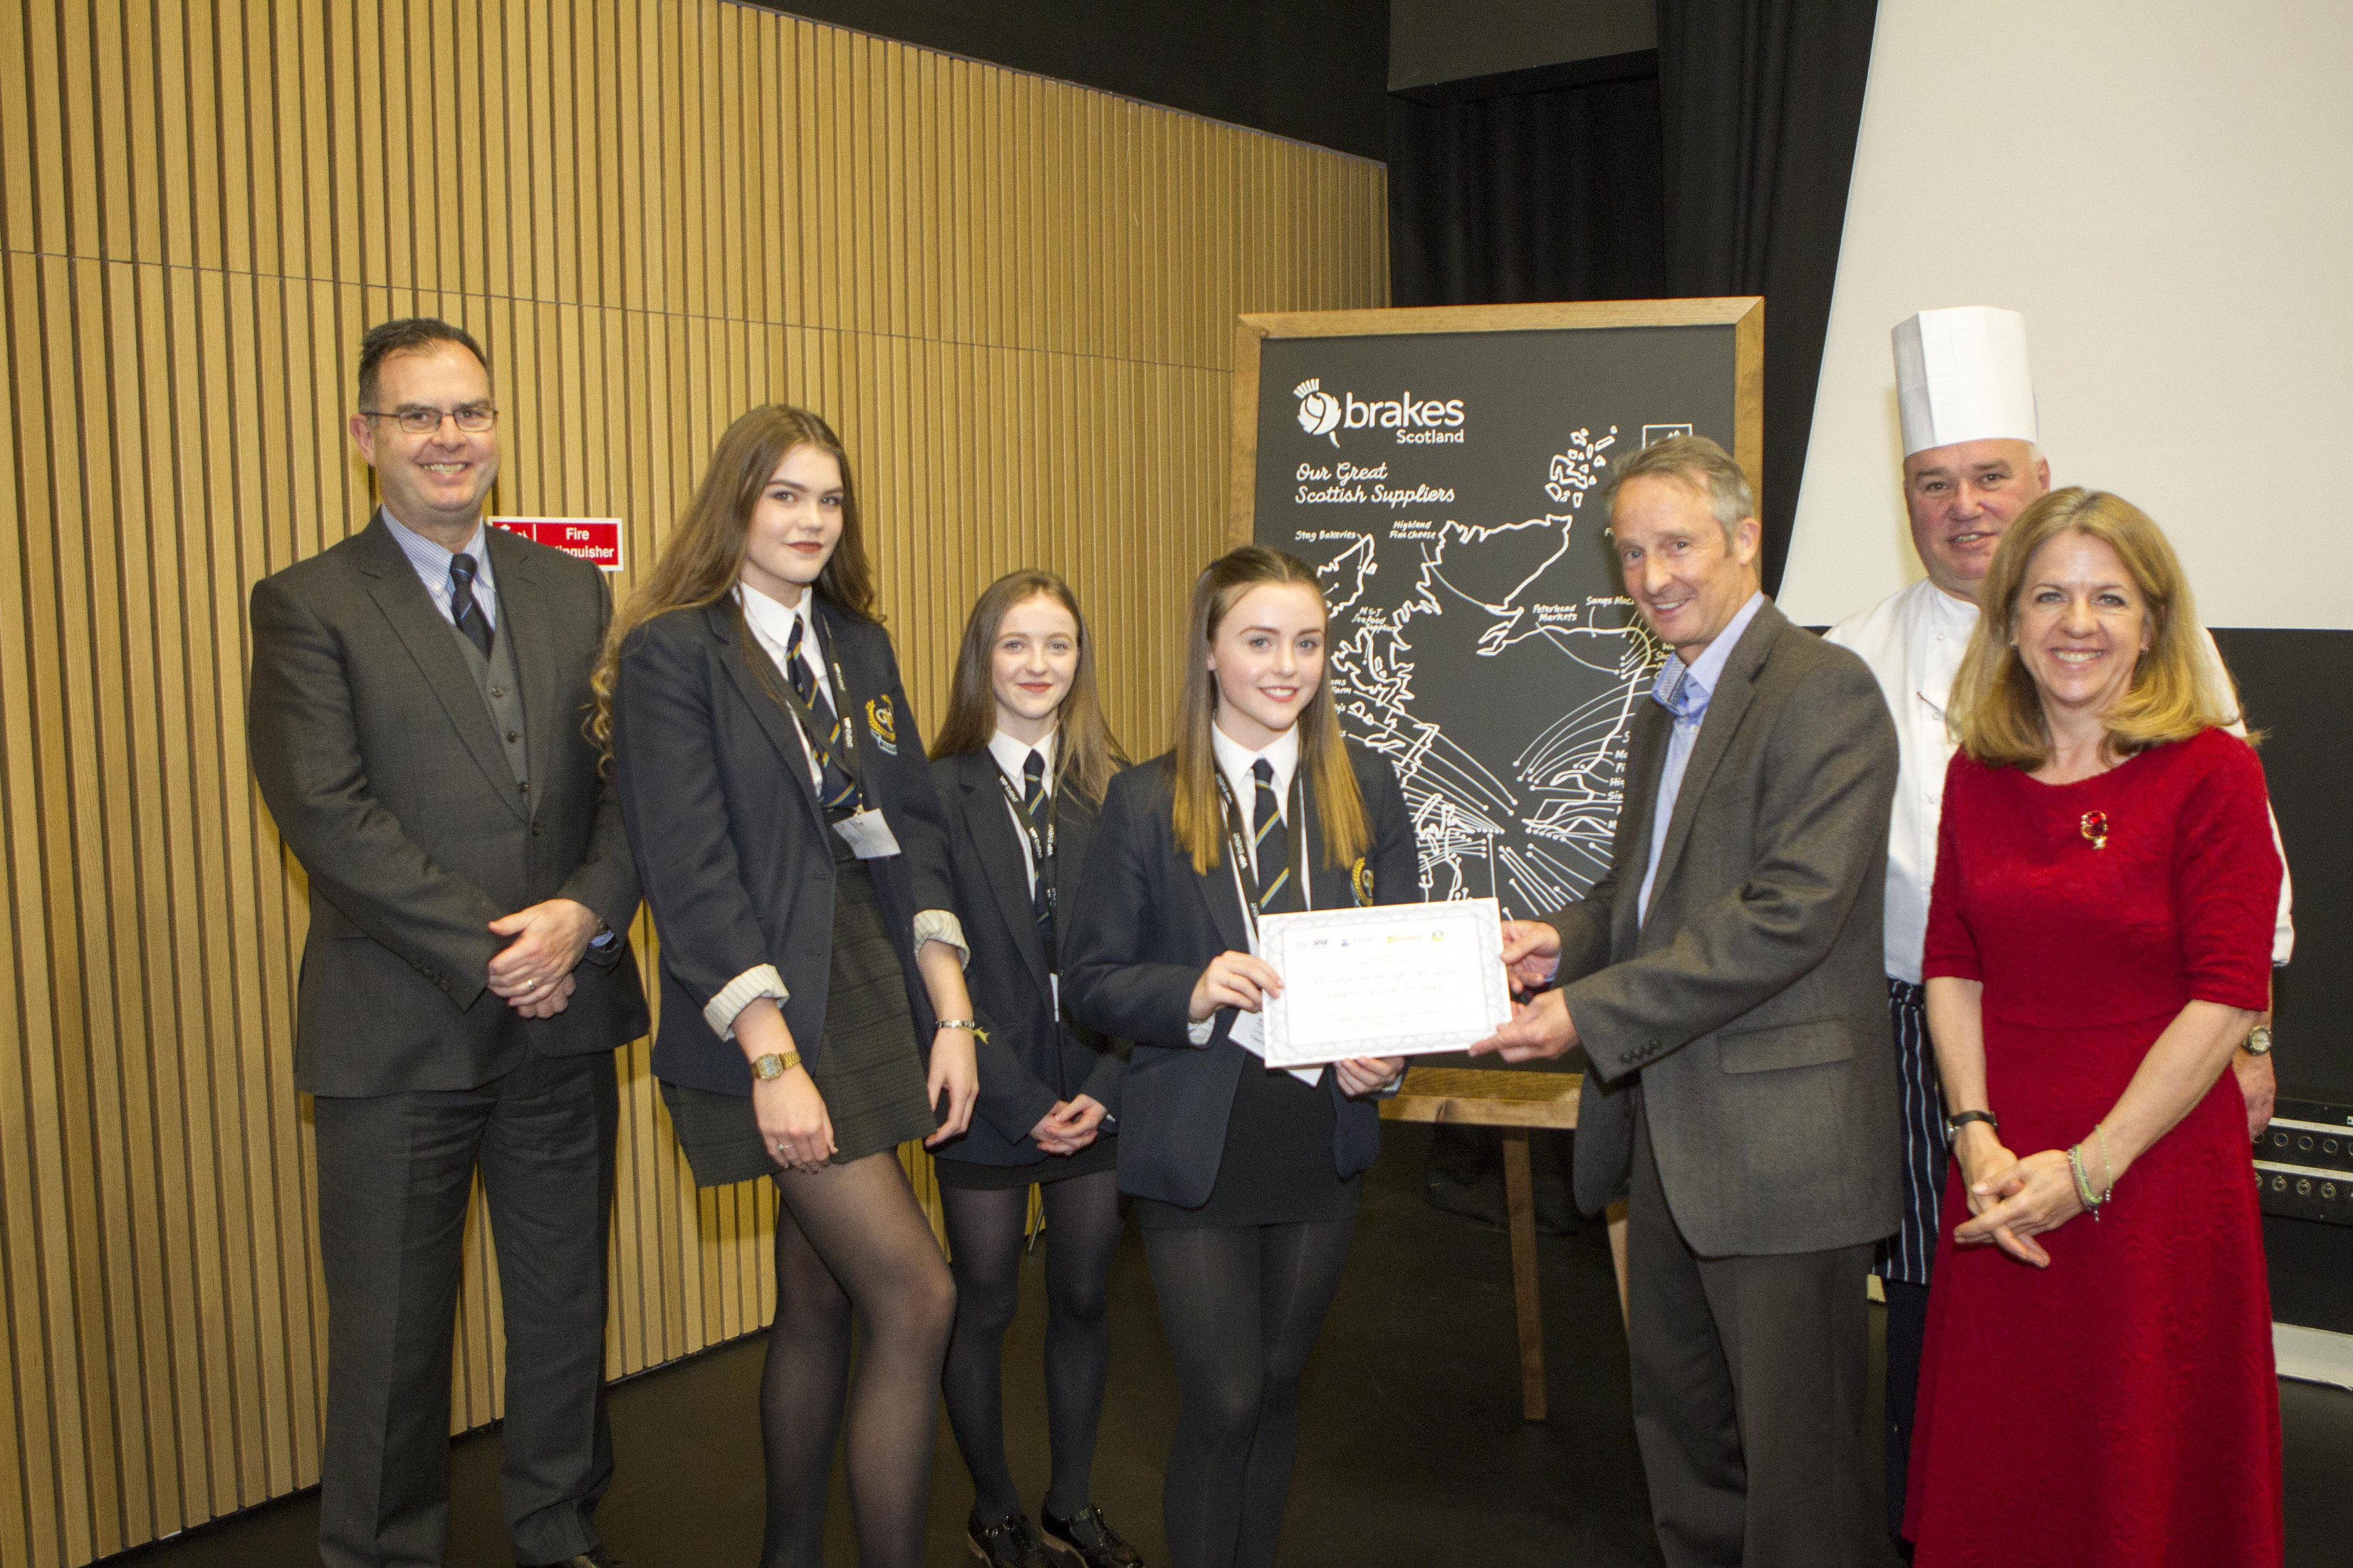
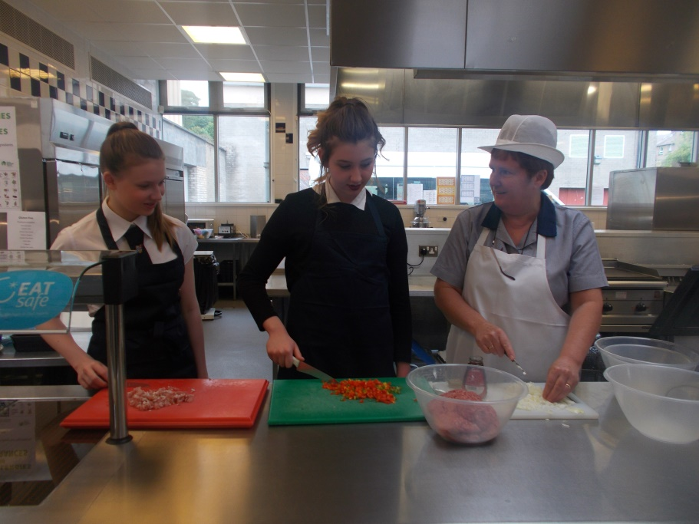
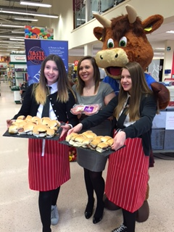
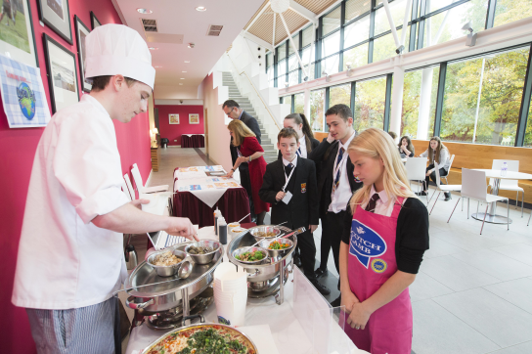
A Future in Food
How do we do this?
School, industry partnerships
Make it with Meat
AK Stoddart, RHET, QMS, TESCO
Big Brakes One Pot Challenge
Brakes Scotland, ASSIST FM, Education Scotland
The Ultimate Food and Drink Challenge
Food and Drink Ambassadors

Slide 8
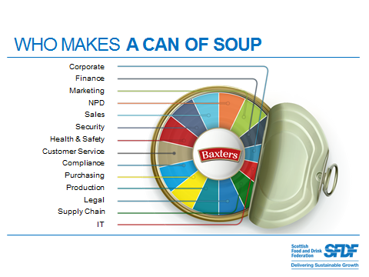
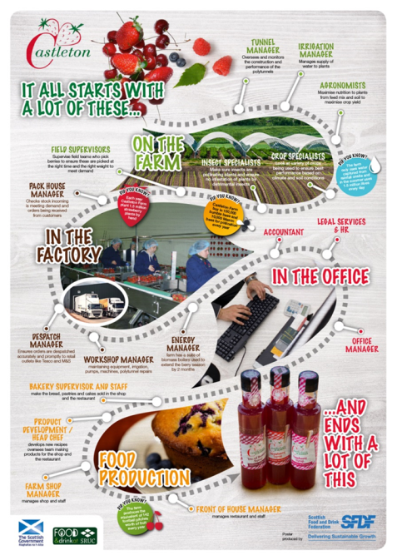
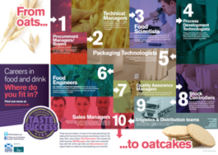
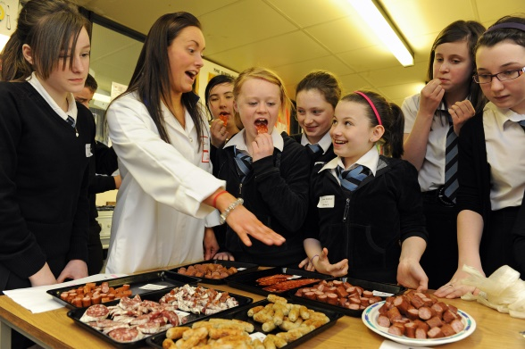
A Future in Food
Careers Campaign
Case studies, posters, infographic, films
Resources
Curriculum support
Case studies
Educators support materials
http://www.fdfscotland.org.uk/sfdf/schools_programme/resources/
Events

Slide 9
Progression Routes and Pathways
Partnerships are key to promoting and developing the next generation in food and drink
Qualifications from school into work and / or FE and HE
Skills for Work
National Progression Award
HNC/D
Degrees
Apprenticeships

Slide 10
Good luck and enjoy!

