Slide 1
We Built It, Where Are They?
Increasing Capacity Through Strategic Communications Planning

Slide 2
GATHERING & INTROS
Poll instructions
What’s your role within your organization?
I’m a volunteer or board member.
I’m staff, but not technically in a communications role.
I’m the staff person responsible for communications.

Slide 3
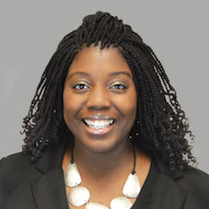
PRESENTING
Jannibah Coleman
Account Director, Global Prairie
Texas Tech University
Background in public sector
  Nonprofits
  Government

Slide 5






OUR EXPERIENCE

Slide 6
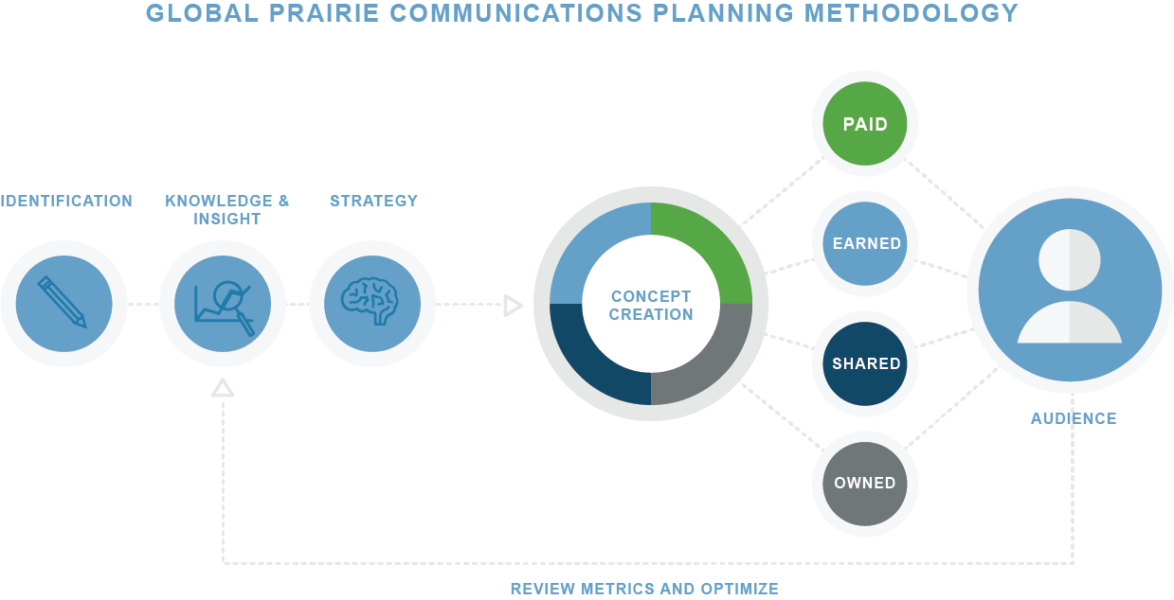
OUR APPROACH
Notes:
Our planning process begins with Identification, a collaborative process to quickly clarify and confirm the specific opportunity or challenge we face and the outcome we wish to see. We believe this is a fundamental step to ensure everything we develop will align with the CDC’s approach to measurement and optimization. Typically, the most effective way to reach this definition is through a simple workshop-style meeting where we work together with key stakeholders from the NCEH/ATSDR team to achieve full alignment on what we are developing, when, for whom, and why, as well as a review of all existing materials.
Our Secondary Sources for Knowledge:
PROQUEST®, EBSCOhost®, HOOVERS®, WARC®, Gale’s Business Insights Global, Euromonitor International®, Saegis, MRI Reporter, Polling the Nations, Ward’s Business Directory, Red Books, The List, BUDDY (Business Demographics and Data for You), CREW (Creative Running Everywhere Worldwide), GIG (Global Innovations Gateway), Wall Street Journal, Harvard Business Review and many more.
Next, we move into the Knowledge & Insight phase where we collect data and information to guide us to the best path forward and inform our messaging and tactical activities. This is perhaps the most crucial step in the planning process which involves reviewing and analyzing client-supplied information as well as sourcing of supplementary secondary materials through our available resources outlined in sidebar. We then organize what we know in a structured way that tells us key details about our target audiences:
Who they are
Key attributes and characteristics
How they consume information
What they believe and what we want them to believe
What drivers we can leverage to move them toward that future belief or action
With this insight in place, we will move to communications strategy development. Here, we will craft a blueprint for the communications plan that captures all relevant information and outlines exactly the way in which we can best deliver against our challenge. Our blueprint will sharply articulate the following: NCEH/ATSDR objective, marketing objective, KPIs, relevant context/background, audience profile, key messaging and support points, channel planning considerations, geography, in-market timing and budget.
From here, we move to our overarching concept development where we work with our team of creative strategists and technical communications specialists to create the core concept that will guide our messaging. This will be the step where we craft an overarching messaging hierarchy to deliver on our strategy, along with key visuals and assets as needed or appropriate. Drawing on our experience managing community outreach and risk communications on behalf of agencies such as FEMA, we anticipate that these messages will be crafted according to our Believe + Value + Ability construct. To ensure our message resonates and drives outcomes, they must be anchored and informed by the current beliefs of the audience we are trying to engage. Then, we must pivot quickly to showing how our information and data can add value to their lives, and ultimately help them understand quickly what the next step or action is that they can take based on this new information. If we get this part wrong, the rest of the plan will fail.
As part of this process, we will deploy cognitive testing of our core messages and materials prior to deployment to ensure language and comprehension of the message. We believe qualitative message testing is most effective, especially for communications requiring rapid response because it allows for not only identification of problem areas, but also delivers solutions. Depending on the quantity and pace of communications requiring testing, Global Prairie can establish a panel of go-to audience members that can quickly provide feedback, or we can recruit participants on an as-needed basis.
We then move into channel planning where, drawing on our landscape and partner analysis, we outline the full set of paid, earned, owned and social channels that will be leveraged in all communications outreach.
Finally, we will constantly review and optimize our strategic framework over time in accordance to the CDC’s standard approach to measurement and optimization.

Slide 7
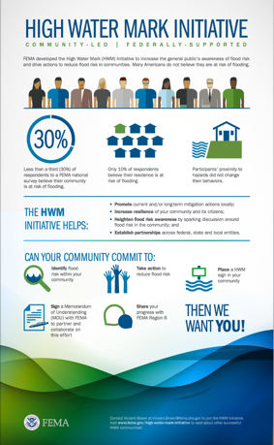
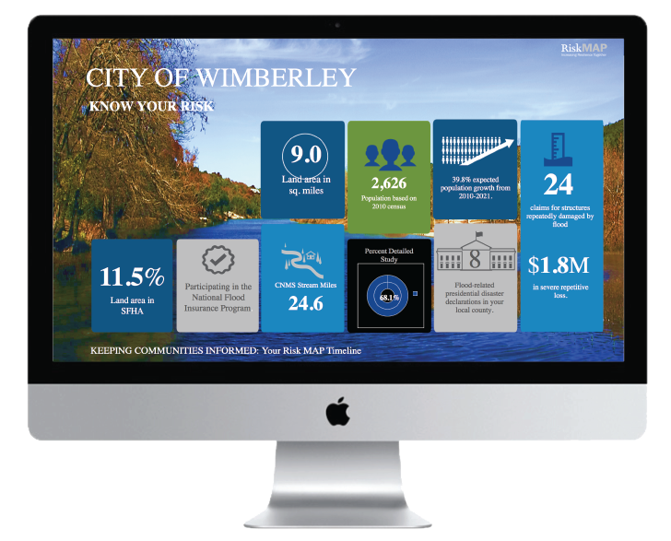

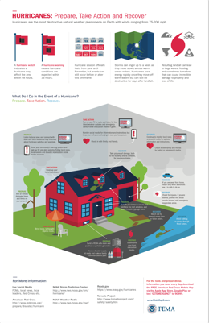
PROBLEM SOLVED
Notes:
Perfect example of having to mobilize stakeholders
Really important mission and a need for audience to take action
Stakeholder ID, understood goals, worked to create materials that strongly suited the needs

Slide 8
TODAY’S GOALS
Make the case for communications;
Develop a simple and practical strategic communications plan; and
Evaluate the effectiveness of communications efforts.
Notes:
Goals for you at the end of this session…

Slide 9

THE WHY
1.5M charitable orgs in the U.S.
71% of charitable giving from individuals
25.3% of Americans volunteer
Blackbaud.com
Urgan.org
Notes:
Importance of communications for public sector
Differs from private sector
How it ties to volunteerism (Fully 25.3 percent of US adults volunteered with an organization in 2014)
How it ties to giving- how much of that pie do you want? How will they know where to find it?
It’s not the same though- marketing is NOT fundraising (You should be communicating and promoting other things besides how much money you need- programs and events, volunteer recruitment, educational/relevant content)
Why the “piece-meal” method doesn’t work- CISNT example- whose job is it, what is the goal, what is the unified message?
Not a magic bullet, but still important function

Slide 10

"Data are becoming the new raw material
of business."
– Craig Mundie, Microsoft
Notes:
Starting with data
Primary vs secondary research
Identifying your target audience (and whether your current messages are reaching them)
Evaluating existing materials

Slide 11
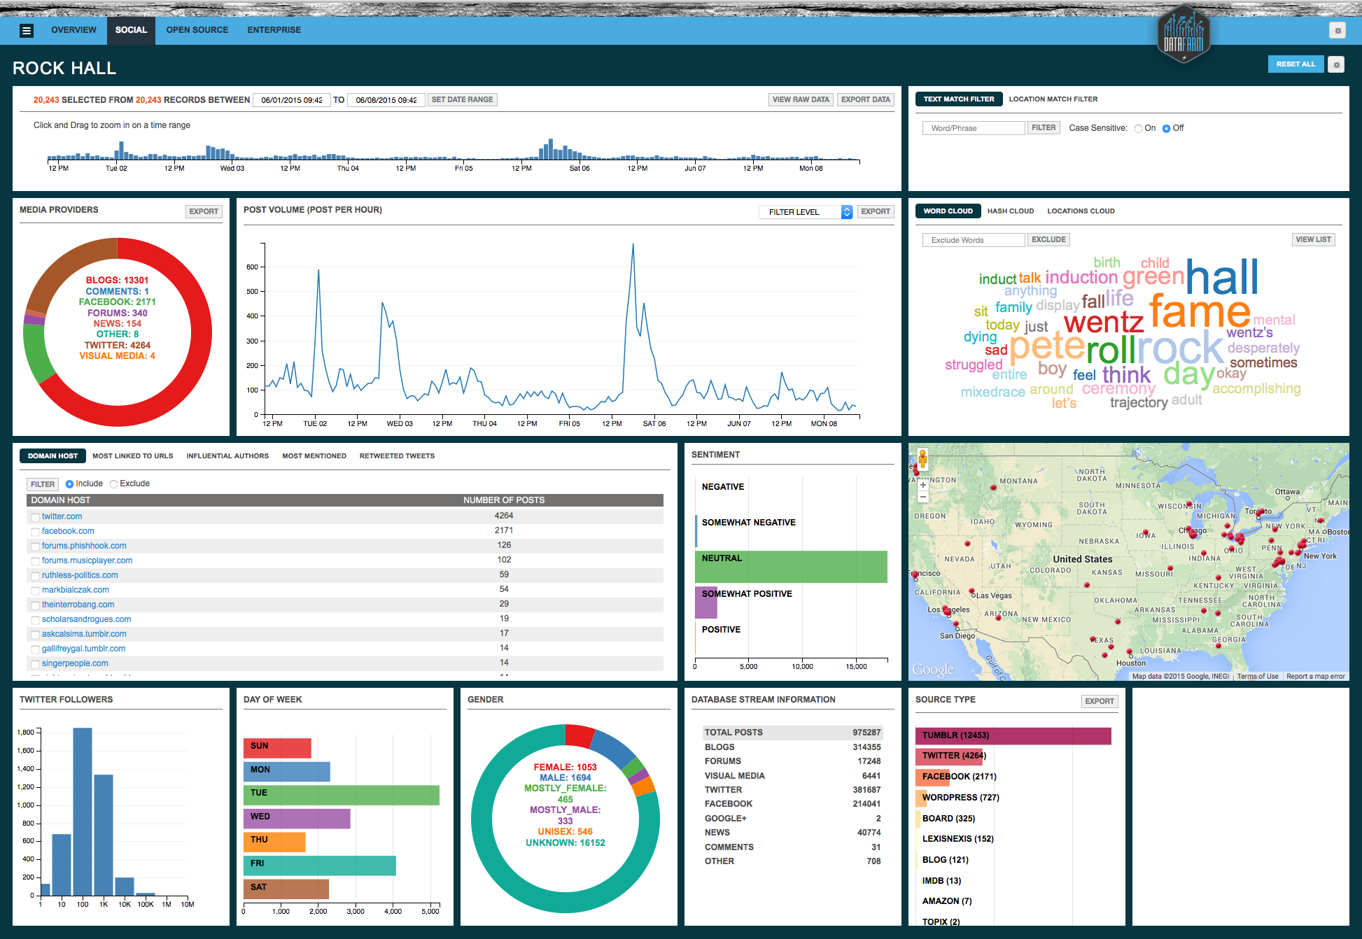
PROBLEM SOLVED
DATA CASE STUDY- Rock & Roll Hall of Fame?
Notes:
The Rock and Roll Hall of Fame engaged Global Prairie to analyze why their 2015 induction ceremony had been more successful than previous years. Using its proprietary DataFarm analytics tool, Global Prairie overlaid and analyzed numerous datasets to help Rock Hall understand which marketing activities resonated most with key audiences. The insights and findings will help Rock Hall refine its marketing strategies around future inductions to generate the biggest impact on their bottom line.

Slide 12
PART OF THE PLAN
Communications objectives
Key messages
Target audience
Strategy, tactics and tools
Timeline
Resources
Evaluation
Notes:
Key components of a communications plan

Slide 13
STEP 1
The objectives should be:
Data-driven
SMART
Align directly with business objectives
Notes:
This is where the case starts
How does what you’re doing support the overall mission and agency goals?
How to write them-
Tie them into the data
Make them SMART- bears repeating
Align the directly to each business objective- there should be a direct line
Think about who and ow

Slide 14
THE TAKEAWAY
Key messages
What these are not…
These ARE:
  Up to 3 main takeaways
  Data and audience-driven
  Broad
  Memorable (for both the deliver and the receiver)
STAY ON TRACK
Notes:
What are the big takeaways that you want your audience to receive?
These are not… talking points, beautifully crafted and wordsmithed, the exact words you must use every time you speak about the topic
Another place where the data comes in handy
Generally broad messages (give an example here- JEH might be a good one- Event logistics, and part of that is ) with supporting “proofs”
Not only will this be easy for you (and any “ambassadors”) to remember, but helps keep control the message

Slide 15
YOUR TURN
    Identify a communications objective
    Develop a key message

Slide 16

TARGET AUDIENCE
“It’s not business to consumer, it’s not business to business, it’s people to people.”
– Brian Solis, Altimeter Group
Notes:
This is something that nonprofits and community organizations have known for a while. So you already have some idea who these people are
Think again about Who and Why
Use the data to build simple personas to target communications

Slide 17
ACTION PLAN
Strategy- idea for how to achieve objectives
  i.e. Increase social media followers
Tactic- actions to help execute the strategy
  Boost high performing posts to increase reach
Tool- instrument used to perform tactics
  Facebook
Strategy: | Increase social media followers
Tactic | Leadership | Deadline | Progress | Notes
Identify and boost high-performing posts | Lauren | May | In progress
Notes:
Definition of strategies versus tactics
Good strategies- true knowledge of strengths and weaknesses (how much can we really do?), stem from data and tie into the business objectives

Slide 18

RESOURCES
Money
Time
People
Notes:
Resource management- people, timeline, budget
Managing these correctly helps strengthen your case for communications

Slide 19

PROBLEM SOLVED
DATA CASE STUDY
Notes:
Objective meets messaging and tactics
Impactful on a budget

Slide 20
YOUR TURN
    Define a strategy
    Create supporting tactics

Slide 21
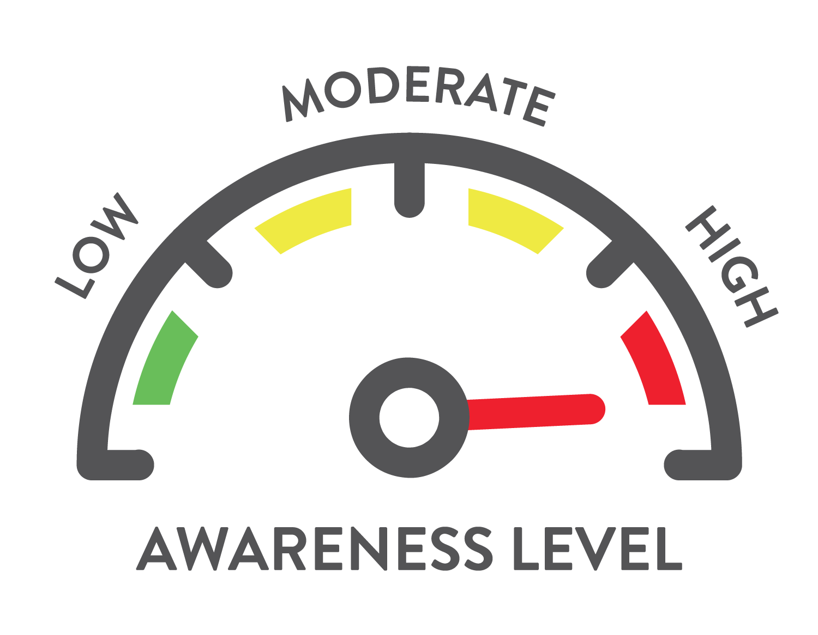
EVALUATION
Importance of measuring efforts
Key performance indicators
Close the loop
Notes:
Establishing metrics keeps you on track
What do you measure? Can be as simple of number of people reached, but how do you determine if you’ve moved the needle?
Close the loop- again helps make the case, determine what efforts were successful and if you achieved what you sought to

Slide 22
YOUR TURN
    Determine your metrics
    Share your results
Notes:
5 minutes for evaluation break out
10 minutes for report out and discussion (a couple of groups)

Slide 23
CONTACT ME
Jannibah Coleman
Jannibah.Coleman@Global-Prairie.com
LinkedIn.com/in/Jannibah
www.Global-Prairie.com
Notes:
Take questions now

