Slide 1
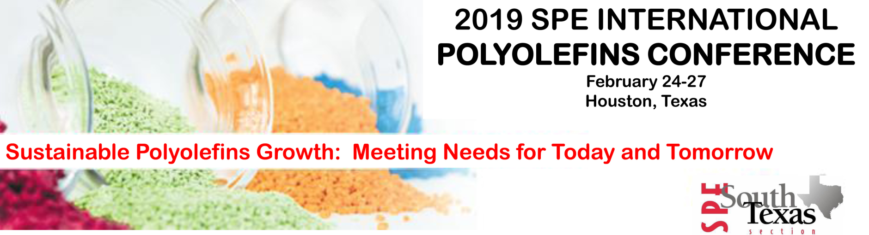
New Opportunities for Stabilizers through Circular Economy
Rudolf Pfaendner
Fraunhofer Institute for Structural Durability and System Reliability LBF
www.lbf.fraunhofer.de

Slide 2

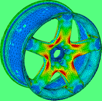
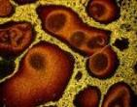
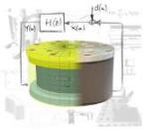
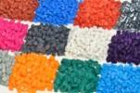

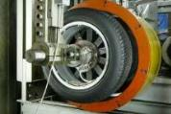
Fraunhofer LBF: Value Chain
Component investigations
Material-
characterization
Polymer-
synthesis
Numerical
simulation
Active systems
Material
development
Durability evaluation,
System- reliability
System analysis

Slide 3
New opportunities for stabilizers through circular economy
Circular economy: Recycling of plastics (European perspective)
Plastic recyclates challenges
Additives to upgrade recyclates
New generation of additive systems for polyolefin recyclates
Conclusions

Slide 4
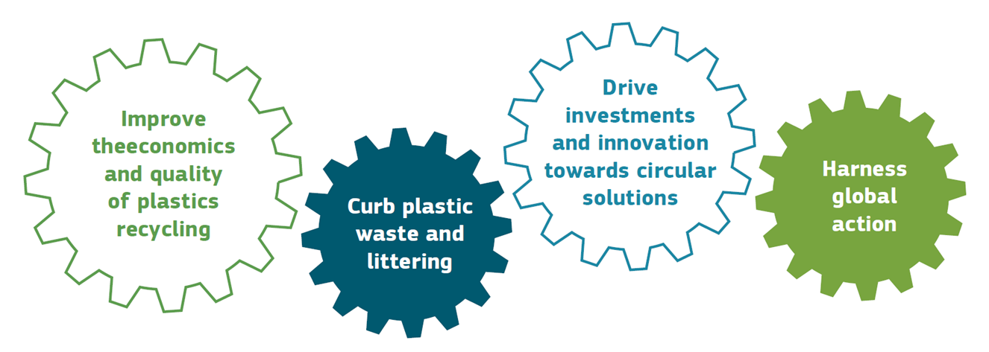
A European Perspective:
Plastic Waste Strategy with Focus on 4 Areas
Source: http://ec.europa.eu/environment/waste/target_review.htm

Slide 5
A European Perspective: Circular Economy
Key elements of the European Union (EU) revised waste proposal:
Target for recycling 65 % of municipal waste, 75 % of packaging waste by 2030
Reduce landfill to maximum of 10 % of municipal waste by 2030
Ban on landfilling of seperately collected waste
Promote re-use and stimulate industrial symbiosis
Economic incentives to put greener products on the market
Support recovery and recycling schemes (e.g. for packaging, batteries, electric and electronic equipment, vehicles)
Source: http://ec.europa.eu/environment/waste/target_review.htm

Slide 6
A European Perspective: Plastics Recycling
Plastics recycling will increase
Quality of plastic recyclates is an important factor
Markets for recyclates will be supported
Use of polymers from natural ressources („bio-polymers“) will grow
Perfect timing to develop additives to upgrade and to improve quality of recyclates

Slide 7
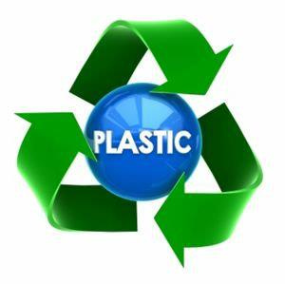
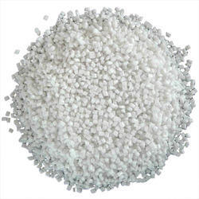
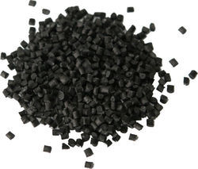
From Virgin Plastics to Recyclates

Slide 8
Polymers: Nothing is Forever
Processing
Aging
Light
Oxidation
Degradation of
Polymer chains
Photooxidation
Deterioration
of mechanical properties
until breakdown
of color
of value in use

Slide 9
Structural Differences Recyclate / Virgin Plastics
Predamage through aging/oxidation (e.g. chemical changes, molecular weight changes,….)
Blends/mixtures (e.g. different grades, producers, additives, ….)
Influence of foreign matter (e.g. other polymers, metal traces, organic impurities and degradation products,…)
Fluctuating composition

Slide 10
Plastics Recyclates and Aging Behavior in New Applications
Recyclates are more prone to oxidation and / or photooxidation than virgin polymers due to predamage and new chemical groups which act as initiator sites for further degradation
Impurities will furthermore accelerate the (photo)oxidation process
Degree of predamage and type / concentration of impurities are important factors

Slide 11
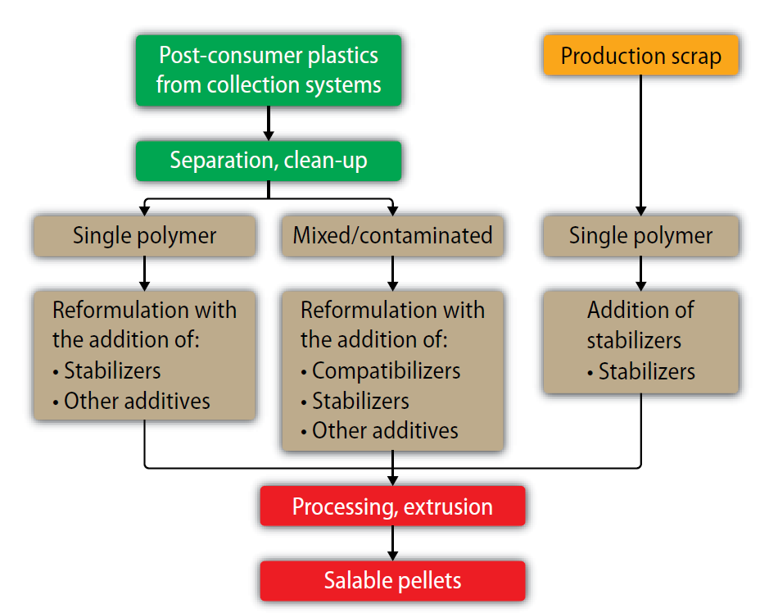
Quality Improvement of Recycled Plastics
Source: R. Pfaendner, Kunststoffe Intern. 12/2015

Slide 12
Example: Bottle Crates from HDPE Recyclate
400
/ / /
300
Spezifikation der Neuware
specification
200
Tensile Impact Strength [kJ/m²]
100
reference (not restabilized)
0.20 % stabilizer combination
0.40 % stabilizer combination
0
/ / /
0
2000
4000
8000
Artificial Weathering (WOM) [h]
Source: C. N. Kartalis, C. D. Papaspyrides, R. Pfaendner, K. Hoffmann, H. Herbst, J. Appl. Pol. Sci. 2000, 77, 1118-1127

Slide 13
Commercial Additives to Upgrade Recyclates
Stabilizers / stabilizer systems to prevent (photo)oxidation during processing and use
Reactive additives / repair systems to increase / to adjust molecular weight to processing and application
Compatibilizers based on functional polymers or minerals to cope with polymeric impurities / polymer blends
Odor neutralizing agents (adsorbers, reactive molecules)

Slide 14
Plastics Recyclates and Aging Behavior in New Applications
Recyclates are more prone to oxidation and/or photooxidation than virgin polymers due to predamage and new chemical groups which act as initiator sites for further degradation
Impurities will furthermore accelerate the (photo)oxidation process
Degree of predamage and type/concentration of impurities are important factors
Restabilisation with replacement of at least the consumed stabilizers is mandatory
Best cost/performance stabilizer combination in recyclates is different from virgin polymers

Slide 15
How to Develop a New Generation of Recyclate Stabilizers?
Best cost/performance stabilizer combination in recyclates is different from virgin polymers
However: today´s stabilizer solutions are variations of typical virgin stabilizer systems, i.e. hindered phenol + phosphite/phosphonite + antiacid
Hypothesis: stabilizers interacting directly with the oxidized structures of recyclates should result in an improved protection

Slide 16
Performance of New Recyclate Stabilizer System: Experimental Parameters
Polypropylen
Virgin PP
Artificial PP recyclate (virgin PP aged in dry air oven at 140 °C for 32 days)
Post consumer PP recyclate (battery cases, ca. 5 years usage time)
Stabilizers
Phosphite, phenolic antioxidant combination as used for virgin PP
Commercial recyclate stabilizer
New system containing selected alditol as key component
Test procedure: Twin screw microextruder MC 5, 30 minutes in continuous mode

Slide 17
Performance of New Recyclate Stabilizer System: Virgin PP
Residual torque [%]
Extrusion time at 200 °C [min]
Performance of new stabilizer system somewhat worse than typical virgin stabilizer, similar to commercial recyclate stabilizer.

Slide 18
Performance of New Recyclate Stabilizer System: Artificial Recyclate
Residual torque [%]
Extrusion time at 200 °C [min]
Performance of new stabilizer system better than virgin stabilizer, similar to commercial recyclate stabilizer.

Slide 19
Performance of New Recyclate Stabilizer System: Post Consumer Recyclate
Residual torque [%]
Extrusion time at 200 °C [min]
New stabilizer system outperforms virgin and commercial recyclate stabilizers.

Slide 20
Performance of New Recyclate Stabilizer System:
Multiple Extrusion of Post Consumer Recyclate
MVR [230/2.16]
Twin screw extrusion at 230 °C
New stabilizer system outperforms virgin and commercial recyclate stabilizers.

Slide 21
Performance of New Recyclate Stabilizer System:
OIT Values After Multiple Extrusion (Post Consumer Recyclate)
Oxygen induction time at 200 °C [min]
Twin screw extrusion at 230 °C
New system seems to protect the phenolic antioxidant during processing.

Slide 22
Performance of New Recyclate Stabilizer System: Polyethylene (HDPE)
Residual torque [%], torque at 190°C/0 min = 100 %)
Extrusion time at 200 °C [min]
New stabilizer system is efficient in Polyethylene.

Slide 23
Take home message
Recyclates need restabilization with adjusted stabilizer systems
The newly developed Fraunhofer system interacts directly with the oxidized structures and thus eliminates initiator sites for further oxidation
The new system can act in addition as hydroperoxide decomposer and metal deactivator
The new system is an excellent processing stabilizer for polypropylene recyclates
Further evaluation of other recyclate streams such as PE, of long-term thermal stability and mechanism is under evaluation

Slide 24
Contact:
Dr. Rudolf Pfaendner
Fraunhofer Institute for Structural Durability and System Reliability LBF
rudolf.pfaendner@lbf.fraunhofer.de

