Slide 1
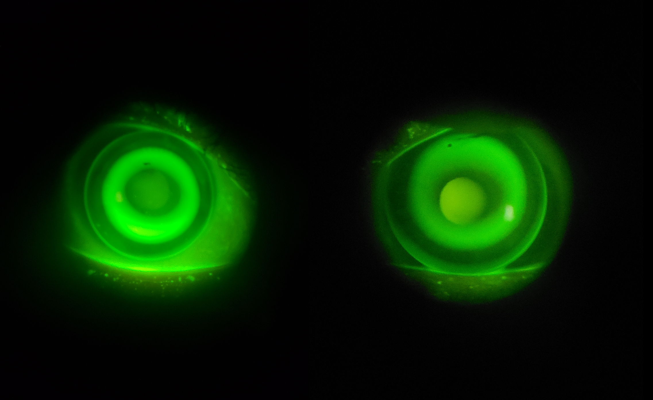
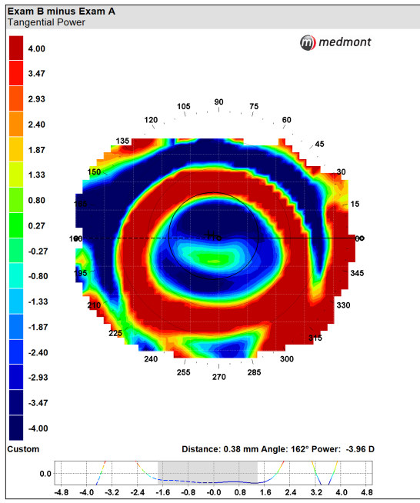
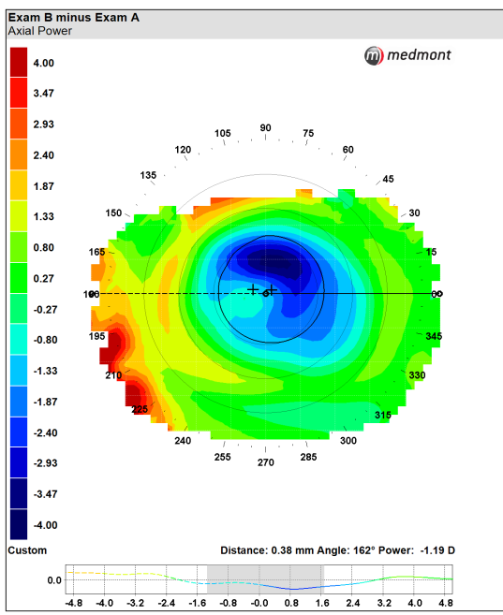
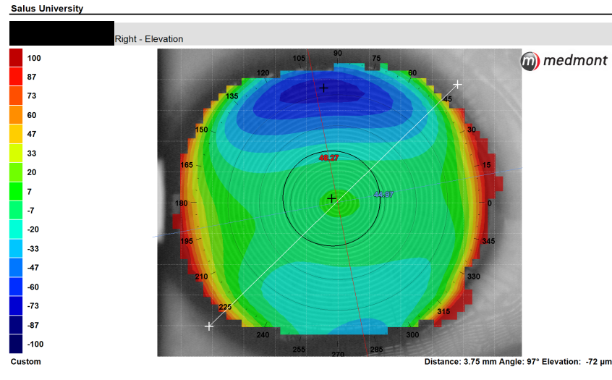
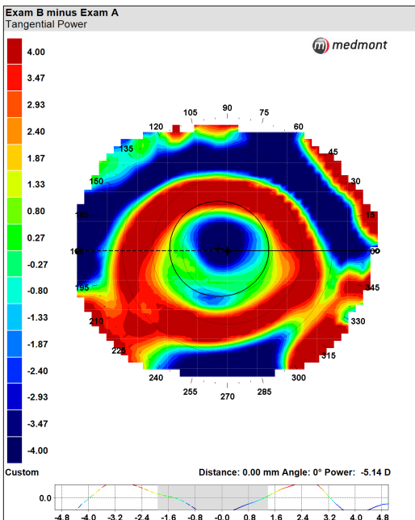
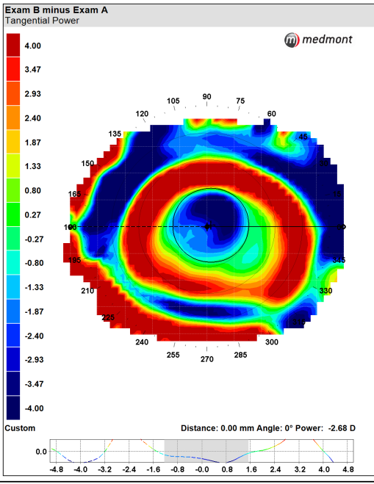
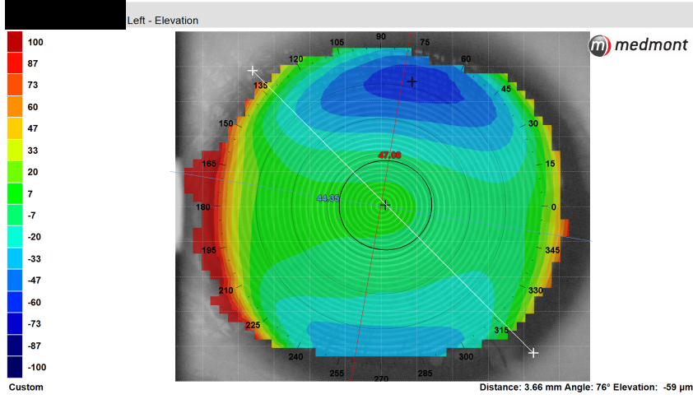
Fitting OrthoK Lenses Nimbly When Astigmatism Extends Limbally
Tanya Vigdal; Sofia Schedler; Nicholas Gidosh, OD, FAAO
PURPOSE
.
Lens Parameters (mm)
 | Base Curve | Alignment Curve 1 | Alignment Curve 2 | Toricity (D)
OD Spherical | 8.33 | 7.50 | 7.76 | N/A
OS Spherical | 8.18 | 7.63 | 7.90 | N/A
OD Toric | 8.33 | 7.50 | 7.76 | 2.00
OS Toric | 8.18 | 7.63 | 7.90 | 1.50
Orthokeratology lenses have been primarily used for spherical myopia correction. The current VST FDA approval is for the temporary reduction of myopia up to 5.00D and astigmatism up to 1.50D. However, with newer lens technologies available through Euclid, corneas with significantly higher limbal to limbal toricity can be fit with Ortho-K lenses. The goal is to assess vision and fit of an Ortho-K lens on a highly toric cornea by comparing a spherical lens to a lens that accounts for limbal to limbal toricity.
Table 2: This table compares the spherical and toric lens parameters ordered. Toricity was the only value that was different between them, per Euclid's Fitting Guide.
LENS FITTING
RESULTS
When deciding to fit a toric Ortho-K lens, the cornea should have over 30μm of Sagittal Height Difference (SHD) between the flat and steep meridian measured at an 8mm chord diameter. This diameter is based on the size of the treatment zone and reverse curves of a Euclid lens. A SHD of 15 μm indicates 0.50D toricity is required in the alignment zone for stable centration. If between values, the least amount of toricity needed for good circumferential alignment is key.
In this case, a 26-year-old male with high limbal to limbal toricity was fit with toric and spherical Ortho-K lenses to compare the outcomes.
Figure 4: This figure shows the toric Ortho-K lenses that were fit on the patient's eyes stained with fluorescein, OD (left) and OS (right). The lens fittings revealed well-centered Bull's Eye patterns with no excessive pooling. The alignment zones showed equal distribution across each meridian (arrows).
DISCUSSION
Measurements Obtained at First Visit
 | OD | OS
Flat Ks | 44.97 D @ 011° | 44.35 D @ 170°
Steep Ks | 48.27 D @ 101° | 47.08 D @ 080°
Spectacle Rx | -3.75 -1.75 x 010 | -2.25 -2.25 x 175
Aided VA | 20/20 | 20/20
HVID | 11.2 mm | 11.5 mm
Sagittal Height Difference | 72.00 microns | 59.00 microns
According to Euclid’s fitting guide, toricity (1.00D- 3.00D) can be added to the alignment zone to improve centration and vision while covering a large range of toric corneas. The patient had a large elevation difference (Table 1 and Figure 1).
When initially fit in spherical lenses, OD and OS showed an incomplete treatment zone on topography with OD also showing inferior decentration. Both fits suggested a toric lens would improve centration and provide a more complete treatment zone.
The lens toricity was calculated using the SHD and the conversion factor of 15 microns = 0.50D toricity.
OD: 72.00/15 = 4.83 x 0.50 = 2.4D OS: 59.00/15 = 3.83 x 0.50 = 1.9D
The patient was under prescribed toricity resulting in 2.0D of toricity, OD and 1.50D of toricity, OS (Table 2). When fit in the Toric Ortho-K lens, centration improved and the patient appreciated the improvements in vision compared to the spherical Ortho-K lens.
Table 1: This table shows the values obtained at the initial visit. They were used to calculate lens parameters.
Figure 2: This figure shows the OD tangential map (left) and OS axial map (right) topographies obtained after the patient wore the spherical Ortho-K lenses for a week. The patient's VAs were 20/25 -2 OD and 20/20 -2 OS. These lenses had poor centration resulting in less defined treatment zones. Tangential maps help show position and size of treatment zone while axial maps help show relative amount of correction.
CONCLUSION
The patient achieved the best uncorrected visual acuity with both eyes in the toric Ortho-K lenses. The topographies revealed adequate, central flattening of the corneas. The lens toricity achieved good centration on the cornea. This case reinforced the importance to follow manufacturer fit guides and to give adequate time for corneal changes between follow ups before making any changes to an Ortho-K fit.
Acknowledgments
This research was supported by Salus University’s Cornea and Contact Lens Service at The Eye Institute. We would like to thank Euclid Systems Corporation for providing the lenses used in this study.
Figure 1: The elevation maps showed significant levels of elevation differences between the horizontal and vertical meridians. In this figure, OD (top) has a limbal to limbal elevation difference (sagittal height difference) of 72 microns while OS (bottom) is 59 microns.
Figure 3: This figure shows the OD (left) and OS (right) tangential topographies obtained after the patient wore the toric Ortho-K lenses for a week. The patient's VAs were 20/20 -1 OD and 20/20 -1 OS. These lenses were well-centered resulting in defined treatment zones.

