Slide 1
Beyond word of mouth:
Winning new clients online
Sera Awad – Growth
#QBConnect | WiFi: QBConnect Password not required

Slide 2
Take a few moments to CONNECT with your neighbour
#QBConnect | WiFi: QBConnect Password not required

Slide 3
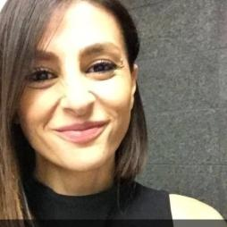
Today’s speaker
Sera Awad
  Growth Specialist
  @SeraAwad

Slide 4

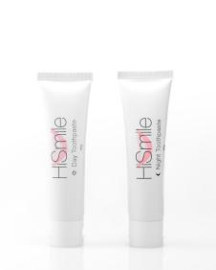
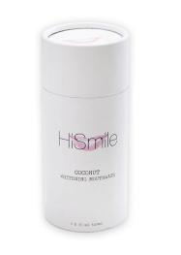
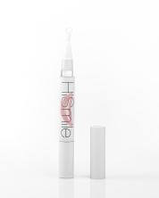
In 2014 HiSmile was created
Notes:
In 2014 Queensland boys, Nik and Alex established HiSmile.
Hismile sold toothpastes, gels and a coconut oil mouthwash

Slide 5
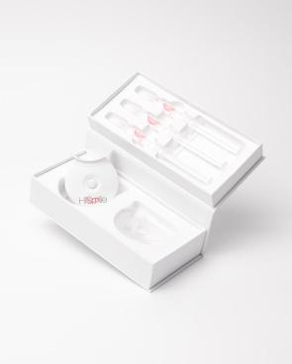
Flagship product
$20,000 investment
Attract and convert campaign
CHANNEL Website
CHANNEL Instagram
Notes:
but their company’s flagship product was an LED teeth whitening kit that cost $79.99
Nik and Alex launched with a pretty decent online store and rather than marketing all of their products across many online channels, they put a $20,000 investment towards ONLY marketing their flagship product in a channel they felt their clients engaged in most – INSTAGRAM.

Slide 6
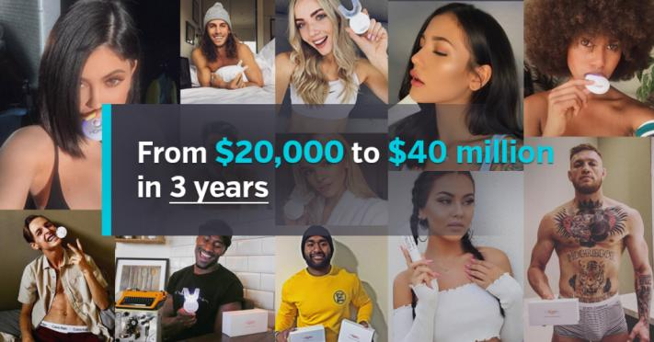
Notes:
Fastforward, 3 years and HiSmile turned its $20K marketing investment to $40 Million in sales.
You wouldn’t actually call this an overnight success. Nik and Alex, focused their campaign on 1 product in 1 channel. They deeply experimented with, and invested time, in Instagram. They ran promotions and offers encouraging their clients to share photo’s of their whitening results and this was going very well. Soon enough, regular HiSmile clients and even some celebrities were posting photo’s of their whitening success too. Eventually they were doing so well they could afford to pay celebrities for the endorsement and spread marketing to many new channels.
END_
and have 30,000 subscribers who pay between $19.95 and $29.95 per month to have their oral hygiene products delivered.
Read more at http://www.adnews.com.au/how-hismile-built-million-dollar-empire#g919YytMeXEB0AHo.99

Slide 7
LED Teeth Whitening Kit
ATTRACT
CONVERT
RETAIN
Online Store
Email
Phone
TODAY
30,000 Australian Subscribers paying
$29.99 a month
Instagram
Google
Facebook
Groupon
Facebook
Visitors/ prospects
Leads/ buyers
Clients/ Advocates
Notes:
Whilst you may say that HiSmile has an attractive and easy to market product, it wasn’t always attractive and it certainly wasn’t unique. It could have easily failed like many new products or services in a busy marketplace.
But rather then spreading their investment and time, they went narrow.
Once they mastered Instagram, HiSmile set up shop in Facebook, mastered Google search, and even started offering their product at a discounted price on Groupon to acquire BRAND NEW customers.
ONCE they acquire a BRAND NEW customers, they email and phone them encourage them to sign up to a monthly subscription for at least $29.99 a month.
And that’s how they created profitable sustainable growth.

Slide 8
Go narrow. Go deep.
Systematic
Measureable
Achievable
Realistic
Cost effective
Repeatable!
Create a campaign to convert new clients to 1 product… then expand to other channels
WINNING New Clients Online
Notes:
My point is – Online marketing can be very broad and complex. So to START with Online Marketing, RATHER Then spreading your time and investment across all products and channels the alternative is to GO NARROW and GO DEEP – i.e. to market your flagship product or service in 1 channel deeply. Attract new clients then expand to other channels or add new products. The broader you go, the more investment and expertise you need.
SO Today we are going to create deep channel marketing campaign to convert new clients to your flagship product or service online. We are only going to focus on DIRECT LEAD GENERATION STRATEGIES! This is not a branding or awareness campaign, this presentation is about WINNING CLIENTS ONLINE.

Slide 9
Deep multi-channel strategy for 1+ products or service
Groupon
LinkedIn
Email
Search
Facebook
Instagram
Website
Whitening Kit
Channels
Whitening Kit
Whitening Kit
Whitening Kit
Whitening Kit
Whitening Kit
Products
Notes:
So lets take a look at how a deep channel strategy would work.
Generally your website would include all of your products and services but it will hero your flagship product to attract and convert new clients to that.
Once you have mastered marketing that product on your website, you move to the next channel and master it there and so on.

Slide 10
Expand to a multi-channel, multi-product strategy
Groupon
LinkedIn
Email
Search
Facebook
Instagram
Website
Whitening Kit
Coconut Mouthwash
Whitening Kit
Coconut Mouthwash
Whitening Kit
Coconut Mouthwash
Channels
Whitening Kit
Coconut Mouthwash
Whitening Kit
Coconut Mouthwash
Whitening Kit
Coconut Mouthwash
Whitening Kit
Coconut Mouthwash
Products
Notes:
As your strategy evolves or your company grows, you can also start to expand your product set across many channels and end up with a deep, multi-channel, multi-product online strategy.

Slide 11
Today’s plan
Present an attract and convert framework
Pick your single product or service + your conversion goal
Come up with a campaign tactic to attract and convert clients to it
Rapidly present 7 online channels to complete your marketing mix
Select the channels and tools that are suited to you and your business
Notes:
So how will we next the next 50 mins or so?
Present an attract and convert framework to plan your marketing within
Build a campaign tactic to attract and convert clients to your campaign
Using a number of case studies and example businesses I present 7 major online channels for you to choose your marketing mix
Suggest the most useful lead conversion tools available in each channel

Slide 12
Our campaign framework

Slide 13
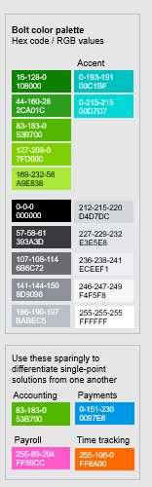
Product or service
Conversion goal
1. Business goal
ONE FLAGSHIP PRODUCT OR SERVICE
A SPECIFIC TRANSACTION TYPE
2. Lead gen
tactic
ATTRACT
CONVERT
RETAIN
Engagement comms
Online lead Magnet
Irresistible
Offer
OUR CAMPAIGN FRAMEWORK
3. Channels
Visitors/ prospects
Leads/ buyers
Clients/ Advocates
Online Channels
Conversion Tools
Comms
Reviews & Ratings
Notes:
This framework is a model that positions your flagship product or service and its conversion goal at the top of your lead generation funnel.
The funnel illustrates the process of attracting visitors, converting them to leads or buyers and turning them into referring clients. Today we are only going to focus on the attract and convert stages.
It also captures what lead generation tactics we are going to use to attract leads and convert them to a specific campaign offer. And then it includes which channel we are going to execute those tactics and exactly what conversion tools you are going to use!

Slide 14
Our planning process
1
2
3
4
Choose your flagship product or service
Create your lead magnet & offer
Pick your online channel mix
Set your conversion goal

Slide 15
Setting business goals
1
2
Choose your product or service
Set your conversion goal

Slide 16
Tax returns
Burgers
Eyebrow feathering
Candles
Choose 1 of your products and services
Notes:
Lets think about what your flagship product will be?
Your flagship product is generally your most popular or low entry product that customers first purchase before buying more products and services from you. For example, a banking customer starts with a standard bank account then expands to credit cards, investments and loans.
For an tax accountant…
For a restu…
Etc etc

Slide 17
Lead
Appointment
An online sale
Select your conversion goal
Notes:
So once you know what flagship product we are focusing on, you need to ,move to your conversion goal. SO EXACTLY, what does ‘WINNING NEW CLIENTS’ mean in online marketing>??
Lead to follow up with a call later?
Is it setting an appointment to attend a beauty session or business meeting?
Or is it an instant online sale?
Regardless which type, I am going to tell you where exactly you find all 3.

Slide 18

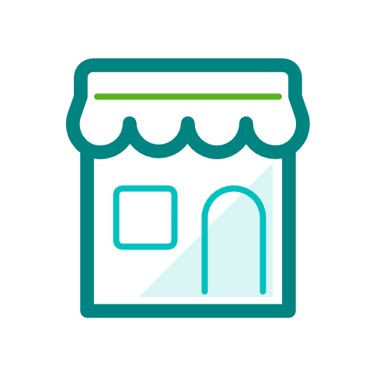
Example BUSINESS GOALS
Product or service
Conversion goal
NEW APPOINTMENTS
TAX RETURN
Accountant
A SERVICES BUSINESS
SCENTED CANDLE
ONLINE SALES
Gift Store
A RETAIL
BUSINESS
Notes:
BUT BEFORE we go ahead, lets look at two examples….
OK ARE YOU READY? DO you know exactly which product and conversion goal you’ve chosen?

Slide 19
Create your lead generation tactic
3
Lead magnet + Irresistible offer

Slide 20
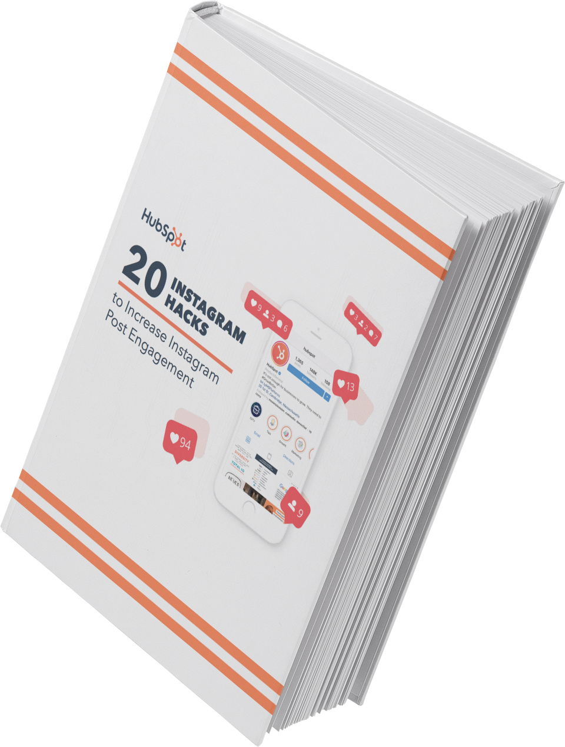
Create a lead magnet
eBook
An event or training
Webinars
Newsletter subscription
Video / Demo
Full article
Survey
Calculators or tool
Download now
Notes:
A lead magnet is an incentive that marketers offer to potential buyers in exchange for their email address, or other contact information
Generally it is something to download
An event to register for
A subscription to a series of articles or reports
Or a tool like a checklist, help guide, marketing kit etc
If you can’t think of what your magnet is right now, don’t worry I am going to offer some thought provoking ideas when I cover content and SEO later

Slide 21
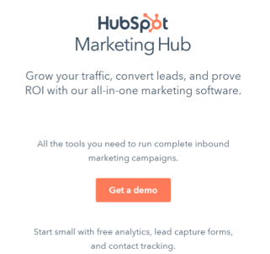
Create an irresistible offer
Discount
Gift with purchase
Free trial
Complimentary service
Fee waiver
Competition of chance
Competition of skill
FREE 3 MONTH TRIAL
Some mock-ups have been applied to snippets
Notes:
An Irresistible offer is something that a prospect with an intent to purchase cannot turn down if they happen to land on your website or other digital marketing channels. Generally it has an end date to drive purchase urgency and is somewhat related to the product or service you offer.

Slide 22
Example LEAD GEN TACTICS
LEAD MAGNET
OFFER
EBOOK OF SMALL BUSINESS SAVINGS
12 MONTH FREE QUICKBOOKS PLUS
Accountant
A SERVICES BUSINESS
FREE CANDLE WITH PURCHASES OVER $100
FREE CANDLE MAKING CLASS
Gift Store
A RETAIL
BUSINESS
Notes:
So … using the same two examples we used before, lets see what our accountant and gift store has selected

Slide 23
Product or service
Conversion goal
1. Business goal
TAX RETURNS
ONLINE APPOINTMENT
2. Lead gen
tactic
ATTRACT
CONVERT
LEAD MAGNET: eBook of small business saving
OFFER: 12 MONTH FREE QUICKBOOKS ONLINE
OUR CAMPAIGN FRAMEWORK
3. Channels
Visitors/ prospects
Leads/ buyers
Online Channels
Conversion Tools
Notes:
Now that we have completed the 2 steps, we need to go ahead and look at all the different marketing channels and their lead generation and conversion tool they offer to created LEADs, APPOINTMENTS or INSTANT SALES!

Slide 24
Online channel mix (RAPID!)
4
Execute across channels
Notes:
You are about to be presented with 7 online channels that can be used to attract and convert clients online. Each channel will contain some potential tools or advertisers you can implement into your marketing mix. it will be up to you to choose the channels that suit you, your audience and your business most.
With a large variety of businesses in this room today I present this section with a variety and business examples to stimulate your thoughts for your channel mix.
So sit tight, take notes and catch me after the session if you want to discuss any channel more deeply.

Slide 25
The channels & tools for you to create your tailored plan to attract and convert sales
3 x Social media
Google search
Lead magnet
Content
Website
Reviews
  Tailored
Google My Business +Maps
Offer
  Free or paid
Email marketing
  Conversion tools
3 x online affiliates
25

Slide 26
Your website

Slide 27
of first website impression are design driven
94%
Notes:
94% of consumers say their first impressions of a website are DESIGN DRIVEN!
END>
https://www.quicksprout.com/website-design-best-practices/
1. Easy navigation (and if you have many pages just add breadcrumbs_ > here > here > here
2. Search engine optimised
3. Clear call to actions - Only 47% of websites have a CTA button. CTAs should not be buried. They need to be big, bold, powerful, and clearly stand out as the action your visitors should take next
4. Internal links
5. Branding and style in line with your business
6. Mobile (According to Alexa rankings, 80% of the top websites are optimized for mobile devices. That’s because mobile browsing is becoming the new normal.) More than half of the web pages worldwide are served to mobile phones. 57% of people won’t recommend a business to others if that company has a mobile site that’s poorly designed
7.New, fresh content
8. Fast load speed

Slide 28
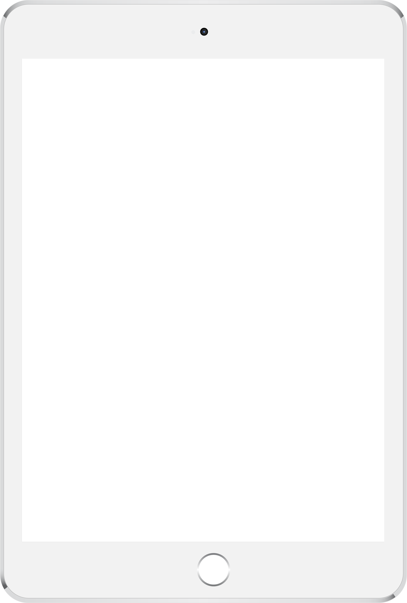
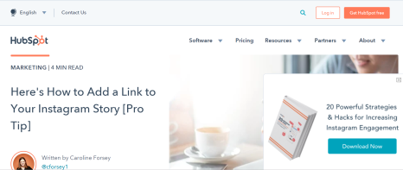
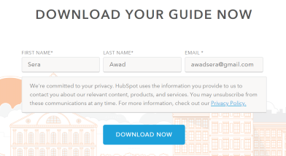
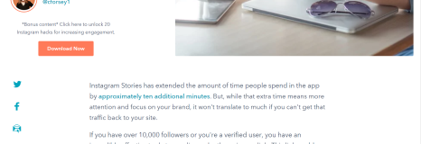
Your website is your online shopfront
It’s the center of your entire digital strategy
Easy navigation
Irresistible offer!
Your CTA or online shop!
Lead magnet!
Good design + mobile friendly
Information and fresh content
Technically sound
Search engine optimised
Some mock-ups have been applied to snippets
Notes:
Your website is your online shopfront – it is the centre of your digital strategy.
A best practice website doesn’t have to be costly but it should have…
1 - 6
If you don’t yet have a website you can build your own with great SEO tools intergrated into it and even ecommerce tools to run a shop. Consider - Spotify, Squarespace or WordPress (templates) platforms.
If you are worried that you website needs a look at be sure to catch our design team and the QB Booth to discuss it. And if you don’t have a website
END>
https://www.quicksprout.com/website-design-best-practices/
Discuss content, linking in SEO
8. Fast load speed
1. Easy navigation
3. Clear call to actions - Only 47% of websites have a CTA button. CTAs should not be buried. They need to be big, bold, powerful, and clearly stand out as the action your visitors should take next
4. Internal links
5. Branding and style in line with your business
6. Mobile (According to Alexa rankings, 80% of the top websites are optimized for mobile devices. That’s because mobile browsing is becoming the new normal.) More than half of the web pages worldwide are served to mobile phones. 57% of people won’t recommend a business to others if that company has a mobile site that’s poorly designed. In 2019 Statista (https://www.statista.com/statistics/274677/forecast-of-mobile-phone-users-inaustralia/
)reported that nearly 85% of Australians have a smart phone which.
7.New, fresh content
2. Search engine optimised

Slide 29
Google Search
(Organic and paid Adwords)
Notes:
- While there are a hand full of search engines I am only going to focus on Google in this section because it owns about 70% of the SE market.
I am also going to spend most my time talking about organic search because 70% of the clicked results are organic (that is, not advertisements)
I will then take you through a quick AdWords campaign why you may consider using Google’s paid search option.

Slide 30
of all internet experiences start with a search engine
93%
And 73% don’t click past page one
Notes:
So it is fair to say that some of us are wanting to choose to MASTER SEARCH for our FLAGSHIP product. So listen up…
https://www.imforza.com/blog/8-seo-stats-that-are-hard-to-ignore/
Making the most out of those referrals
93% of all Internet experiences start with a search engine. So your SEO strategy must go far beyond just adding keywords to your blog posts.
Of which Google owns 65-70% of the SE market.
70% of the links search users click on are organic
75% of users never scroll past the first page of search results
Search is the #1 driver of traffic to content sites, beating social media by more than 300%
EO leads have a 14.6% close rate, while outbound leads (such as direct mail or print advertising) have a 1.7% close rate
For Google, 18% of organic clicks go to the #1 position, 10% of organic clicks go to the #2 position and 7% of organic clicks go to the #3 position

Slide 31

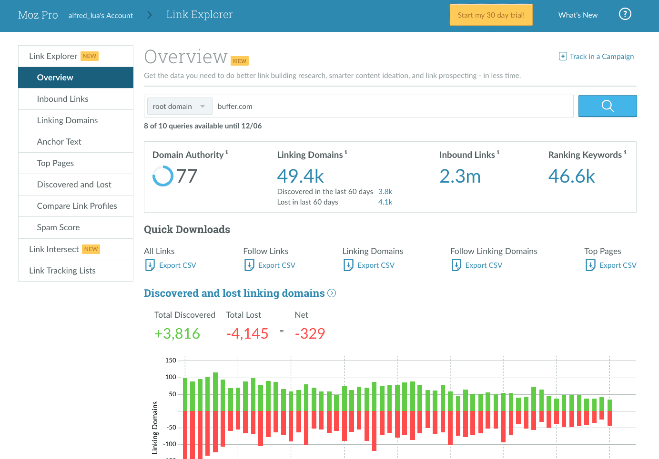
Get your search basics right
Moz.com/link-explorer
Notes:
SEO is a really important component of online marketing HOWEVER
The reality is that it can be highly technical thing. Your sites SEO health is impacted by functions like your heading structures, site maps or your domain authority. So rather than spending time on the technicalities of SEO I would suggest do a quick site health check with a free explorer like MOZ.COM and then speak to a professional.
The best use of our time is to understand some SEARCH BASICS so can consider these when creating new website or blog content to rank on a certain topic.
END>
Google Webmaster Guidelines
END>

Slide 32

What type of search queries are made
Navigational
10% of search queries
Youtube
Informational
80% of search queries
How to make vegetarian pizza
Transactional
10% of search queries
Pizza delivery
Notes:
TO RANK on page 1, we need to understand what type of content people are searching for; The words and phrases that people type into a search box in order to pull up a list of results – come in different flavors. It is commonly accepted that there are three different types of search queries:
Navigational search queries – which relates to domain name searches. YOU want to own your brands nav query by making sure your sites health is good OR buying your own search term in google adwords. FUN FACT: YouTube and Facebook are the top NAVIGATIONAL two searches on GOOGLE!
Informational search queries – Relates to questions people are asking. This is potentially where your lead magnet or other informational web content can rank.
Transactional search queries – These searches are related to people that have an immediate intent to buy. This is where you IRRESISTIBLE OFFER comes into the mix. These type of queries are also worth paying for.

Slide 33

Why does certain content rank better than others?
Ads
Relevance
Its own content
Webpage content
My Business
Usefulness
Maps
Credibility
Notes:
To be completely honest, it is near impossible to understand Googles algorithms or AI behaviour. Experts speculated there are about 200 ranking factors that determine a search results ranking PLUS Google makes up to 600 changes to its search algorithm.
BUT WHAT WE do know, that besides it own content GOOGLE LOVES
Relevance, what is most clicked on
Usefulness, how a user behaviours after the click on the ad
Credible content – Based on the domain the content is stored in and how credible, popular and technically sound it is.

Slide 34
Go narrow. Go deep.
Use locations with your term
Use verbs with your term
Use your brand with your term
Master 1 niche/local category … then expand to others
Green
Organic home
Apples
Chadstone
Whitening Kit
Notes:
As a result, my suggestion is like our main strategy rather than spreading your search efforts across many categories start by – GO NARROW and GO DEEP.
Try to really master 1 categorical phrase or Niche, rather than chasing broad terms, like accountant or teeth whitening. Rather chase, TAX ACCOUNTANT CHADSTONE, ORGANIC HOME WHITENING KIT.
That takes care of your brand and transactional Queries but how can we create and rank for informational content that is relevant??

Slide 35
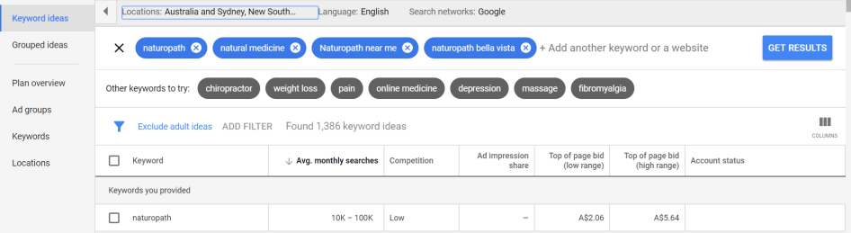
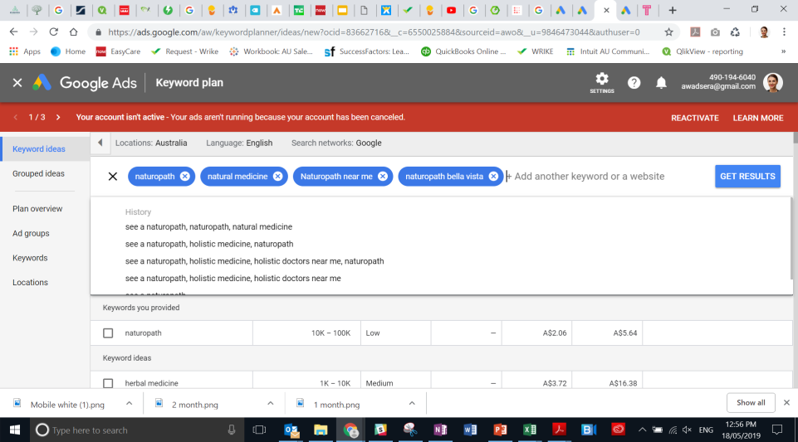
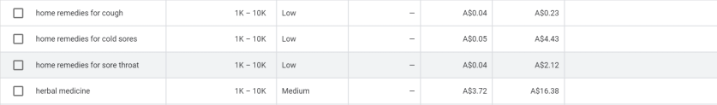
What type of searchable content could I create?
Google Keyword planner
Good’ informational content’ for my lead magnet
Transactional content worth bidding on
Notes:
That is where Google’s Keyword planner comes in!
The planner is…
Using a Naturopath business as my example, I used Google’s Keyword planner to understand what keywords are being searched so I could point my SEO strategy to those.
Now remember, it is best to try not to win in every category but to win in an important local or niche category

Slide 36
Where to point your SEO energy
Navigational
Naturopathic health solutions
Informational
SEO health + Google My Business account + Bid on this term
Natural home remedies for a cough
Transactional
Create a eBook about natural home remedies + focus much on-page and off-page content on this
Naturopath near me
Improve SEO on this term + BID on this in paid AdWords
Notes:
If we go back to search query types we can decide how the words that showed up in keyword planner influencers our organic and potentially paid word strategy.
For example, it goes without saying that we want to own our brand name to rank in the navigational queries. So we need to ensure our SEO health is strong and even consider paying for the brand name.
For informational queries, we saw that natural home remedie searches were high but the competition to score for these terms were low. So this Naturopath should consider creating content on this topic and potentially creating the lead magnet to capitalise on this
Last, the Transactional query “Naturopath Near Me’ attracted a lot of searches to so we want to ensure we add this clinics address to Google Maps and its website and potentially buy the term “Naturopath Bella Vista’ which is where this Clinic is based.

Slide 37
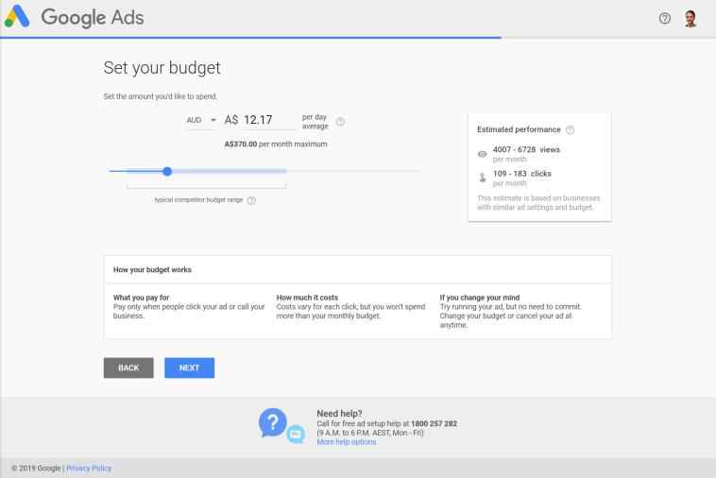
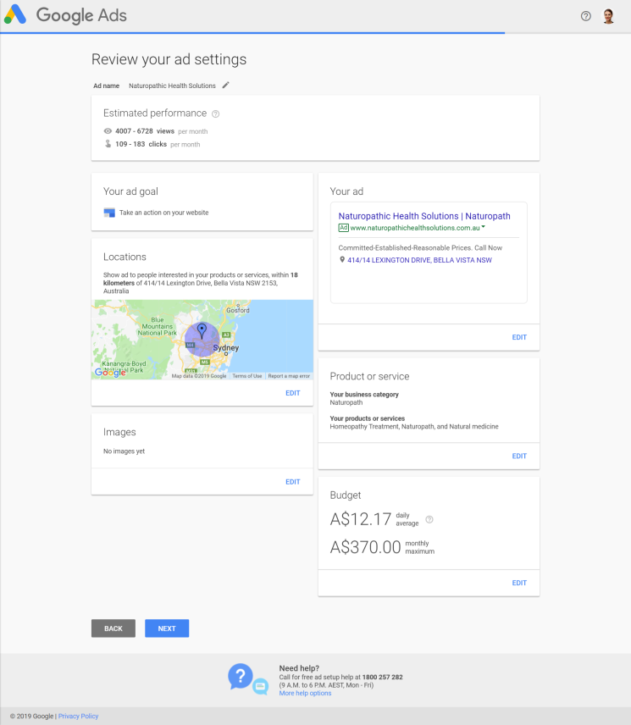
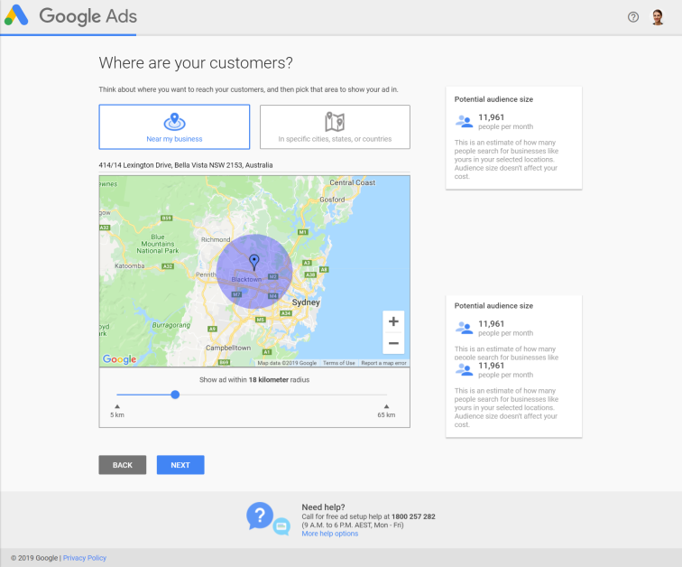
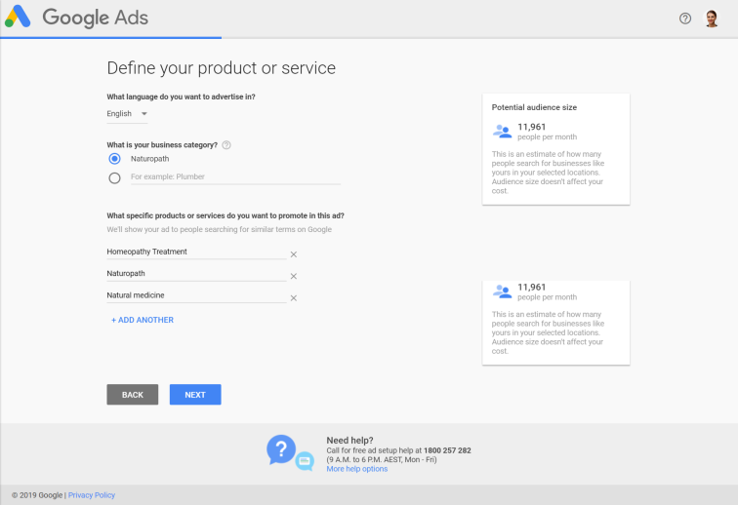
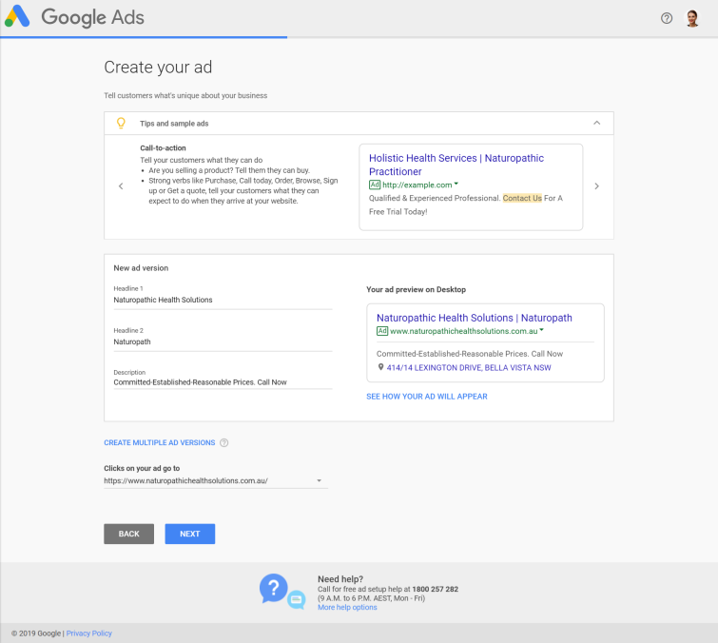
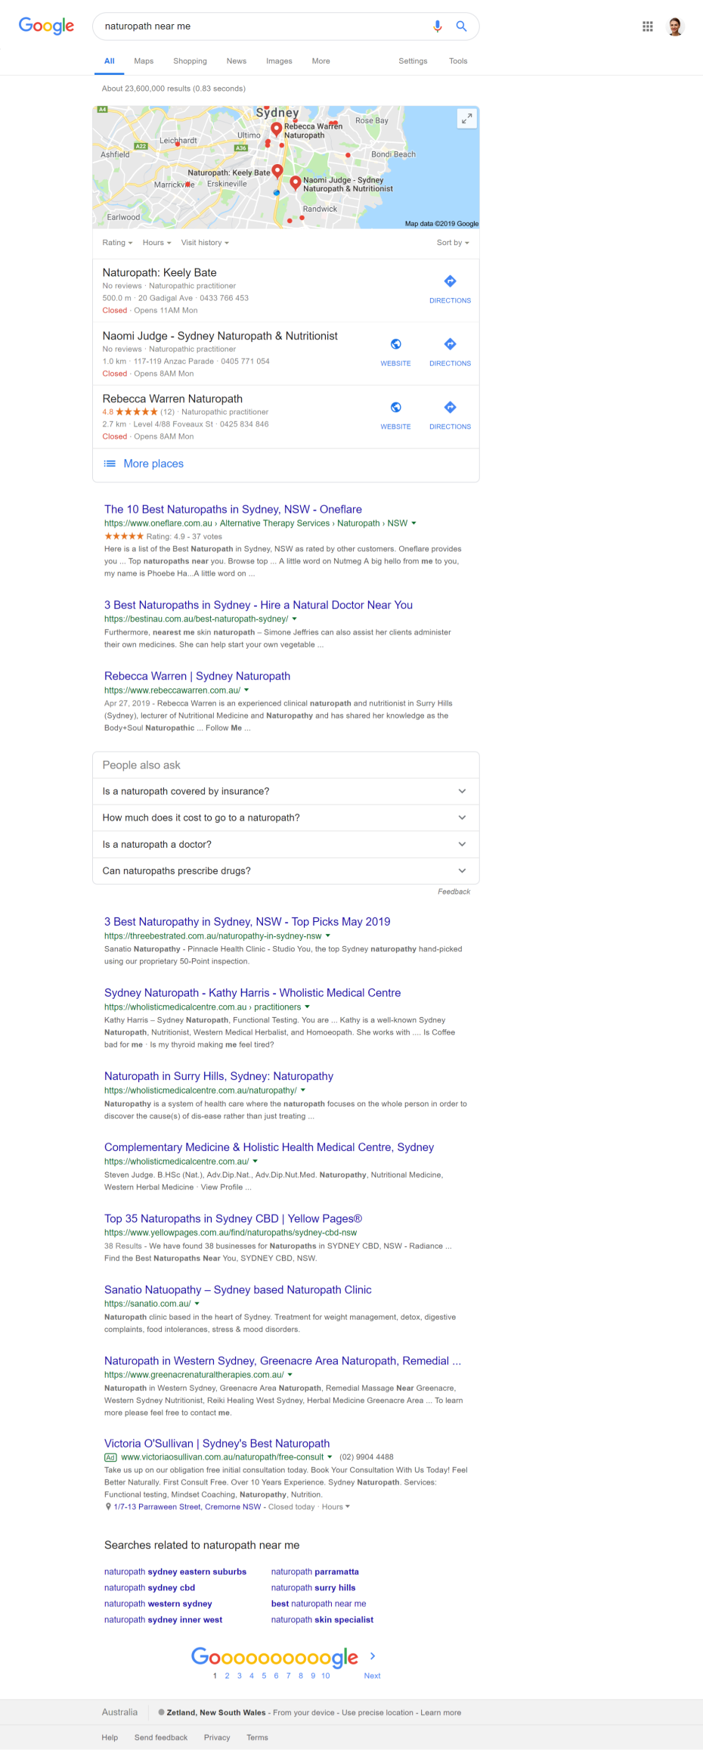

Paid Ads – Naturopath near me
Notes:
NO SCRIPT

Slide 38
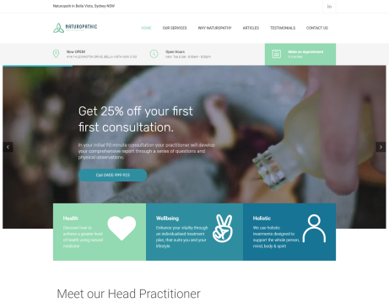
Organic and paid traffic goes to our website to convert
CTA (book an appointment)
Irresistible offer
Lead magnet
eBook – natural home remedies for winter bugs
Some mock-ups have been applied to snippets

Slide 39
Google My Business
Notes:
NO SCRIPT!
WHY: Whether through a search result or a maps query, over five billion searches are made each day through Google.
Its free
It supports your website search score
Map and search visibility (local 3 pack and organic results)
Give you access to these cool features (chat, offer/posts, CTA, CTCall, reviews etc adwords)
https://blog.hubspot.com/marketing/google-my-business
https://triadwebservice.com/web-design-blog/10-benefits-using-google-business-attract-local-customers-clients/
https://thrivehive.com/benefits-of-having-a-google-my-business-listing/
Making the most out of those referrals

Slide 40
Top source for local business phone number or address
#1
Notes:
A recent survey to 500 consumers asked what sources are most used to find a local business phone number or address and the answer was Google My Business.
The second answer, which was 20% behind Google My Business, was your businesses website.
END>
https://blog.hubspot.com/marketing/google-my-business
https://triadwebservice.com/web-design-blog/10-benefits-using-google-business-attract-local-customers-clients/
https://thrivehive.com/benefits-of-having-a-google-my-business-listing/
Making the most out of those referrals
https://searchengineland.com/survey-more-consumers-trust-accuracy-of-smb-websites-over-google-my-business-316363/amp
In the face of Google My Business growth small business websites are increasingly irrelevant — argue some local SEOs. However, a new consumer surveyfrom BrightLocal contradicts that thinking and makes the case that SMB websites are still a critical part of small business marketing.
GMB top source for basic local information. The survey of 500 consumers asked about sources used to find a local business phone number or address. Google My Business listings was the top answer, but websites came in at number two:
62% GMB listing/profile (in search results).
49% The business website.
44% GMB listing/profile (in Google Maps).
23% Online directory.
13% None of the above.
The survey allowed for multiple responses, which is why the numbers exceed 100 percent.
BrightLocal also found that 75 percent of respondents visited small business websites at least half the time, after a local search.
Consumers think SMB websites more accurate. Almost twice as many respondents (56%) said they expected the website to have more accurate content than Google My Business (32%). This is an interesting finding. It’s not clear whether this is simply an assumption that the local business site will have more accurate data as a matter of course or whether this reflects uncertainty about the quality and accuracy of GMB content.
Dominant preference for calls vs. email, messaging. After identifying the target business, 60% of consumers said they overwhelmingly would prefer to contact that business over the phone compared to other methods:
60% Call on phone.
16% Send email.
15% Visit the physical location.
4% Message through online form.
3% Contact on social media.
2% Request callback.
1% Other.
This is another big findings. However, the survey doesn’t expose demographic information so we don’t know whether and how these contact preferences might change by age group. I suspect there would be some differences when comparing Millennials to Baby Boomers, for example.
BrightLocal also asked about the most used features of Google My Business. Opening hours (69%), directions (50%) and “read reviews” (44%) are the top three use cases. Most booking scenarios (other than restaurants) were used by less than 15% of consumers. Q&A was not widely used either.
Why we should care. The industry has generally been downplaying the importance of local business websites for several years in favor of GMB and social media presence management. They’re obviously critical, but this survey and other data show that websites remain an essential piece of the overall digital marketing pie for SMBs. This survey data is likely to now show up in the slide decks of lots of companies selling websites to local business owners.
Another really striking data point is the consumer preference for phone calls. Some people reading this may be skeptical of the finding. However, it’s the immediacy and confidence that a phone contact brings that consumers are seeking. Yet large numbers of SMBs don’t answer the phone for one reason or another. This is partly why Google is introducing virtual assistant CallJoy.

Slide 41

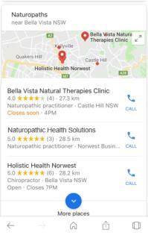
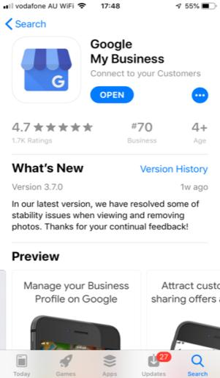
Google my business
Free, searchable and puts you in the 3 pack
3 pack
Some mock-ups have been applied to snippets
Notes:
Google my business is a free tool that points searches to local businesses.
It’s greatest benefit is it’s SEO benefit which gives you the greatest chance at appearing in Google’s top 3 local search results, which they call the ‘3 pack and sending new clients your way.
But you don’t have to be a local business to own a My Business Page so I recommend you download the app today and get started! Let’s look at its other functions.

Slide 42

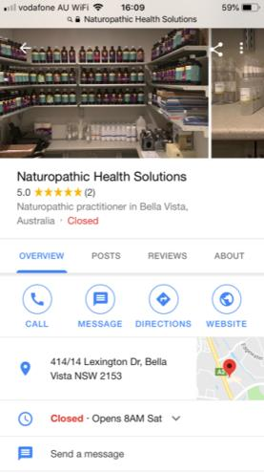
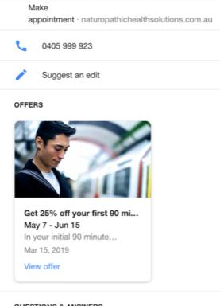
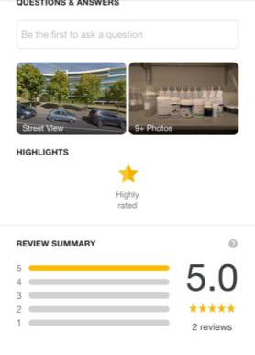
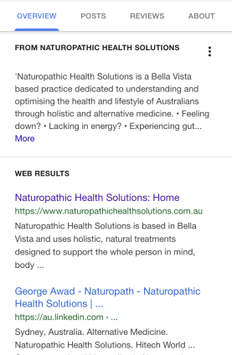
Photo library
Share button
(provide clients this link for reviews)
Rating at a glance
Website traffic
Click to call + message
Live trading times and public holiday notifications
Google Maps and directions
Call to Action button !!!
Scheduled offers
User Q & A
Google street view and photos
Rating and reviews
Search results related to your business
Notes:
NO SCRIPT!
The more up-to-date info you have on your page + the more reviews and clicks, the higher the chance of landing in the Google 3 pack!
END
>
https://www.google.com.au/business/?gmbsrc=%7BCOUNTRY%7D-%7BLANGUAGE%7D-ha-se-z-gmb-s-z-h~bk-1001313-RSA-c&ppsrc=GMBS0&utm_campaign=%7BCOUNTRY%7D-%7BLANGUAGE%7D-ha-se-z-gmb-s-z-h~bk-1001313-RSA-c&utm_source=gmb&utm_medium=ha&gclid=CjwKCAjw2cTmBRAVEiwA8YMgzcHHNGVadEVu-8KhgX6z8huF7uo26JqrAv5q8a1F1JaVlsymFyWNExoCdTsQAvD_BwE

Slide 43
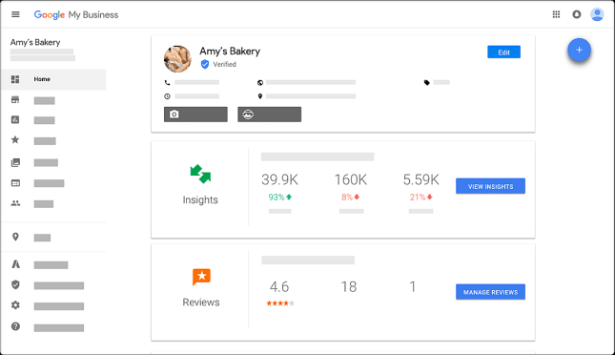
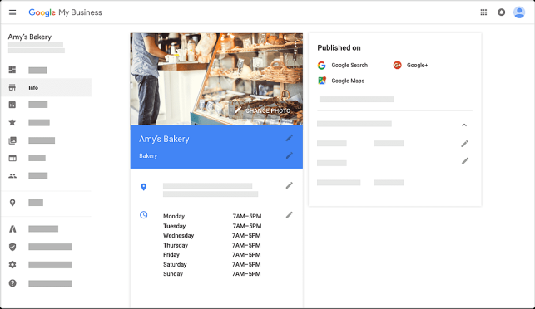
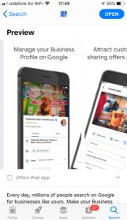
Google my business
Set it up, see your results, update regularly

Slide 44
Content marketing
Notes:
NO SCRIPT
https://help.cliniko.com/patient-management/cliniko-and-mailchimp/integrate-cliniko-with-your-mailchimp-account
Making the most out of those referrals

Slide 45
Content marketing
Finding the right topics
Regular content
Stuff tangentially related to your brand
Stuff your audience cares about
SWEET
SPOT
Stuff search engines loves
(use Keyword planner or Incognito mode)
Home remedies and herbal medicine for colds and flu’s
Notes:
Content marketing is used to stimulate interest in the products and services you provide. It is the process of creating content and then publishing it across your online channels like your website or social media to drive traffic and lead generation.
To find the right topics YOU NEED TO FIND YOUR SWEET SPOT> To do that, you will need to come up with content that
1 – your audience cares about
2 – Is tangibly related to your brand
3 – loved by search engines
ONCE YOU find YOUR SWEET SPOT, you have can focus your content energy or a narrow topic, win in that category and then expand to others.
For our Naturopathy business we researched earlier, we found our content sweet spot covering home remedies for winter bugs.
END>
Tactic: Create content your audience actually cares about, even if it’s not entirely focused on your product or service. By doing extensive research to understand your audience, you can find more ways to reach out to potential customers by looking for influencers that your prospects listen to. These influencers, individuals, or blogs, can easily be researched to uncover what their most popular content surrounds.
Results: Steady growth by building a relevant audience based on content that people WANT to read. Use your influencers wisely! For example, including quotes from influencers within an article can encourage them to share those pieces with their networks, increasing your reach without spending another dime.
Why this matters: It’s less about how to make a boring subject interesting and more about finding interesting topics and angles to engage your prospects. A structured approach using tools that are readily available to back up your hunches with actual data will make this approach a dream for anyone who loves logical processes.

Slide 46
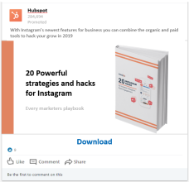
Content marketing
To syndicate across all your channels
Channel 1
Your campaign tactic
Convert!
Website full download
Main content (website teaser article)
Channel 2
Convert!
Channel 3
Some mock-ups have been applied to snippets
LinkedIn full download
Notes:
Once you know what type of stimulating content you’ll create, you’ll want to syndicate a repurposed version of it across your online channels to make good use of it and then hopefully your lead magnet and irresistible offer will convert your prospects.
In this example slide I have shown an example of how HubSpots displayed a TEASER version of LEAD MAGNET article on their website and then published a post on LinkedIn.
That way hubspot will generate new leads from their website traffic and their LinkedIn traffic. If this Lead Magnet is scoring well in Google search, you can image the volume of traffic hubspot is gaining which increases their lead conversion reach.

Slide 47
Social media
Notes:
SOCIAL MEDIA For Business

Slide 48
Are likely to recommend when they had a positive social media experience with a brand
71%
Notes:
NO SCRIPT!
2.16 hours per day, average time on social and 83% actively engaged with or contributed to some in the past month = https://www.smartinsights.com/social-media-marketing/social-media-strategy/new-global-social-media-research/
https://www.oberlo.com/blog/social-media-marketing-statistics
How much time and content do you have?
3.2 billion people are on it (42% of globe)
54% of social media users use it to research products
91 acces by mobile
71% of consumers who have had a positive brand on social are likely to recommend the brand to their family and friends
90.4% of socil isers are millennials

Slide 49
Create your social media account then…
Engage with them
Grow your audience
Your social media
Share or publish content
Advertise your offer
Advertise your offer
Publish your lead magnet
Publish your lead magnet

Slide 50
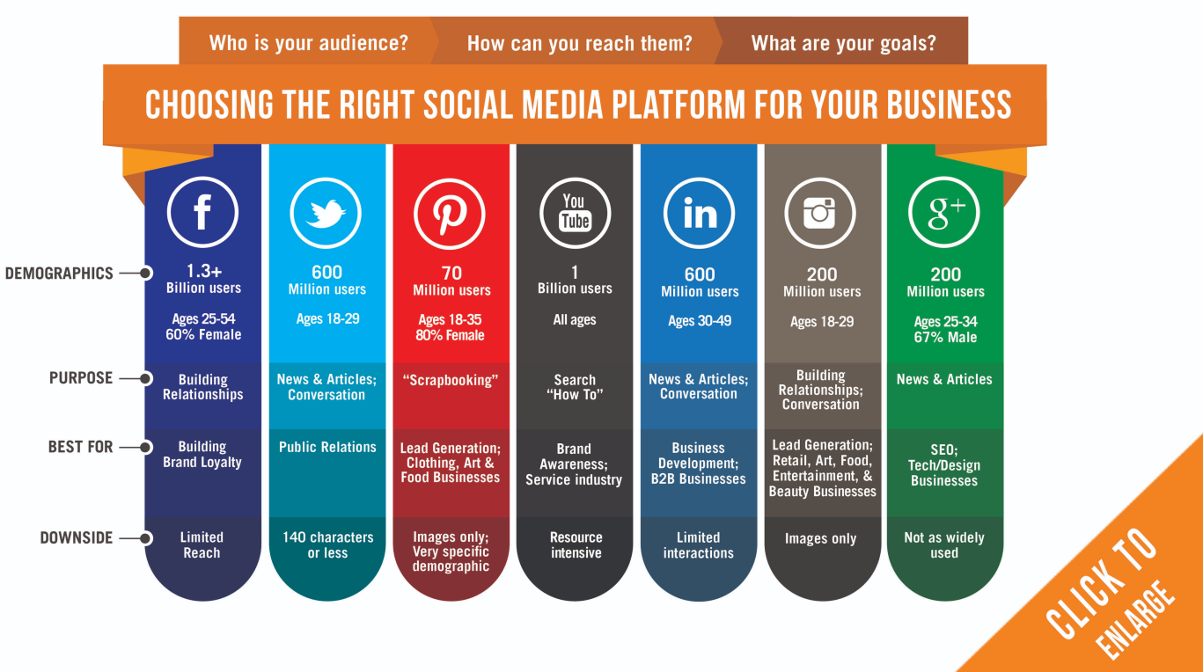


Which social media
is right for your business
A few words of wisdom
Don’t join if you have no intent or time to engage
Showcase your authentic voice and identity
Create a plan and schedule your activity
Be ready to experiment
Don’t be afraid to sell
Set ROI targets check the social media analytics
Where is your audience
How much time do you have?
Which social media tools can generate new business?
FREE
PAID

Slide 51
74%
Of users visit Facebook daily
Notes:
Compared to 63% for Snapchat and 60% for Instagram
https://sproutsocial.com/insights/facebook-stats-for-marketers/

Slide 52
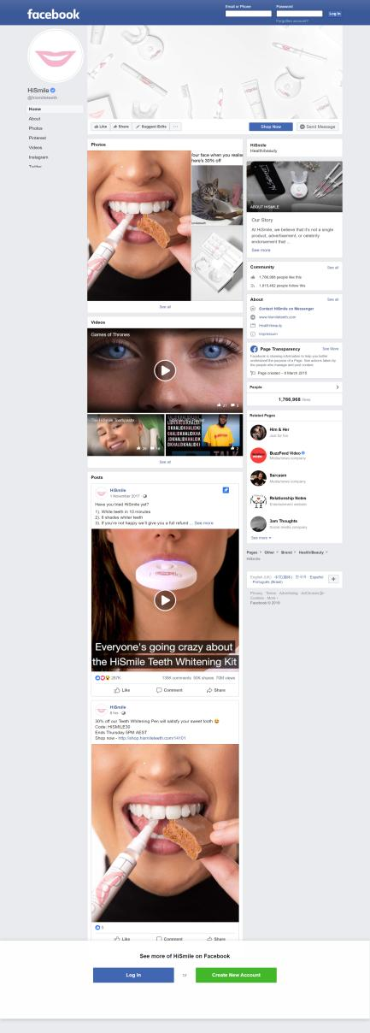
Facebook
Engage with communities to build brand loyalty and trust. Sell from Facebook
Call to action tools to convert your followers
Suitability
Book
Sign up
Call Now
Use App
60% female,
25-55 years
2 hours for 4 posts per week
Shop Now
Download
Retail | Local Stores | Non Profits | B2B
See Offers
Contact
Notes:
Start with slide content …then…
In this section I am going to present 2 lead generation tools follow by 2 Online Sales tool that you can use to drive or close sales through facebook.
END>
https://www.facebook.com/business/help/465446147173921?ref=fbb_pages
https://www.oberlo.com/blog/social-media-marketing-statistics
How much time and content do you have?
Environment
Rich communication channels
Rich media and features and functionality
Easy to use
Limited reach
Tools
Business pages
Analytics
CTA tools
Events system
Paid ads
Shopping Cart

Slide 53
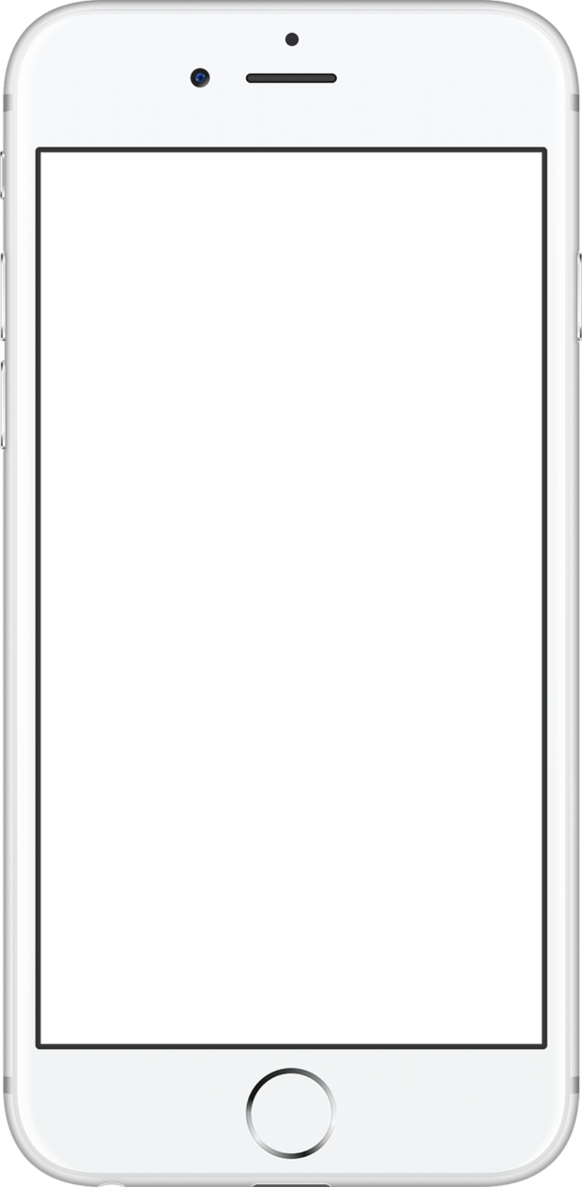
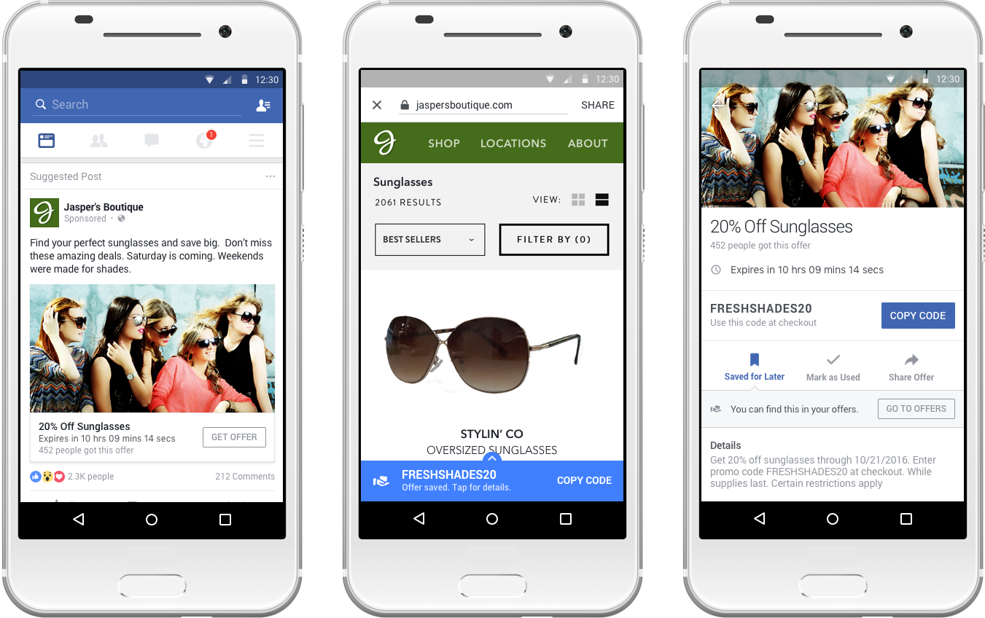
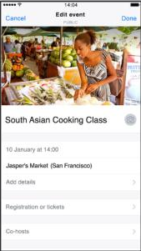
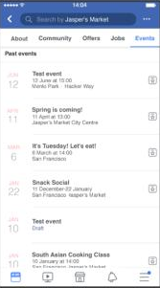
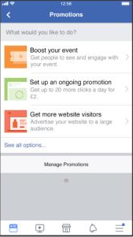
2 Facebook tools for lead generation
Use offers to post and boost offer reach
Use events to reach guests
Notes:
700 million people use Facebook events each month to market their events¹.
NO SCRIPT!
Set up your offer image:
http://blog.fptraffic.com/engage-fans-facebook-offers/
Insructions:
https://www.facebook.com/business/pages/post-offer
Create the offer from your page and then use ads manager to define your audience, set upi budget and schedule your offer
Description
Images (up to 5) or Video
Expiration Date
Discount Code (Optional)
Terms and Conditions (Optional)
https://www.facebook.com/business/pages/post-event
Events are free and easy to create on Facebook.
Make it easy for people to find your next event. Use Facebook Events to help you set up an event, reach your audience, increase attendance and sell tickets.
35 millionpeople view a public event on Facebook every day².

Slide 54
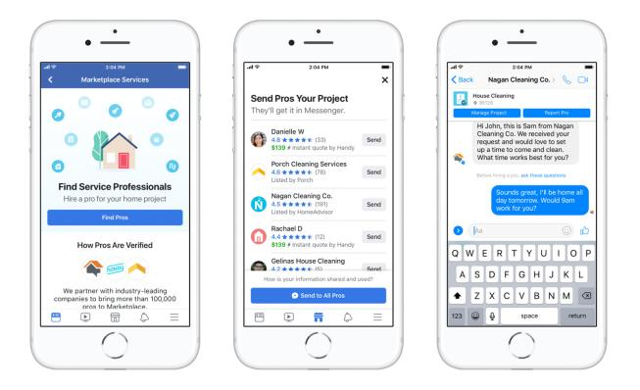
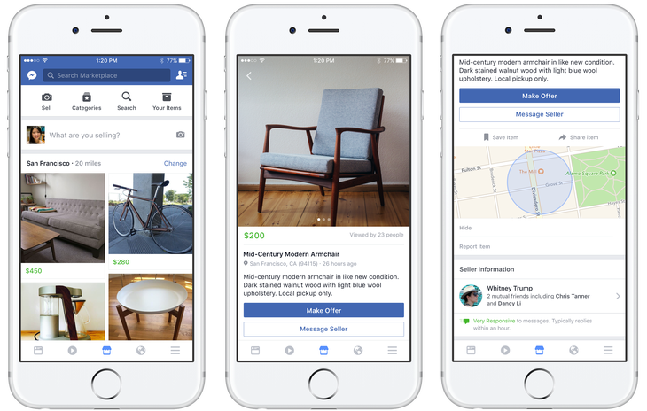
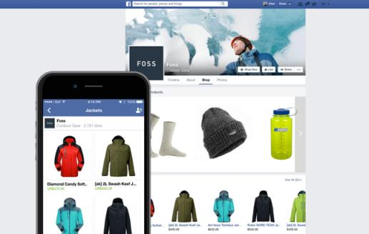
2 Facebook tools for online sales
1
2
Own a Facebook Store
Sell your products on marketplace
Or your services
Notes:
NO SCRIPT!

Slide 55
More engagement with brands then on Facebook and 84x higher then Twitter
10x
Notes:
NO SCRIPT
https://www.brandwatch.com/blog/instagram-stats/
Engagement with brands on Instagram is 10 times higher than Facebook, 54 times higher than Pinterest, and 84 times higher than Twitter.

Slide 56
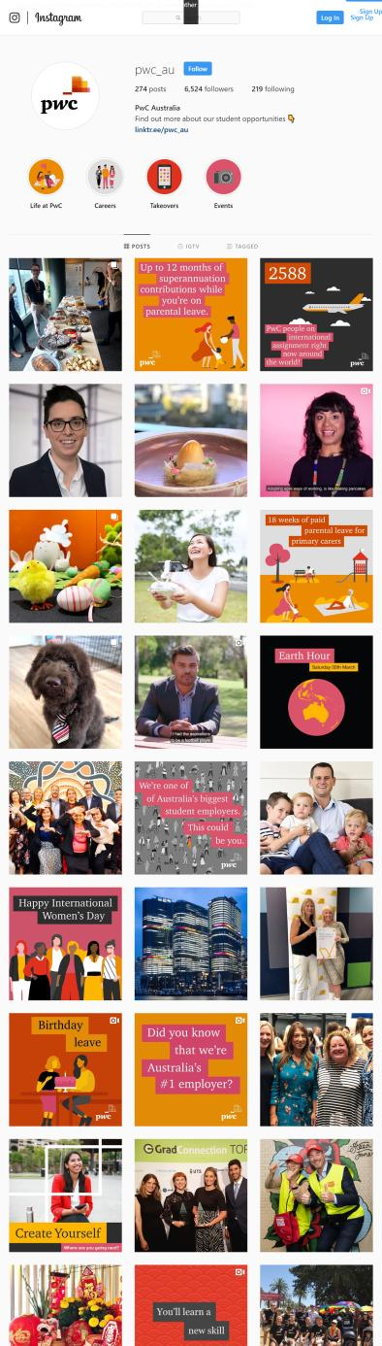
Instagram
Express and promote your brand visually. Sell from Instagram.
Suitability
Convert
Apply now
Book now
Start order
Reserve
53% female,
18-44 years
1 hours for 4 posts per week
Buy tickets
See products
Get Showtimes
Download
Retail | Local Stores | Non Profits
Notes:
NO SCRIPT

Slide 57
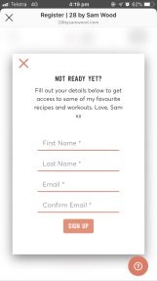
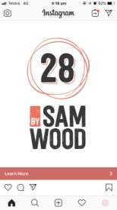
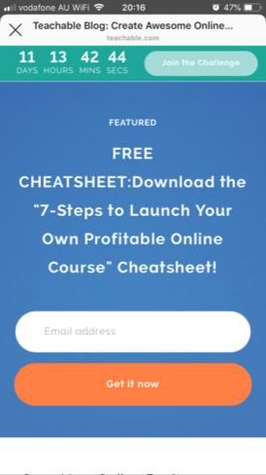
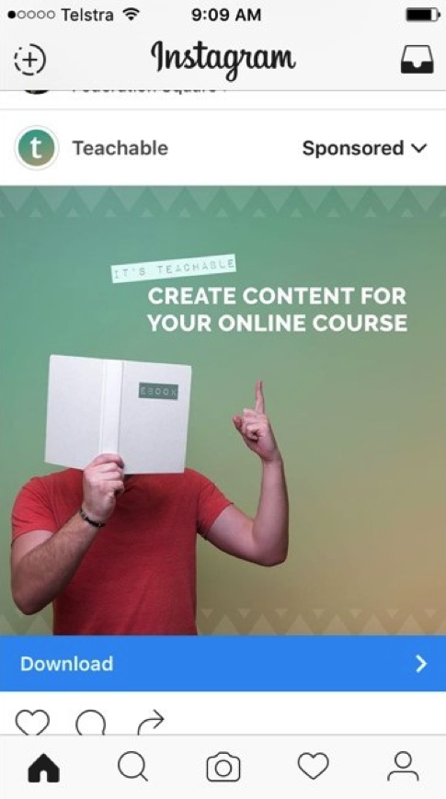

Instagram
Lead generation
Sponsored post to download an eBook
Lead capture (email)
Notes:
NO SCRIPT

Slide 58




Instagram
Online sales
Create and boost a post to generate sales on products
Sell products from your page
Notes:
NO SCRIPT

Slide 59



Instagram
Profile | Integrated action buttons
Health & Beauty: GlossGenius, Booksy, Genbook, goPanache, Setmore, Fresha, Acuity Scheduling, Appointments by Square, Vagaro, StyleSeat, Squire, Shore, GetTimely, Schedulicity, MyTime, Salon Iris, Schedulista, Treatwell, and Appointy.
Dining: Tock, Restorando, Resy, Reserve, Yelp, SevenRooms, OpenTable, LaFourchette, Quandoo, Gurunavi, and Bookatable.
Order Food: EatStreet, ChowNow, and GrubHub.
Lifestyle and Entertainment: Eventbrite, Atom Tickets, Fandango.
Inspire beauty salon using Acuity Appointments integration
Book now
Start order
Buy tickets
Reserve
Notes:
Health and Beauty software like Acuity Scheduling!
Local business software like; Appointments by Square
And Dining software like OpenTable

Slide 60


Instagram
Profile | Integrated action buttons
Toko restaurant using Resy integration to convert reservations
Notes:
Profile page (contact etc) but integrated action buttons

Slide 61
45%
Of posts are read by upper ranks
Notes:
45% of those reading LinkedIn posts are in the upper ranks of their companies, including VPs and CEOs. Support your executives in publishing relevant thought-leadership content that expresses your brand’s expertise and gets your key messages out there.
https://business.linkedin.com/content/dam/me/business/en-us/marketing-solutions/cx/2018/images/infographics/read_me_if_you_want_to_drive_more_leads_using_linkedin.pdf

Slide 62






LinkedIn – not your typical social media site
Publish content and build relationships prospective for business deals.
Learn more
Download
Sign up
Some mock-ups have been applied to snippets
Notes:
Unlike Facebook and Instagram that positions themselves as a social networking sites, Linkedin actually positions itself as a Publishing networking site. This makes content publishing on LINKEDin really important for companies and influencers but also really rewarding!
Companies that post weekly see a 2x lift in engagement with their content.
Here is an example of KPMG using Linkedin to publish useful content about Digital Transforming. But then also using LINKEDin lead generation tools to capture Sign Ups for thei Hackathon that teaches business to embrace emerging technologies.
Once a LinkedIn user selects Learn More, a Lead Gen form captures their details which KPMG potentially use later for marketing and sales purposes.
https://business.linkedin.com/content/dam/me/business/en-us/marketing-solutions/cx/2018/images/infographics/read_me_if_you_want_to_drive_more_leads_using_linkedin.pdf
https://www.oberlo.com/blog/social-media-marketing-statistics
How much time and content do you have?
There are more than 9 million LinkedIn users in Australia.
https://www.brandwatch.com/blog/instagram-stats/
Engagement with brands on Instagram is 10 times higher than Facebook, 54 times higher than Pinterest, and 84 times higher than Twitter.
if you have over 10,000 followers or you're a verified user, you have an incredibly effective tool at your disposal -- the swipe up link
Build word of mouth, awarness and sales
https://www.facebook.com/business/help/465446147173921?ref=fbb_pages
https://www.oberlo.com/blog/social-media-marketing-statistics
How much time and content do you have?
Environment
Rich communication channels
Rich media and features and functionality
Easy to use
Limited reach
Tools
Business pages
Analytics
CTA tools
Events system
Paid ads
Shopping Cart

Slide 63


LinkedIn – content suggestions
Share content that matters! Show authority and stay front of mind.
Notes:
So if content is SO IMPORTANT, how do we share content that matters? Well LINKEDIN is true to its belief that content matters.
SO THEY HAVE DEVELOPED this amazing tool called CONTENT SUGGESTIONS that allow you to discover trending topics and articles to share with target audiences.
Simply select your audience, explore what’s trending, and share selected articles.
END>
https://business.linkedin.com/marketing-solutions/linkedin-pages/best-practices

Slide 64




LinkedIn – paid ads
Paid posts for reach and lead generation
Gold Phase post
Great read on the future of #AI and #gaming
$989.34
154,532
Https/goldenphase.com/linkedinposts
Notes:
If the Post is doing really well organically then you can choose to boost it with their PAID advertising tool called ‘SPONSORED CONTENT’ by to reach more prospects outside of your network.
You simply set up your boosted post, select your audience, their job descriptions and their location then, add a little investment and your post makes its way to more eyeballs!
You can also use Sponsored Posts to promote your lead magnet to generate traffic to your irresistible offer.
END>
Sponsored Content – sponsor your best posts or promote your lead magnet or special offer
Run native ads in the LinkedIn feed across desktop and mobile https://business.linkedin.com/marketing-solutions/native-advertising

Slide 65




LinkedIn – InMail & Sales Navigator
Targeting prospects via their inbox
Notes:
And lastly I want to present LINKEIND inMail tool and Sales Navigator tool to reach professionals straight in their inbox.
For a set fee, you can set up a campaign to send message and display ads in prospects Mailboxes. OR If you have a sales team, you can sign them up for $80 a month to use LinkedIn ‘Sales NAVIGATOR tool’ which will allow them to search for lead as a sales rep.
Quickly discover the right people at your target accounts with suggestions customized for you.
https://business.linkedin.com/sales-solutions/sales-navigator

Slide 66
3rd parties | Affiliates
Notes:
Airtasker - Amazon – QuickBooks Directory – MenuLog - HiPages
https://www.roymorgan.com/findings/7623-top-online-shopping-auctions-websites-march-2018-201806180044

Slide 67
Directories and listing sites
Offer and lead generation sites
3rd party online sellers
3rd party / affiliate types

Slide 68




Benefits of 3rd parties & affiliates Free and paid
Directories
Your site links
Naturopathic health solutions
Improve Search results
Gain exposure to new customers
You maintain leads and post sales relationships
Potentially get marketing support
Referrer links
Some mock-ups have been applied to snippets
Notes:
By placing your products, services, lead magnets and offers on other sites, you can potentially multiply the benefits in page 1.

Slide 69







Directories & listings
Join niche and broad directories for free
Directories
Notes:
12,000 small businesses search for a ProAdvisor on this directory just last year and 7,000 connections were made in the same period.
FREE AND PAID for Priority positions.
END>
https://betakit.com/clarity-fm-acquired-by-fundable-now-a-part-of-startups-co/ if you’rerunning a mentor or consultating business for start ups and growth companies
Think Yellow, Finder or an industry directory like your Accounting Software company
12,000 small businesses search for a ProAdvisor on this directory just last year and 7,000 connections were made in the same period.

Slide 70








Offer and lead generation sites
List your irresistible offer or negotiate a job
Comparison and offers sites
Notes:
Groupon is an online platform that manages the sale of discount vouchers (coupons) created by businesses selling products or services. The value for businesses advertising on Groupon is its captive customer base—49.3 million users worldwide. Listing your product is really easy on group but they will ask for a special customer discount that (like you irresistible offer) and then take 30-50% of the cut!
If you think Groupon is for product based business only – you are wrong! –Lawyers are offering basic will services for $35, schools promoting discounted education and a Dentist offering Titanium dental implants for about $14K (discounted from $20K)
The other options I want to present are for the tradies and freelancers
HI PAGES is for people looking for a tradie. It is free to use but based on how popular your customer type is, you can pay $9-$60 for each lead.
Other similar offer and lead generation sites include:
Will Lead offer sites be the channel you master first?
END>
Free to use
No obligation to hire
Responses within minutes
Finder, croupon, catch, scoopon, cudo (living social) - etc
FINDER: Join 2.4 million Aussies today. Be a Finder.
Australia’s Top 15 Online Shopping & Auction sites – visitation in an average four weeks over 12 months to March 2018
https://www.roymorgan.com/findings/7623-top-online-shopping-auctions-websites-march-2018-201806180044

Slide 71













3rd party sellers
introduce new distribution channels
Economies (marketplaces, sharing and gig)
Amazon
will SELL, PACK and DELIVER your items starting at
$49.95 (excl. GST) per month. Cancel anytime.
Notes:
Lets talk about 3rd party distribution channels!
Deliveroo restaurants saw their takeaway sales increase by up to 30% on average but they can take about 10-20% per order.
And for our retail businesses in the room, by selling your products on Amazon you will access its 100 million customers globally. They will sell, pick, pack and deliver your items for $50 per month put the cost per sale.
If you are a designer or developer – you can sell the same template an unlimited about of times or custom work through marketplaces like Envato, 99 designs or design crowd.
And lastly, if you are a professional with the ability to pack and deliver a training course, then you may want to consider selling that course on Learning sites like UDEMY, LYNDA and Teachable for a fee per course.

Slide 72
Email marketing
Notes:
All the sources of email data you captured from those prior ideas -= Now you have a list of targetable contacts!
https://help.cliniko.com/patient-management/cliniko-and-mailchimp/integrate-cliniko-with-your-mailchimp-account
Making the most out of those referrals

Slide 73
Digital marketers rated email the highest ROI
73%
Consumers rate email as their preferred marketing channel
Notes:
73% of consumers say email is their preferred marketing channel
If you don’t have an email marketing software then you can try mailchimp – it integrates with a lot of CRM software that you are prob already using/
Email offers best ROI Rating
For marketers compared to
SEO - 67%
Content - 62%
PPC - 59%
Affiliate – 47%
https://www.superoffice.com/blog/email-marketing-strategy/. Email marketing outperforms all online marketing strategies, including SEO, PPC, and content marketing!

Slide 74


Email marketing
For lead nurture and offers
Regular emails with value add content that deepens their need and retains their brand awareness
Offer emails to convert email contacts
Blast your irresistible offer!
The sweet spot!
Notes:
Nurture emails are excellent tools that you can use to move prospective customers down the sales funnel until they make a purchase. Consider all of the email addresses you captured from your amazing, lead magnet tactics! Well the idea is that you periodically send these leads useful ‘SWEET SPOT Content’ to stay front of mind an encourage a sale, resale or cross sale.
Offer emails are highly tactical emails intended to be sent to leads at the time that they have the highest propensity to buy or when you have a sale on!
It is a super-low costs and effective method to triggering a purchase if you have an online store or an appointment booking system built into your website!

Slide 75



Email marketing
For communication and engagement
Time based email to prompt the next sale or discussion
Transaction based emails after a sale or other event
Suggest a re-order or ‘next best product’
A link to your Google or QuickBooks listing
Some mock-ups have been applied to screens
Notes:
Regular communication and engagement emails are great tools to reengage your existing customers.
Time or trigger based emails are a great way to trigger reminders to clients cto suggest when it is time to purchase a next product.
For example, if you are a home loan provider, then triggering a reminder to your client to review their home loan every two year would be helpful for the client and potentially mean a new sale for you.

Slide 76
So which channels appeal to you most?

Slide 77
The final plan

Slide 78
Product or service
Conversion goal
1. Business goal
TAX RETURNS
ONLINE APPOINTMENT
2. Lead gen
tactic
ATTRACT
CONVERT
LEAD MAGNET: eBook of small business saving
OFFER: 12 MONTHS QBO
OUR CAMPAIGN FRAMEWORK
3. Channels
Visitors/ prospects
Leads/ buyers
Online Channels:
Website
Google My Business
Groupon
ProAdvisors Listing
Conversion tools:
Online bookings
Online Booking
12 MONTHS QBO COUPON
Online enquiry form

Slide 79
Experiment with different channels, offers and tactics
Track your campaign and measure your return on investment

Slide 80
Thank you

Slide 81
Questions?
#QBConnect | WiFi: QBConnect Password not required

Slide 82



Rate this Session on the QuickBooks Connect Mobile App
Provide feedback to help us design content for future events
1. Select Sessions
2. Select Title
3. Add Rating and Comments

Slide 83

Material Download
1. Find the session on the agenda
2. Select + for more information
3. Download PDF of slides and/or
supplemental material
https://au.quickbooksconnect.com/agenda/

