Slide 1


Designing and Troubleshooting Proteomics Experiments
Mike Kinter, Ph.D. Alan Tackett, Ph.D.
Resource co-Director Resource co-Director
Darrin Akins, Ph.D. Lawrence Cornett, Ph.D.
OK-INBRE Program Director Arkansas INBRE Program Director

Slide 2
Speakers and Workshop Schedule
Dr. Tackett: co-Director of IDeA National Resource for Proteomics, >20 years of experience in discovery phase proteomic workflows
Dr. Kinter: co-Director of IDeA National Resource for Proteomics, >20 years of experience in targeted/validation phase proteomics
Dr. Mackintosh: co-Director Univ. of Arkansas for Medical Sciences Proteomics Core Facility, >15 years of experience operating a discovery phase-based core
Dr. Stephanie Byrum: Director COBRE Bioinformatics Core, >15 years experience with bioinformatics in proteomics
1:00-1:10 Dr. Tackett’s Overview
1:10-1:30 Dr. Mackintosh: Discovery Phase Proteomics
1:30-1:50 Dr. Kinter: Targeted/Validation Phase Proteomics
1:50-2:50 Group Discussion

Slide 3
Challenges for IDeA Investigators interested in proteomics
Insufficient access to and maintenance of state-of-the-art instrumentation
Lack of educational outreach programs to help investigators design, implement, and analyze data from proteomics studies
PA-16-172 (06/07/2016): “enhance core facilities and core facility services available to investigators in IDeA-eligible states”

Slide 4
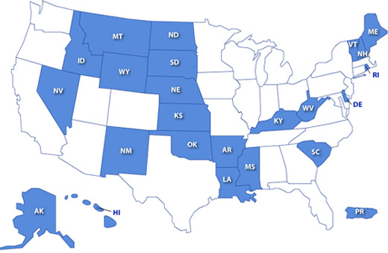
Goals for the IDeA National Resource for Proteomics
Regional consolidation of 2 Proteomics Cores to create the IDeA National Resource for Proteomics
  UAMS: Alan Tackett, PhD
  OUHSC/OMRF: Mike Kinter, PhD
Goal 1: Provide access to state-of-the-art proteomic instrumentation and expertise for all IDeA states; and to enhance existing IDeA state cores
Goal 2: Provide educational outreach in the area of proteomics to local core directors, investigators, and students in IDeA states

Slide 5
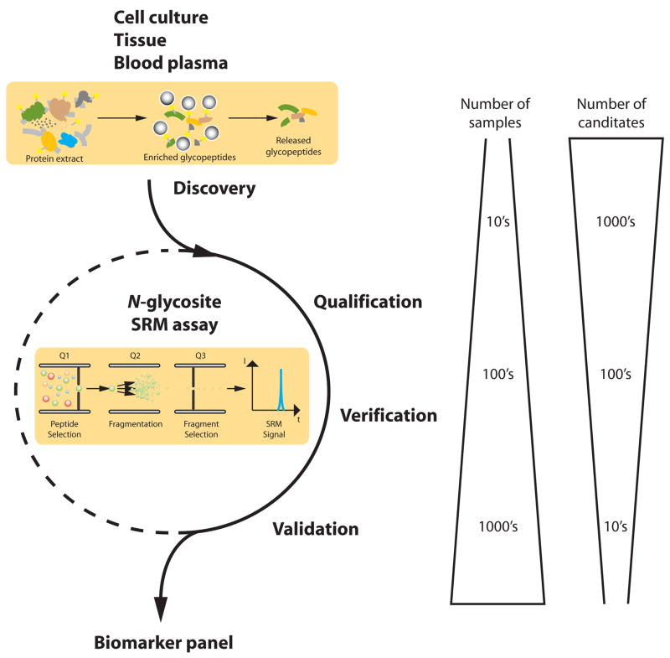
Two Complementary Proteomics Core Facilities
UAMS
“Discovery
Phase”
OUHSC/
OMRF
“Targeted
Validation
Phase”
Notes:
60% went on to grad school/med school/hlth prof school
85% got a STEM degree or went on to grad school/med school/hlth prof school

Slide 6
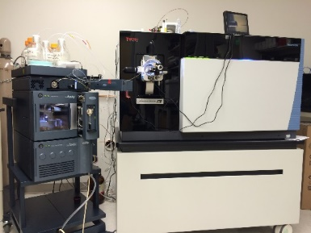
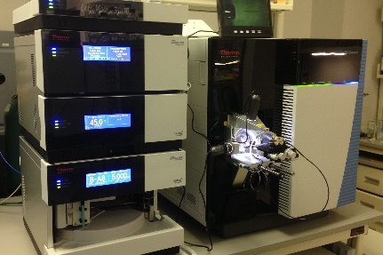
Regional Core Consolidation
MOU to ensure respective instrumentation is kept state-of-the-art
Eliminates regional duplication of expensive, high-end instrumentation
Each core added one cutting-edge mass spectrometer
Arkansas
Oklahoma
New
Thermo Orbitrap Lumos
Existing
2 Orbitrap Fusions
Orbitrap Velos
New
Thermo TSQ Quantiva QQQ
Existing
Q-exactive Plus
TSQ Vantage QQQ
Notes:
60% went on to grad school/med school/hlth prof school
85% got a STEM degree or went on to grad school/med school/hlth prof school

Slide 7
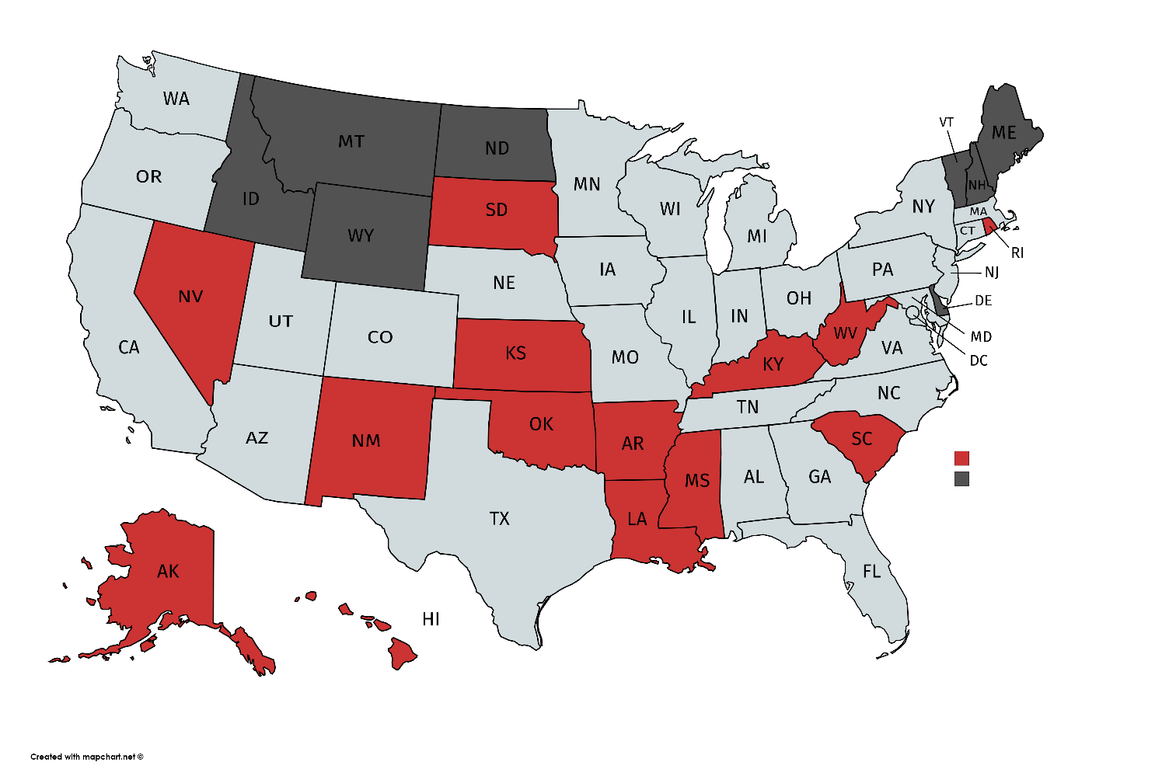
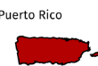
Goal 1: Access to Proteomic Instruments and Expertise
67% of IDeA states have used resources
Notes:
60% went on to grad school/med school/hlth prof school
85% got a STEM degree or went on to grad school/med school/hlth prof school

Slide 8
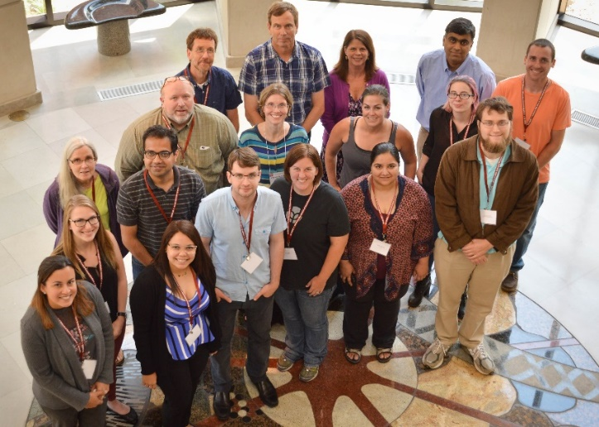
Goal 2: Educational Outreach
Proteomics Core Staff Workshops
  Cutting-edge technologies that can be translated back to their home institutions
    41 attendees (2017-18)
IDeA Faculty and Student Workshops
  Fundamentals
  Proper experimental design and data analysis
  94 attendees (2017-18)
100% IDeA state representation!
Notes:
60% went on to grad school/med school/hlth prof school
85% got a STEM degree or went on to grad school/med school/hlth prof school

Slide 9
Workshop Example
Day 3: Small group discussions on focused topics
Day 2: Real data analysis with the specific technique – bioinformatics, pathway analysis, etc.
Day 1: Didactic and fundamentals
Notes:
60% went on to grad school/med school/hlth prof school
85% got a STEM degree or went on to grad school/med school/hlth prof school

Slide 10
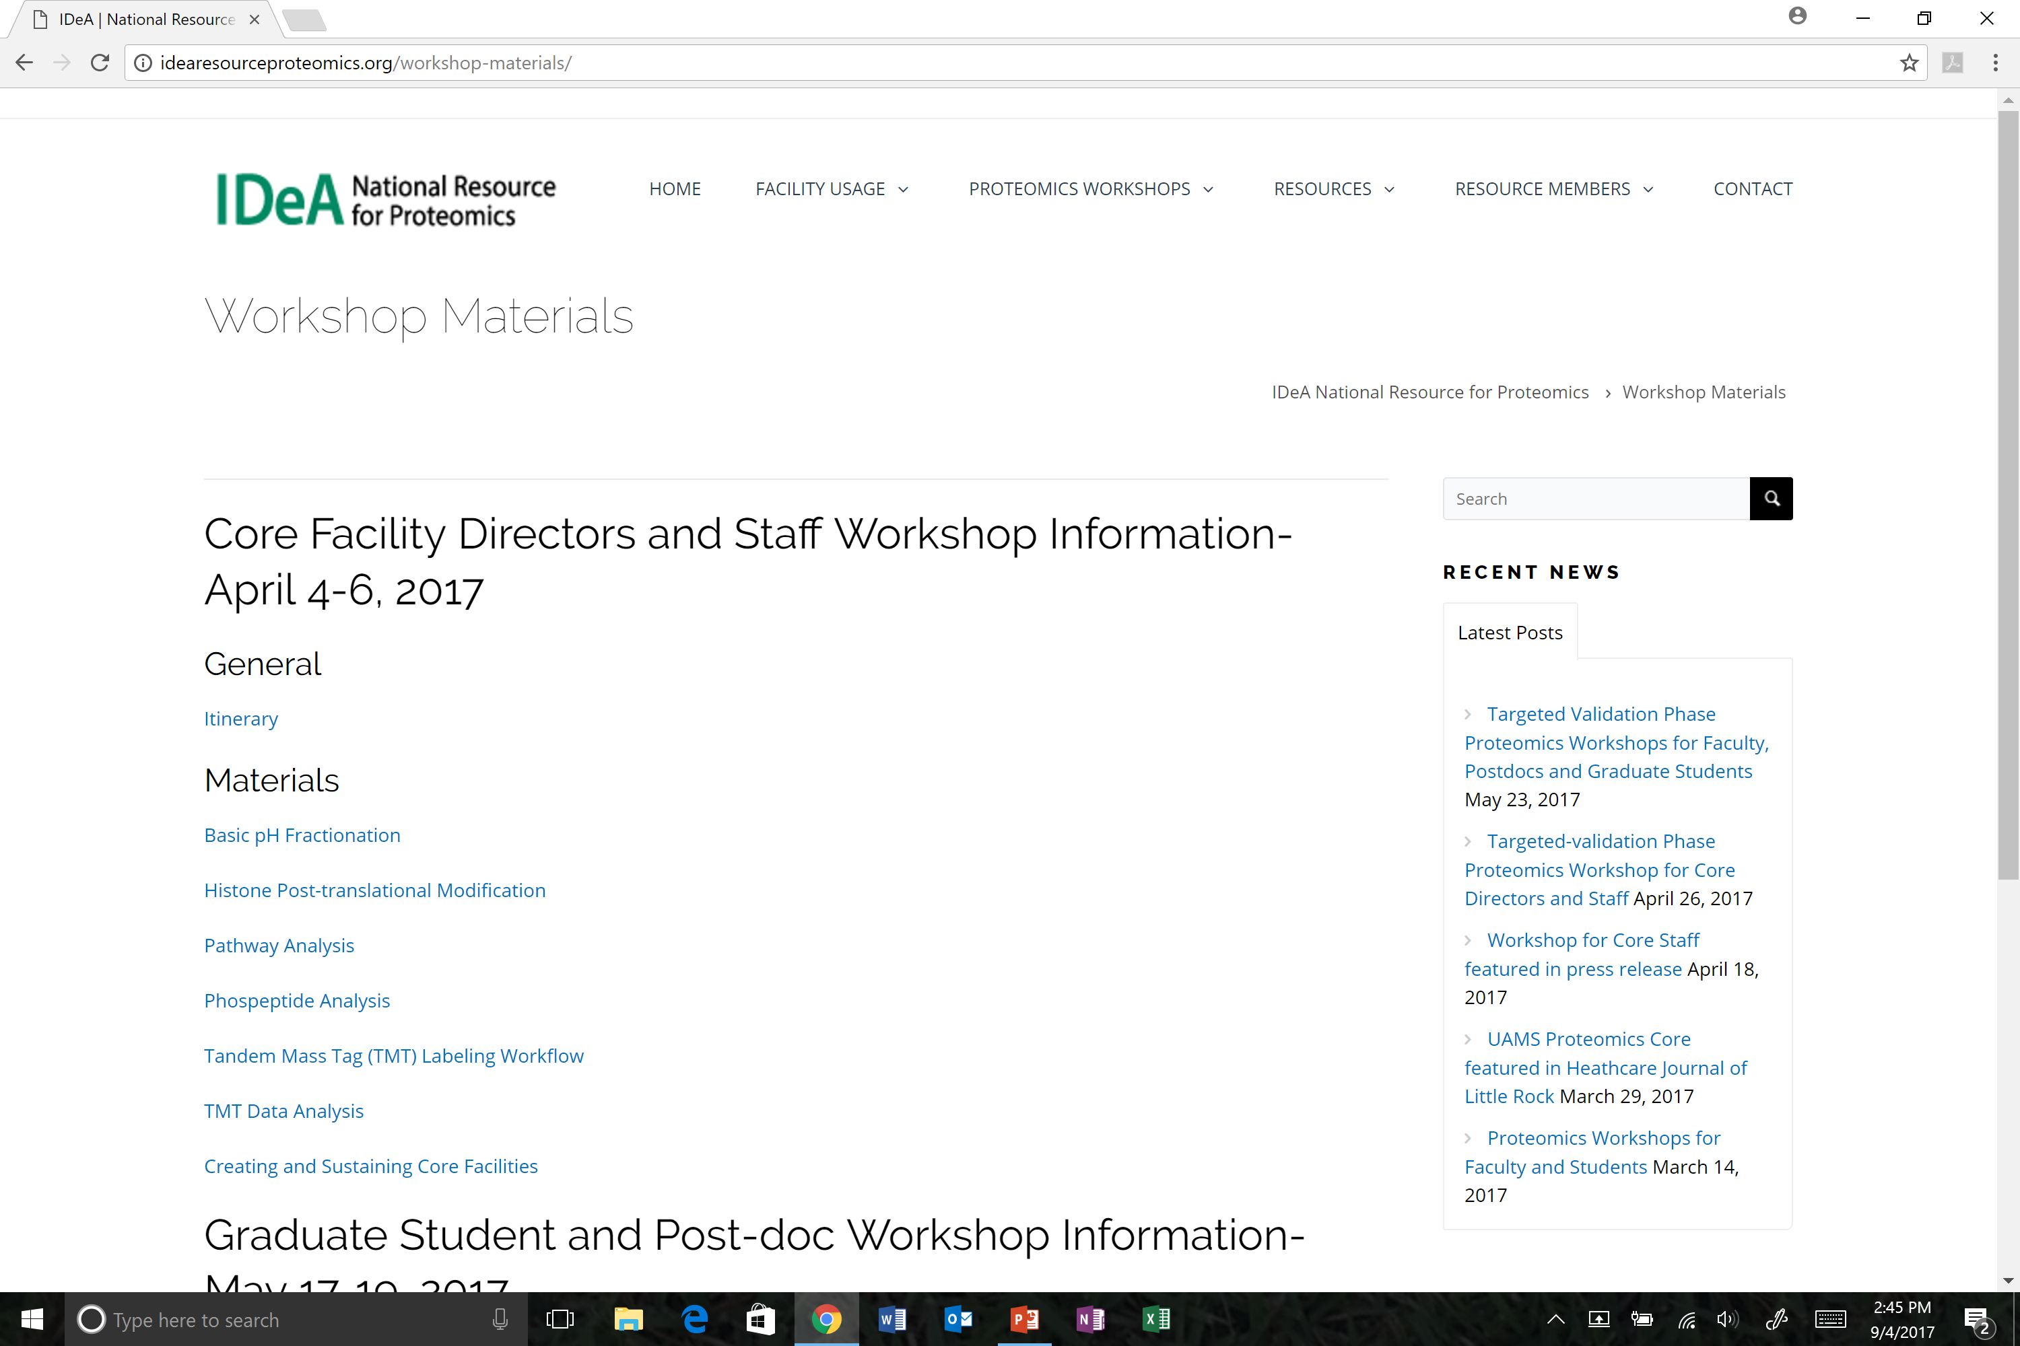
Workshop Material is Open Access
http://idearesourceproteomics.org/
Notes:
60% went on to grad school/med school/hlth prof school
85% got a STEM degree or went on to grad school/med school/hlth prof school

Slide 11
Upcoming Workshops
Proteomics workshop for IDeA faculty and students at OMRF/OUHSC in spring 2019
Core Facility Staff workshop in spring 2019 in Arkansas or other host venue
Notes:
60% went on to grad school/med school/hlth prof school
85% got a STEM degree or went on to grad school/med school/hlth prof school

Slide 12
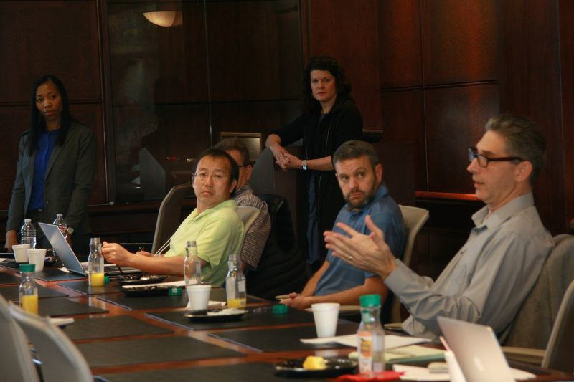
Objectives for Today
Effective design of proteomics experiments
Understanding and avoiding common issues in proteomics experimental designs and data analysis
One-on-one input for on-going proteomics studies
Notes:
60% went on to grad school/med school/hlth prof school
85% got a STEM degree or went on to grad school/med school/hlth prof school

Slide 13
ACKNOWLEDGMENTS
NIGMS & IDeA, Dr. Jon Lorsch, Dr. Fred Taylor
Drs. Krishan Arora and Régine Douthard
NIH/NIGMS –P20GM103447 & P20GM103429
Project Managers: Sonet Smitherman (UAMS) and Cecilia Nguyen (OUHSC)

