Slide 1
EPSCoR-like program at USDA NIFA
Liang-Shiou Lin
National Institute of Food and Agriculture
NIS-BRE
June 25, 2018

Slide 2
NIFA’s EPSCoR-like program is FASE (Food and Agriculture Science Enhancement)
Goals:
Strengthen science capabilities in research, education and/or extension programs
Help institutions that have not been as successful to develop competitive projects
Attract new scientists into careers in high-priority areas of national need

Slide 3
Food and Agricultural Science Enhancement (FASE) Grants (https://nifa.usda.gov/afri-fase-epscor-program)
Special Opportunities for:
USDA Established Program to Stimulate Competitive Research (EPSCoR) states & entities
Small and mid-sized academic institutions with limited institutional success
Minority-serving institutions
Pre- and postdoc fellowships
New investigators
Notes:
Note: EPSCoR is a subset of FASE (essentially an eligibility option) More later.

Slide 4
AFRI FASE Grants
New Investigator Grants (no set-aside funds)
Strengthening Grants (11.25% of AFRI funding)
Eligibility:
EPSCoR states
Minority-serving institutions not among most successful
Small or mid-sized institutions not among most successful
Pre- and Postdoctoral Fellowship Grants
(3.75% of AFRI funding)
Sabbatical Grants
Equipment Grants
Seed Grants
Strengthening: - Standard Grants
- CAP (Coordinated Agricultural Project) Grants - Conference Grants - Collaborative Grants
https://nifa.usda.gov/resource/afri-fase-epscor-program

Slide 5
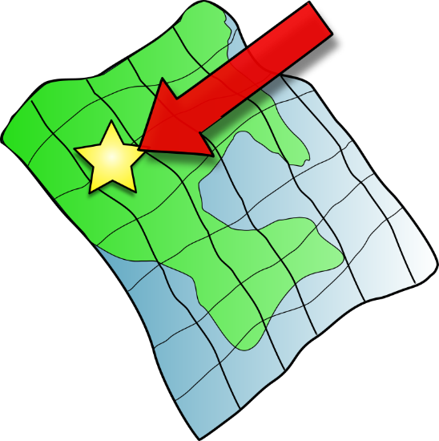
Food and Agriculture Science Enhancement (FASE) Grants
Where are they offered? → Only in the Agriculture & Food Research Initiative (AFRI) Program (https://www.nifa.usda.gov/program/agriculture-and-food-research-initiative-afri )
→ AFRI is USDA’s largest competitive grants program
AFRI
Notes:
Note: EPSCoR is a subset of FASE (essentially an eligibility option) More later.

Slide 6
No Specific FASE RFAs
The PD identifies and submits to best fit AFRI program
No specific panels for FASE applications; reviewed in regular AFRI panels
Education & Workforce Development (Pre-and Postdoc fellowships) has its own RFA & its own panels

Slide 7
AFRI FASE Grants
Strengthening Grants
(11.25% of AFRI funding)
Eligibility:
EPSCoR states
Minority-serving institutions not among most successful
Small or mid-sized institutions not among most successful
Pre- and Postdoctoral Fellowships Grants (3.75% of AFRI funding)
- Education and Workforce Development RFA
New Investigator Grants (no set-aside)
Sabbatical Grants
Equipment Grants
Seed Grants
Strengthening: - Standard Grants
- CAP (Coordinated Agricultural Project) Grants - Conference Grants - Other Grants (e.g. Collaborative)
https://nifa.usda.gov/resource/afri-fase-epscor-program

Slide 8
2018 Education & Workforce Development RFA
4 Program Focus Areas (Including 2 FASE) Projects address one of general AFRI topic areas
(1) Enhancing Agricultural Literacy – Professional Development for Secondary School Teachers & Educational Professionals (PD-STEP) NOT FASE (2) Developing Pathways – Research & Extension Experiences for Undergraduates NOT FASE (3-4) Advancing Science – Pre- & Post-doc Fellowships (FASE)
Eligibility: Pre- or postdoctoral fellow must be citizen, national, or permanent resident of US.
Notes:
Speak about: 1) purpose of the program 2) provide examples of the types of awards funded, and 3) award levels.

Slide 9
AFRI FASE Grants
Strengthening Grants
(11.25% of AFRI funding)
Eligibility:
EPSCoR states
Minority-serving institutions not among most successful
Small or mid-sized institutions not among most successful
Pre- and Postdoctoral Fellowships Grants (3.75% of AFRI funding)
- Education and Workforce Development RFA
New Investigator Grants (no set-aside)
Sabbatical Grants
Equipment Grants
Seed Grants
Strengthening: - Standard Grants
- CAP (Coordinated Agricultural Project) Grants - Conference Grants - Other Grants (e.g. Collaborative)
https://nifa.usda.gov/resource/afri-fase-epscor-program

Slide 10
New Investigator Grant Applications
Less than 5 years of postgraduate, career-track experience
Not received competitive Federal research funds beyond pre- or postdoctoral grants or AFRI seed grants
Do not need to be US citizens if associated with US institution
Research, education, &/or extension
Application written same as non-new investigator, except box checked indicating eligibility

Slide 11
How are New Investigators (NIs) funded? (2 funding chances in a program)
All proposals in a program 1st compete against each other & ranked (non-NIs & NIs)
Program funds (not set-aside) support top “X” number of proposals (= initial funding cut-off)
Top “X” may already include new investigators
No set-aside funds for new investigators
BUT program can go below cut-off to fund a meritorious NI proposal close to the cut-off by SKIPPING OVER what would have been the last proposal funded with program funds (to an established investigator) and give those $$ to new investigator instead

Slide 12
AFRI FASE Grants
Strengthening Grants(11.25% of AFRI funding)
Eligibility:
EPSCoR states
Minority-serving institutions not among most successful
Small or mid-sized institutions not among most successful
Pre- and Postdoctoral Fellowship Grants (3.75% of AFRI funding)
-Education and Workforce Development RFA
New Investigator Grants (no set-aside)
Sabbatical Grants
Equipment Grants
Seed Grants
Strengthening: - Standard Grants
- CAP (Coordinated Agricultural Project) Grants - Conference Grants - Other Grants (e.g. Collaborative)
https://nifa.usda.gov/resource/afri-fase-epscor-program

Slide 13
Strengthening Grants Eligibility (Seed, Sabbatical, Equipment, Strengthening Standard/CAP/Conference/Collaborative…)
Eligibility Limited to Degree-granting institutions in:
EPSCoR (Established Program to Stimulate Competitive Research) states & entities:
States with funding level no higher than the 38th percentile of all states from AFRI during previous 3 years (19 states);
EPSCoR states recalculated each year; states can move in & out of the list depending on their success in receiving AFRI awards.
Small and mid-sized institutions with limited institutional success; and/or
Minority-serving with limited institutional success

Slide 14
FY 2018 USDA EPSCoR States
Alaska Arkansas*** Idaho Louisiana Maine Mississippi Montana Nevada New Hampshire New Jersey | New Mexico North Dakota Oklahoma Rhode Island South Carolina Utah Vermont West Virginia Wyoming | Others: American Samoa District of Columbia Guam Micronesia Northern Mariana Islands Puerto Rico U.S. Virgin Islands
2018 Graduation: SD
*** 2018 New Entry: AR

Slide 15
Strengthening Grant Eligibility (cont’d)
Small and Mid-sized institutions: → Current total enrollment of 17,500 or less
Minority-serving: → Enrollment of single minority group or combination of minority groups exceeds 50% of total enrollment
Limited institutional success: → Not among most successful universities & colleges receiving Federal funds for science & engineering research & development (Table 1 in AFRI RFA)

Slide 16
Helpful eligibility
flow chart on last page of AFRI RFAs (Figure 1)

Slide 17
AFRI FASE Grants
Strengthening Grants (11.25% of AFRI funding)
Eligibility:
EPSCoR states
Minority-serving institutions not among most successful
Small or mid-sized institutions not among most successful
Pre- and Postdoctoral Fellowship Grants (3.75% of AFRI funding)
- Education and Workforce Development RFA
New Investigator Grants (no set-aside)
Sabbatical Grants
Equipment Grants
Seed Grants
Strengthening: - Standard Grants
- CAP (Coordinated Agricultural Project) Grants - Conference Grants - Other Grants (e.g. Collaborative)
https://nifa.usda.gov/resource/afri-fase-epscor-program

Slide 18
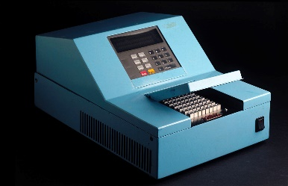
Strengthening Grant Types
Seed Grants ($150,000/2 years):
Collect preliminary data for future AFRI funding
Up to $150,000/2 years
Sabbatical Grants:
Up to one year of salary, funds for travel & supplies; mini-sabbaticals also appropriate
Equipment Grants: 50% of cost or $50,000 (whichever is less) for one piece of equipment ($10,000-250,000). Requires Non-federal matching, but waivers (<$25K) for lowest one third institutions (Table 2 in RFA)
7-page limitation (project narrative) for these 3 grant types

Slide 19
How are Seed, Sabbatical, Equipment proposals reviewed?
Seed, Sabbatical & Equipment Proposals: reviewed together in particular AFRI program that received them.
Those 3 grant types ranked relative to each other. (competition only among those 3 grant types)

Slide 20
Strengthening Grant Types (cont.)
Strengthening Standard Grants:
Proposal same as standard proposal (e.g., 18 page narrative) except box checked indicating eligibility
No specific RFA: → application submitted to AFRI program that is the best fit for the topic → “Strengthening standard” reviewed with “Standard” proposals in same panel

Slide 21
Strengthening Standard Grants (incl. CAPs…)
Two chances to be funded
1st: Competing with all proposals (strengthening + non-strengthening) for program $$$. Strengthening proposals above funding line will receive program dollars, not set-aside.
2nd: Strengthening proposals below funding cut-off (but that ranked well) are eligible to be considered by program staff to receive set-aside funds.

Slide 22
How are Seed, Sabbatical, Equipment & Strengthening Standard proposals selected
Each program balances division of 11.25% set-aside among highest-ranked FASE proposals
Often mix of FASE awards… such as… 2 seed grants + 1 equipment grant (based on rank in that cluster)+ 1 strengthening standard award (depending on closeness to funding “cut-off”)

Slide 23
NIFA FASE/ EPSCoR Team
Effie Baldwin, AFRI coordinator ebaldwin@nifa.usda.gov
Nancy Cavallaro, National Program Leader (Soil, Water & Climate), Committee Co-Chair, ncavallaro@nifa.usda.gov
Sharon Lumpkin, Program Analyst, Committee Co-Chair, slumpkin@nifa.usda.gov
Liang-Shiou Lin, National Program Leader (Plant Biology) LLIN@nifa.usda.gov
Peter Johnson, National Program Leader (Animal Health & Animal Well-Being) PJohnson@nifa.usda.gov

