Slide 1
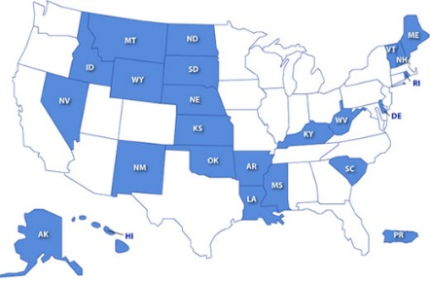
Clinical Research Opportunities at the NIH Clinical Center
7th Biennial National Institutional Development Award (IDeA) Symposium of Biomedical Research Excellence
June 25, 2018
John I. Gallin, MD
Chief Scientific Officer, NIH Clinical Center and
NIH Associate Director for Clinical Research
David J. Eckstein, PhD
Program Director for Strategic Partnerships and Policy Development
Office of Clinical Research

Slide 2
Outline
Opportunities at the NIH Clinical Center
Panelist Discussion
Teresa Fan, PhD-Edith T. Gardner Chair in Cancer Research, University of Kentucky
Suresh Mohan, MD-Harvard Otolaryngology Resident

Slide 3
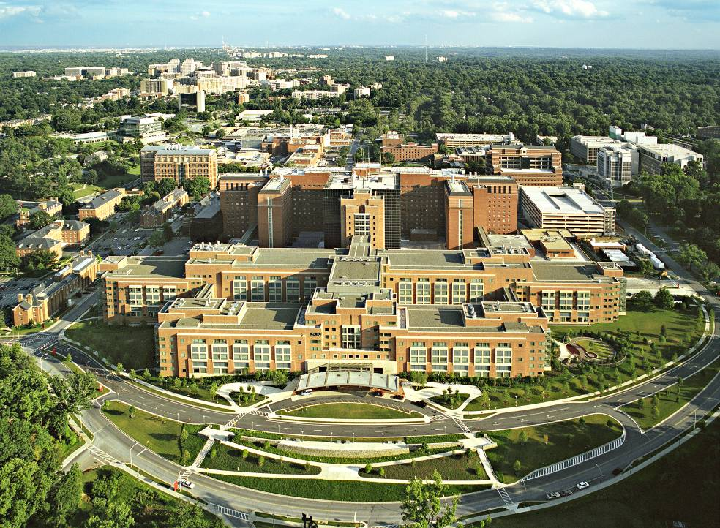
NIH Clinical Center
Mission Statement: We provide hope through pioneering clinical research to improve human health.
Notes:
And now to the best part of today’s meeting—a look at this remarkable new hospital.

Slide 4
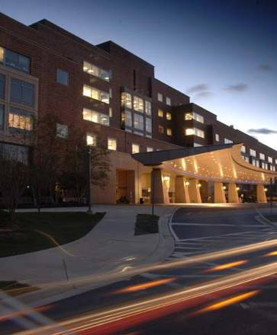
Clinical Center Profile
~545,000 patients since opening in 1953
200 beds; FY 2018 Budget $499.2 M
Hospital surrounded by research labs
Every patient is a research volunteer on a protocol
Care is free
Patient travel/housing provided as needed
2,000 CC employees + ~4,000 employees from 16 ICs that use hospital
1,334 credentialed physicians
1,532 active protocols
Interventional/Clinical Trials – 739 (48%)
Natural History – 706 (46%)
Screening – 63 (4%)
Training – 24 (2%)

Slide 5
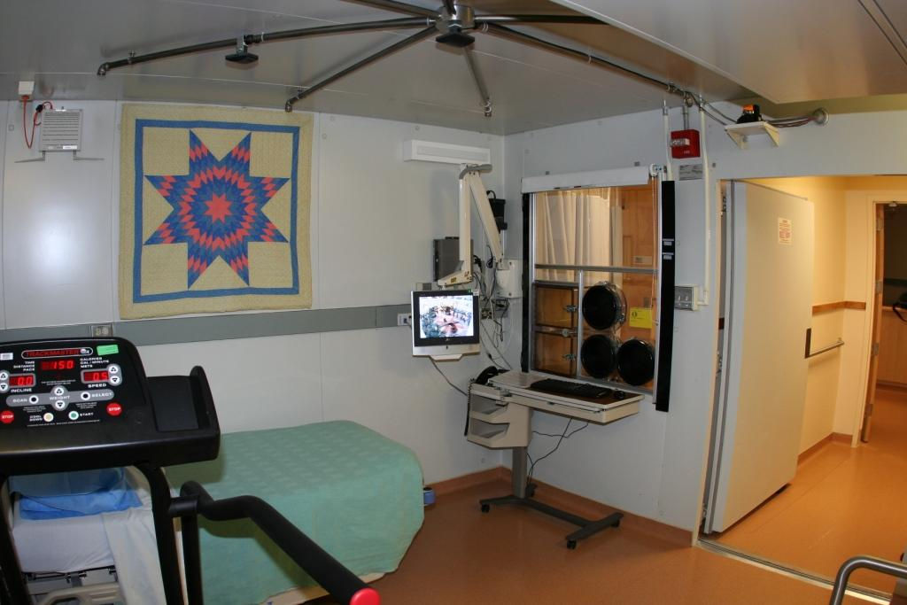
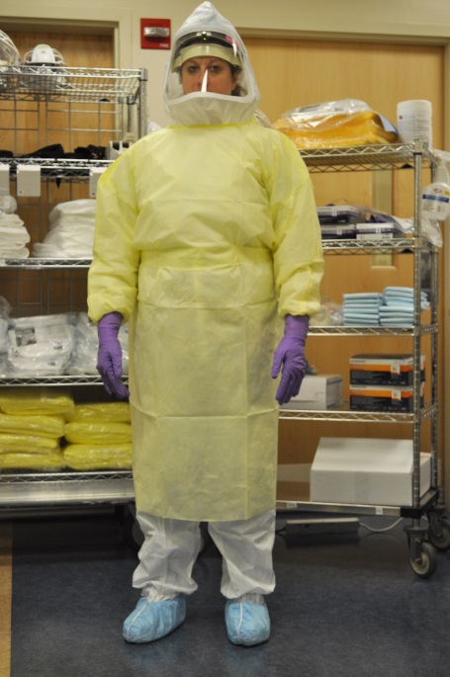
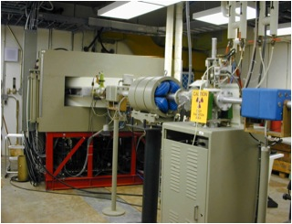
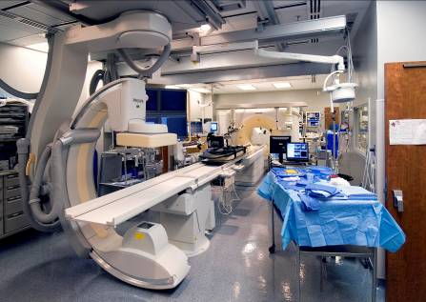
Specialized Services and Facilities
Biomechanics laboratory
Metabolic chambers
Cell processing in transfusion medicine
Undiagnosed diseases program
MRI center
PET research-3 cyclotrons
High intensity psychiatric services
Patient care unit for high containment infectious diseases

Slide 6
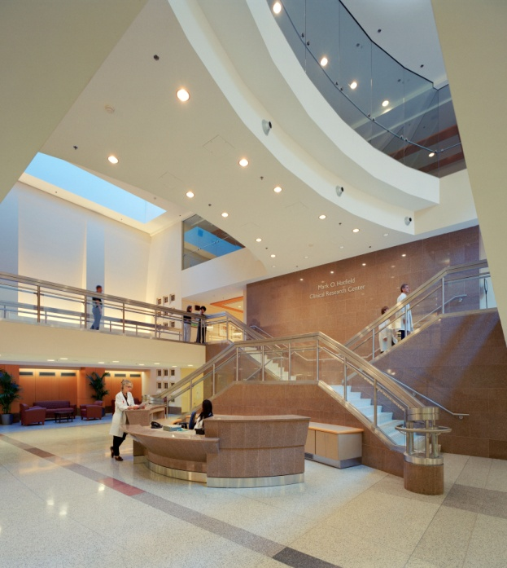
What is the purpose of this session?
The Clinical Center is committed to enriching the collaborative environment for a strong continuum of translational research.
We want to encourage more participation by IDeA States’ scientists.

Slide 7
Fostering New Collaborations with IDeA States
Bench to Bedside Awards
U01 “Opportunities for Collaborative Research at the CC”
Medical Research Scholars Program for medical, dental and veterinary
students
Summer course “Clinical and Translational Research for PhD Students”
Sabbatical in Clinical Research Management

Slide 8
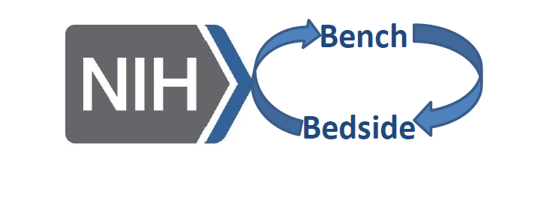
NIH Bench-to-Bedside (BtB) Awards
A program established in 1999 to seed new partnerships between basic science and clinical investigators. Currently $150K per year X 2 yrs.
Since 2006, the program encourages intramural and extramural investigator partnerships (>90%).

Slide 9
Bench to Bedside Awards
Since 2006:
174 awards with partnerships at 90 institutions (11 international); 9 to IDeA states
757 unique investigators on BtB awards (454 IM; 303 EM)
93% of awards involve extramural partners
170 articles in high impact journals (rating >3)
4 INDs
18 patents, 3 drug licenses
20% average success rate
Notes:
excludes 5 awards that were funded for 1 year as a result of stable funding

Slide 10
Funding of Bench-to-Bedside Awards
Office of AIDS Research
Office of Rare Diseases Research, NCATS
Office of Behavioral and Social Sciences Research
Office of Research on Women’s Health
Office of Dietary Supplements
National Institute on Minority Health & Health Disparities
Office of Clinical Research

Slide 11
Bench to Bedside Awards Topics

Slide 12
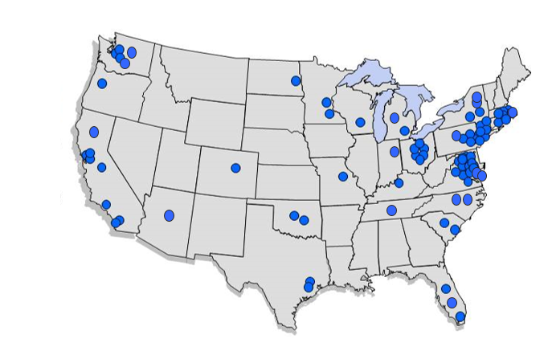
Domestic Extramural Institutions Partnering on Bench to Bedside Awards, 2006 - 2017

Slide 13
IDeA States BtB
Bench To Bedside Program
Investigator's Name | State
Teresa Fan | Kentucky
Carolyn Mervis | Kentucky
Scott Engel | North Dakota
Scott Engel | North Dakota
Madeleine Cunningham | Oklahoma
Joan Walker | Oklahoma
Phillip Buckhaults | South Carolina
Terry Day | South Carolina
Louis Luttrell | South Carolina

Slide 14
Opportunities for Collaborative Research at the NIH Clinical Center (U01)
Notes:
excludes 5 awards that were funded for 1 year as a result of stable funding

Slide 15
U01-Opportunities for Collaboration at the NIH Clinical Center
$500K per year for up to 5 years with optional first year for planning
Money to extramural PI; support for intramural PI variable across Institutes
No charge for hospital costs, except expensive drugs from grant (new)
Requires patients be seen at the Clinical Center

Slide 16
Scientific Focus of U01

Slide 17
U01 Awards (34)
International
South Africa
Denmark
4
http://www.cc.nih.gov/translational-research-resources/U01/index.html

Slide 18
U01 IDeA Programs Awardees
U01 Program
Investigator's Name | State
Valerie Cardenas-Nicolson | Hawaii
Thomas Kozel | Nevada
Sara Cathey | South Carolina

Slide 19
What Program Offers
Stimulated new collaborations with expanded areas of research
Promote understanding between IM & EM
Access to CC resources including unique patient populations
Access to known research experts
Low clinical costs
Notes:
Talk about the BtB IM and EM collaborators

Slide 20
Medical Research Scholars Program (MRSP)

Slide 21
MRSP Eligibility
The MRSP is designed for:
U.S. citizens and permanent residents
Applicants must be currently enrolled in an accredited medical, dental, or veterinary program
Applicants are in their 2nd, 3rd, or 4th year of professional school

Slide 22
MRSP Program Characteristics
Year-long with optional second year
Housing available
Clinical research experience
Clinical teaching rounds
Dedicated research mentor and advisor
Access to many courses including
Principles and Practice of Clinical Research
Principles and Practice of Clinical Pharmacology
Ethical and Regulatory Aspects of Clinical Research

Slide 23
MRSP Participants by State (2012-2018)
Participants' States | Counts |  | Participants' States | Counts
Alabama | 1 |  | Louisiana | 5
Arizona | 1 |  | Connecticut | 6
Arkansas | 1 |  | Georgia | 6
Iowa | 1 |  | Missouri | 6
Kentucky | 1 |  | Rhode Island | 6
Minnesota | 1 |  | Tennessee | 6
Nebraska | 1 |  | Texas | 6
Mississippi | 1 |  | Florida | 7
Puerto Rico | 1 |  | Washington DC | 7
South Carolina | 1 |  | Illinois | 10
Washington | 1 |  | Maryland | 10
Colorado | 2 |  | Massachusetts | 10
Indiana | 2 |  | Michigan | 12
Utah | 2 |  | California | 13
Virginia | 2 |  | North Carolina | 18
Wisconsin | 2 |  | Pennsylvania | 18
Nevada | 2 |  | New York | 27
New Hampshire | 3 |  | Ohio | 28
New Jersey | 3
Blue Shaded states are eligible for IDeA
represents MRSP Participants’ States

Slide 24
MRSP Participants-Where are They Now?*
65% conducting research
~80% in faculty positions at AMCs
55% spending >25% of their time conducting research
33% earned an advanced degree after completing their professional doctorate
Individuals published, on average, 1-2 manuscripts during time at NIH
25% have received an NIH grant
*Source : Ognibene, F. P., et al Acad. Med. 91:1684-1690, 2016

Slide 25
What we hope for the future
More collaborations from investigators in IDeA states.
More students participating in medical research scholars program from IDeA states.
For more information https://ocr.od.nih.gov

Slide 26
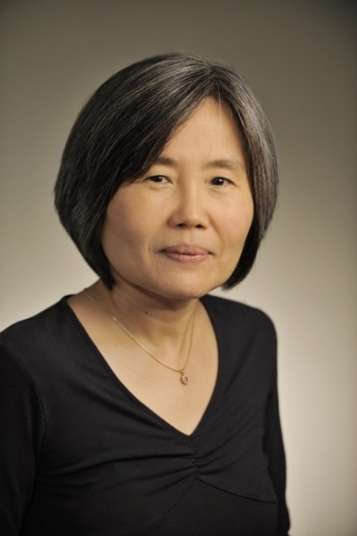
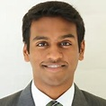
Panelists
Teresa Fan, PhD, Edith T. Gardner Chair in Cancer Research, University of Kentucky- Bench to Bedside Awardee 2012
Project Title :Elucidation of cancer metabolism by Stable isotope-Resolved Metabolomics
PIs: NCI: Linehan, Marston; NICHD: Roualt, Tracey Ann; University of Louisville: Lane, Andrew; Fan, Teresa
Suresh Mohan, MD Harvard Otolaryngology Residency-MRSP participant 2013-2014

