Slide 1
Bioinformatics:
Big Data, Big Opportunities
Student Workshop on the NGS Revolution

Slide 2
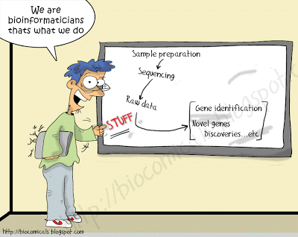

Slide 3
Bioinformatics is the science of collecting, classifying, storing, exchanging, securing, analyzing and visualizing biological data.
Bioinformaticians no longer have to limit themselves to just the STUFF.

Slide 4
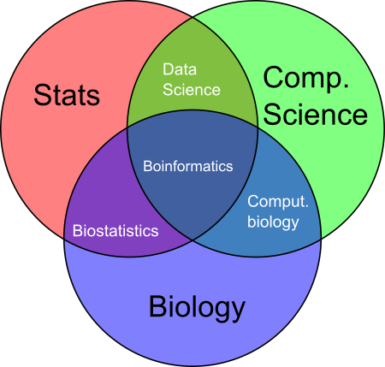

Slide 5
Biological Milestones
Scientific acknowledgement of Mendel
Morgan-1st genetic model organism
Discovery of restriction enzymes, reverse transcriptase, etc.
Development of PCR & gene cloning
Venter-Announced global ocean sampling expedition (metagenomics)
Avery-1st DNA is heredity material
“Completion” of human genome project
Miescher-identification of DNA
Hershey & Chase-confirm Avery’s work
1st genome of multicellular eukaryote
Mendel-description of heredity
Nirenberg & Khorana-
Determination of genetic code
Human Genome Sequencing Project
Watson & Crick –structure of DNA
Yeast chromosome sequenced
454 Life Sciences Pyrosequencing
NGS revolution
Sanger-Sequencing strategy
1st viral genome sequenced
$1000 genome
1st bacterial genome
1st eukaryotic genome
1865
1871
1900
1944
1952
1961
1977
1980s
1953
1990
1992
1995
1996
1998
2003
2005
2007
2017

Slide 6
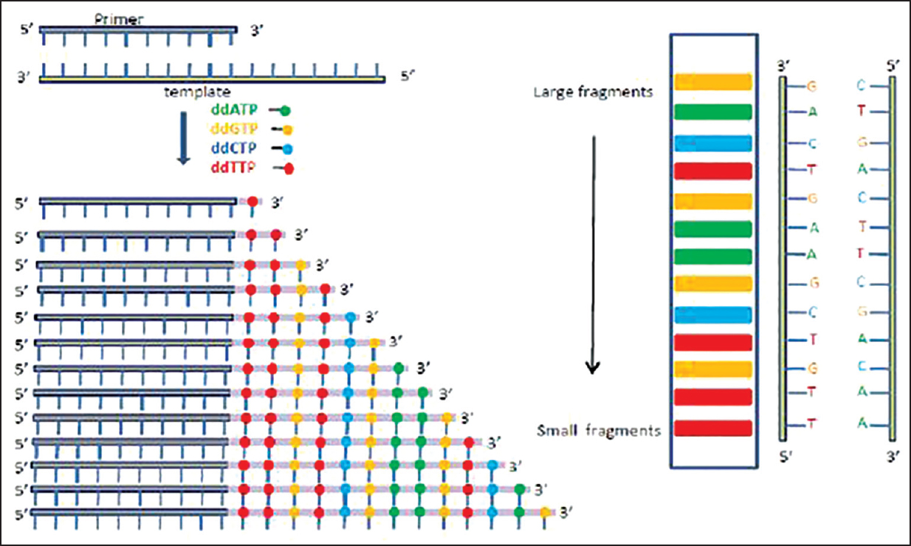
Sanger sequencing
One molecule is sequenced at a time!

Slide 7
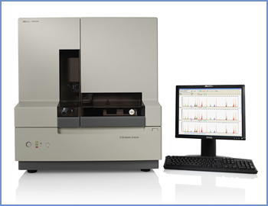
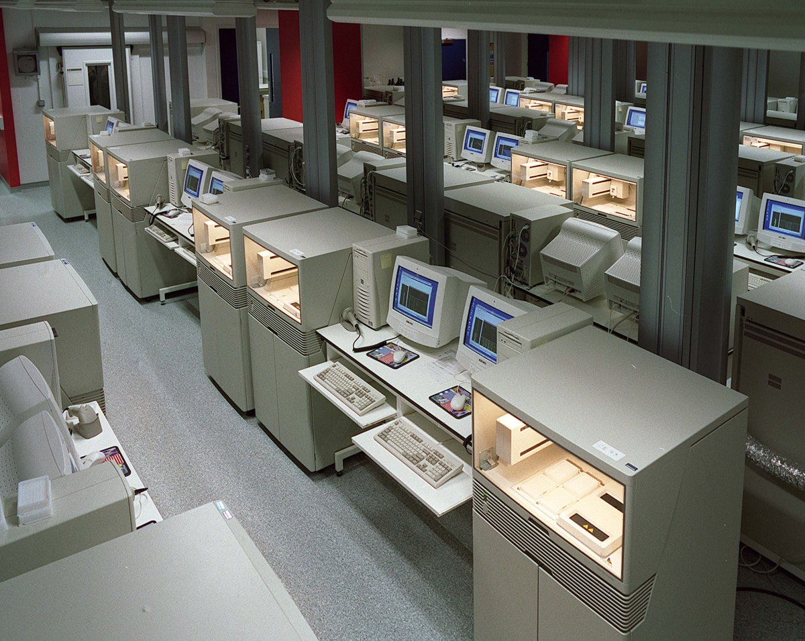
Increasing speed is expensive!

Slide 8
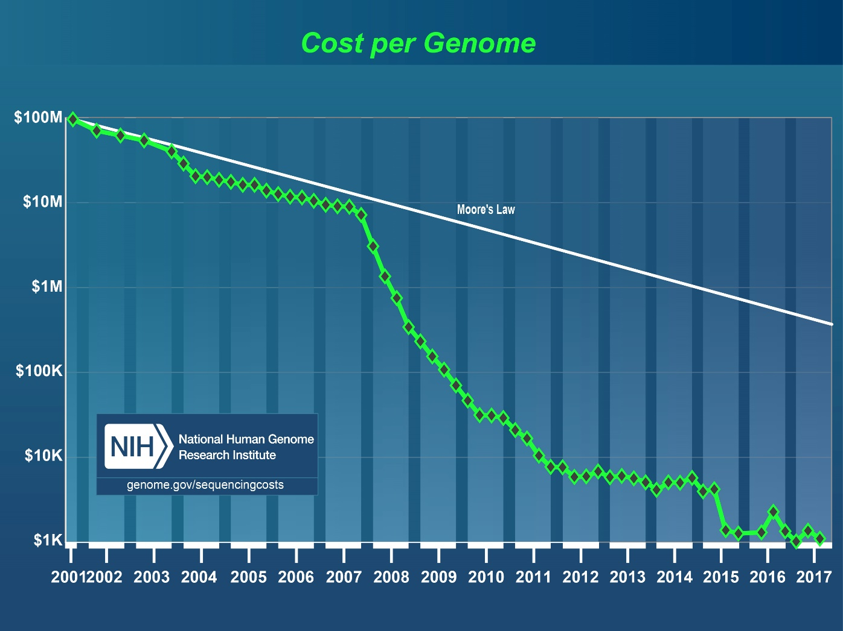

Slide 9
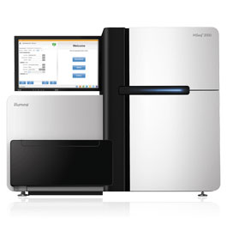
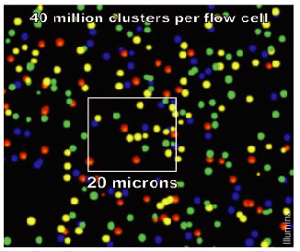
What makes NGS special?
NGS technologies rely on massively parallel sequencing.

Slide 10
Next Generation Sequencing
Illumina

Slide 11
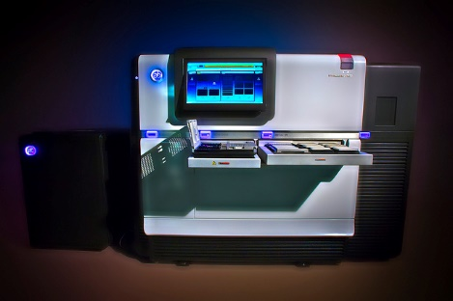
Next Generation Sequencing
Single Molecule Real Time (SMRT) technologies (Pac Bio)

Slide 12
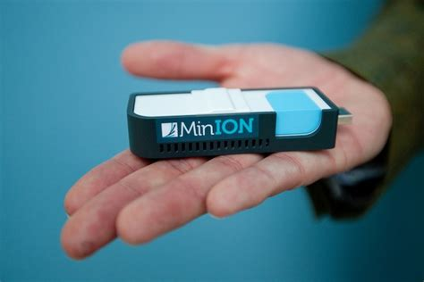
Next Generation Sequencing
Nanopore

Slide 13
How is NGS changing the field?
RRBS-SEQ
DNA-SEQ
RNA-SEQ
MAINE-SEQ
CHIP-SEQ
RIBO-SEQ
DNASE-SEQ
FAIRE-SEQ
RIP-SEQ
BS-SEQ
MEDIP-SEQ
GRO-SEQ

Slide 14
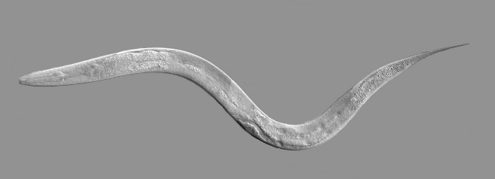
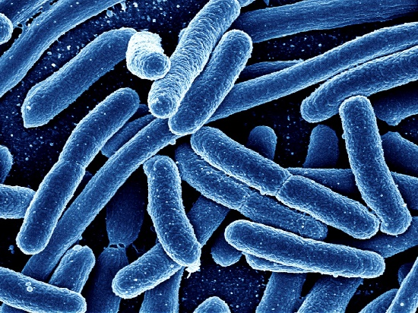
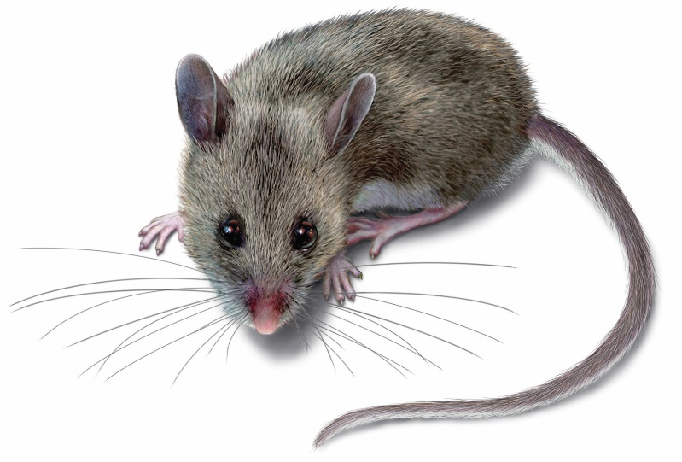
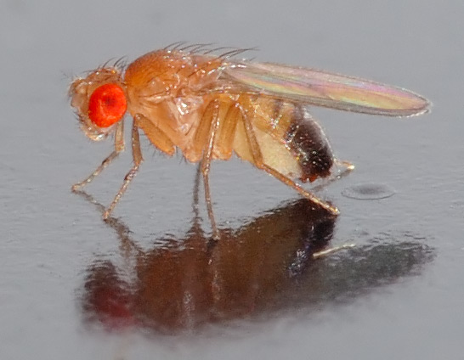
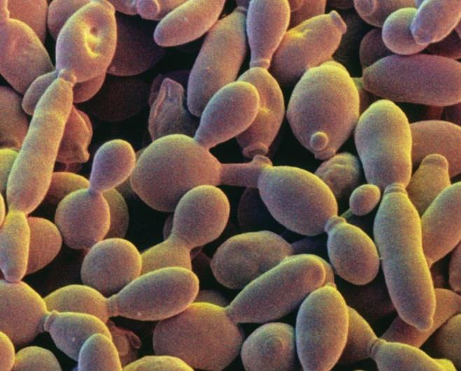
How is NGS changing the field?

Slide 15
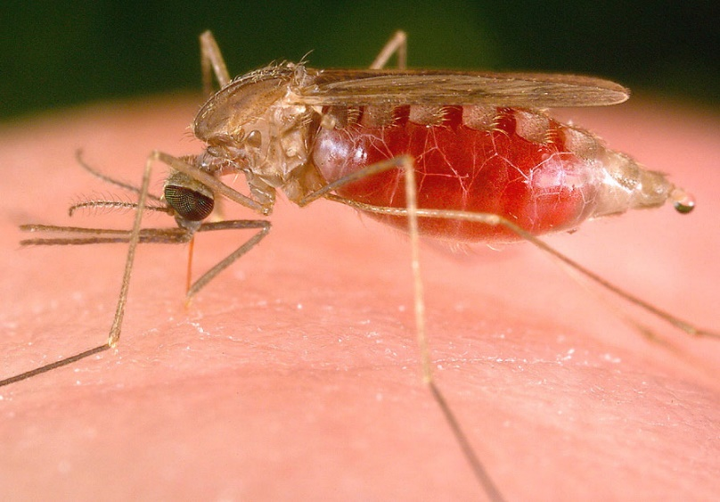
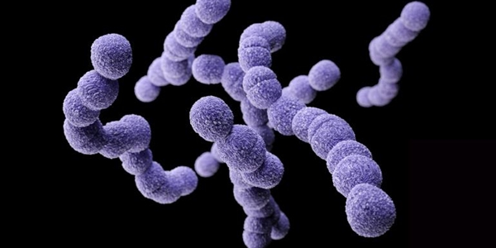
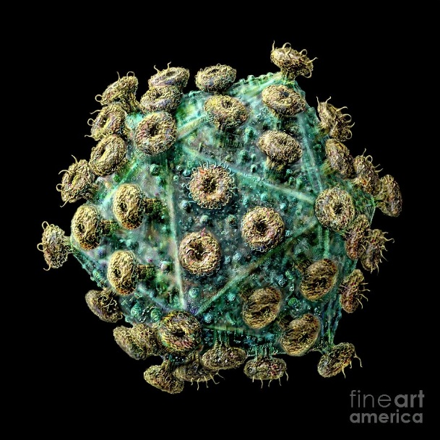
How is NGS changing the field?

Slide 16
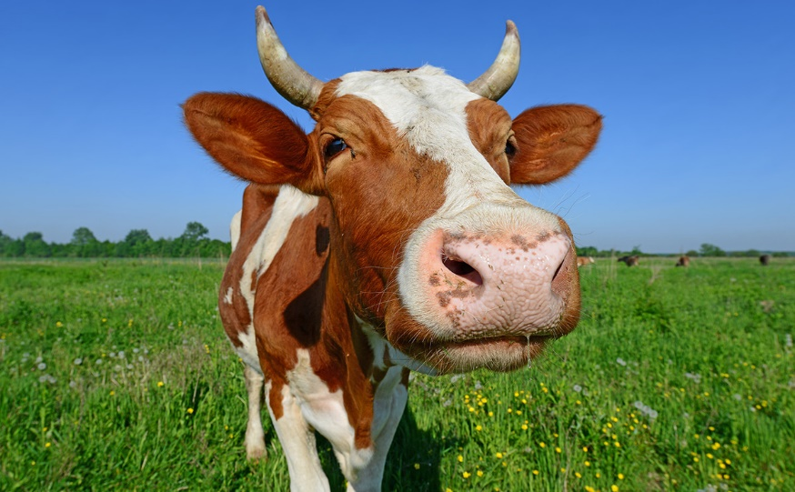
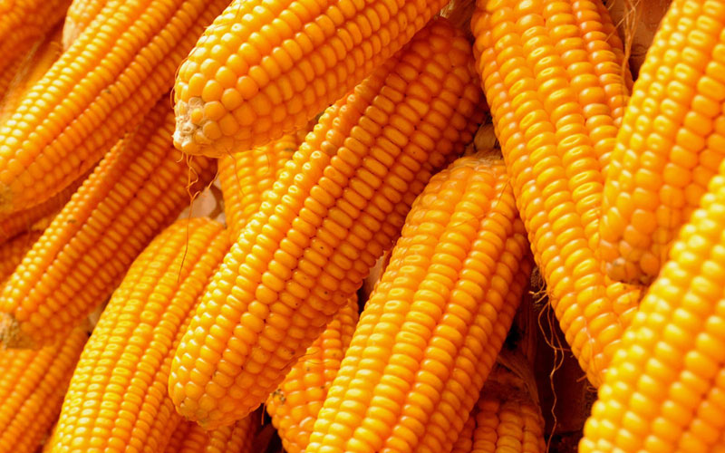
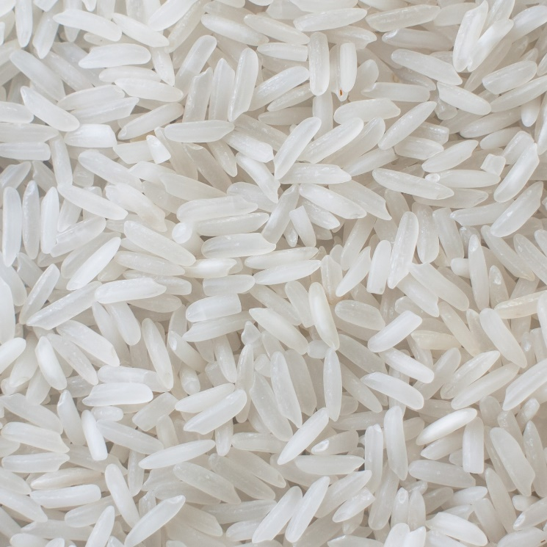
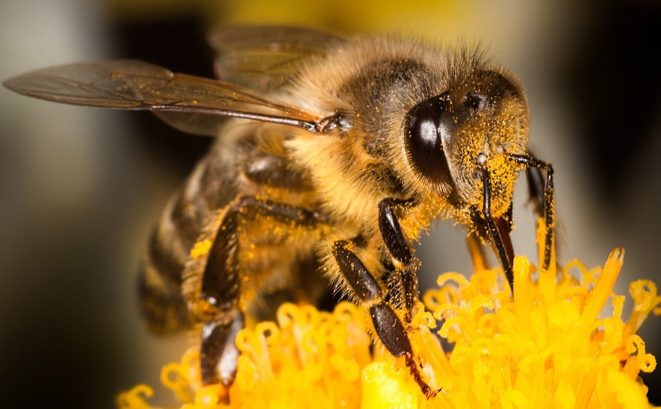
How is NGS changing the field?

Slide 17
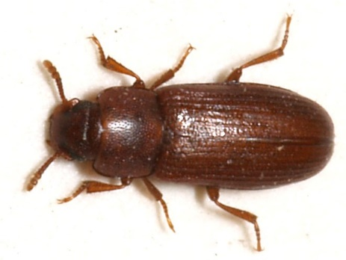
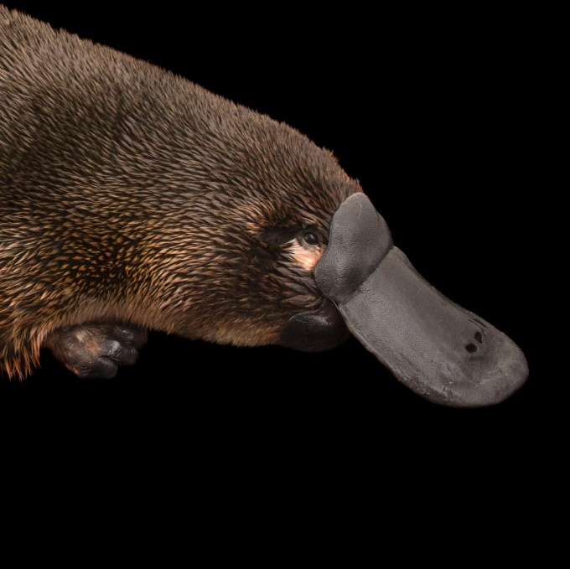
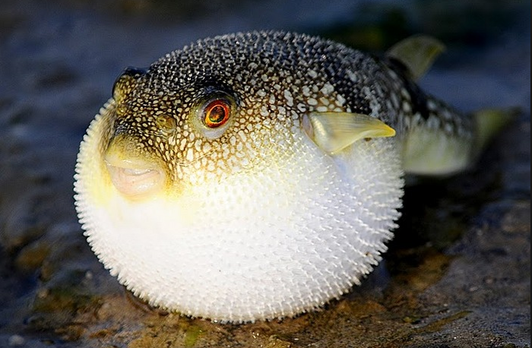
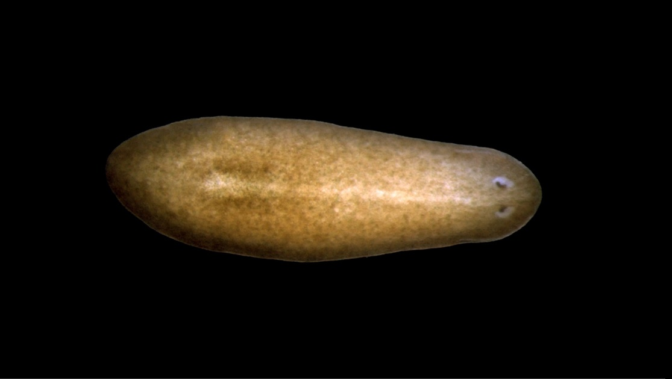
How is NGS changing the field?

Slide 18
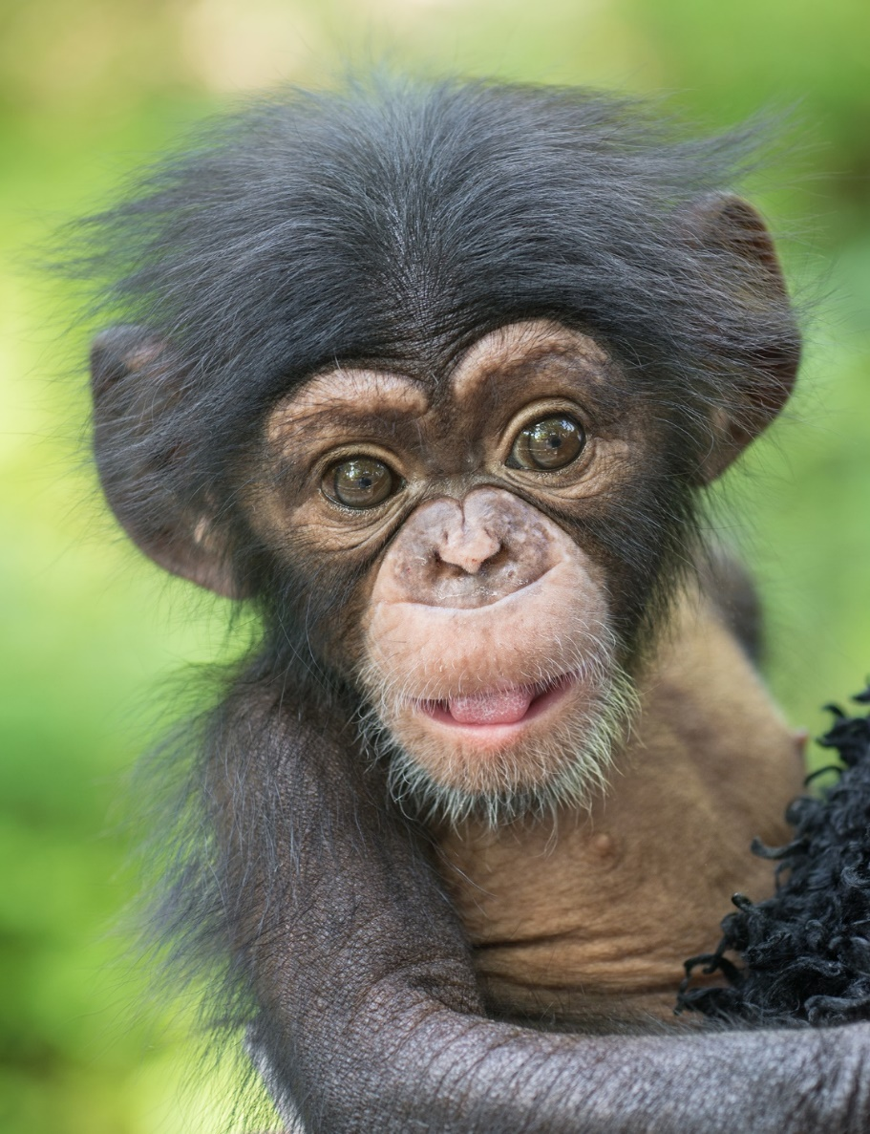
How is NGS changing the field?

Slide 19
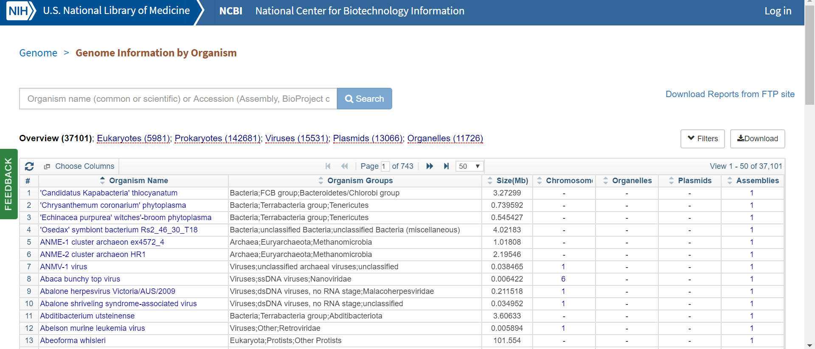
How is NGS changing the field?
Comparative Genomics-Answers Biological Questions

Slide 20
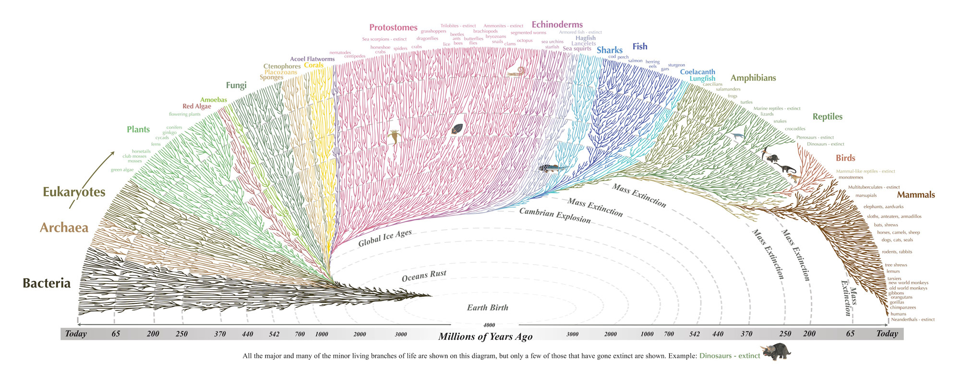
How is NGS changing the field?
Comparative Genomics-Builds Better Trees

Slide 21
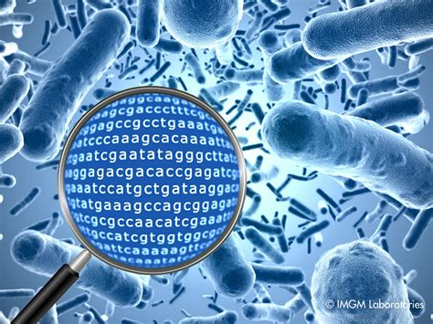
How is NGS changing the field?
Metagenomics

Slide 22
How is NGS changing the field?
Diagnostics-Genome or Exom Sequencing

Slide 23
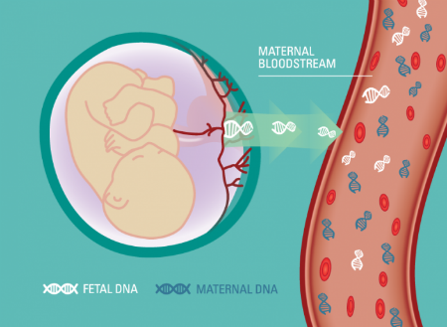
How is NGS changing the field?
Diagnostics-Prenatal Care

Slide 24
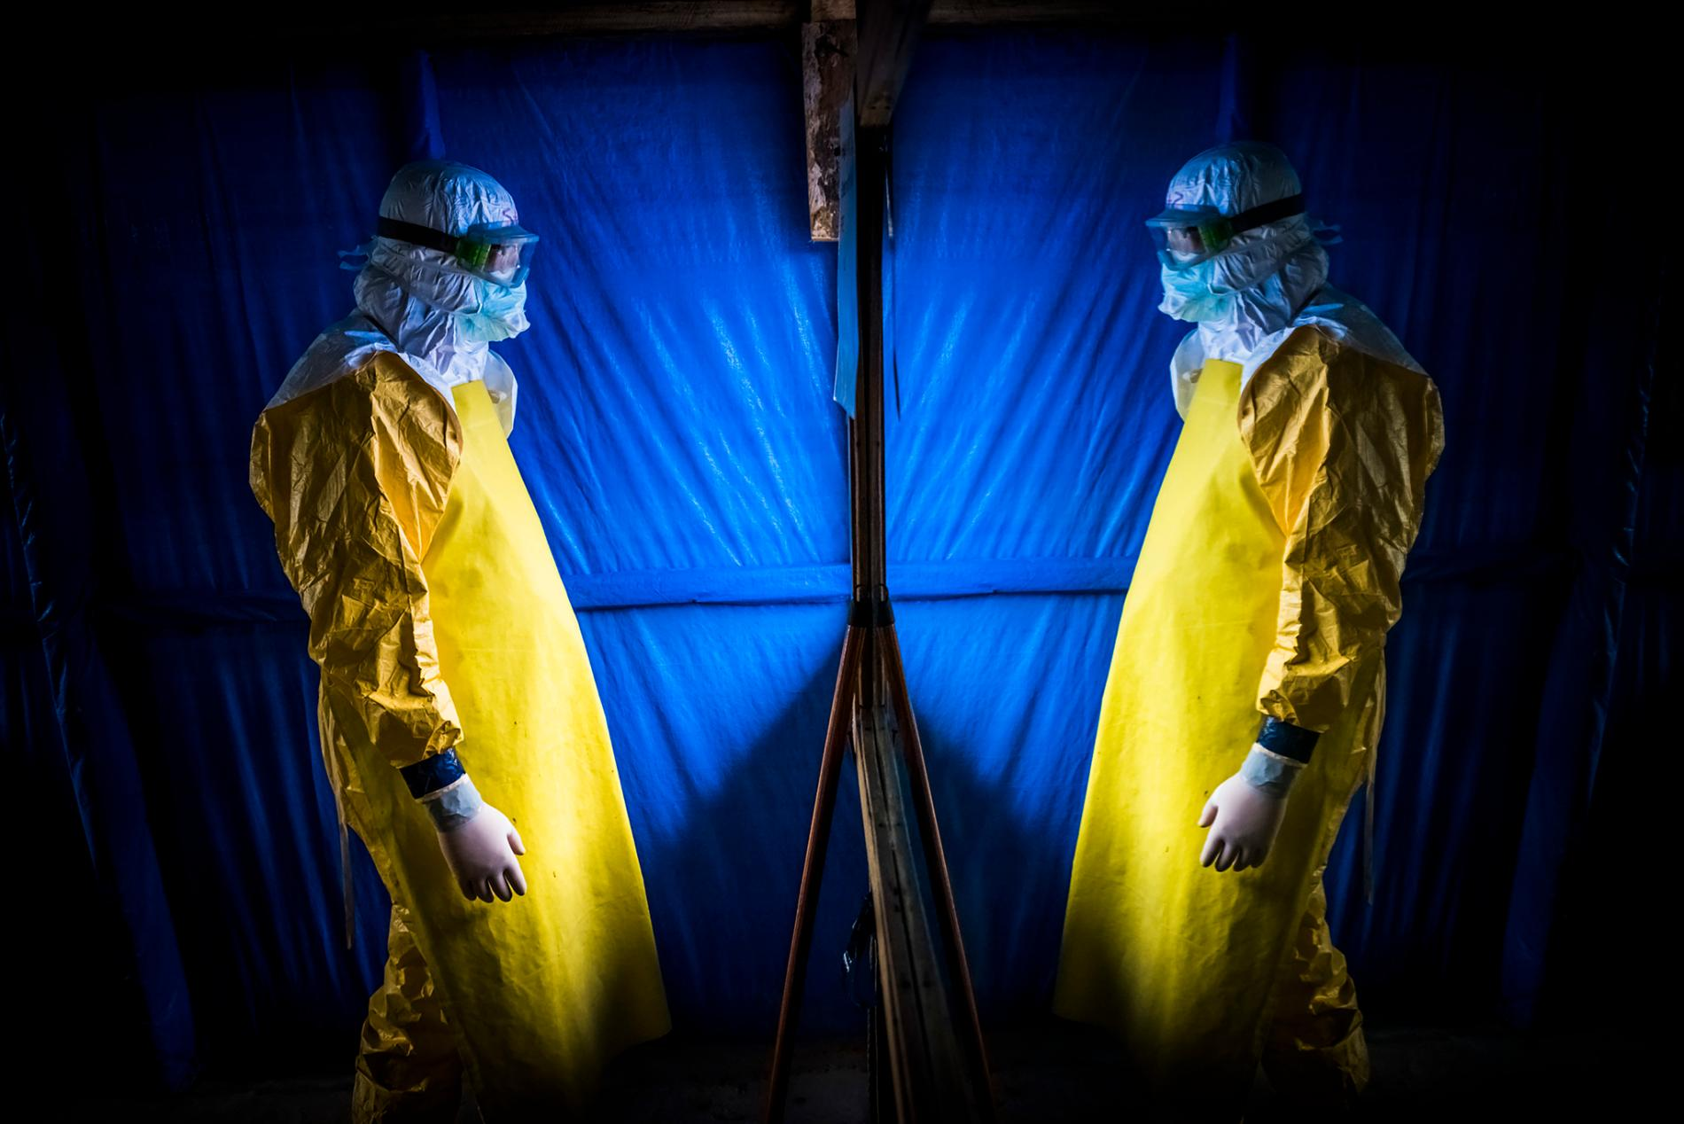
How is NGS changing the field?
Diagnostics-Epidemic/Pandemic Study & Control

Slide 25
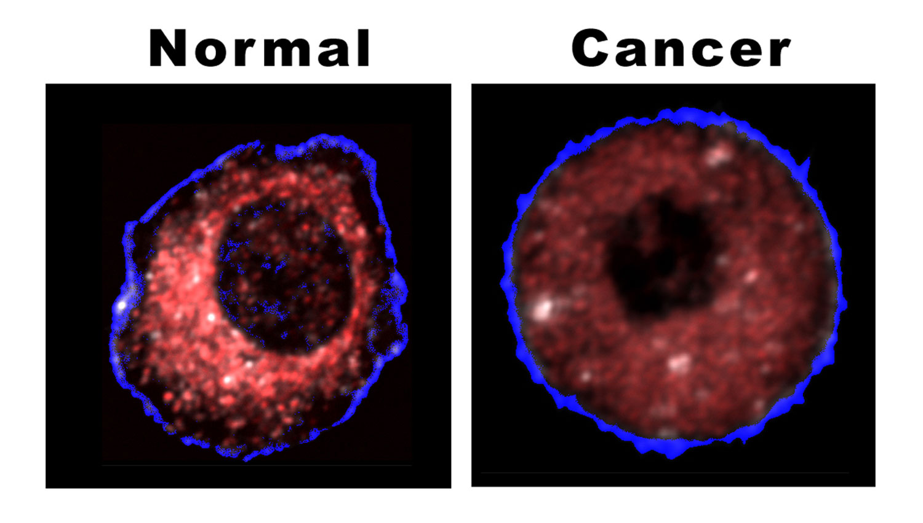
How is NGS changing the field?
Personalized Medicine

Slide 26
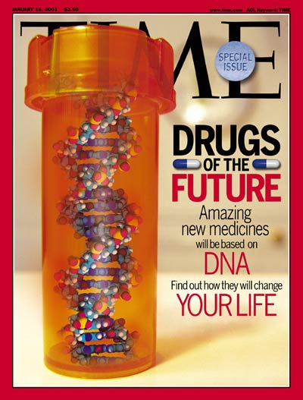
How is NGS changing the field?
Precision Medicine

Slide 27
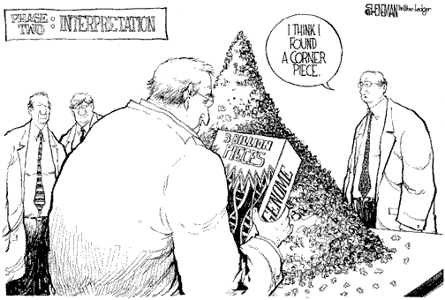
Why does NGS technology require bioinformatics?
Genome (and Transcriptome) Assembly

Slide 28
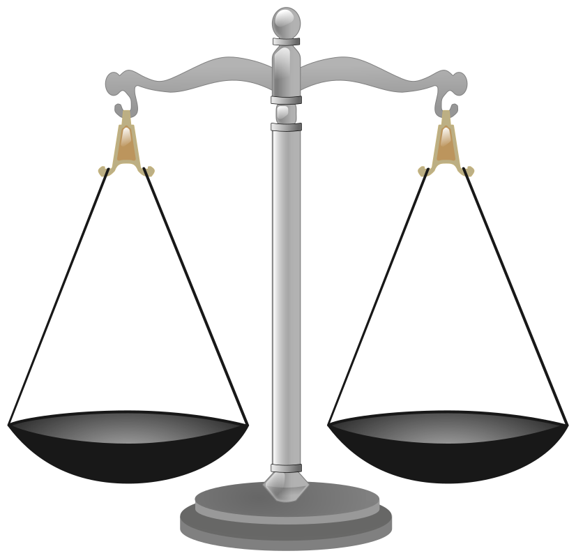
Why does NGS technology require bioinformatics?
Sample Comparisons
Differential Expression
Variant Calling
Genome Comparisons for Tree Building
Sequence Comparisons for Metagenomics (species identification & discovery)

Slide 29
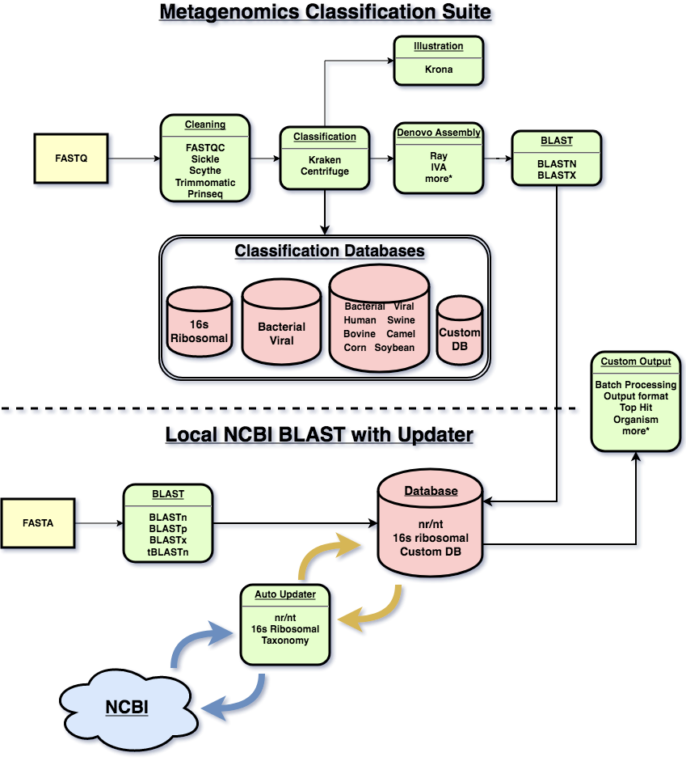
Why does NGS technology require bioinformatics?
Tool Development & Pipeline Construction
Most data analysis requires more than one tool. Bioinformatics pipelines allow these tools to consecutively attached and automated for multiple samples.

Slide 30
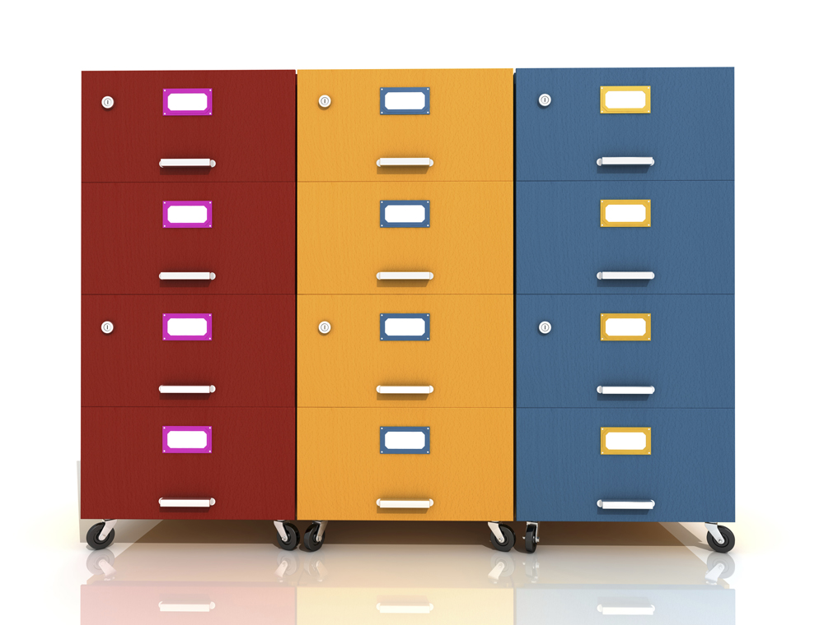
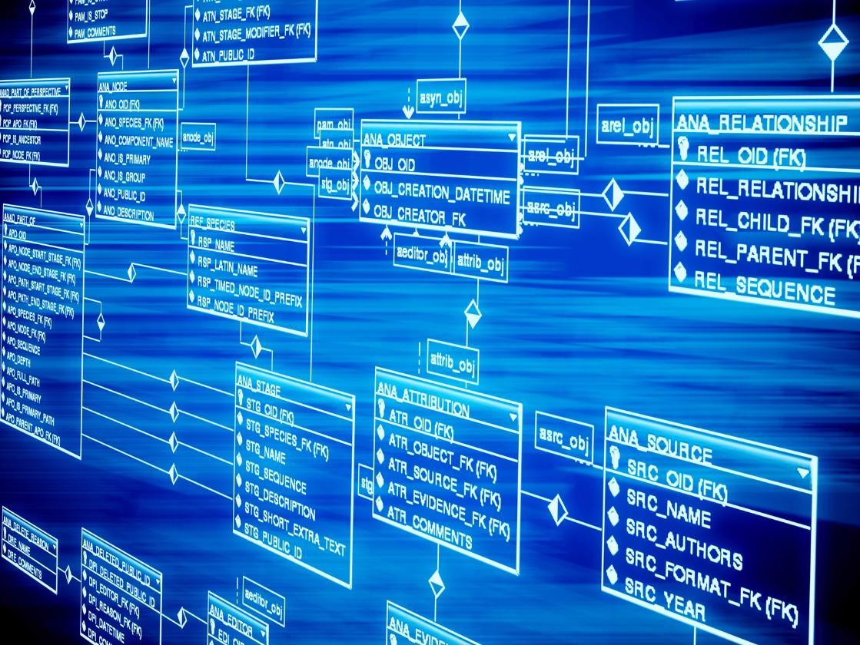
Why does NGS technology require bioinformatics?
Database Construction & Management

Slide 31
Why does NGS technology require bioinformatics?
Data Visualization

Slide 32
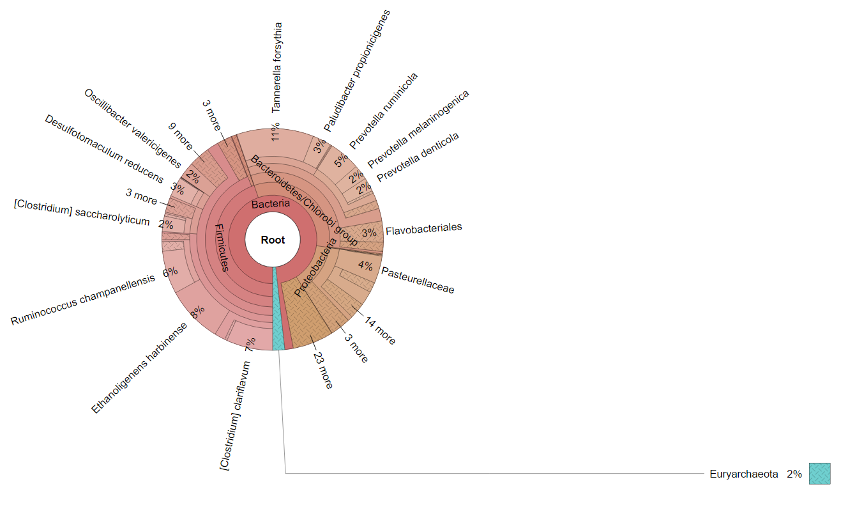
Why does NGS technology require bioinformatics?
file:///C:/Users/Sherry/Desktop/raw_kraken_krona.html
Data Visualization

Slide 33
Other areas of bioinformatics
Bioinformatics as a field did not develop because of NGS technologies. Bioinformatics has been an important subfield of biology since the molecular biology era began but NGS technologies is what is driving the field today because of the creation of BIG DATA.
There are other areas of biology that require bioinformatics that do not rely on NGS technologies.

Slide 34
Why be a bioinformaticist?

Slide 35
Why be a bioinformaticist?
$
$
$

Slide 36
Why be a bioinformaticist?
There is now a ‘big data’ analysis bottleneck
Bioinformaticists are needed and are compensated as such.
According to salarylist which uses data from government agencies and companies the average salary for a biologist is $58,634, the average salary for a bioinformaticist is $67,814.
According to Allied Health World. Health information administrators who specialize in bioinformatics have salaries that are significantly higher than the nationwide average. Nationally, the average bioinformaticist in health information makes $74,000 annually (which is about ten percent higher than the average for all professions). With appropriate credentials and a few years of experience, health bioinformaticians make annual salaries of well over $100,000.

Slide 37
Why be a bioinformaticist?
Job availability
&
Job security

Slide 38
Why be a bioinformaticist?
It is getting harder to find a job in academia as a biologist.
According to the Bureau of Labor Statistics 2011 45 years of data suggests the number of highly paid full-time tenured faculty has been steadily decreasing while the number of part-time faculty has skyrocketed.
The 2011 study conducted by the American Association of University Professors shows that
The percentage of full-time tenured faculty fell from a high of 29 percent in 1975 to 16.8 percent in 2009
Full-time tenure-track faculty fell from 16.1 percent to 7.6 percent
Part-time faculty shot up from 24 percent in 1975 to 41.1 percent in 2009

Slide 39
Why be a bioinformaticist?
However, positions in bioinformatics are on the rise!
According to science magazine (2014)
“Today’s bioinformaticists are in for a real treat. With a seemingly endless stream of biological data being generated across sectors, there is high demand for talented, experienced professionals at the crossroads of biology, statistics, and computer science. Scientists who can analyze large amounts of information and present it in a clear manner to decision makers are finding the sky is the limit in terms of jobs and career pathways, especially in the big pharma and biotech sectors.”

Slide 40
Why be a bioinformaticist?
Allows for varied biological interest

Slide 41
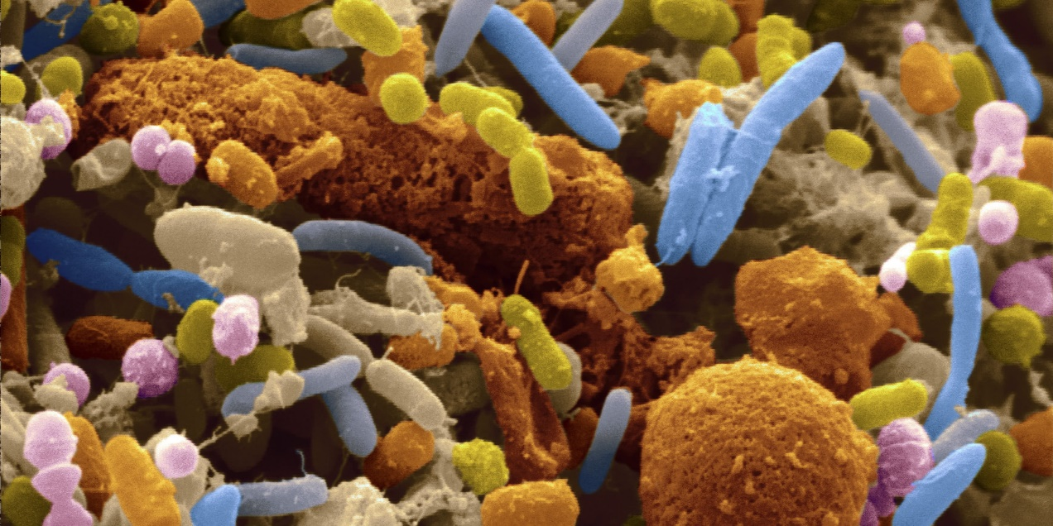
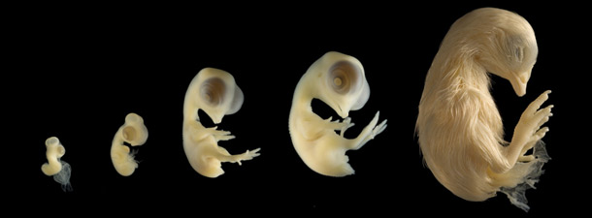
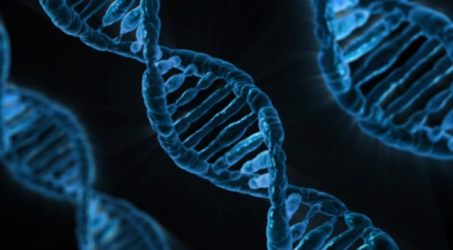
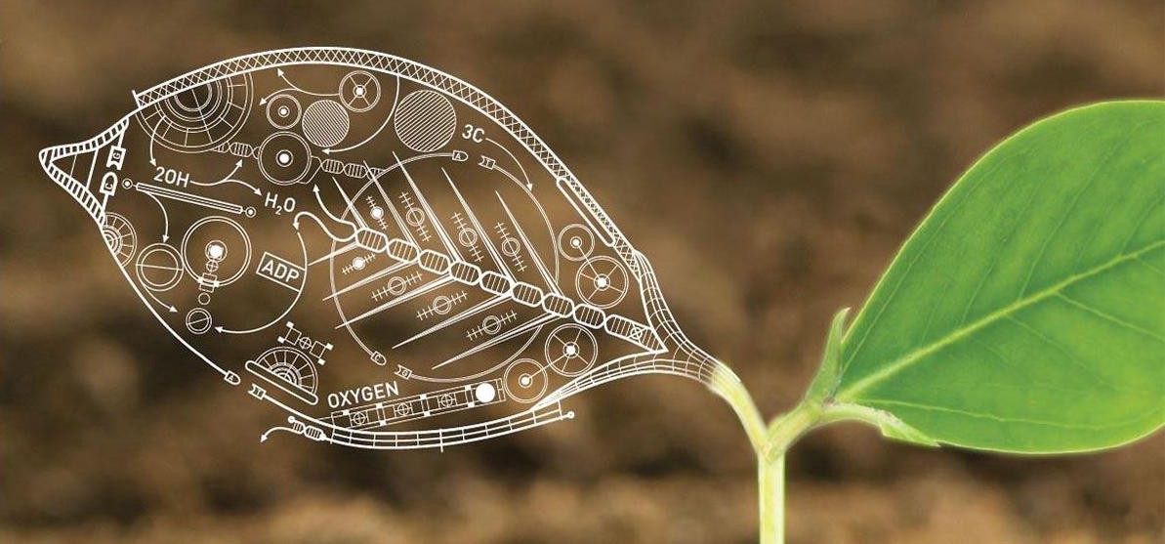
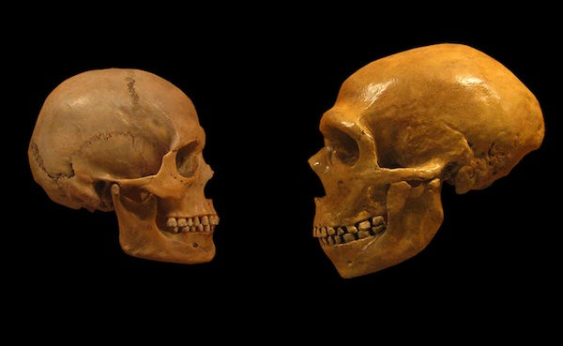
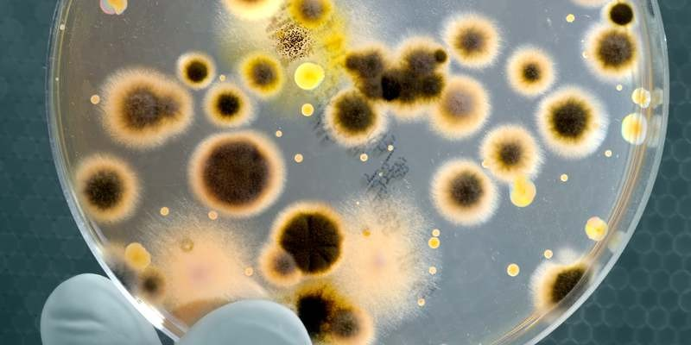
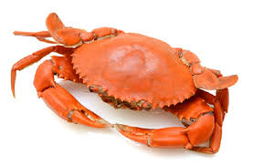
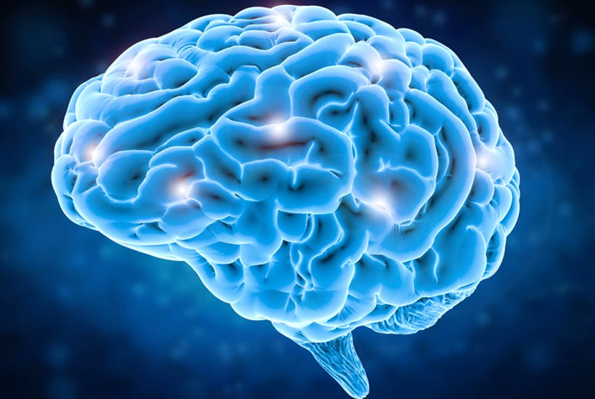
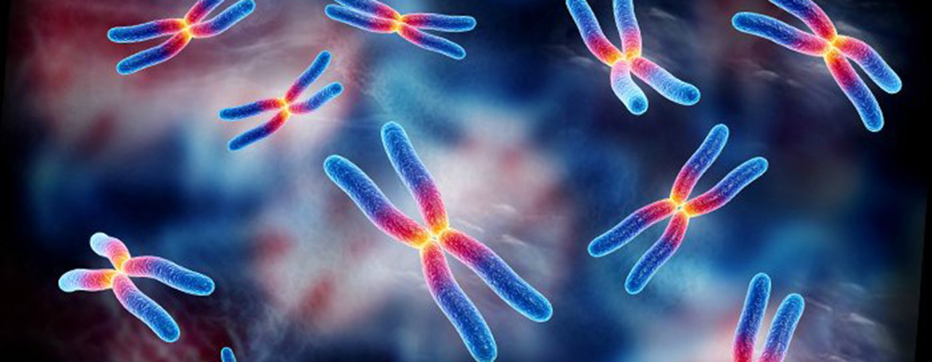
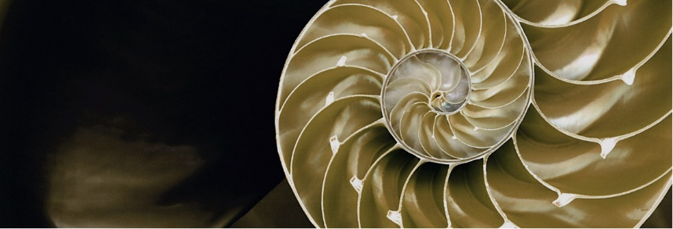
Why be a bioinformaticist?

Slide 42
Why be a bioinformaticist?

Slide 43
Careers in Bioinformatics
According to the ISCB Education Committee
Categories of people with bioinformatics skills
Bioinformatics user
Bioinformatics scientists
Bioinformatics engineers
Career areas include
Individual contributor (specific lab, specific area of research)
Core facility (central resource for institution, many areas)
Educator (academics career, build research program)
Software developer (companies dedicated to deploying tools)

Slide 44
Computational skills of the bioinformaticist
Understanding NGS technology
Command line
Scripting
Programing
Data structure
Computational logic
Common methodology in statistics
*Note: Not all skills are required for all areas of bioinformatics

Slide 45
What can you do to prepare for the genomic era?
Classes
Bioinformatics
Computer Science
Statistics
Applied Bioinformatics Journal Clubs
Departmental JCs can sometimes can be taken for credit
Campus or regional workshops
Software Carpentry/Data Carpentry
Online resources (Coursera, other open source classes, webinars, podcasts, YouTube tutorials)
Look for graduate schools that have a strong bioinformatics program/core/center/faculty. Even if you are intending to get a degree in biology or medicine---local bioinformaticians can help and programs with strong bioinformatics cores tend to have more educational experiences available.

Slide 46
Discussion Topics
Specifics of NGS technology
What it is like to work in the bioinformatics field
Introduction to Galaxy platform
Pipeline example
What bioinformatics study/tools apply to your field (medicine, biology, biochemistry)

Slide 47
Contact Information
Sherry Miller, PhD
Kansas State University
sherrymiller@ksu.edu
Teresa Shippy, PhD
Kansas State University
tshippy@ksu.edu

Slide 48
Additional slides for discussion

Slide 49
Sequencing by synthesis
Light is emitted for each of the nitrogenous bases added
Reversible terminators have to be removed with each cycle
Number of cycles is the limiting step
Maximum read size of ~350 bp
Individual nucleotide accuracy of over 99%
Well supported by bioinformatics (dominant technology)

Slide 50
Sequencing by synthesis
Light is emitted for each of the nitrogenous bases added
Bases added in real time, reversible terminators not needed
Maximum read size ~50,000, individual nucleotide accuracy of ~90% (raw data), uses consensus calling to increase accuracy to over 99%

Slide 51
Is NOT Sequencing by synthesis, sequenced as a single molecule flows through a pore which changes the electrical current
Read length 100,000 bp
Accuracy of 95% (raw data)
Great for field work
Not as many bioinformatics tools… YET!

